Slide 1
Lesson 1: Sexual Reproduction and Gametes

Slide 2
Key Concepts
Male and female reproductive cells combine to produce a zygote

Slide 3
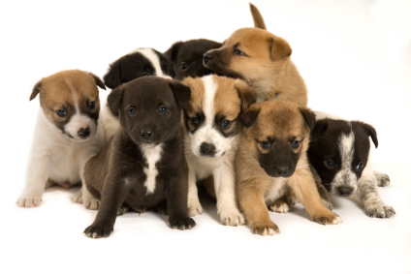

Slide 4
Sexual Reproduction
Requires two parents
Produces offspring that are genetically different from each other, from either parent, and from any other member of their species
Variation, or inherited genetic differences, is called genetic diversity

Slide 5
Sex Cells
Sex cells are also known as gametes
Gametes: male or female reproductive cells
The male parent contributes one gamete, the sperm cell.
The female parent contributes the other gamete called the ovum or egg cell

Slide 6
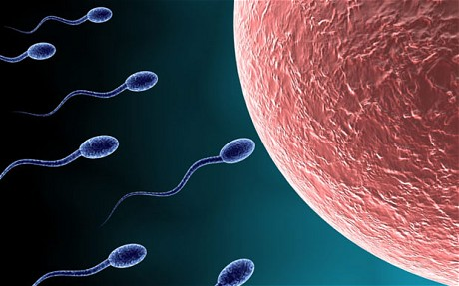
Sex Cells https://www.youtube.com/watch?v=kTy8HyrUY0w

Slide 7
Fertilization
Fertilization: the combining of male and female reproductive cells
The nuclei of the two gametes fuse together to produce a single cell called a zygote
The zygote is the first cell that develops into a new organism containing genetic information from both the sperm cell and the egg cell.

Slide 8
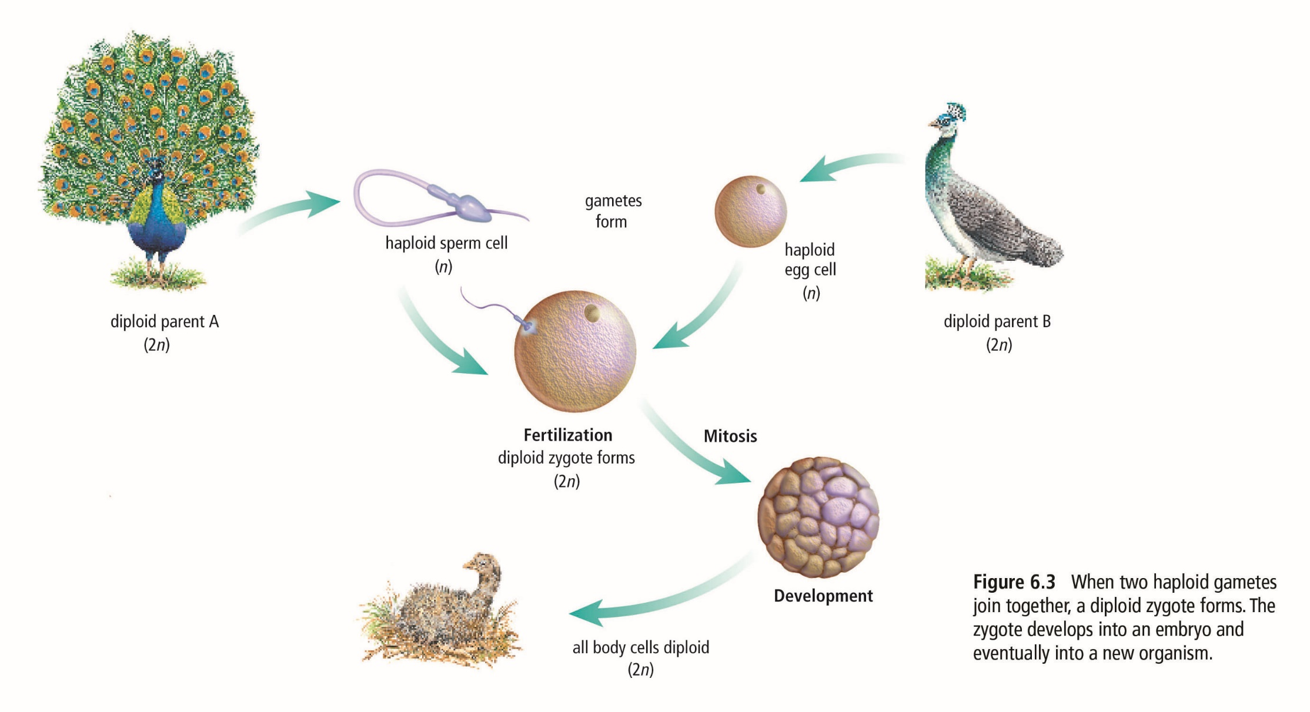

Slide 9
The Role of Gametes
Humans have 46 chromosomes that are organized into 23 pairs
Chromosomes that are paired are called homologous chromosomes.
Homologous Chromosomes have similar features and carry similar genetic information
During fertilization, each parent contributes one chromosome of each pair.

Slide 10
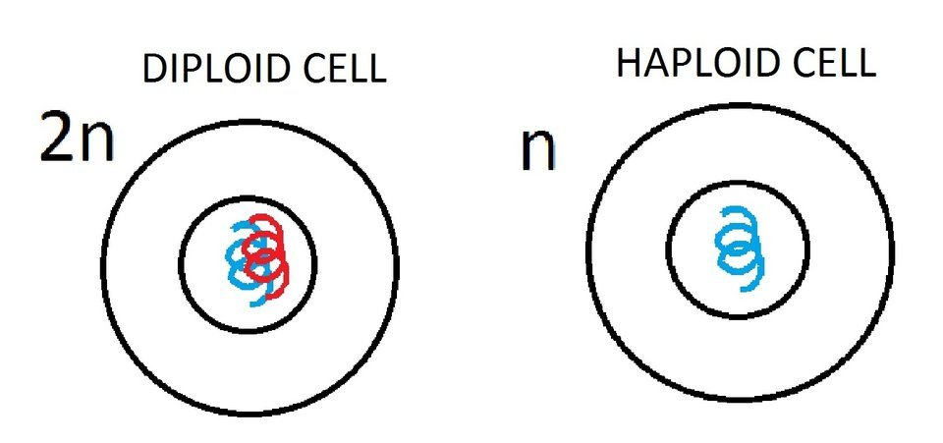
The Role of Gametes
Cells with half the normal number of chromosomes, such as gametes, are called haploid cells
Our body cells, which have a full number of chromosomes, are called diploid cells.

