Slide 1
Lesson 2: Meiosis

Slide 2
Key Concept
Reproductive cells are formed by a cell-dividing process called meiosis

Slide 3
Meiosis
Meiosis involves a diploid cell dividing twice to produce four haploid cells
Offspring are genetically different from their parents and from one another because the gametes that a parent produces are not all genetically the same.

Slide 4
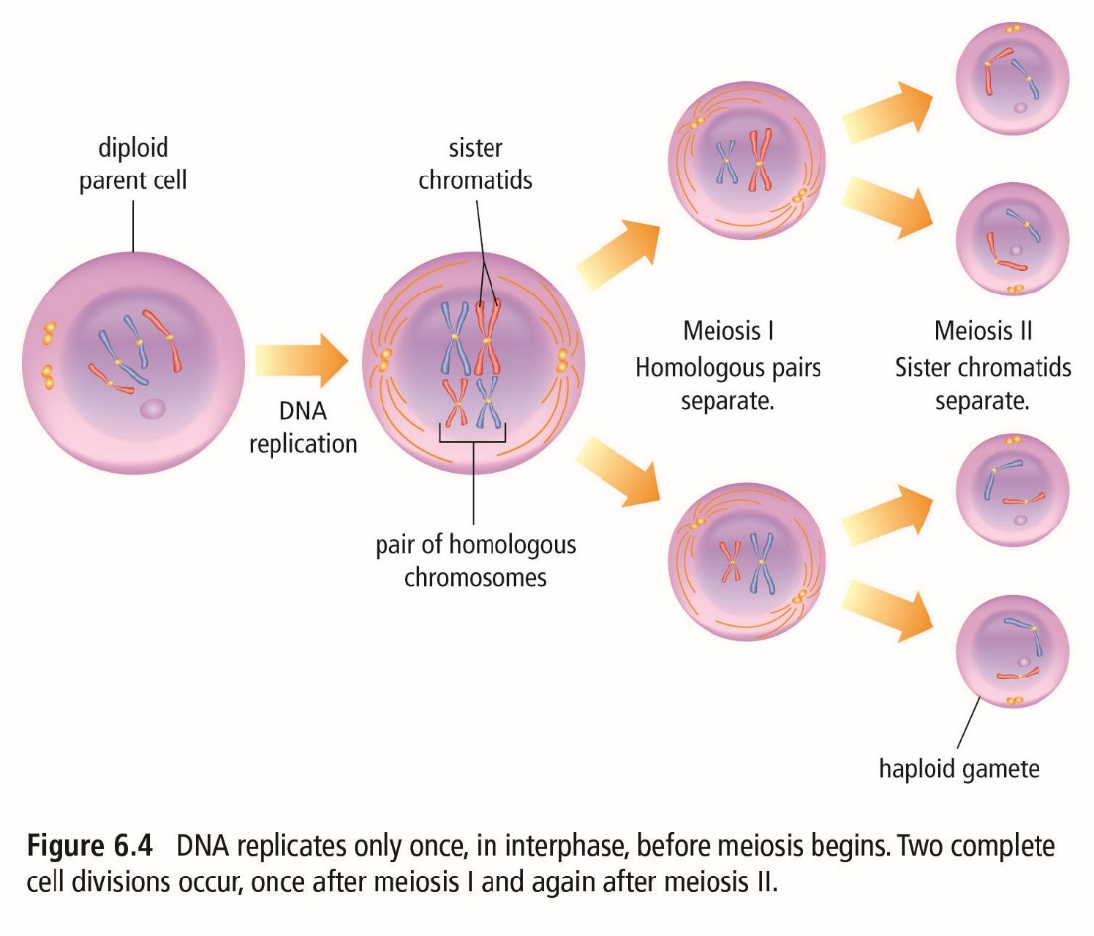

Slide 5
Meiosis
Meiosis I
  Prophase I
    Nuclear membrane begins to disappear
    DNA condenses into duplicated chromosomes and homologous chromosomes are paired
    Crossing over swaps some genes from one homolog to another
  Metaphase I
    Spindle fibres guide chromosome movement
    Homologous chromosome pairs line up along the middle of the cell

Slide 6
Meiosis
Meiosis I
  Anaphase I
    Homologous chromosome pairs separate and go to each end of the cell
  Telophase I
    Two nuclei form and each nucleus contains a complete copy of the cell’s DNA
    The cell divides

Slide 7
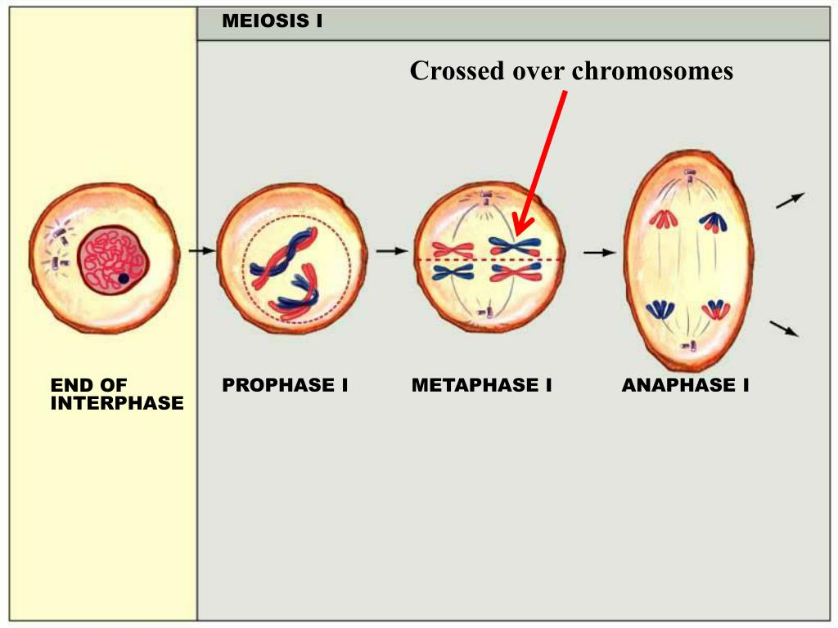
Homologous chromosomes line up
Crossing over of homologous chromosomes
Homologous chromosomes move to opposite sides

Slide 8
Meiosis
Meiosis II
  Prophase II
    Nuclear membrane begins to disappear
    DNA exists as chromosomes
  Metaphase II
    The chromosomes line up along the middle of the cell

Slide 9
Meiosis
Meiosis II
  Anaphase II
    The copies of DNA are separated and go to each end of the cell
  Telophase II
    Four nuclei form
    The cells divide, forming four new cells

Slide 10
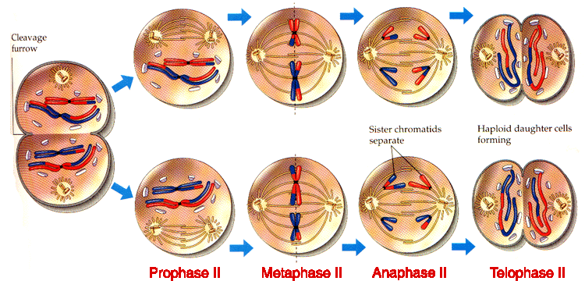

Slide 11
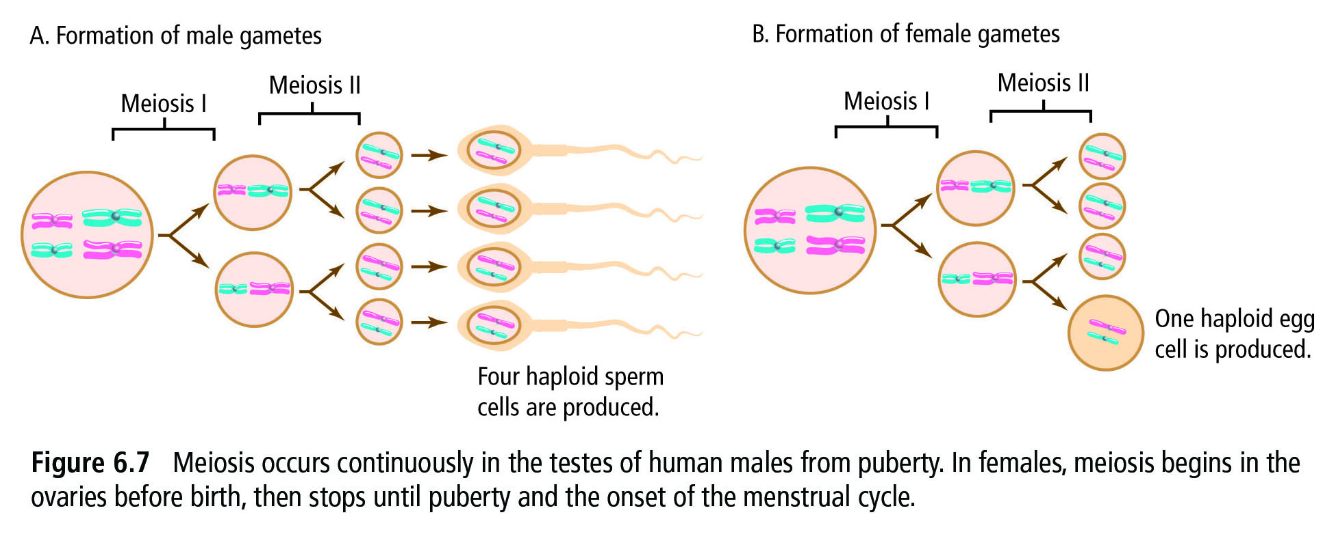
https://www.youtube.com/watch?v=nMEyeKQClqI

