Slide 1
Some Background Information
Before the American Revolution, America was a British colony. They had to follow whatever rules Britain told them and they had to send a lot of their resources and money back to Britain.
Americans didn’t like this. They wanted to split from Britain and become their own country. Britain said no. So the Americans started a Revolution (called “The American Revolution”). America won and became their own country.
The group of men who worked to create a new American government were called “The Founding Fathers”. They included Samuel Adams and Paul Revere.

Slide 2
Lost Treasure of America’s Founding Fathers
December 2014, a copper time capsule from 1795, buried by Paul Revere and Sam Adams (two of America’s “founding fathers”), was unearthed at the Massachusetts State House in Boston.
Workers repairing a leak at the Massachusetts State House in Boston uncovered the time capsule originally placed in the building’s cornerstone in 1795. It took conservators from the Boston Museum of Fine Arts nearly seven hours to remove the box from its encasing; it was later transported to the museum to be X-rayed and thoroughly examined. Yesterday, in a press conference at the museum, officials from the museum and the Massachusetts Archives opened the time capsule and revealed its contents—some 220 years after it was originally planted.
The contents included a pine tree shilling coin dating back to 1652, a copper medal showing George Washington, dozens of coins, several newspapers, and a silver plate thought to be engraved by Paul Revere.

Slide 3
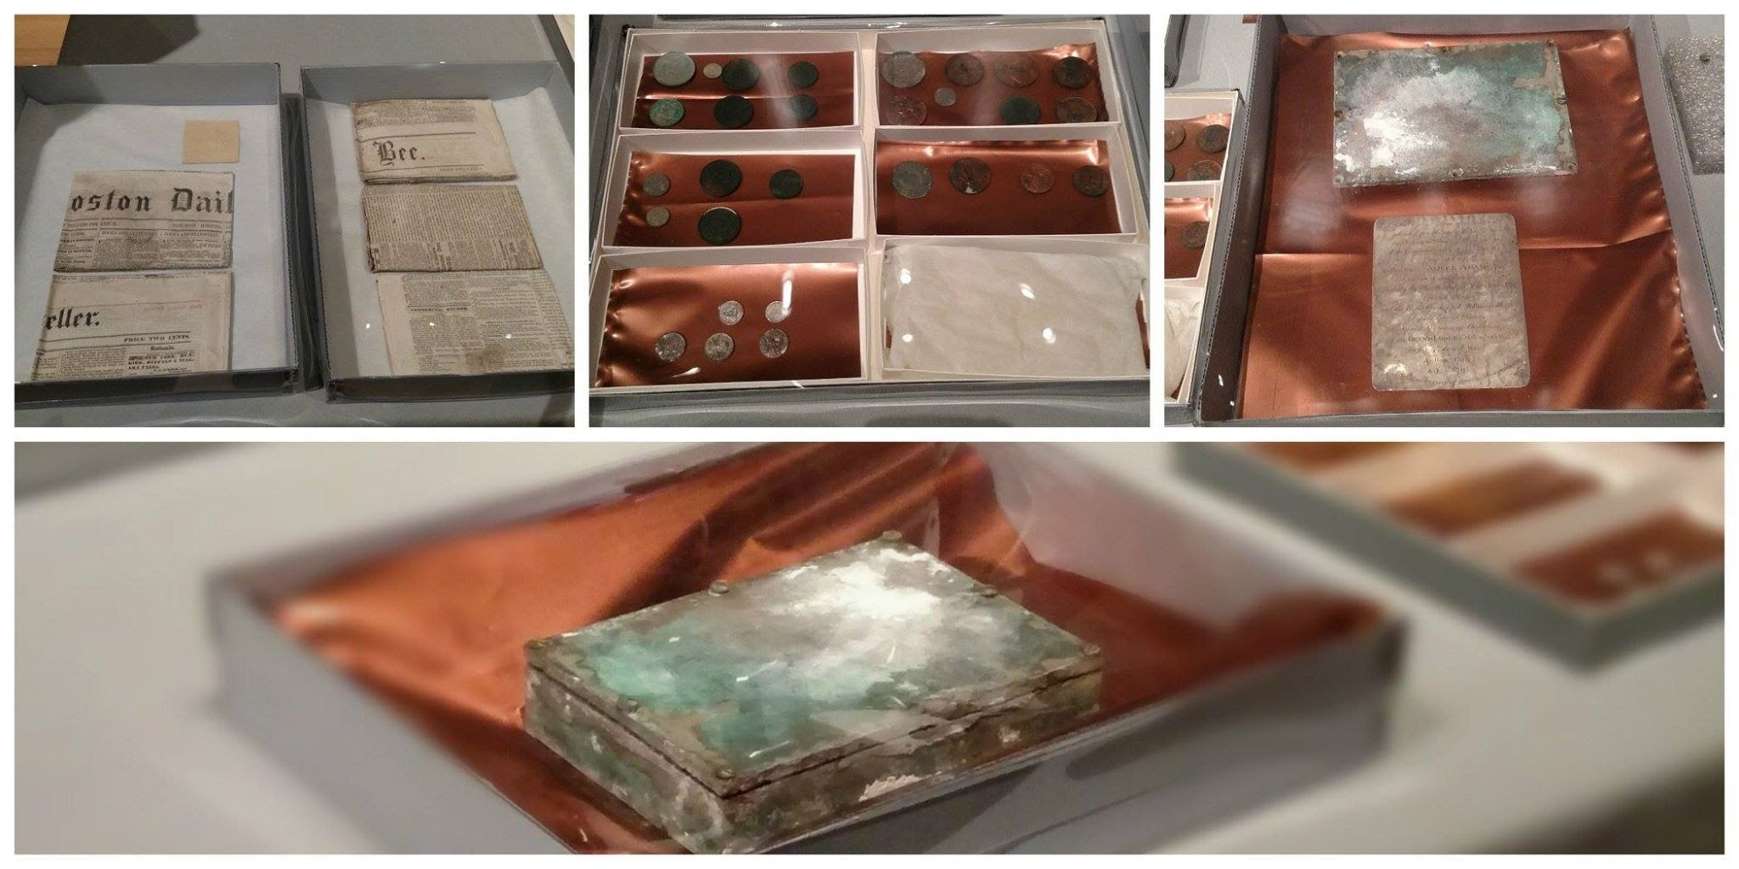
Why do you think Adams and Revere chose the objects that they did?

Slide 4
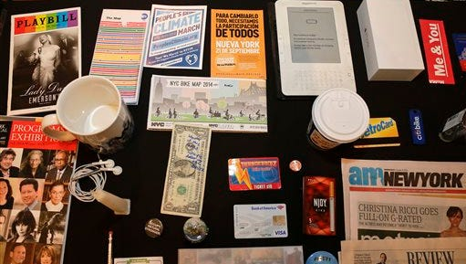

Slide 5
Time Capsule
Imagine you tasked with creating a time capsule that will be unearth in 150 years. You are allowed to include five primary sources (documents, artifacts, etc.) to help those who find it piece together what your life was like and you were in 2022.
What five things would you include? For each object, write a 2-3 sentences explanation about what that object says about your life and/or who you are.

Slide 6
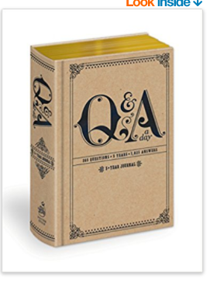
Example
Object 1: Question a Day book. I would include this because it offers valuable insight into me. Everyday, I answer a question in the book. You cycle through the questions every year, so those who find it will not only get an idea of who I am, but also see how I changed over time.
Object 2: My patch and year bars from my summer camp. I worked at a summer camp for six years. I began as an one-on-one counsellor for kids with disabilities, but worked my way up to a Director position. Summer camp was a huge part of my life, as it was where I first started working with children and youth, and it was an important step in becoming a teach.

