Slide 1




UNDERSTANDING
PRIMARY AND
SECONDARY SOURCES

Slide 2


When historians look at documents in order to understand history, they often divide these documents into categories, including primary and secondary sources.

Slide 3
One category includes
material produced by
individuals who lived
through an event and
the other includes material produced from individuals after an event happened.

Slide 4

Copy this chart in your notebook or on a piece of loose-leaf paper.
Label each section with the following headings:
Definition
Characteristics
Examples
Things to consider
Definition
Characteristics
PRIMARY SOURCES
EXAMPLES
Things to Consider

Slide 5
Definition
A primary source is a document or object created by someone who was involved in or witnessed an event. (Original Documents, Creative Works, Relics or Artifacts)
Definition
Characteristics
PRIMARY SOURCES
EXAMPLES
Things to Consider

Slide 6
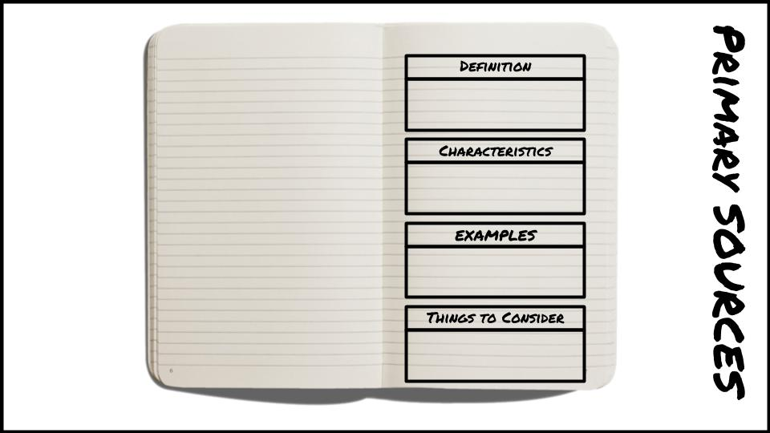

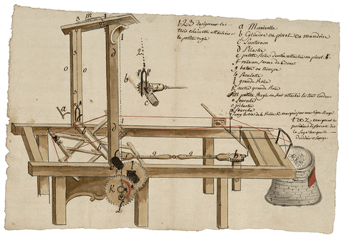
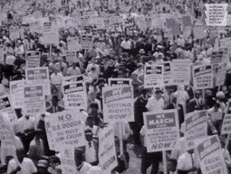
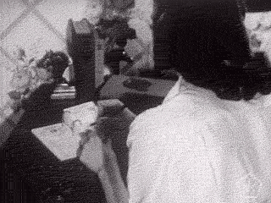
Characteristics
The Creator of the document or object witnessed, participated, or lived during the time of the event. (First-Hand)
Primary SOURCES

Slide 7
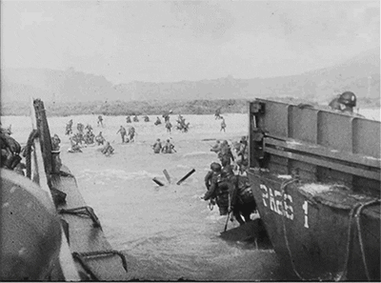
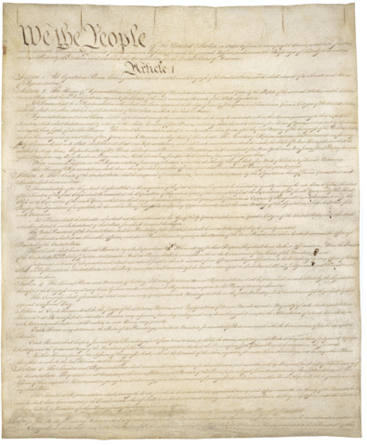
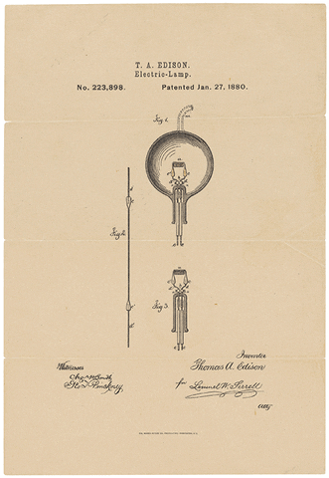
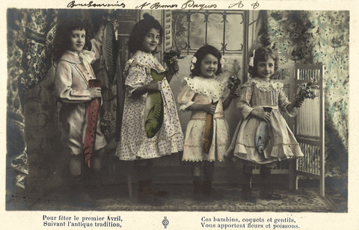
Examples
archives and manuscript material
photographs, audio recordings,
video recordings, films
journals, letters and diaries
speeches
scrapbooks
published books, newspapers and
magazine clippings published at the time
government publications
oral histories
records of organizations
autobiographies and memoirs
Artifacts (clothing, costumes, furniture)
research data, e.g. public opinion polls
PRIMARY SOURCES

Slide 8
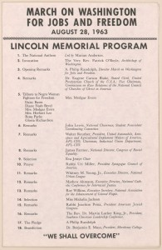

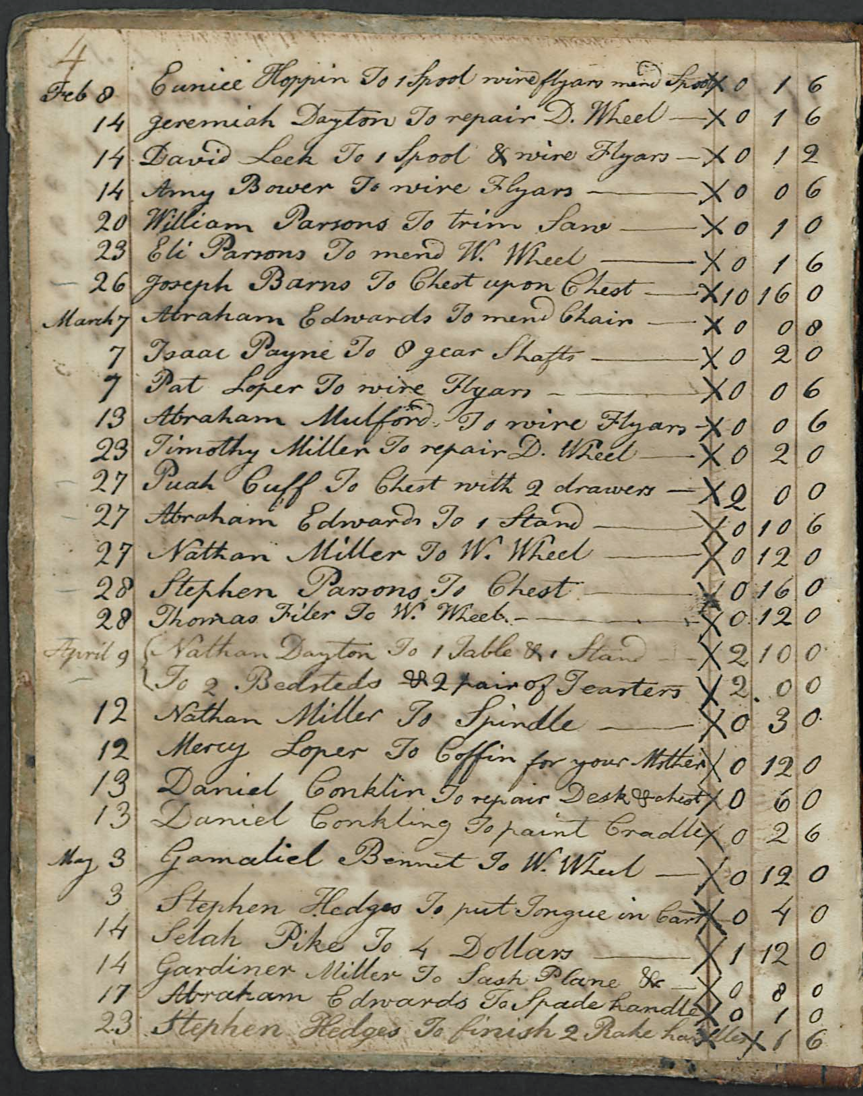
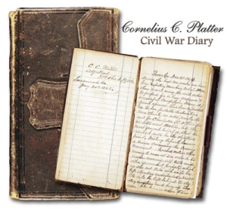
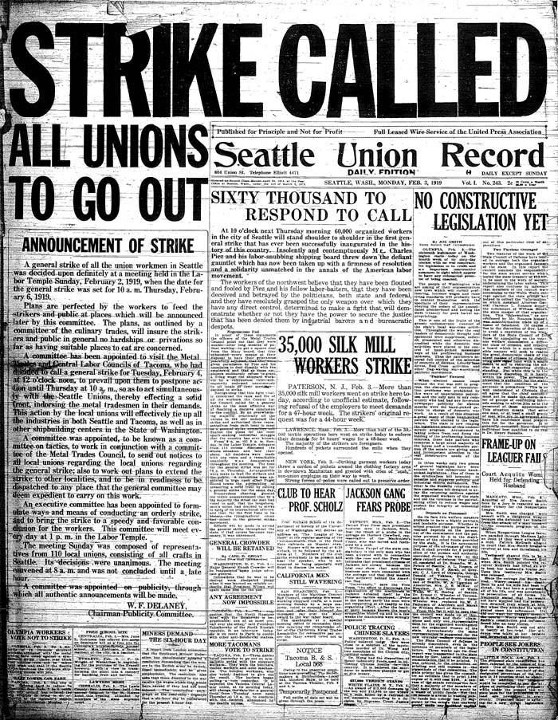
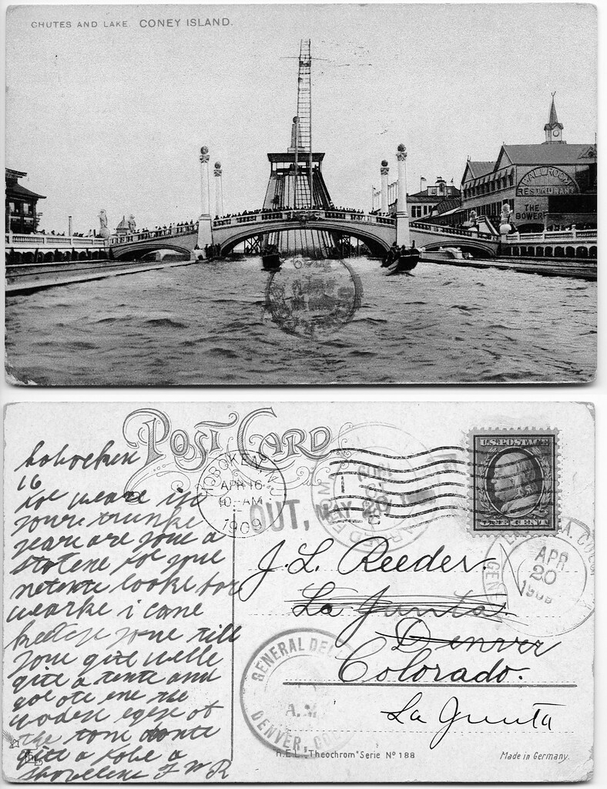
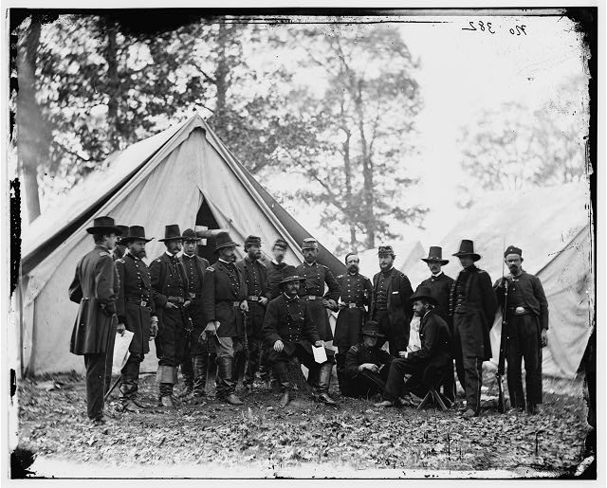
WHICH ONE DOES NOT BELONG? (WHICH ONE IS NOT A PRIMARY SOURCE?)

Slide 10

Things to consider
Who Wrote or created this?
When did they write or make this?
Why did they write or make this?
What is your overall impression of this source? Is it trustworthy?
PRIMARY SOURCES

Slide 11
Copy this chart in your notebook or on a piece of loose-leaf paper.
Label each section with the following headings:
Definition
Characteristics
Examples
Things to consider
Definition
Characteristics
SECONDARY SOURCES
EXAMPLES
Things to Consider

Slide 12
A secondary source is an opinion, account, or interpretation of a past event by someone who wasn’t actually there.
Definition
A secondary source is an opinion, account, or interpretation of a past event by someone who wasn’t there.
Definition
Characteristics
SECONDARY SOURCES
EXAMPLES
Things to Consider

Slide 13
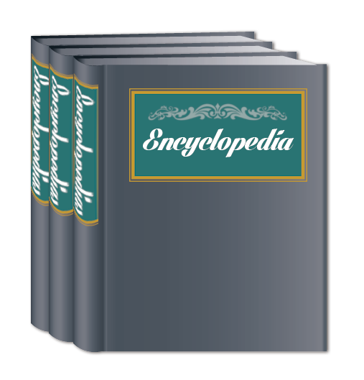
Characteristics
Interpretations of information written after the event; Offers a review or a critique
SECONDARY SOURCES

Slide 14
Examples (Record 5 Examples)
Biographies
Encyclopedias
Textbooks
Documentaries
Newspaper and magazine articles written after the event
Definition
Characteristics
SECONDARY SOURCES
EXAMPLES
Things to Consider

Slide 15
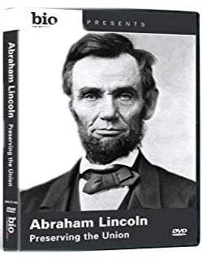
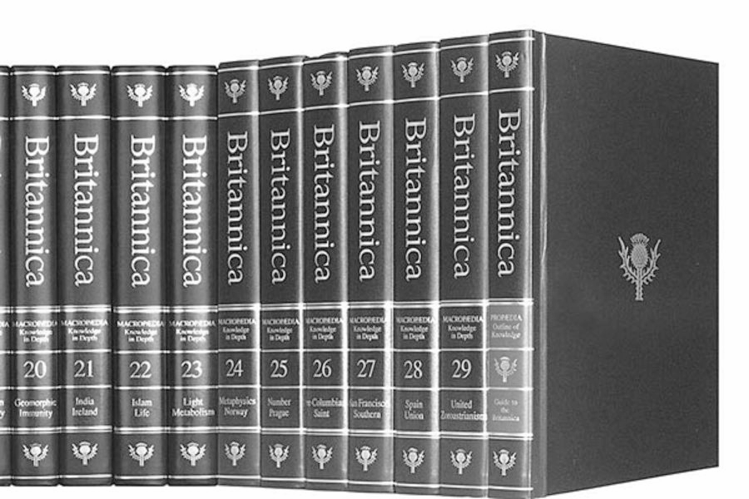

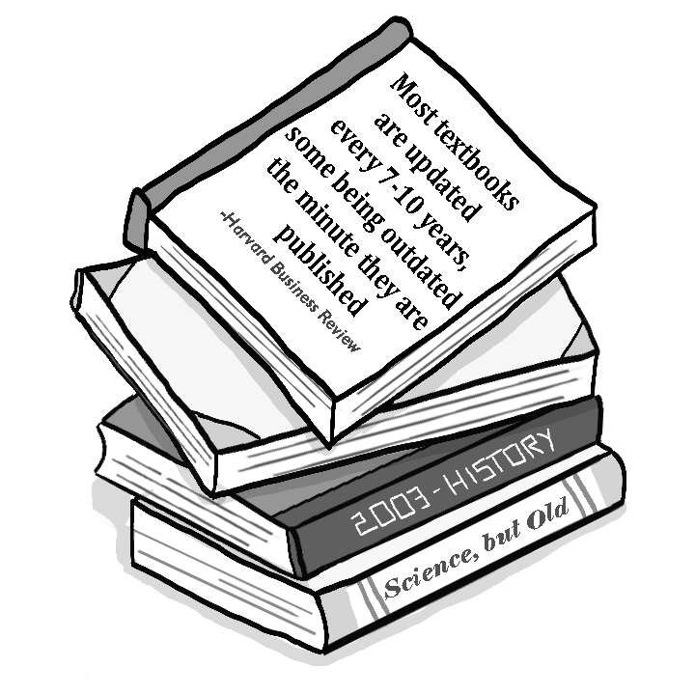

podcast

Slide 16
Things to consider
Who Wrote or created this?
When did they write or make this?
Why did they write or make this?
What is your overall impression of this source? Is it trustworthy?
Definition
Characteristics
SECONDARY SOURCES
EXAMPLES
Things to Consider

Slide 17
INTERPRETATION
HISTORICAL RECORD
FACTS
OPINION
CREDIBLE
BIAS
SECONDARY SOURCE
PRIMARY SOURCE

Slide 18
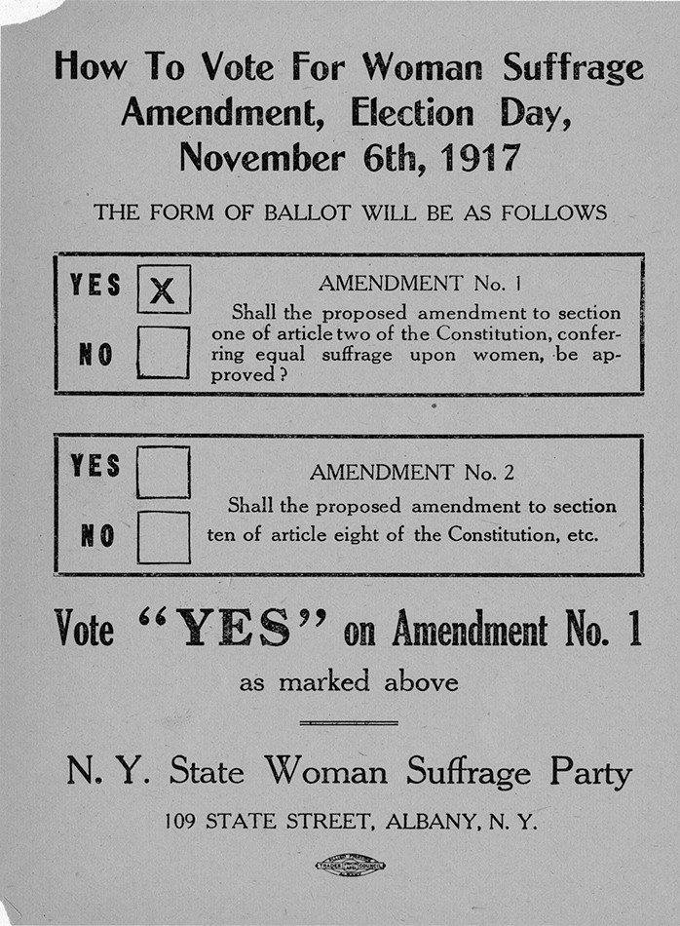
Quiz
When was this poster made?
1717
1817
1917
2. What period or social movement is being represented in this poster?
Abolitionist movement
Women’s SUffrage Movement
Prohibition
3. Who made this poster?
A. Daughters of Liberty
B. Women’s Christian Temperance Union
C. NY State Women Suffrage Party
4. Is this Poster a primary or secondary source? Explain your answer.

Slide 19
Quiz
When was this poster made?
1717
1817
1917
2. What period or social movement is being represented in this poster?
Abolitionist movement
Women’s SUffrage Movement
Prohibition
3. Who made this poster?
A. Daughters of Liberty
B. Women’s Christian Temperance Union
C. NY State Women Suffrage Party
4. Is this Poster a primary or secondary source? Explain your answer.

Slide 20

Task: If you were a historian researching the March on Washington, what primary and secondary sources would you consult? Open the “Sources Assignment” on Moodle.
Notes:
Scavenger Hunt link: https://docs.google.com/presentation/d/1A_6kcnlh_S-qcpRfA46jHee2ULiVA3568mXy0hUHpRk/copy?usp=sharing

