Slide 1

Who Makes our Laws?
Government in Canada

Slide 2

Opening Thoughts
Is government important? Why or why not?
How does government affect your life?
Why is it important to know who your elected representative is?

Slide 3
Governments in Canada
Canada is a parliamentary democracy and constitutional monarchy.
As a parliamentary democracy, we elect members to our parliament and legislatures across the country.
As a constitutional monarchy, Canada’s head of state is a hereditary sovereign (queen or king), who reigns in accordance with the Constitution.

Slide 4
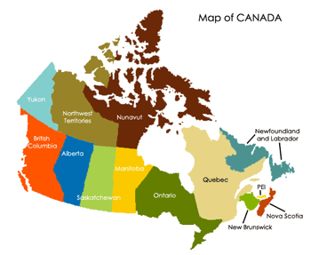
Three Levels of Government
Canada is a very large country with different needs and interests.
In order to meet the needs of citizens, the Canadian government is structured into a three-level system: federal, provincial/territorial and municipal/local.
Each level has its own arrangement of elected and appointed officials as well as a unique set of responsibilities.

Slide 5
Three Branches of Government
Legislative Branch: Creates laws, rules and regulations under federal jurisdiction. The legislative branch is made up of federal elected representatives called Members of Parliament.
Executive Branch: Responsible for government operations, and implementing and enforcing laws and regulations. Includes the Queen’s representative (the governor general) and cabinet ministers (appointed by the prime minister).
Judicial Branch: Interprets the law and determines the penalty for those who violate established laws, rules and regulations. Includes the Canadian court system, which is headed by the Supreme Court and nine appointed judges.

Slide 6
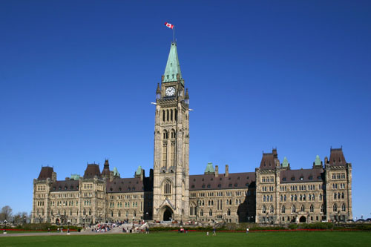

Federal
The elected representative at the federal level is called a Member of Parliament (MP).
Canadians will elect 338 MPs in the current election. This is the federal legislative body, which creates or enacts laws.
MPs debate and pass laws in the House of Commons in Ottawa.
The leader of the government is called the prime minister.
The Queen is represented by the governor general.

Slide 7
Provincial/Territorial
The elected representatives are called Members of the Legislative Assembly (MLAs), Members of Provincial Parliament (MPPs), Members of the National Assembly (MNAs) or Members of the House of Assembly (MHAs), depending on the province or territory.
Elected representatives debate and pass laws at the provincial or territorial legislature.
The leader of the government is called the premier.
The Queen is represented by a lieutenant governor in Canada’s ten provinces and by a territorial commissioner in the three territories.

Slide 8
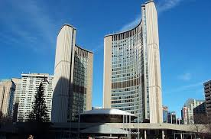
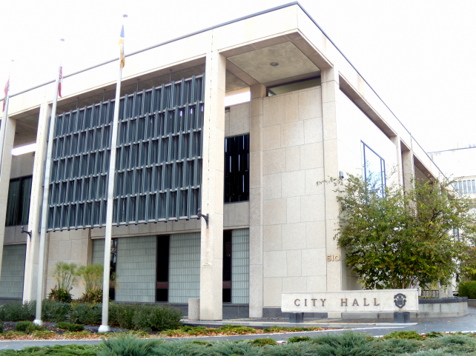
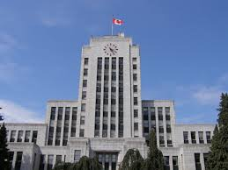
Municipal/Local
The elected representative at the municipal level is called a councillor or alderman.
The head of the council is called a mayor, reeve or chairperson.
The size and structure of the council differs depending on the population it represents.

Slide 9
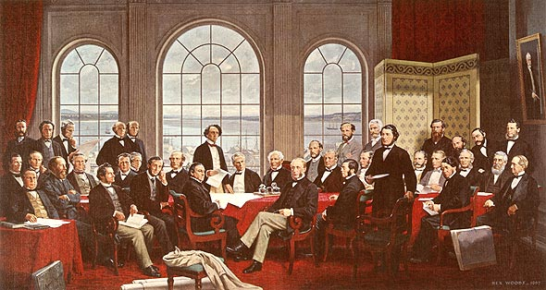
Section 91-95, Constitution
When they chose a federal form of government, the Canadian Fathers of Confederation assigned particular responsibilities to the federal and provincial governments (outlined in Sections 91–95, Constitution Act).
This division of powers is based on the idea of subsidiarity, meaning that the government level closest to the issue governs it.
Municipal/local governments receive powers from their province or territory.

Slide 10
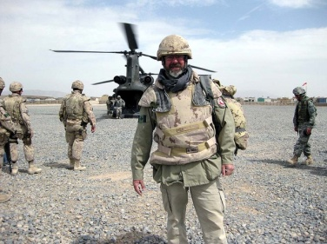
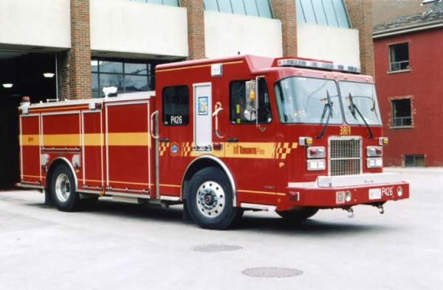

Division of Responsibilities
Federal: Justice, citizenship and immigration, national defence, currency, public safety, fisheries and oceans
Provincial/Territorial: Education, healthcare delivery, environment, energy
Municipal/Local: Road maintenance, water and sewer service, recreation and community facilities, libraries, police protection services

Slide 11
Federal Elections
Federal elections, like the upcoming one on Sept 20th, elect our members of parliament.
What is parliament?
https://www.youtube.com/watch?v=YSO27QPieTs

Slide 12
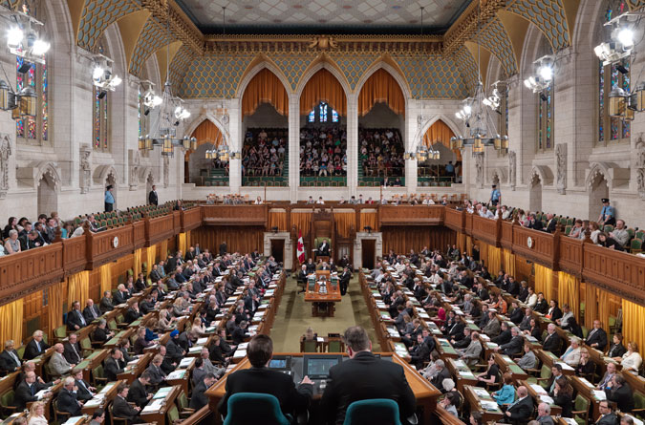
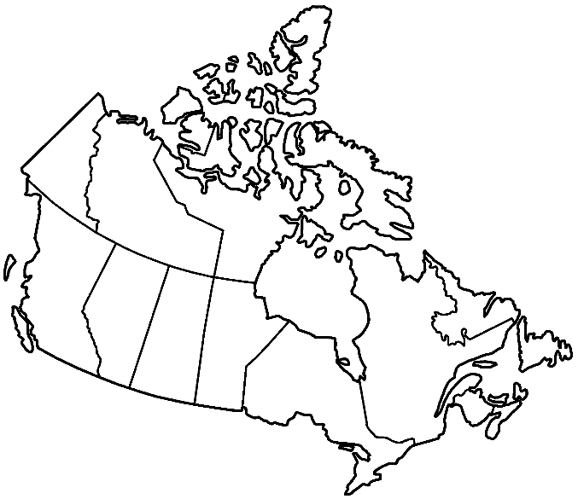

What is an MP?
A Member of Parliament (MP) is a person elected to a seat in the House of Commons who serves as a representative of one of Canada’s 338 ridings.

Slide 13

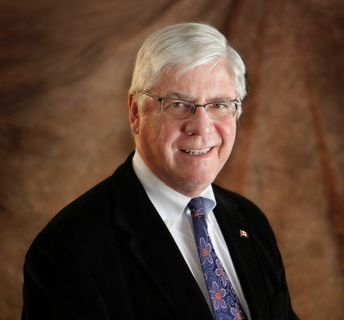
Who can be an MP?
Any Canadian citizen 18 years of age and older can become an MP.
The youngest sitting MP is Pierre-Luc Dusseault, who was first elected at 19. He was elected for a second time and is now 24.
The oldest sitting MP is David Tilson, who was elected for a fifth time at the age of 74.

Slide 14
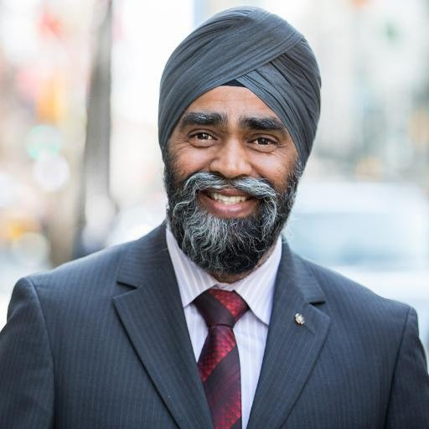
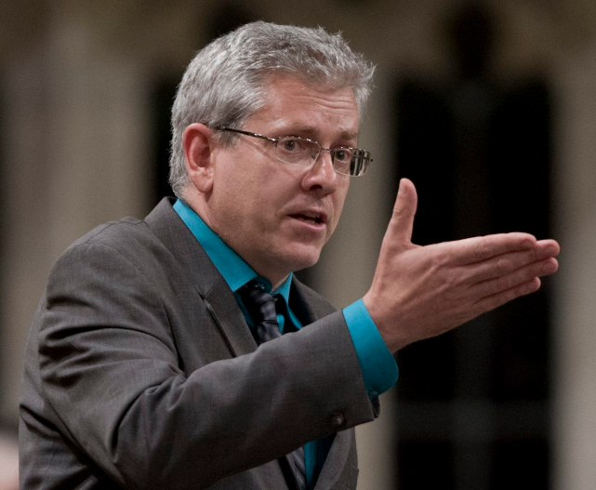
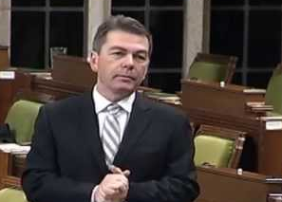
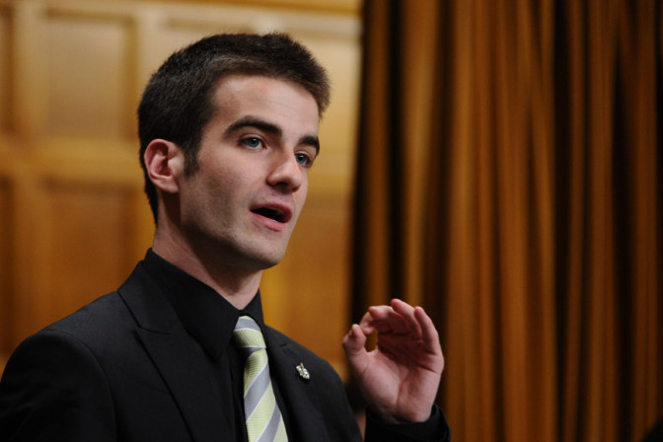
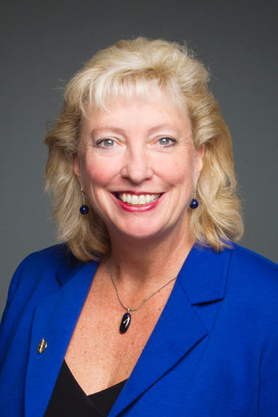
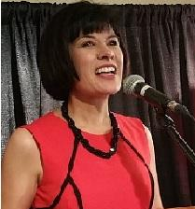
Before they were MPs…
Farmer &
Businessman
Musician
Soldier & Police Officer
Social
Worker
Student
Engineer
Notes:
Top Row, Left to right:
David Anderson (Cypress Hills-Grasslands, SK) (CPC)
Harjit Sajjan (Vancouver South, BC) (LPC)
Charlie Angus (Timmins-James Bay, ON) (NDP)
Bottom Row:
Matthew Dubé (Beloeil-Chambly, QC) (NDP)
Marilyn Gladu (Sarnia-Lambton, ON) (CPC)
Ginette Petitpas-Taylor (Moncton-Riverview-Dieppe, NB) (LPC)

Slide 15
What does an MP do?
An MP has no set job description, but some duties include:
  representing constituents’ concerns
  assisting constituents
  serving on committees
  proposing legislation
  participating in House of Commons debates and discussing and amending bills.
Debate: https://youtu.be/SBQYMzHf3IM

Slide 16
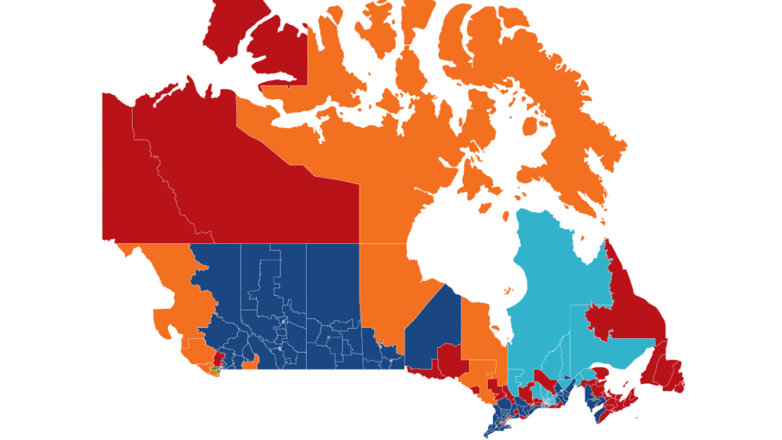
These are the ridings in Canada and how the voted in the last election. What do you notice about what areas of Canada voted for who?

Slide 17
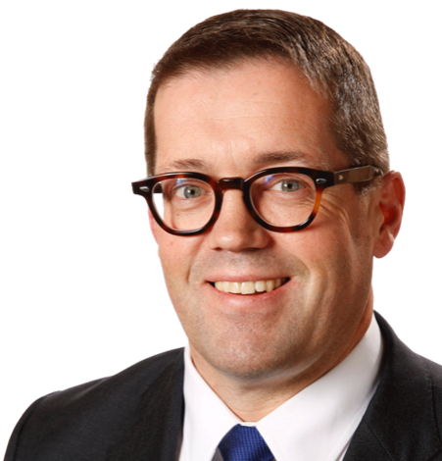
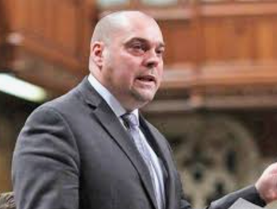
Who are our MPs?

Slide 18
How does our riding choose who wins?
Plurality, or First Past the Post
Person with the most votes wins, even if most people didn’t vote for them.
For example:
Conservatives: 40%
Liberal:35%
NDP: 25%

Slide 19
So the conservatives have won the seat and are heading to parliament. But who is gonna be Prime Minister?
The leader of whichever party has the most seats in parliament.

Slide 20
Final Thoughts
What do you think the purpose of an MP should be?
What qualities and past experience do you look for in your elected representative?
What are some federal responsibilities that are important to you?
What questions would you like to ask your MP?

Slide 21
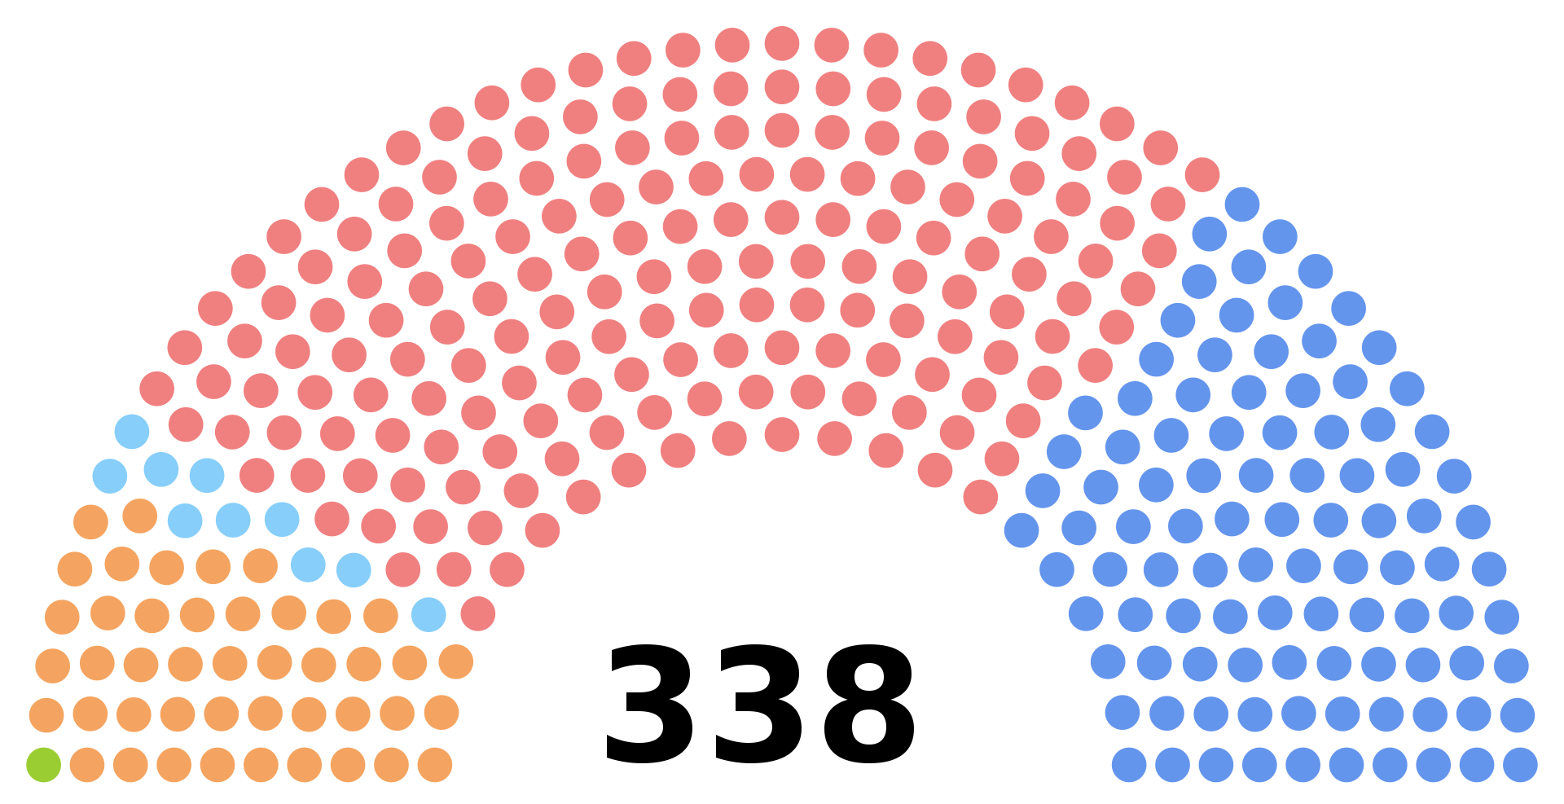
Majority vs Minority Government

Slide 22
