Slide 1



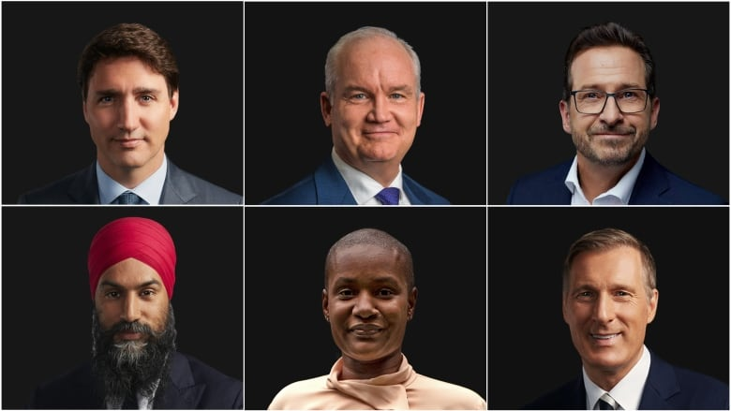



In your table groups you will be research and sharing one of the main party’s platforms.
Using party websites, online resources and campaign literature, each group should conduct research into the following:
What does the political party stand for?
Who is the current leader of the party?
Who is the local candidate?
What are the party’s logos, slogans, posters and advertisements? What are the party’s key messages?
What are the party’s main priorities or ideas (platform)? What is their vision for Canada?
As you research, create a poster to share with the class

