Slide 1

How to vote

Slide 2

REVIEW FROM YESTERDAY
SUBHEADER TEXT HERE

Slide 3
If the conservatives win 55% of the seats in parliament, what type of government will they form?
SUBHEADER TEXT HERE

Slide 4
What does “first past the post” mean?
SUBHEADER TEXT HERE

Slide 5
Do we elect our Prime Minister directly?
SUBHEADER TEXT HERE

Slide 6
What level of government is responsible for health care? Military? Garbage collection?
SUBHEADER TEXT HERE

Slide 7
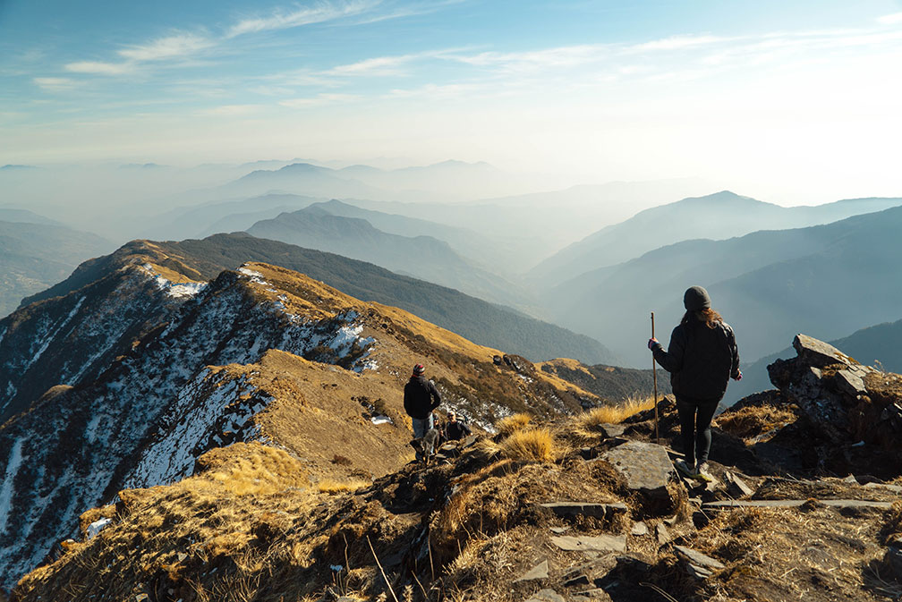
How do I vote?
SUBTITLE GOES HERE

Slide 8

Question brainstorm:
In your table groups, brainstorm what you know about voting and what your curious or have questions about.

Slide 9

Federal Election voting guide
In your table group, use the election guide to see if you can find the answers to your questions.
Also, what is something new you didn’t know before?

Slide 10

Federal Election voting guide

Slide 11
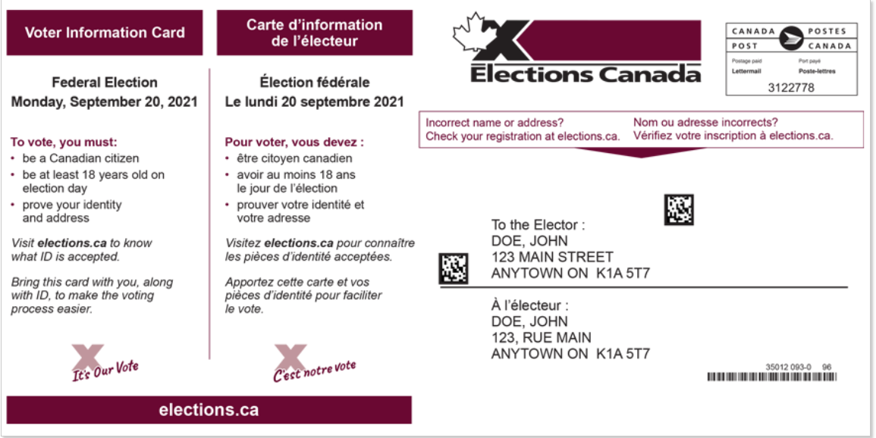

Slide 12

What happens when you go to vote?
Watch the video!!

Slide 13

Individual or Small Group Task
Option 2:
Option 1:
Create a flow chart or other visual to help explain the steps that a Canadian goes through in order to cast their ballot. Remember to include details and specifics.
In a group of three, create a skit or video explaining the voting process when you arrive at a polling station. Remember to include what happens before and during the voting process.

