Slide 1

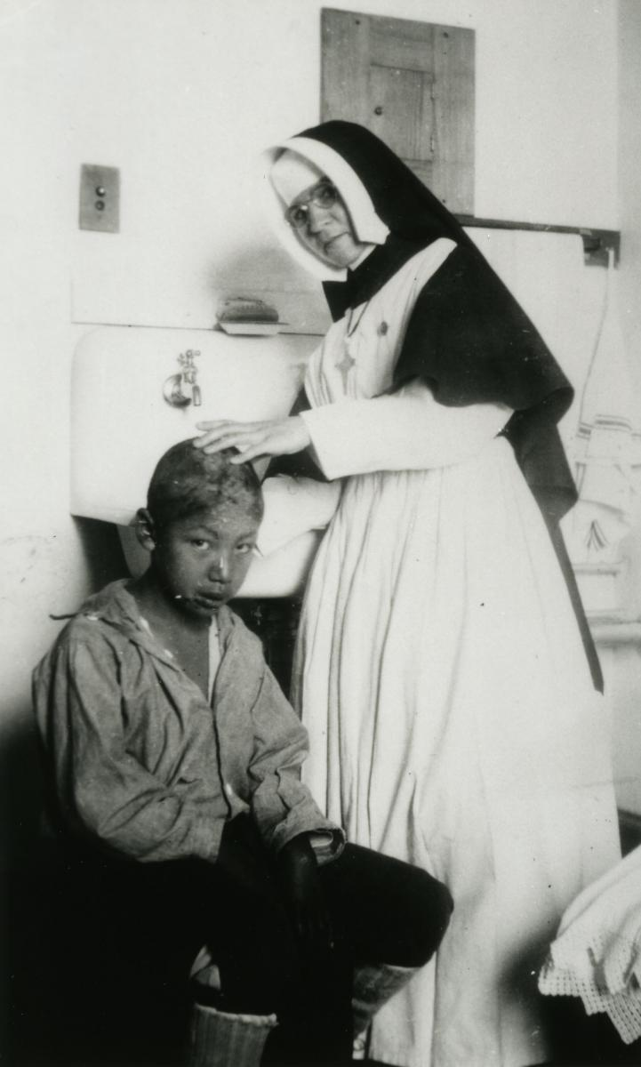
Canada’s Indian Residential Schools (IRS)

Slide 2
Vocabulary
CBC Kids’ “The Word Indigenous”
Indigenous
Aboriginal
Indian
Native
First Nations
Metis
Inuit
Specific Nation names (Haudenosaunee, Algonquin, Cree, Lheidli T’enneh, Haida)

Slide 3
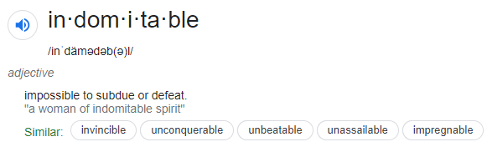
Indomitable

Slide 4
Residential Schools Map

Slide 5
Purpose of residential schools
Each of you will have a sheet with both primary and secondary sources that explain or explore why Canada established residential schools. With a partner, read over these excerpts and make a list of the reasons residential schools were established. You can make notes right on your paper.

Slide 6

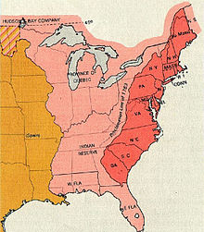
Why would the Canadian government want Indigenous people to assimilate?

Slide 7
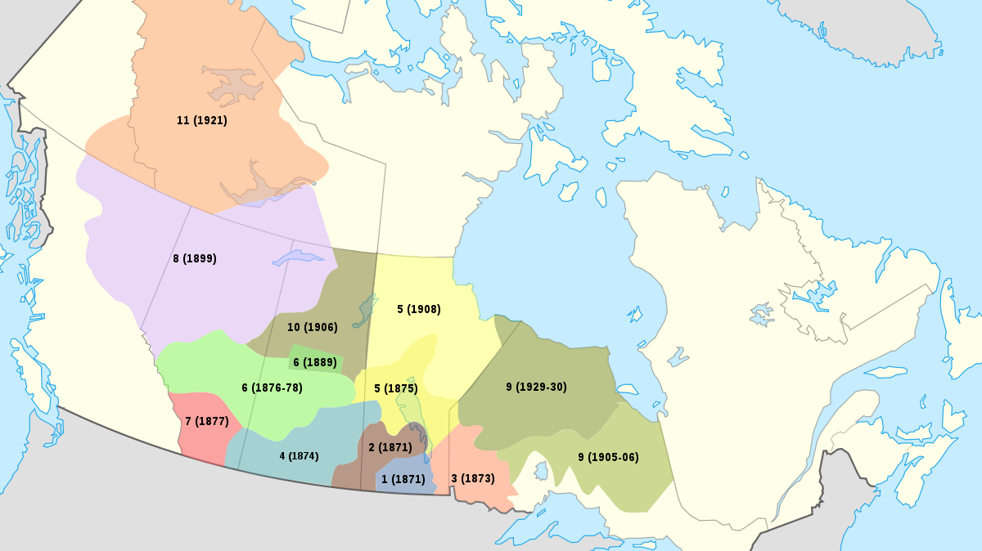
Why would the Canadian government want Indigenous people to assimilate?

Slide 8
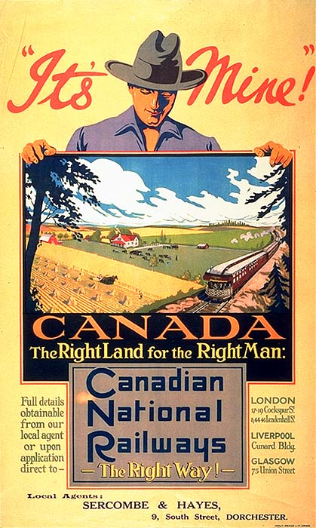
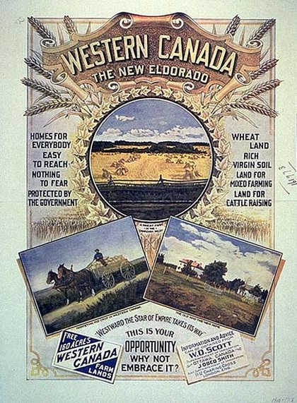
Western Settlement

Slide 9
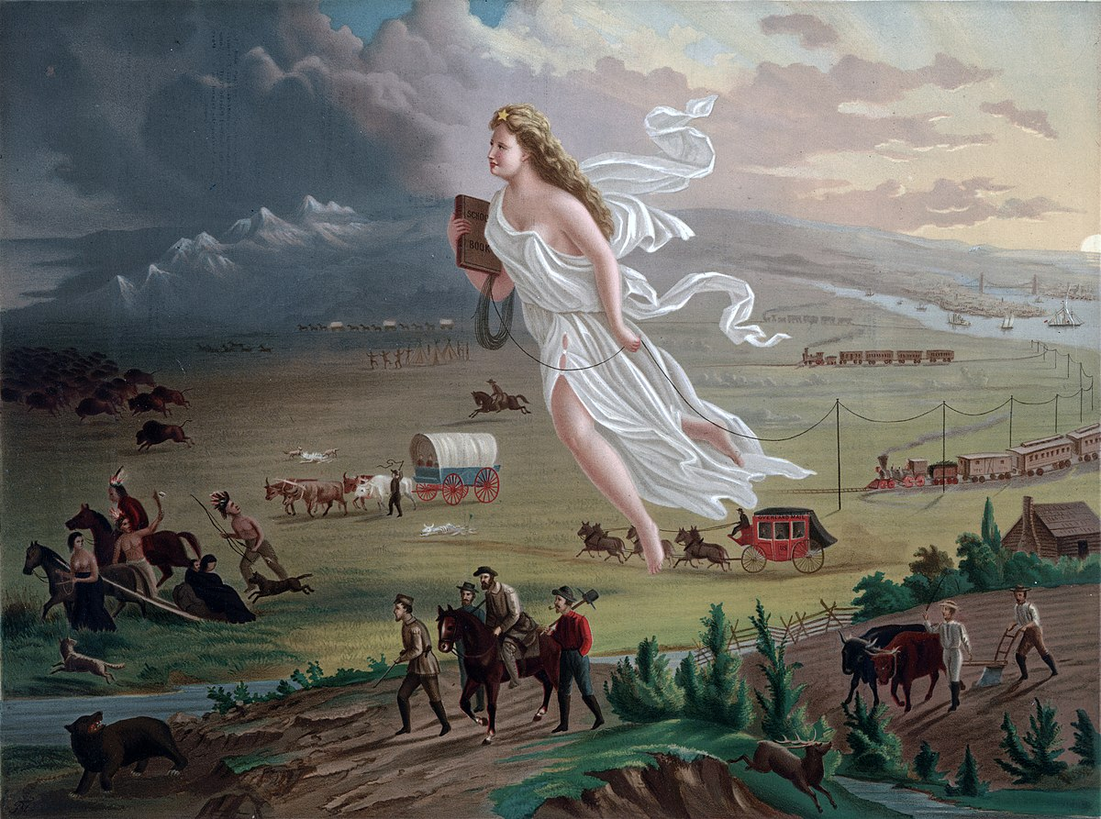
Manifest Destiny

Slide 10
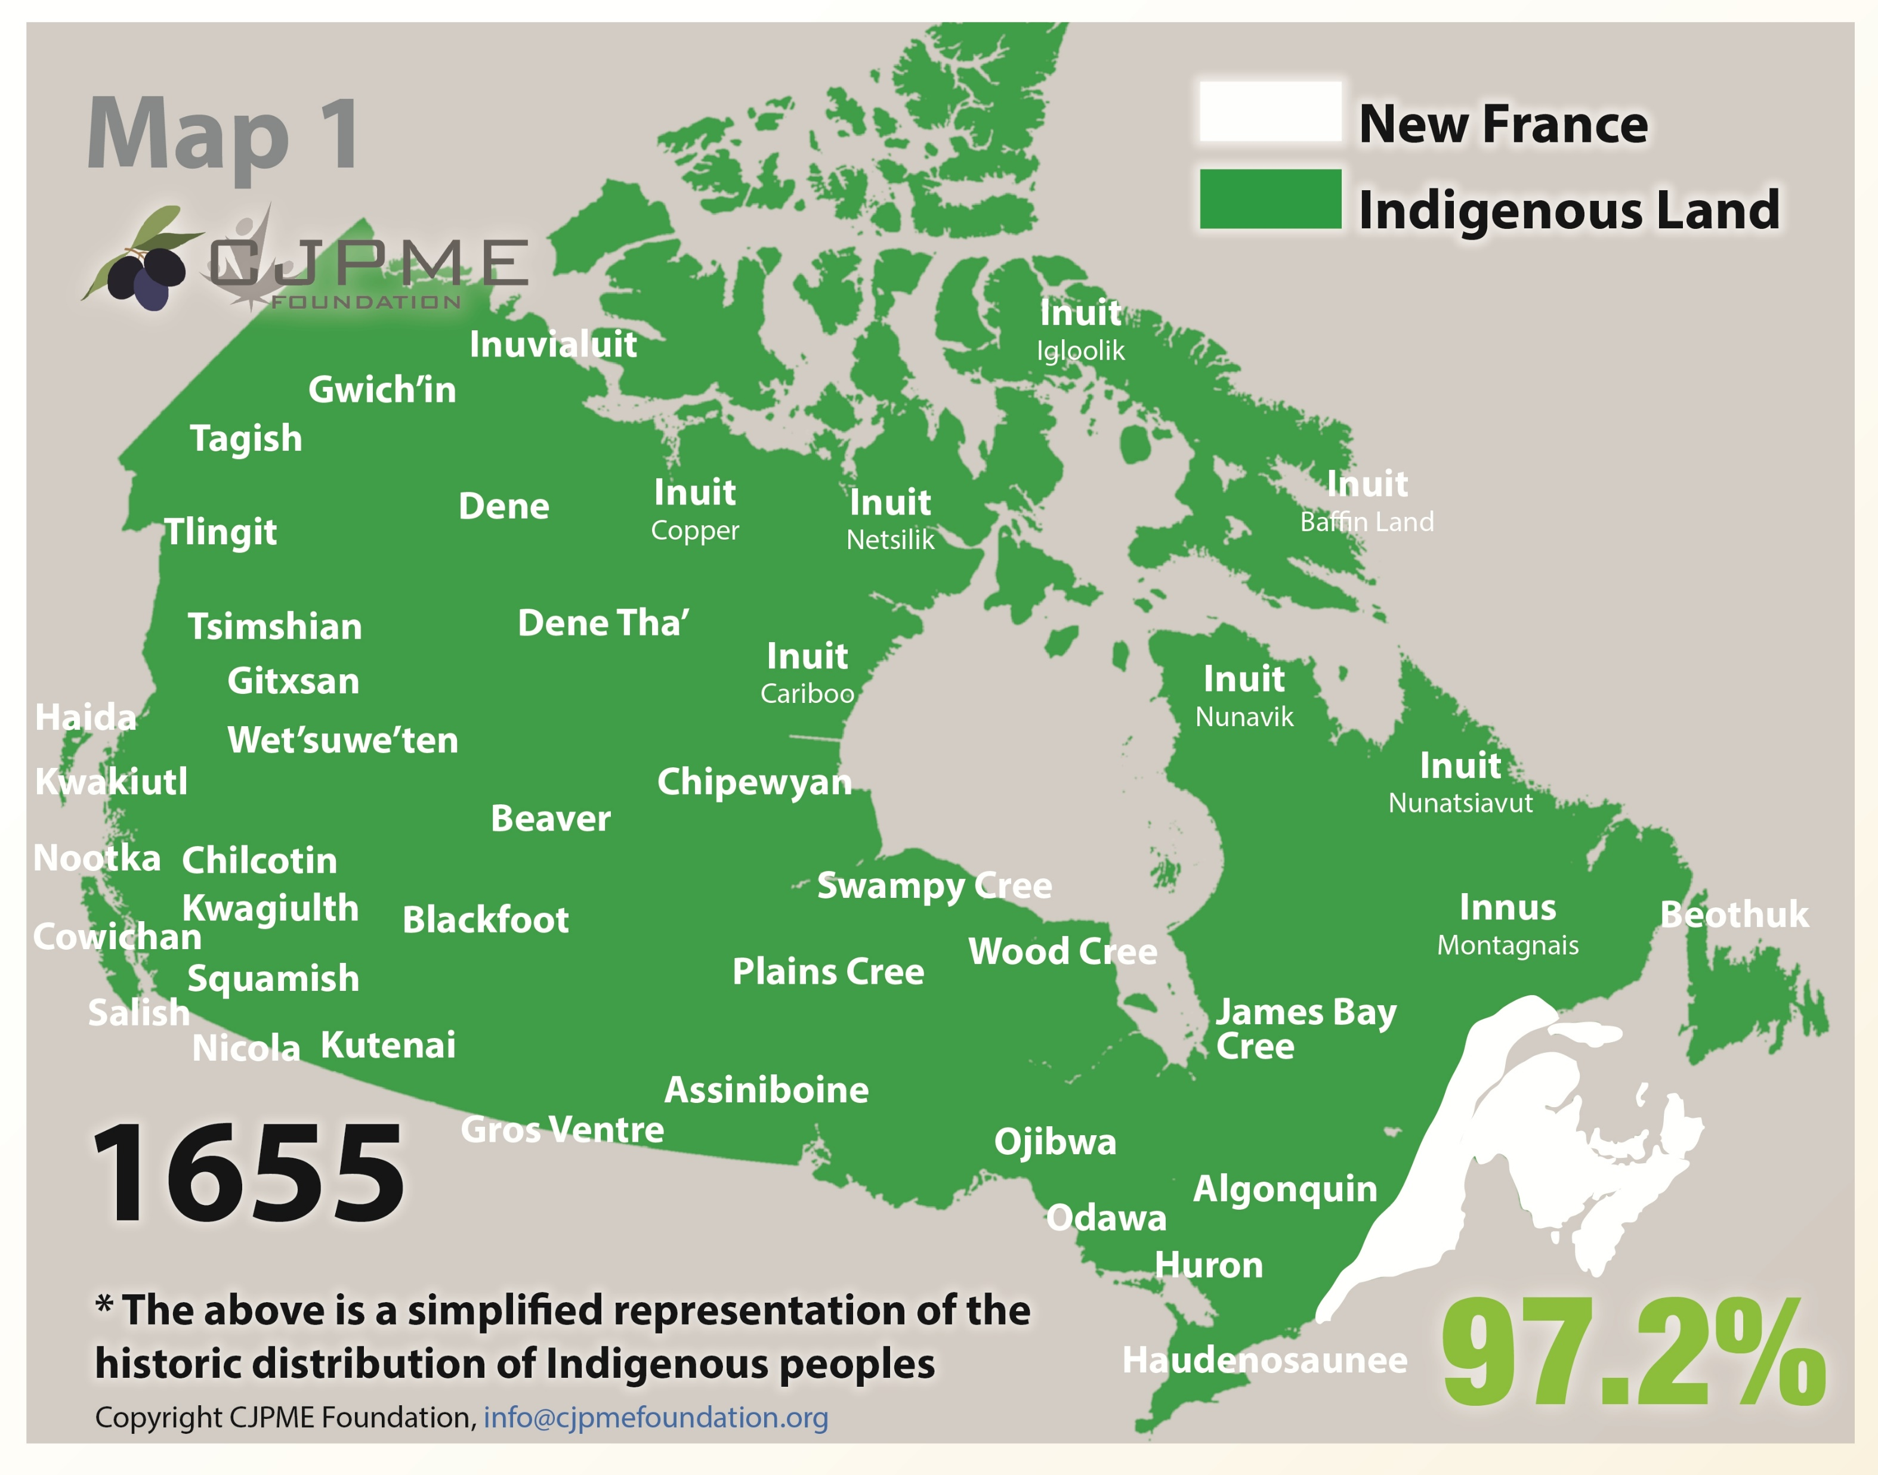
https://native-land.ca/

Slide 11
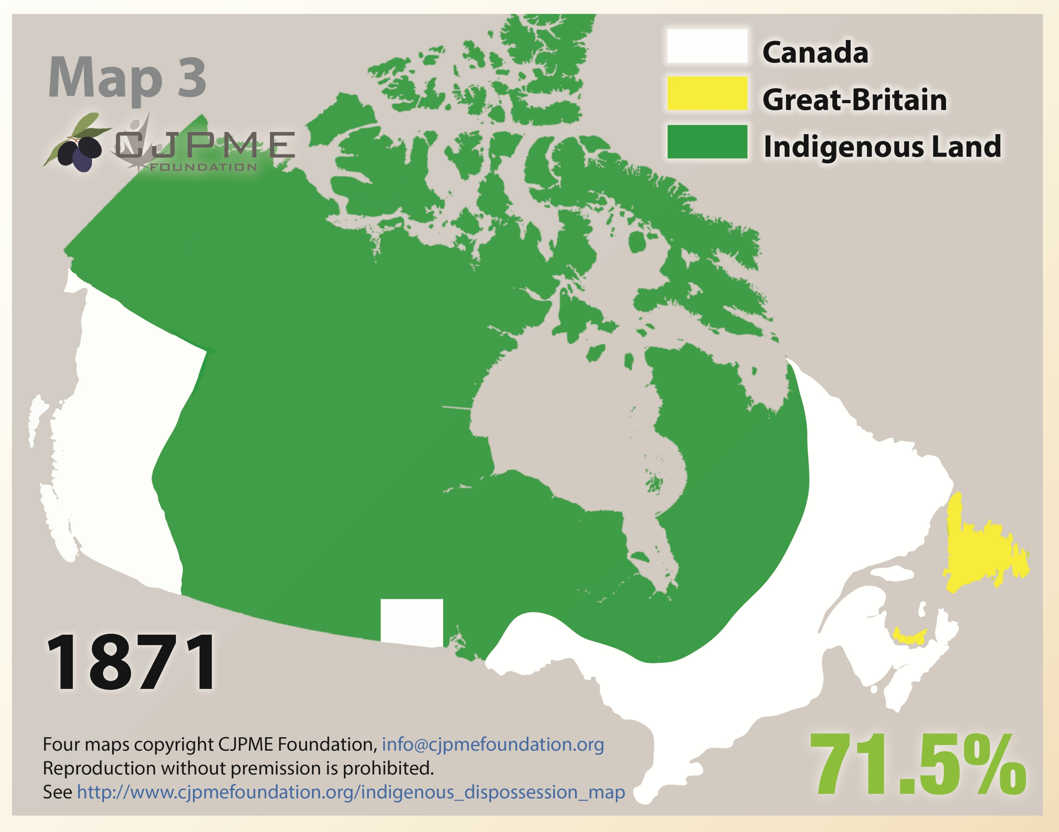

Slide 12
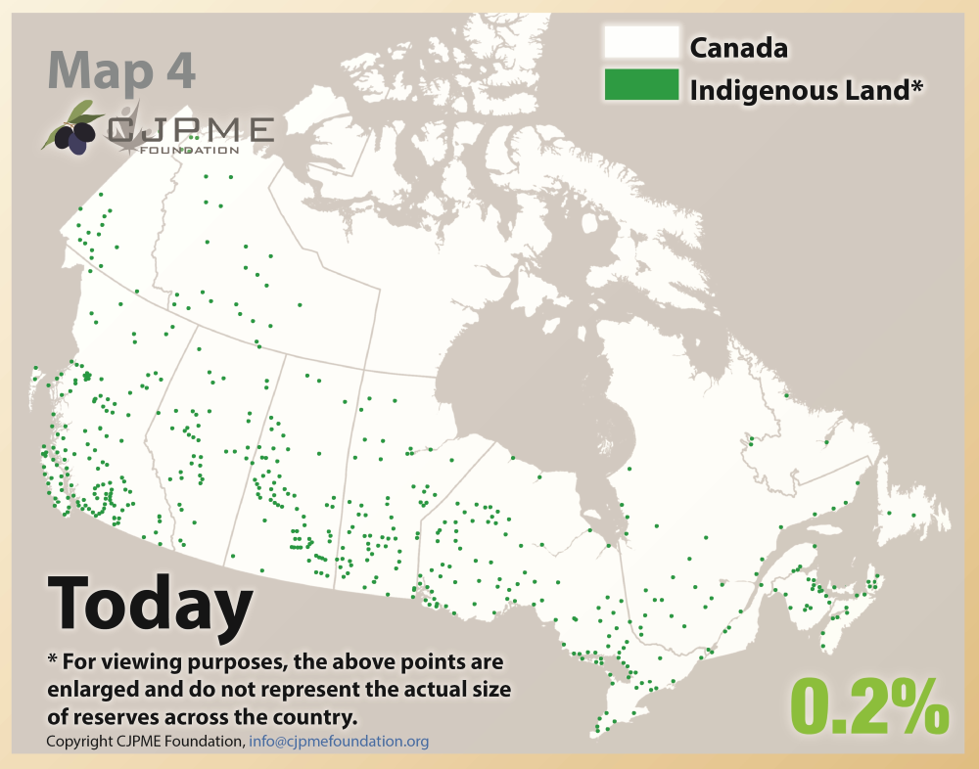

Slide 13
Timeline
As you watch, list the way people, both Indigenous and settler, pushed back against residential schools.

