Slide 1
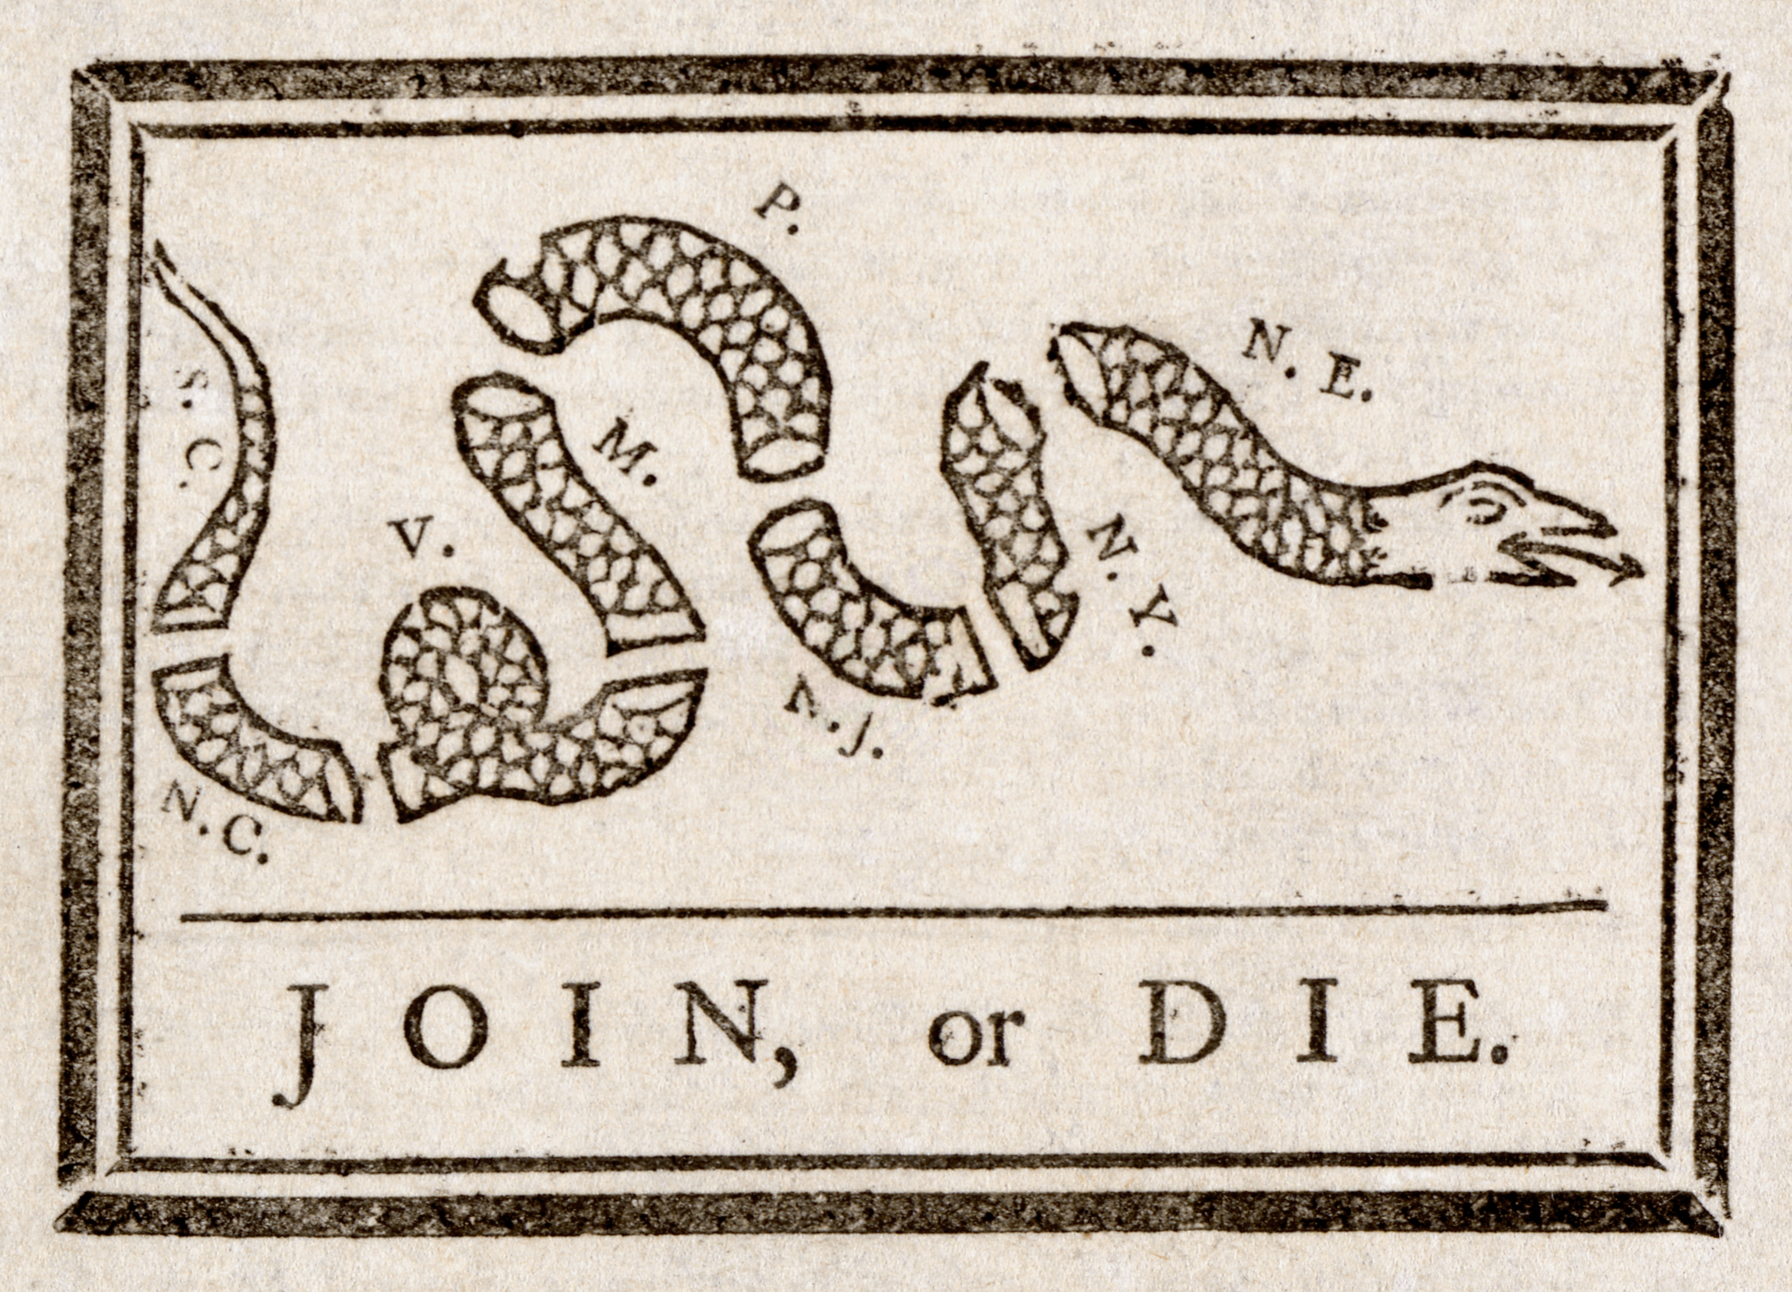
In 1754 Benjamin Franklin drew this image of a severed snake to encourage the British colonies to unite against the threat posed by French and Indian forces. It regained popularity later during the American Revolution.
DAY 2
Place Date Here
1. Describe the cartoon, including the caption.
2. What was the message of the cartoon
3. Why might the cartoon made a comeback during the Revolution?
Notes:
KEY
1. A snake is cut into pieces and the caption reads, “Join, or die”
2. The colonists needed to join together in order to win the conflict.
3. The message of colonial unity was important to success against the British

Slide 2

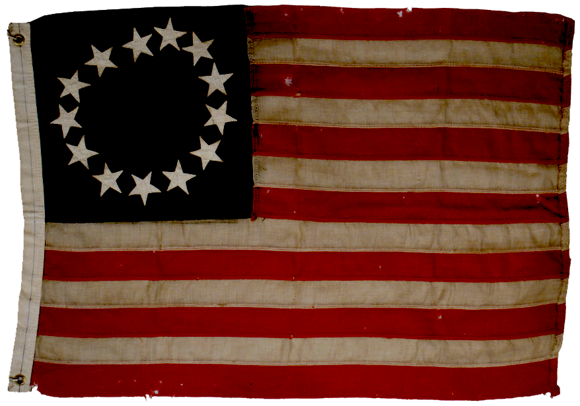
INDEPENDENCE

Slide 3
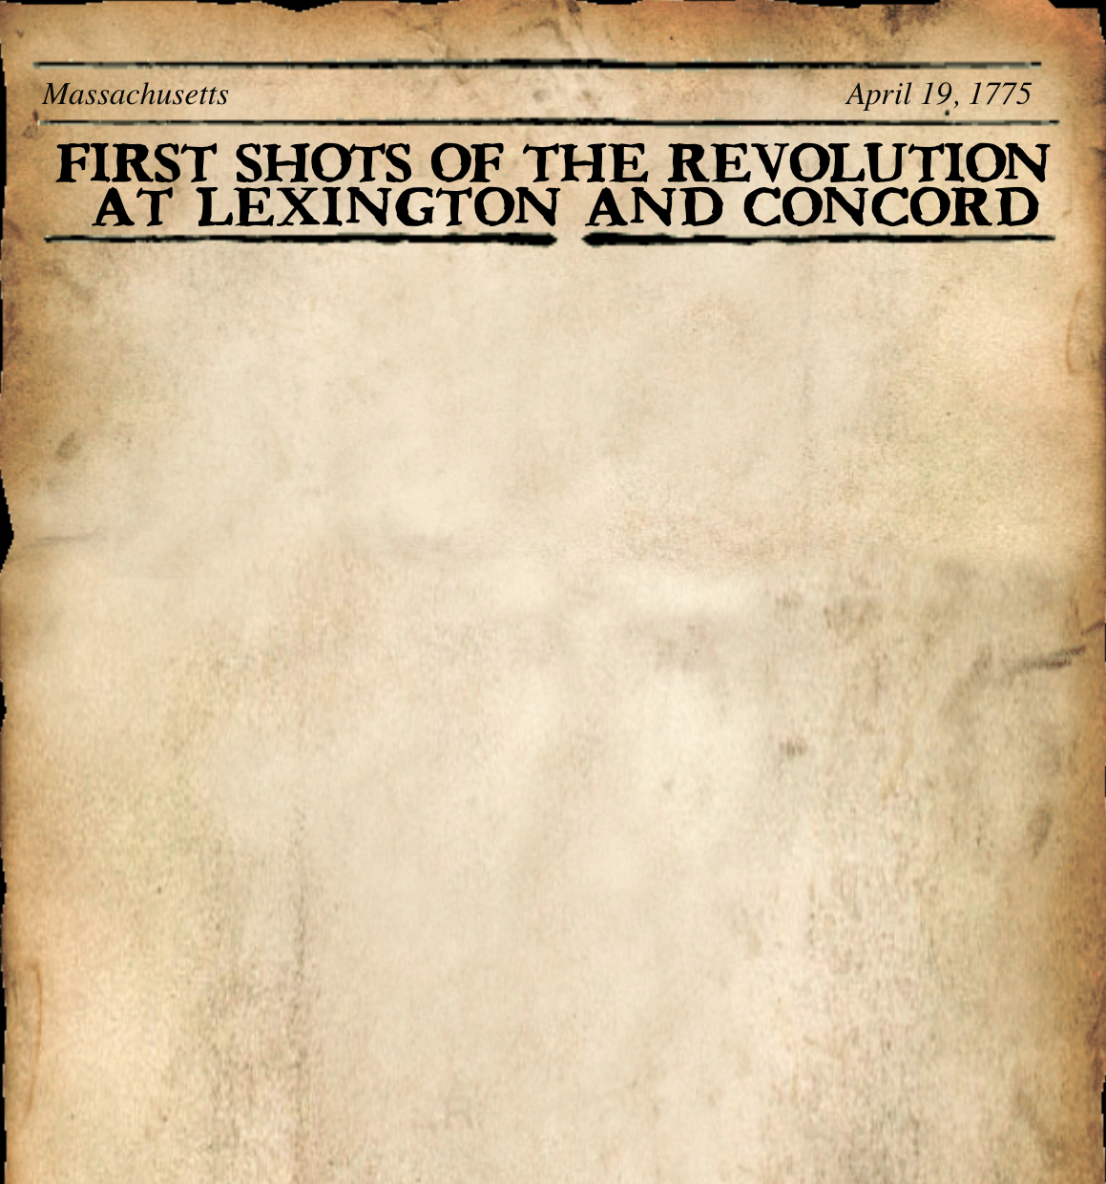

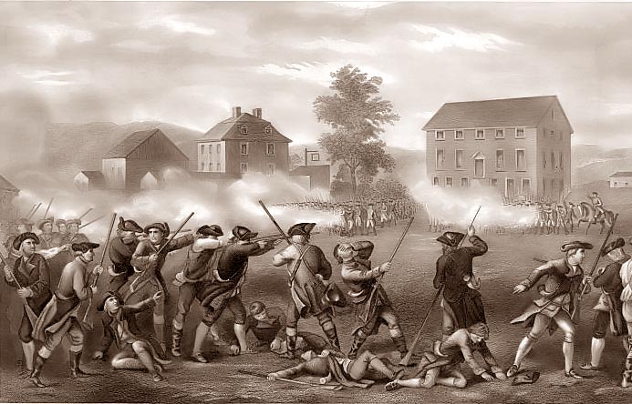
III. Fighting in Lexington & Concord
First Continental Congress
    organization of the 13 colonies
    called for boycotts from & to England
    Minuteman - civilian soldiers
Lexington Battle
    1st battle of Rev. War
    Not official battle - militia fought instead of actual soldiers
    ‘Shot heard around the world’
April 19, 1775: First Shots of War
Notes:
Original Youtube Link: https://youtu.be/eVObshccu30
The First Continental Congress met in 1774 to address and organize protests against the Intolerable Acts: The delegates took two major actions:
They sent a letter to King George III explaining the issues the colonies had with the way they were being treated. And . . .
They demanded that the King stop the Intolerable Acts or they would boycott imports from Britain and stop exporting to England.
After the First Continental Congress, colonists in many eastern New England towns stepped up military preparations. Minutemen, or civilian soldiers, began to quietly stockpile firearms and gunpowder.
Concord, by the Lexington Road: Another result of the Intolerable Acts, General Thomas Gage, commander in chief of British forces in North America, was appointed the new governor of Massachusetts. In the spring of 1775, he became concerned about reports brought to him regarding large amounts of arms and munitions hidden outside of Boston.
In March, Gage sent agents toward Concord, a town outside of Boston reported to be the site of a stockpile of weapons. Gage was also looking for John Hancock and Samuel Adams, two important leaders of the rebellion against the British. They may have been staying in Lexington, a smaller community about five miles east of Concord. Gage drew up orders for his men to march along the Lexington Road to Concord, where they would seize and destroy all munitions that they could find.
This where you have that famous story about Paul Revere, a member of the Sons of Liberty, warning the militias that the British were coming.
Lexington Concord Battle (Covered in Video)
By the morning of April 19, 1775, the king’s troops reached Lexington. As they neared the town, they saw 70 minutemen drawn up in lines on the village green. The British commander ordered the minutemen to leave, and the colonists began to move out without laying down their muskets. Then someone fired, and the British soldiers sent a volley of shots into the departing militia. Eight minutemen were killed and ten more were wounded, but only one British soldier was injured. The Battle of Lexington lasted only 15 minutes.
The British marched on to Concord, where they found an empty arsenal. After a brief skirmish with minutemen, the British soldiers lined up to march back to Boston, but the march quickly became a slaughter. Between 3,000 and 4,000 minutemen had assembled by now, and they fired on the marching troops from behind stone walls and trees. British soldiers fell by the dozen. Bloodied and humiliated, the remaining British soldiers made their way back to Boston.
While the battles were going on, Adams and Hancock were fleeing deeper into the New England countryside. At one point, they heard the sound of musket fire in the distance. Adams remarked that it was a fine day and Hancock, assuming that his companion was speaking of the weather said, “Very pleasant.” “I mean,” Adams corrected Hancock, “this is a glorious day for America.”

Slide 4
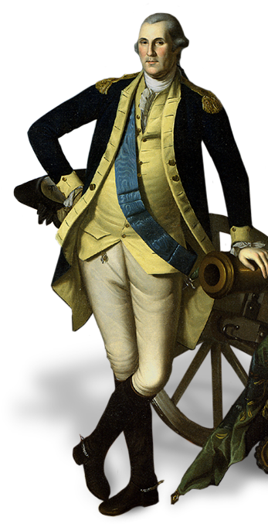
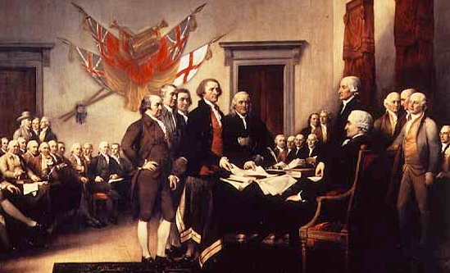

Iv. PEACE Or WAR
Second Continental Congress 1775- 1776
    named George Washington military commander of its army
    authorized printed money
  - issued the Declaration of Independence
Notes:
The Second Continental Congress: The loyalties between the colonists was being debated in the Second Continental Congress. Should they stay or should they go? Loyalists were those who wanted to stay with the king, while the patriots reluctantly wished to separate from the British, risking being tried for treason and put to death. John Adams of Massachusetts suggested a radical plan - that each colony set up its own government and that the Congress declare the colonies independent. He also argued, that Congress should consider the militiamen gathered in Boston to be an official Continental Army. This new army would need a commander to lead them. After months of debate, the Congress agreed to recognize them as the Continental Army and appointed as its commander a 43-year-old veteran of the French and Indian War, George Washington. The Congress, acting like an independent government, also authorized the printing of paper money to pay the troops and organized a committee to deal with foreign nations.

Slide 5
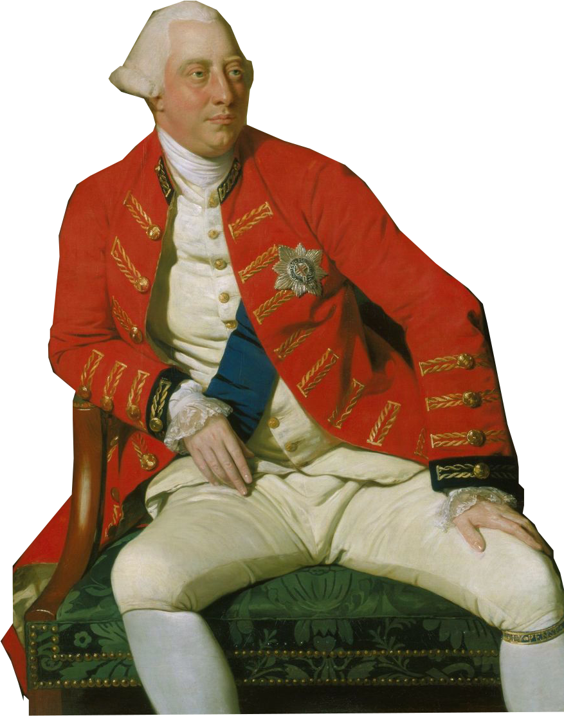
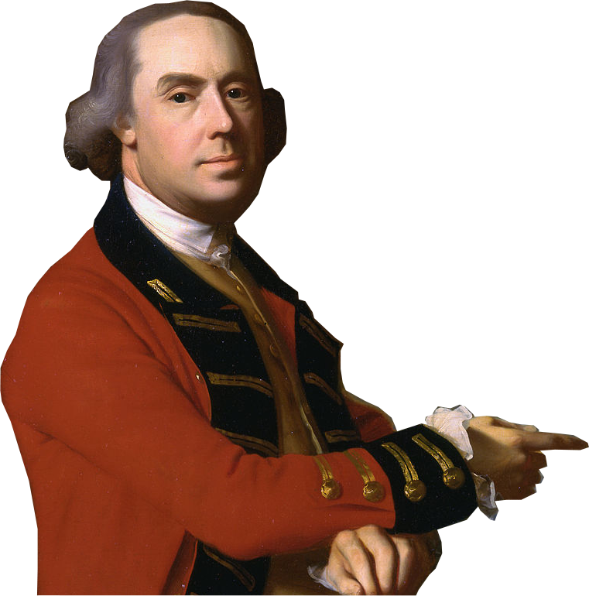
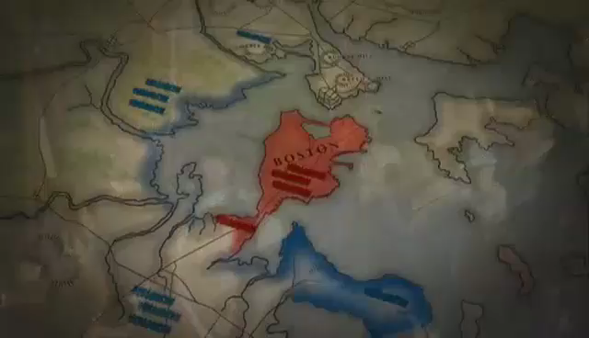

General Thomas Gage, commander of British forces in North America
King George III of England
Battle of Bunker hill
  Battle on Breed’s Hill outside Boston
  Deadliest battle of the war
  Olive Branch Petition - Colonists ask to negotiate w/Britain
  - king George rejects it
Notes:
Battle of Bunker Hill:
In Boston, British General Thomas Gage decided to strike at militiamen who had dug in on Breed’s Hill, north of the city and near Bunker Hill. On the summer morning of June 17, 1775, Gage sent out almost 2,400 British troops. The British, sweating in wool uniforms and heavy packs, began marching up Breed’s Hill in their lines. The colonists held their fire until the last minute, then began to shoot down the advancing redcoats. The surviving British troops made a second attack, and then a third. The third assault succeeded, but only because the militiamen ran low on ammunition.
In the end, the colonists had lost 450 men, while the British had suffered over 1,000 casualties. The Battle of Bunker Hill, which actually took place on Breed’s Hill was the deadliest battle of the war.
Olive Branch Petition: By July, the Second Continental Congress was readying the colonies for war while still hoping for peace. Most of the delegates, like most colonists, felt loyalty to King George III and blamed the dead on the military rather than the king. On July 8, 1775, the Congress sent the king the so-called Olive Branch Petition, urging a return to peace between Britain and the colonies. It had three demands on the king - 1. cease-fire in Boston, repeal of the Intolerable/Coercive Acts & negotiations to establish American rights.
King George rejected the petition. And, he issued a proclamation stating that the colonies were in rebellion and urged Parliament to order a naval blockade of the American coast.

Slide 6
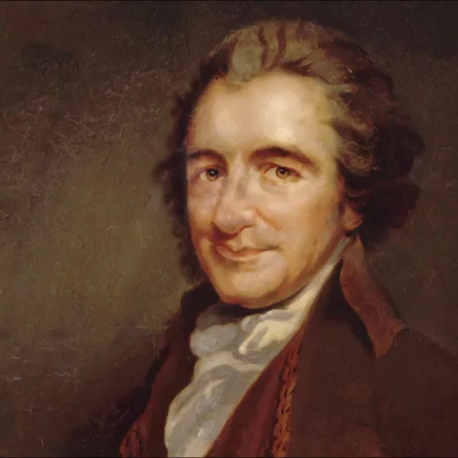
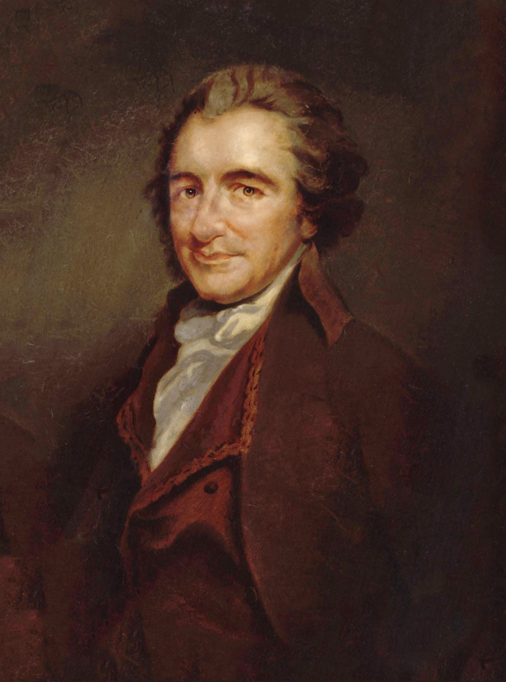
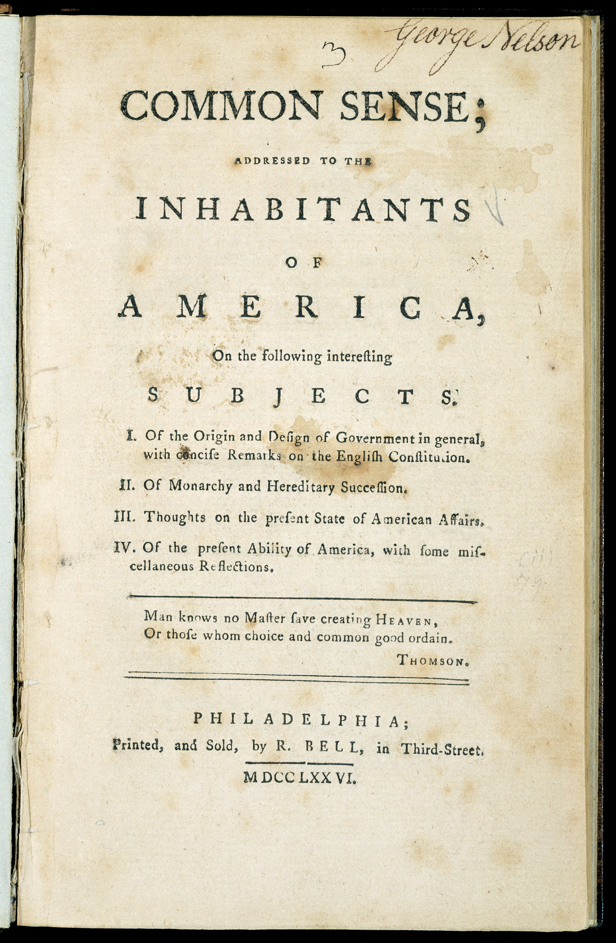


V. Patriots declare independence
  Common Sense
  by Thomas Paine
  outlined King's abuses & stated colonists had a right to declare independence
  - Convinced many colonists
Notes:
In the months after the Olive Branch Petition, a document containing the powerful words of an angry citizen began to circulate and change public opinion.
Common Sense - Thomas Paine was a new immigrant in the colonies. He was from a Quaker background in England. He wrote anonymously Common Sense for fear of being hunted by the British. In the 50-page pamphlet, Thomas Paine attacked King George III. Paine explained that his own revolt against the king had begun with Lexington and Concord.
Paine declared that the time had come for colonists to proclaim an independent republic. He argued that independence, which was the American “destiny,” would allow America to trade freely with other nations for guns and ammunition and win foreign aid from British enemies. Finally, Paine stated, independence would give Americans the chance to create a better society—one free from tyranny, with equal social and economic opportunities for all.
Common Sense was hugely popular and sold nearly 500,000 copies, and convinced many colonists that independence and a Revolutionary War were justified. In April 1776, George Washington wrote, “I find Common Sense is working a powerful change in the minds of many men.” Common Sense helped set the stage for the Declaration of Independence that would be declared in July 1776, only a few months later.
`

Slide 7
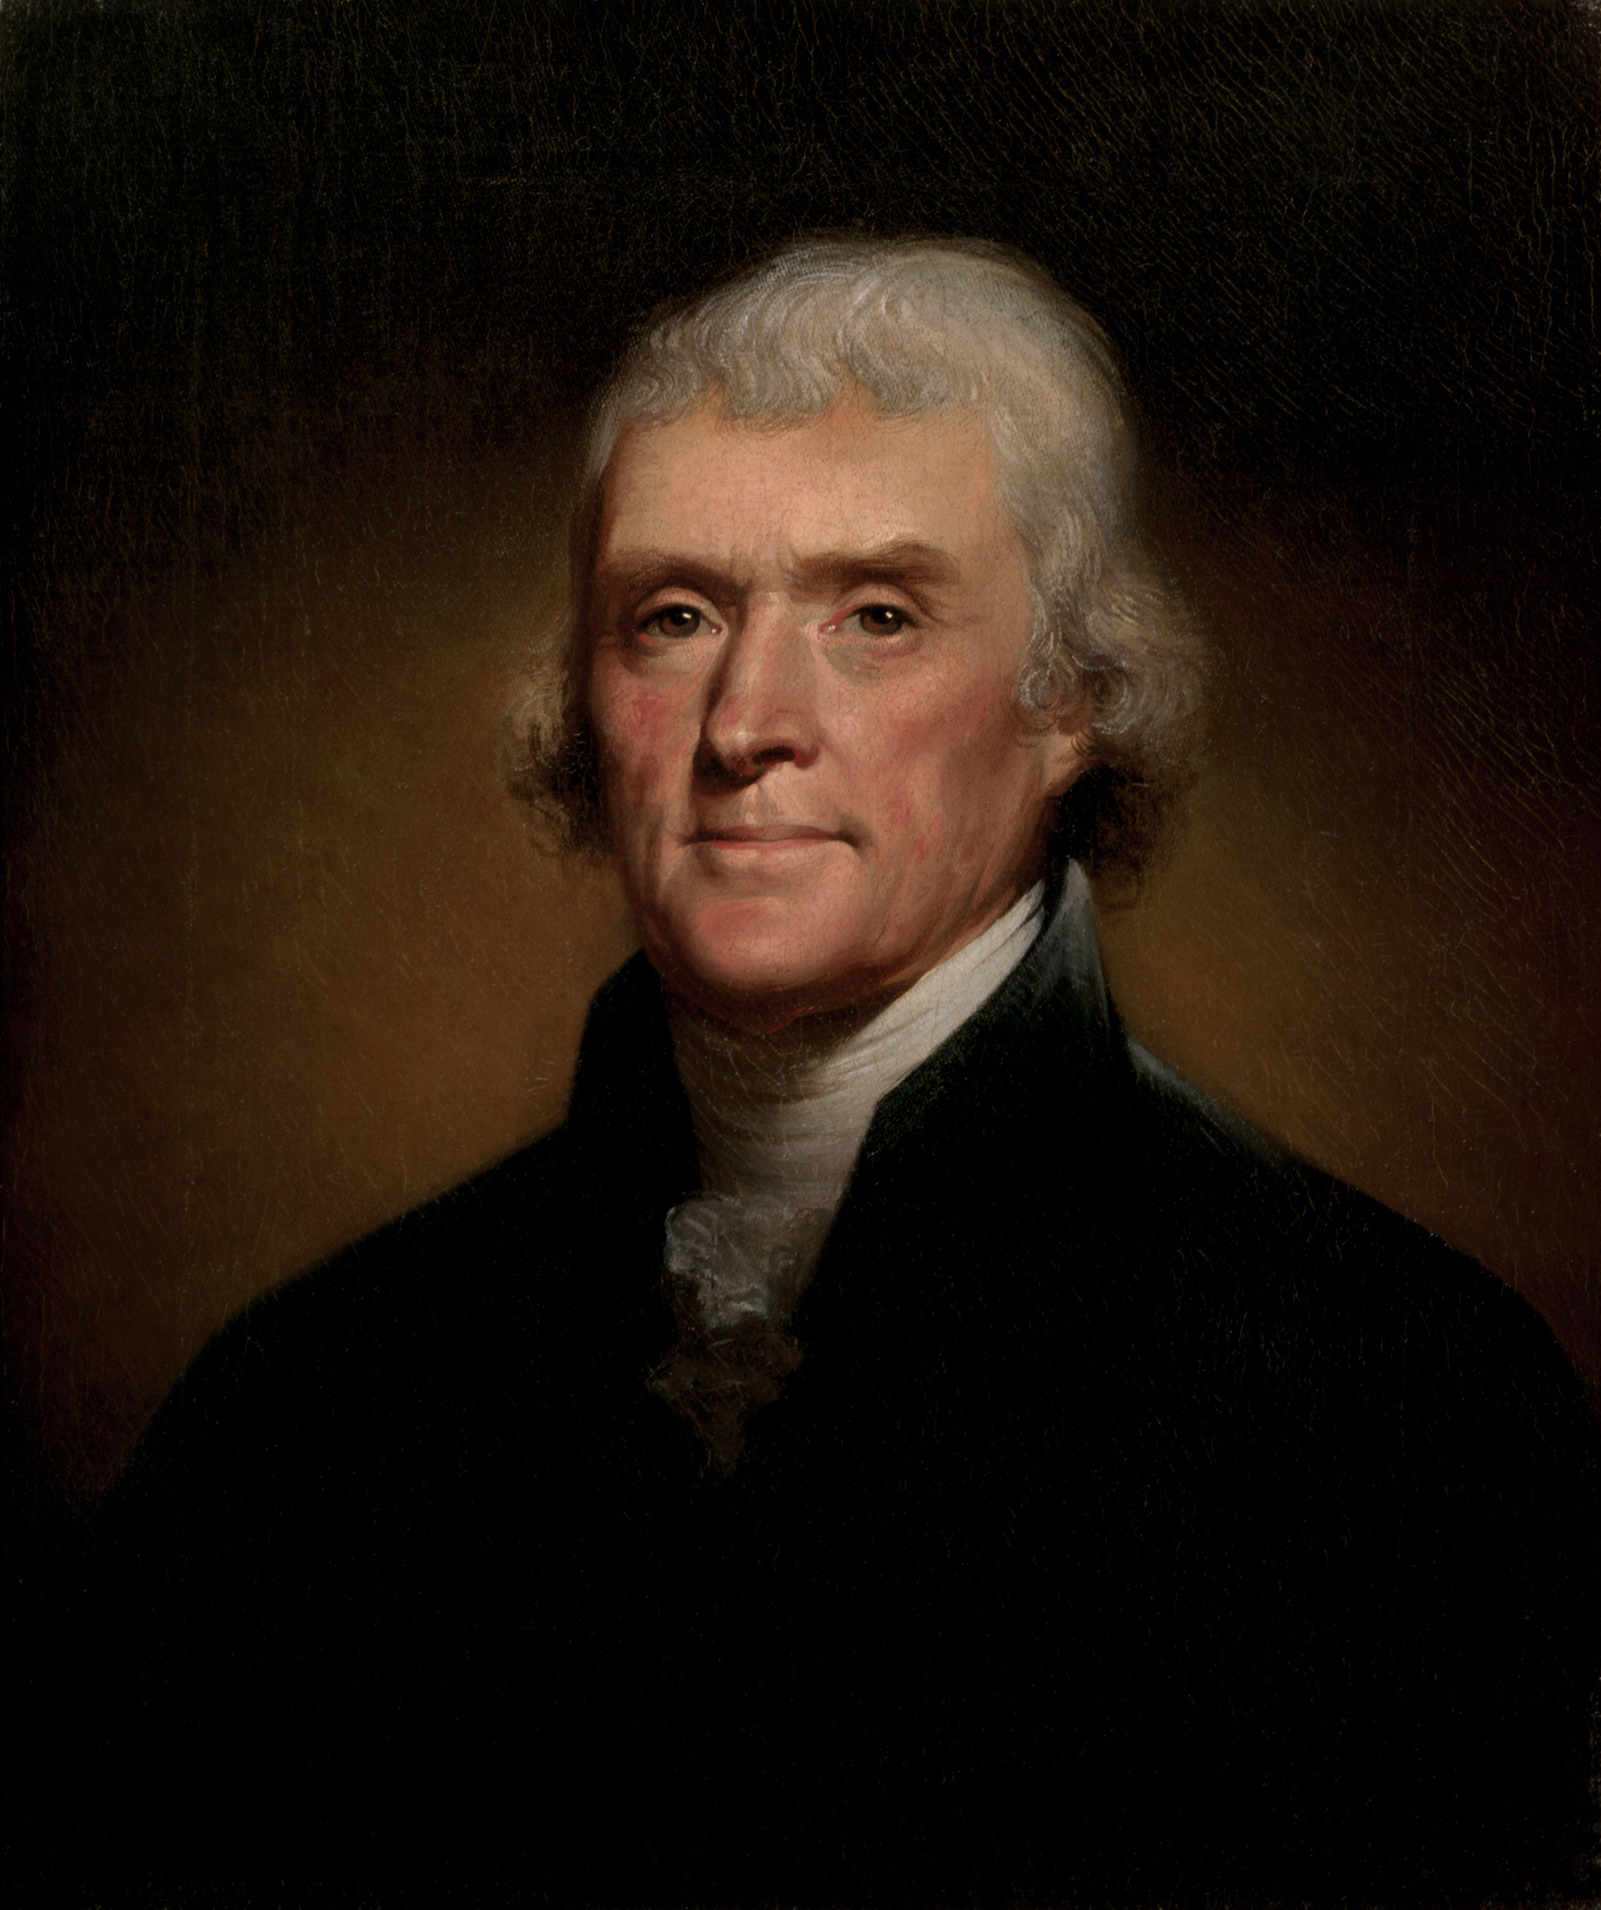
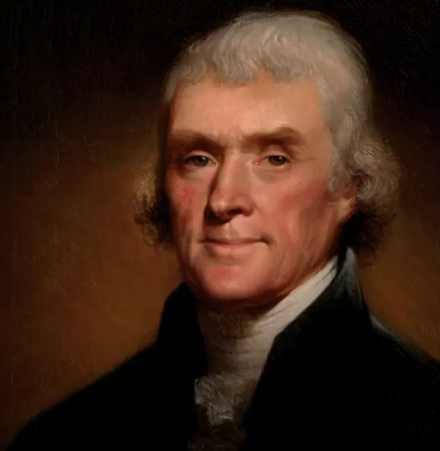


V. Patriots declare independence
Declaration of Independence break up letter w/England
  - Thomas Jefferson - principal author
- people have basic rights that can’t be taken away by govt.
- the people have a right to rebel
Notes:
By early summer 1776, events pushed the Continental Congress toward a decision of declaring independence. Congress appointed a committee to prepare a formal declaration explaining the reasons for the colonies’ actions. Virginia lawyer Thomas Jefferson, known for his intelligence and his writing skills, was chosen to write the document. Jefferson’s Declaration of Independence drew on the concepts of the English philosopher John Locke, who maintained that people enjoy “natural rights” to life, liberty, and property. Jefferson described these rights as “Life, Liberty and the pursuit of Happiness.”
Also, Jefferson took Locke’s ideas, when he declared that governments derive “their just powers from the consent of the governed”—that is, from the people. This right of consent gave the people the right “to alter or to abolish” any government that threatened their unalienable rights and to install a government that would uphold these principles.
On the basis of this reasoning, the American colonies declared their independence from Britain, listing in the Declaration the numerous ways in which the British king had violated the “unalienable rights” of the Americans.
The Declaration states that “all men are created equal.” When this phrase was written, it expressed the common belief that free citizens were political equals. It did not claim that all people had the same abilities or ought to have equal wealth. It did not apply women, Native Americans, and African-American slaves, and men who did not own land(they wouldn't be able to vote)—a large number of Americans. However, Jefferson’s words presented ideals that would later help these groups challenge traditional attitudes.
In his first draft, Jefferson, an owner of over 600 slaves himself, included an attack on the cruelty and injustice of the slave trade. However, South Carolina and Georgia, the two colonies most dependent on slavery, protested. In order to gain their votes, Jefferson dropped the passage.
On July 2, 1776, the delegates voted unanimously that the American colonies were free, and on July 4, 1776, they adopted the Declaration of Independence. While delegates created a formal copy of the Declaration, the document was read to a crowd in front of the Philadelphia State House—now called Independence Hall.

Slide 8

V. Patriots declare independence
Declaration of Independence break up letter w/England
  - Thomas Jefferson - principal author
- people have basic rights that can’t be taken away by govt.
- the people have a right to rebel
Notes:
Original YouTube link: https://youtu.be/DZBqbfAziXE
By early summer 1776, events pushed the Continental Congress toward a decision of declaring independence. Congress appointed a committee to prepare a formal declaration explaining the reasons for the colonies’ actions. Virginia lawyer Thomas Jefferson, known for his intelligence and his writing skills, was chosen to write the document. Jefferson’s Declaration of Independence drew on the concepts of the English philosopher John Locke, who maintained that people enjoy “natural rights” to life, liberty, and property. Jefferson described these rights as “Life, Liberty and the pursuit of Happiness.”
Also, Jefferson took Locke’s ideas, when he declared that governments derive “their just powers from the consent of the governed”—that is, from the people. This right of consent gave the people the right “to alter or to abolish” any government that threatened their unalienable rights and to install a government that would uphold these principles.
On the basis of this reasoning, the American colonies declared their independence from Britain, listing in the Declaration the numerous ways in which the British king had violated the “unalienable rights” of the Americans.
The Declaration states that “all men are created equal.” When this phrase was written, it expressed the common belief that free citizens were political equals. It did not claim that all people had the same abilities or ought to have equal wealth. It did not apply women, Native Americans, and African-American slaves, and men who did not own land(they wouldn't be able to vote)—a large number of Americans. However, Jefferson’s words presented ideals that would later help these groups challenge traditional attitudes.
In his first draft, Jefferson, an owner of over 600 slaves himself, included an attack on the cruelty and injustice of the slave trade. However, South Carolina and Georgia, the two colonies most dependent on slavery, protested. In order to gain their votes, Jefferson dropped the passage.
On July 2, 1776, the delegates voted unanimously that the American colonies were free, and on July 4, 1776, they adopted the Declaration of Independence. While delegates created a formal copy of the Declaration, the document was read to a crowd in front of the Philadelphia State House—now called Independence Hall.

Slide 9

What was the Olive Branch Petition? What was its result?
Notes:
Day 2 Exit Ticket

