Slide 1
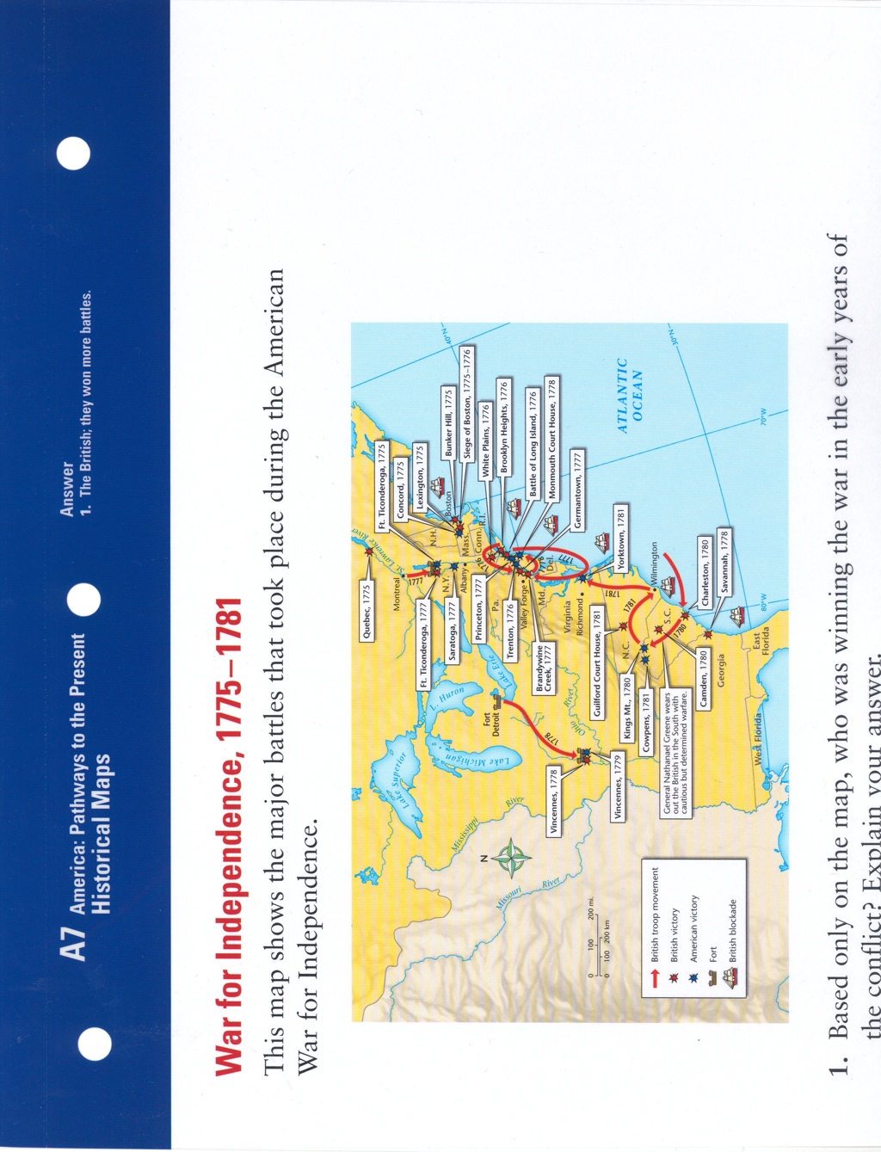

1. Based only on the map, who was winning the war in the early years of the conflict? Explain.
2. How did the British navy play a role in the battle of Brandywine Creek?
3. How did the battles of Vincennes reflect the shifting fortunes of the Americans?
DAY 3
Place Date Here
Notes:
War for Independence, 1775-1781 KEY
This map shows the major battles that took place during the American War for Independence
1.The British; they won more battles
2. The map shows that British troops sailed South from the area of New York City and then north through Chesapeake Bay to reach the site of the battle.
3. The South and West became key battlegrounds in the latter part of the war. After losing at Vincennes (vin-senz) in 1778, the Americans were victorious the next year, helping secure the Ohio River valley and the West for the Patriot cause.

Slide 2
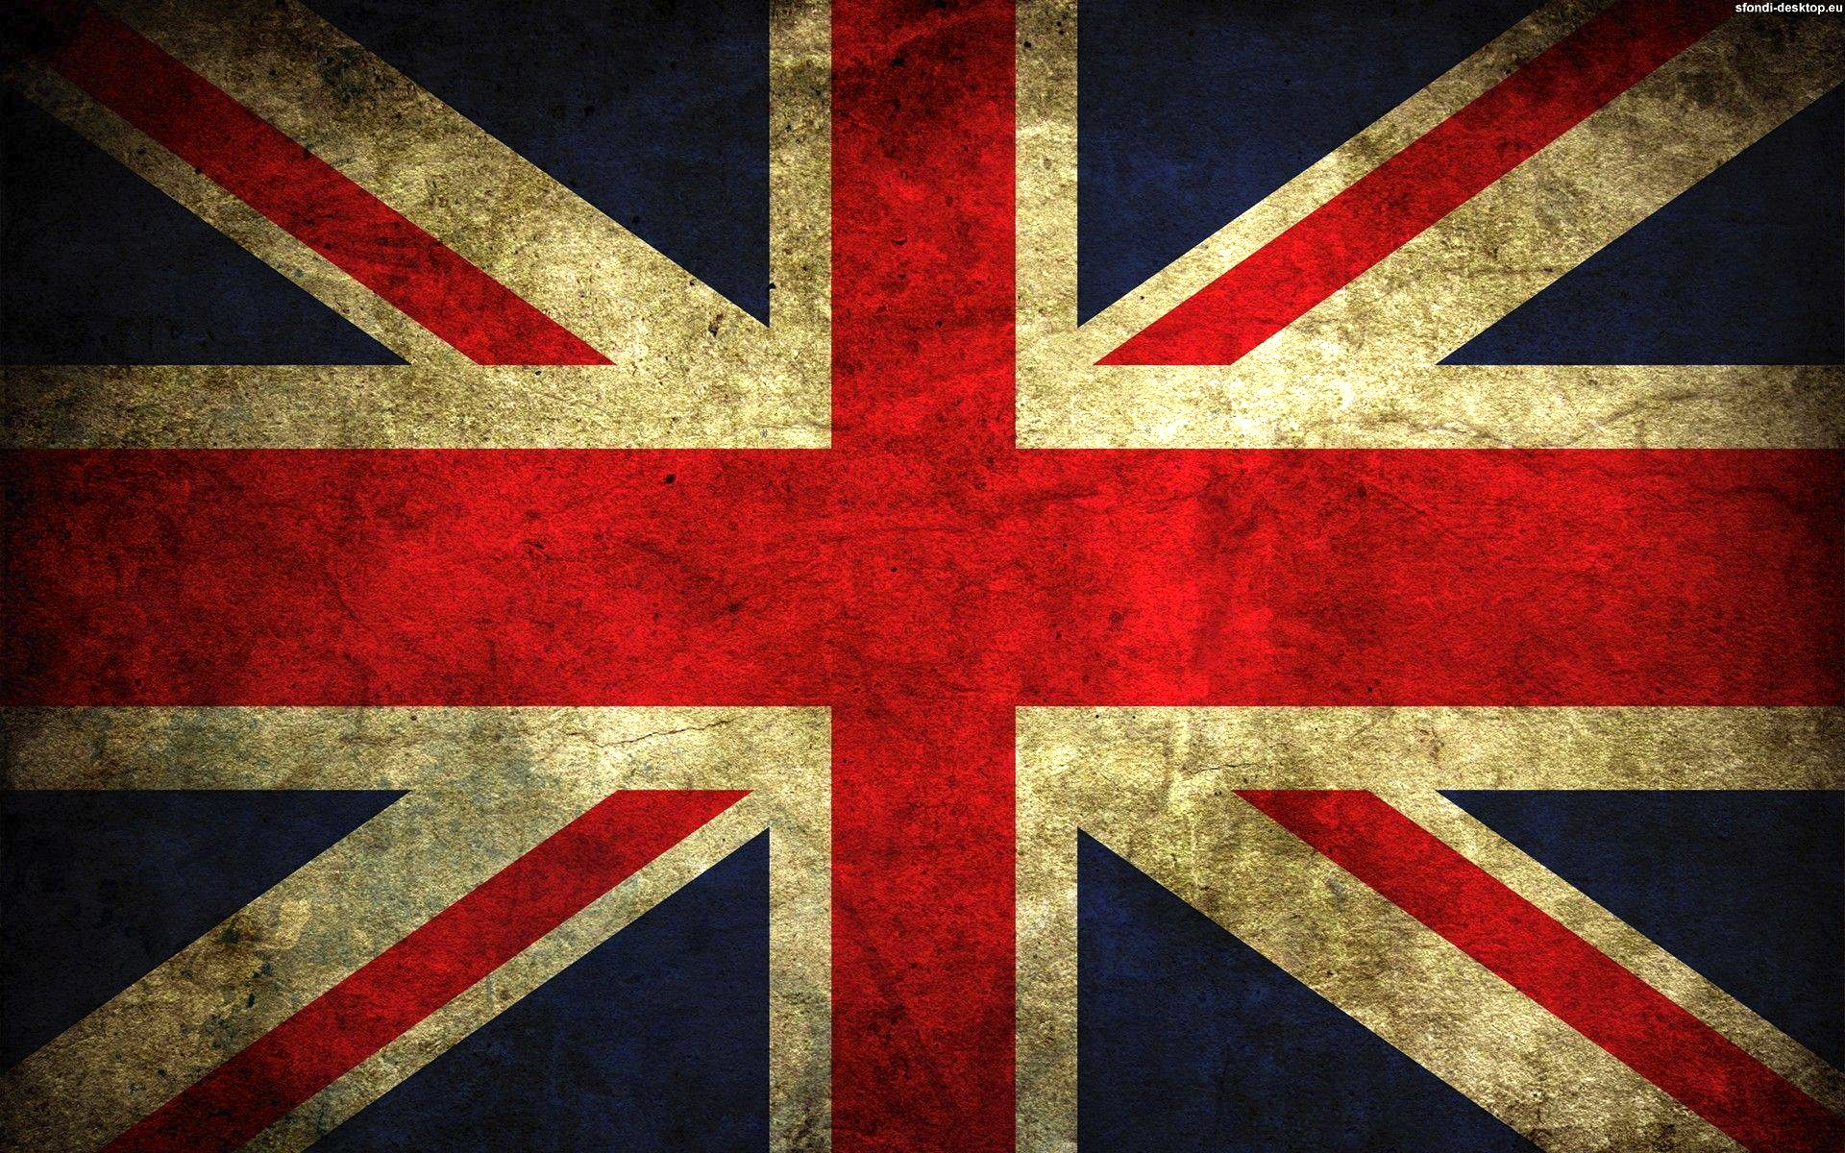
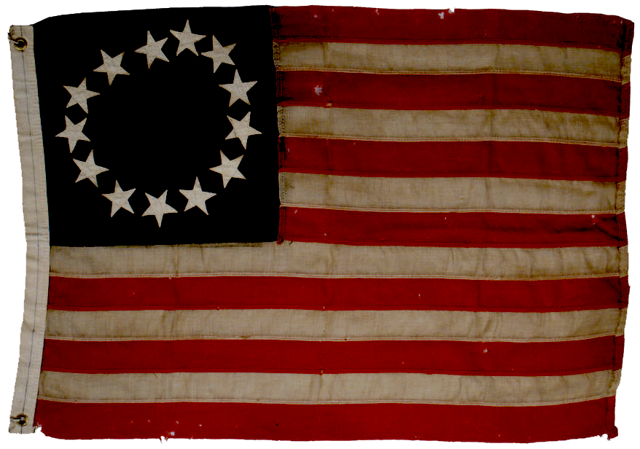
WAR

Slide 3

VI. From Boston to the Middle States
Battle of
Bunker Hill.
Patriots Lose
Declaration of
Independence signed
Washington Retreats
from New York City
Patriots Lose Fort Washington & Fort Lee
Patriots Lose the Battle of Harlem Heights
Thomas Paine's "Common Sense" published
Battle of Long Island/Brooklyn.
Patriots Lose
Lose at Lake
Champlain
June 1775
January
1776
July
1776
September
1776
October
1776
October
1776
October
1776
November
1776
Losing New York
British leave Boston - Strategy: Move attacks to middle states to isolate rebellion to Massachusetts
British fight with Hessians - mercenaries or soldiers who fight just for money
Washington & Patriots lose their largest city(NYC) to the British
Notes:
*Students DO NOT have to copy timeline. Note however, the string of losses for the patriots
British Strategy: The British had previously retreated from Boston in March 1776, moving their attacks to the Middle states. This was part of their plan to stop the rebellion by isolating the New England states. Their new target was the colonies’ most prosperous and busiest port city, New York City.
Defeat in New York: Two brothers, General William Howe and Admiral Richard Howe, joined forces on Staten Island and sailed into New York harbor in the summer of 1776 with the largest British expeditionary force ever assembled— 32,000 soldiers, including thousands of German mercenaries, or soldiers who fight solely for money. The Americans called these troops Hessians, because many of them came from the German region of Hesse.
Washington rallied 23,000 men to New York’s defense, but he was outnumbered. Most of his troops were untrained recruits with poor equipment. The battle for New York ended in late August with an American retreat following heavy losses.
By late fall, the British had pushed Washington’s army across the Delaware River into Pennsylvania. The vast majority of Washington’s men had either deserted or had been killed or captured. Fewer than 8,000 men remained under Washington’s command, and the terms of their enlistment were due to end on December 31. Washington desperately needed some kind of victory for his men to keep them from going home.

Slide 4


VI. From Boston to the Middle States
Battle of Trenton.
Washington wins!
Washington loses at Brandywine - British take Philadelphia!
Battle of Princeton.
Patriots win
December
1776
January
1777
September
1777
Battle of Trenton
- Washington hasn’t won a battle.
Morale is low
- Washington surprise attacks Hessians in Trenton, NJ. - Patriots win
- Significance - boosts morale of country & military
1777 - British take Philadelphia - Continental Congress flees
Notes:
Original YouTube Link: https://youtu.be/J8_5ym1xSMc
Battle of Trenton:
Washington doesn’t look good. By the end of 1776, Washington had lost one quarter of his army (Captured or dead) Thomas Paine writes, “(These are) the times that try mens souls.” There’s a lot of talk that he should be removed. It’s the beginning of winter and this is a time where everyone lays down their weapons and camps-in for winter. They get rested, train and replenish supplies and wait for spring to resume fighting. Washington has one last chance. . .
Play video
(Trenton Descripiton - however video covers everything Trenton) Washington decided to risk everything on one large attack over Christmas night, 1776. In the face of a fierce storm, he led 2,400 men in small rowboats across the ice-choked Delaware River.
By 8 o’clock the next morning, the men had marched nine miles through sleet and snow to Trenton, New Jersey, held by a unit of Hessians. Because of the storm and the holiday, most of the Hessians had drunk too much rum the night before and were still sleeping it off. In a surprise attack, the Americans killed 30 of the enemy and took 918 captives and six Hessian cannons.
The Americans had another victory eight days later against 1,200 British stationed at Princeton. Encouraged by these victories, Washington marched his army into winter camp near Morristown, in northern New Jersey.
Fight for Philadelphia:
By spring 1777 the war resumes, British General Howe marches his troops to Philadelphia, the Patriot’s capital, the home of the Continental Congress. By September Washington and Howes troops meet at Brandywine Creek head on. Washington loses. Howe takes Philadelphia, and Congress flees. Washington again tries to regain the city, but loses again at the battle of Germantown.

Slide 5

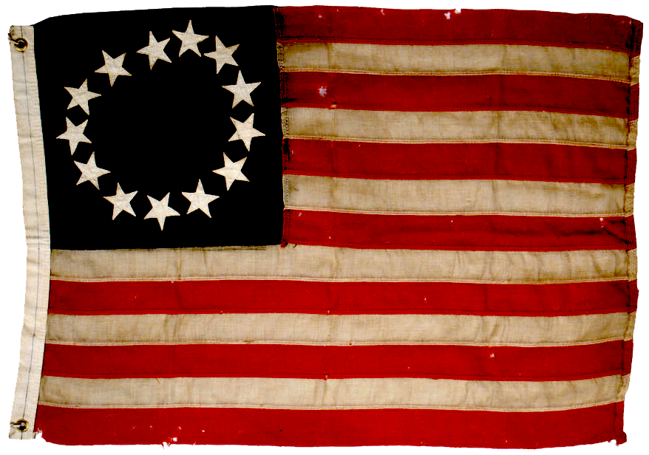

VI. From Boston to the Middle States
Washington
Loses at the
Battle of
Germantown
Patriots win
the Battle of Saratoga
Battle of Saratoga
- Patriots win
- Significance: France joins the war w/the Patriots
September
1777
October
1777
Notes:
Saratoga:
General John Burgoyne set out with 4,000 redcoats, 3,000 mercenaries, and 1,000 Mohawk to surround New England and isolate it from the rest of the colonies.
The Continental Congress’ General Horatio Gates commanded the Northern Department of the Continental Army. Gates gathered militiamen and soldiers from all over New York and New England. Burgoyne lost several hundred men every time his forces clashed with the Americans. American troops finally surrounded Burgoyne at Saratoga, New York, where he surrendered his battered army to General Gates on October 17, 1777. The Americans captured over 8,000 troops.
Why is this Battle important? Now France, who was waiting for an American victory, recognized American independence, openly signed a treaty with the Americans and joined the war. The Americans now had the help of French troops, and have a navy.

Slide 6
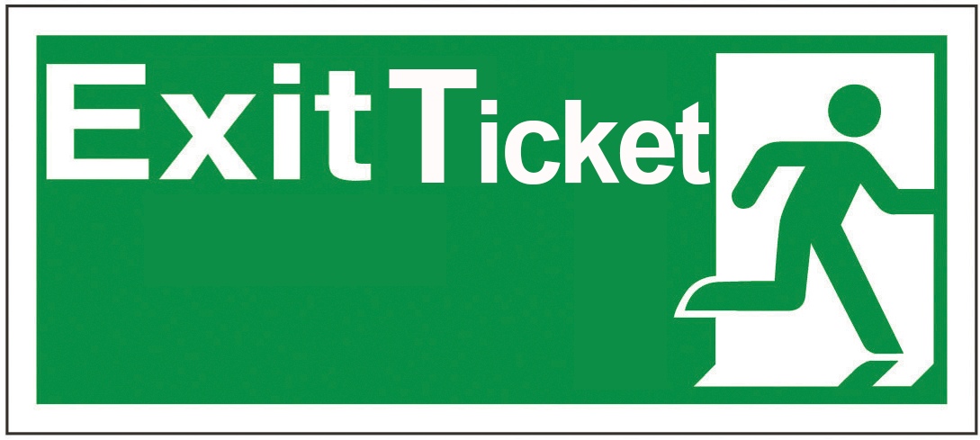
What was significant about General Washington’s first battle victory of the war?
Notes:
Day 3 Exit Ticket

