Slide 1
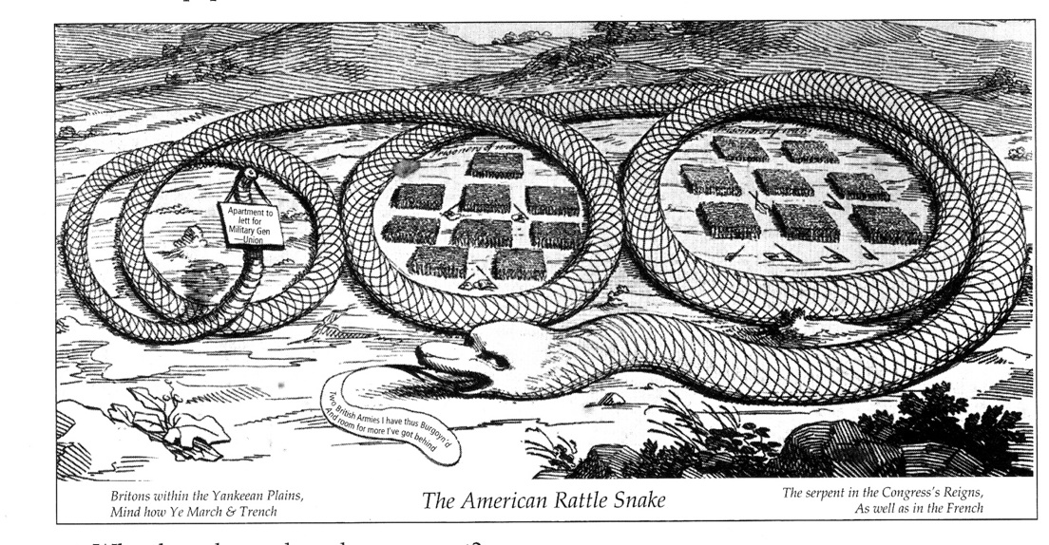
DAY 4
Place Date Here
1. Who does the rattlesnake represent?
2. The snake boasts that it has already defeated two British armies. What is meant by the snake’s statement, “...and room for more I’ve got behind”?
3. From which side of the war does the cartoon represent? Americans? British?
Notes:
KEY
1. Rebellious Americans or Patriots
2. The snake is saying that it has room in its stomach for more British armies, meaning the Americans are prepared to continue defeating the British on the battlefield
3. Colonist

Slide 2
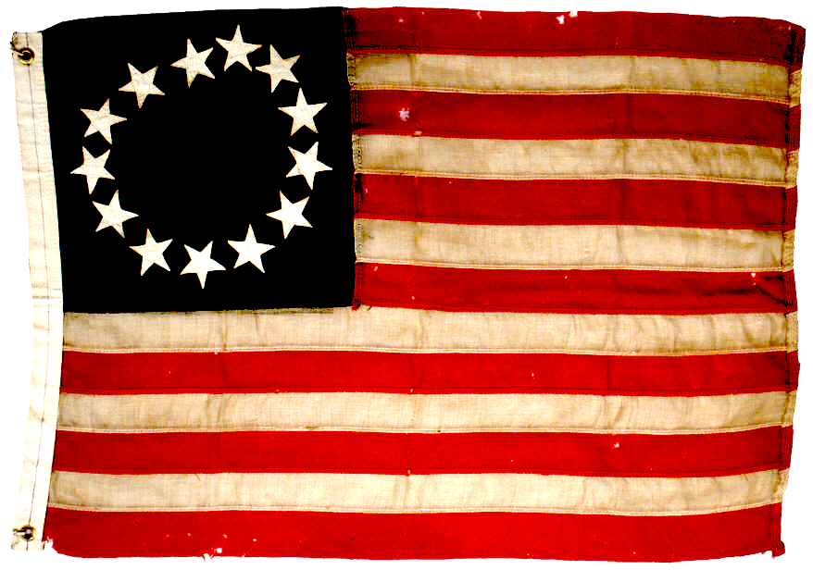
WINNING THE
WAR
Notes:
Saratoga; Meanwhile, one of Howe’s fellow British generals, General John “Gentleman Johnny” Burgoyne, convinced the London high command to allow him to pursue a complex scheme. Burgoyne’s plan was to lead an army down a route of lakes from Canada to Albany, where he would meet Howe’s troops as they arrived from New York City. According to Burgoyne’s plan, the two generals would then join forces to isolate New England from the rest of the colonies.
Burgoyne set out with 4,000 redcoats, 3,000 mercenaries, and 1,000 Mohawk under his command. His army had to haul 30 wagons containing 138 pieces of artillery along with extra personal items, such as fine clothes and champagne. South of Lake Champlain, swamps and gullies, as well as thick underbrush, bogged down Burgoyne’s army. Food supplies ran low.
The Continental Congress had appointed General Horatio Gates to command the Northern Department of the Continental Army. Gates, a popular commander, gathered militiamen and soldiers from all over New York and New England. Burgoyne lost several hundred men every time his forces clashed with the Americans, such as when Ethan Allen and his Green Mountain Boys attacked Burgoyne at Bennington, in what is now Vermont. Even worse, Burgoyne didn’t realize that Howe was preoccupied with conquering and occupying Philadelphia and wasn’t coming to meet him.
Massed American troops finally surrounded Burgoyne at Saratoga, where he surrendered his battered army to General Gates on October 17, 1777. The surrender at Saratoga dramatically changed Britain’s war strategy. From that time on, the British generally kept their troops along the
coast, close to the big guns and supply bases of
the British fleet.

Slide 3
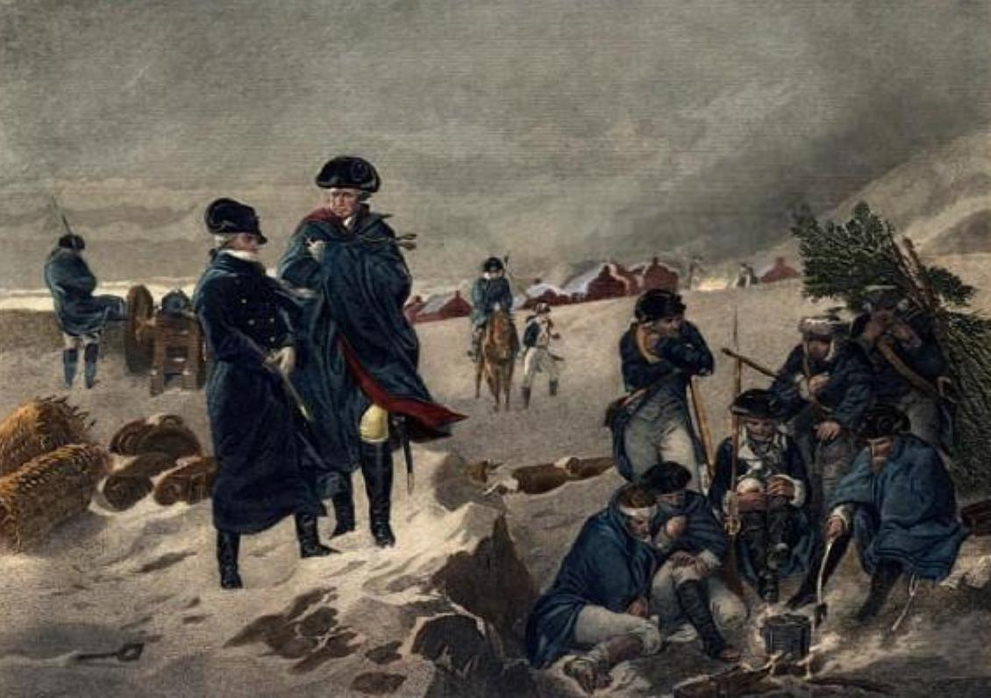

VII. European Allies shift the balance
Valley Forge 1778
Brutal winter partly responsible for the 2,000 soldiers who died
Friedrich von Steuben - Prussian drill master train Americans to be “soldiers"
- Marquis de Lafayette - Frenchman who led troops in VA.
Notes:
Winter at Valley Forge:
The Battle of Saratoga was significant because it gave the French the confidence to join the war on behalf of the Americans. However, it would take months for French aid to arrive.
The war in the American North was in recess for the winter. British troops wintered comfortably in Philadelphia, this city they had conquered, driving out the Continental Congress. At the same time, Washington and his little Continental Army struggled to stay alive amidst bitter cold and primitive conditions at winter camp in Valley Forge, Pennsylvania. Soldiers suffered from freezing and frostbite, and surgeons worked constantly but often unsuccessfully to save arms and limbs from amputation. Of the 10,000 soldiers who braved wind, snow, and hunger at Valley Forge that winter, more than 2,000 died. Yet those who survived remained at their posts.
Friedrich von Steuben: In February 1778, in the midst of the frozen winter at Valley Forge, American troops began an amazing transformation. Friedrich von Steuben, a Prussian captain and talented drillmaster, volunteered his services to General Washington and went to work “to make regular soldiers out of country bump-kins.” Von Steuben taught the colonial soldiers to stand at attention, execute field maneuvers, fire and reload quickly, and wield bayonets. With the help of such European military leaders, the raw Continental Army was becoming an effective fighting force.
LAFAYETTE AND THE FRENCH Around the same time, another military leader, the Marquis de Lafayette, a brave, idealistic 20-year-old French aristocrat, offered his help. Lafayette joined Washington’s staff and lived through the misery of Valley Forge. He lobbied for French reinforcements in France in 1779, and led a command in Virginia in the last years of the war.

Slide 4
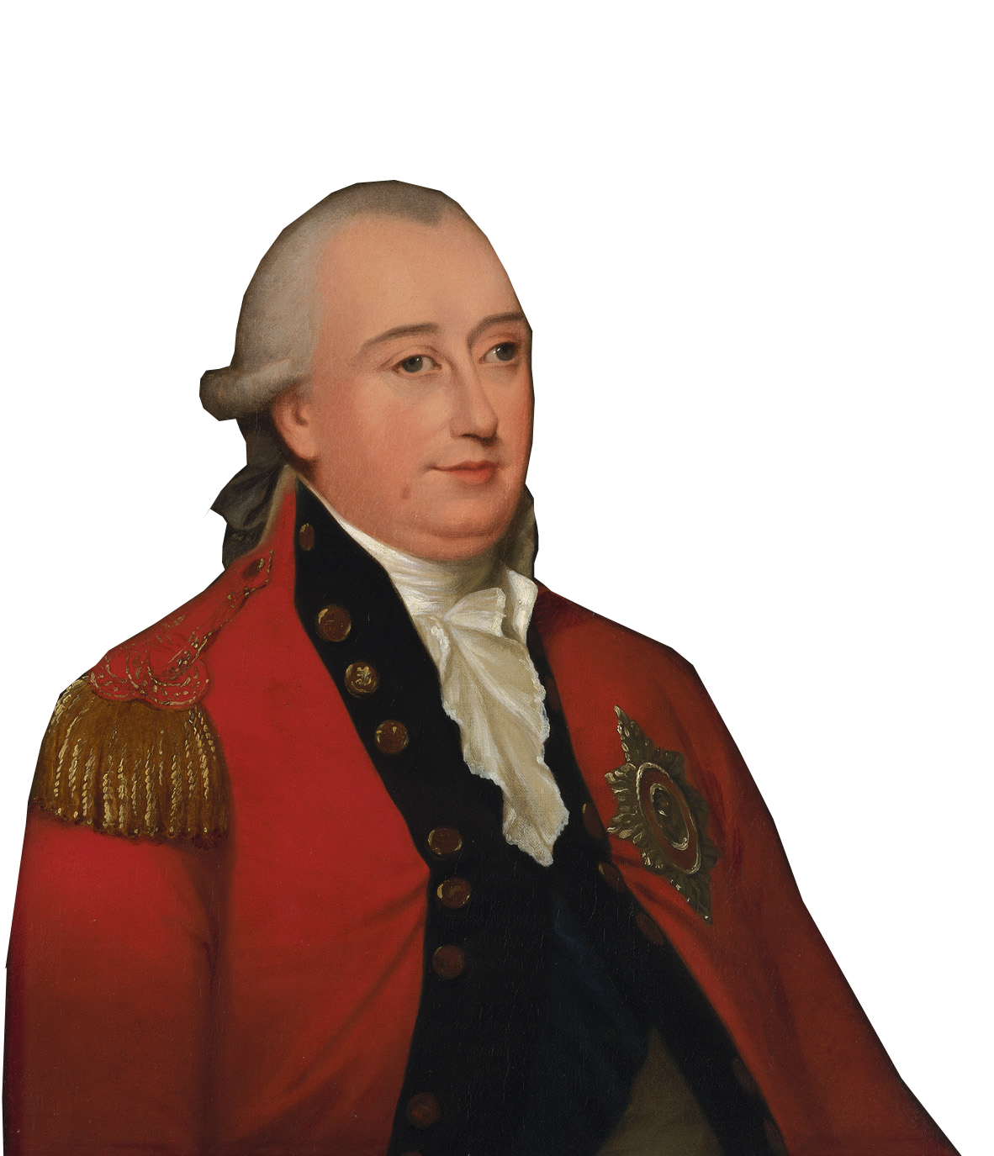
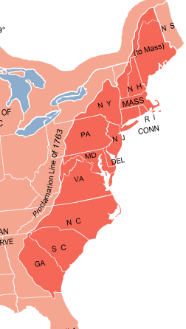
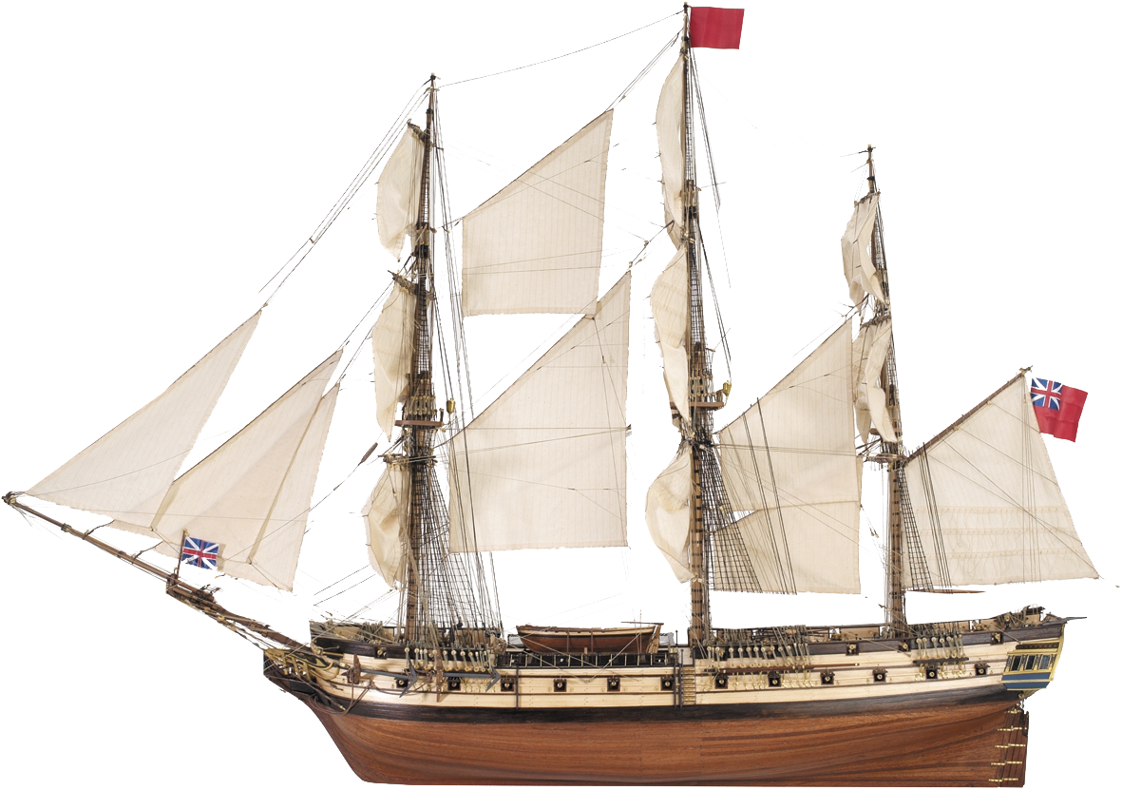


VIII. The Southern Strategy
Cornwallis vs. Green
in North Carolina
British capture Charleston, S. Carolina
British capture Savannah, Georgia
British capture Camden,
S. Carolina
Battle of
Yorktown, Virginia
December
1778
May
1778
August
1778
April-May
1781
October
1781
Yorktown
General Charles Cornwallis (British)
British Southern Strategy
Britain thought more loyalist in the South.
take the S. & march northward to middle colonies
Charles Cornwallis British Commander quickly captures GA & SC, then to Yorktown
Camden
Charleston
Savannah
Notes:
Southern Strategy: After a huge defeat at Saratoga, the British changed their military strategy. In the summer of 1778 they began to shift their efforts to the South. There strategy was to rally Loyalist support, reclaim their former colonies in the region, and then slowly fight their way back north.
Early Success in the South: At the end of 1778, a British expedition easily took Savannah, Georgia, and by the spring of 1779, they had taken Georgia. In 1780, British commanders, General Henry Clinton and General Charles Cornwallis sailed south with 8,500 men. They took Charles Town, South Carolina in May 1780 and captured 5,500 American soldiers. Clinton then left for New York, leaving Cornwallis to conquer the rest of the South.
For most of 1780, Cornwallis succeeded. His military was joined by thousands of African Americans who had escaped from Patriot slave owners to join the British. England had promised to free them after the war. In August, Cornwallis’s army had taken much of South Carolina. However, when Cornwallis and his forces advanced into North Carolina, Patriot bands attacked them and cut British communication lines. They were forced to retreat to South Carolina.

Slide 5


Victory in Yorktown 1781
French blockade prevented escape to the sea
Cornwallis surrounded by French & American forces almost twice his size - surrenders
last big battle of the war - Britain wants peace
Notes:
Original YouTube Link: https://youtu.be/Ly3kYOn34c0
British Losses: In 1781 Washington ordered Nathanael Greene, his ablest general, to march south and harass Cornwallis as he retreated to South Carolina. Greene’s gorilla warfare tactics greatly weakened Cornwallis’s army.
Cornwallis then chose to move the fight to Virginia, where he met up with reinforcements. First he tried to capture the divisions led by Lafayette and von Steuben. When that failed, Cornwallis led his army of 7,500 onto the peninsula between the James and York rivers and camped at Yorktown. Cornwallis planned to fortify Yorktown, take Virginia, and then move north to join Clinton’s forces towards NewYork.

Slide 6
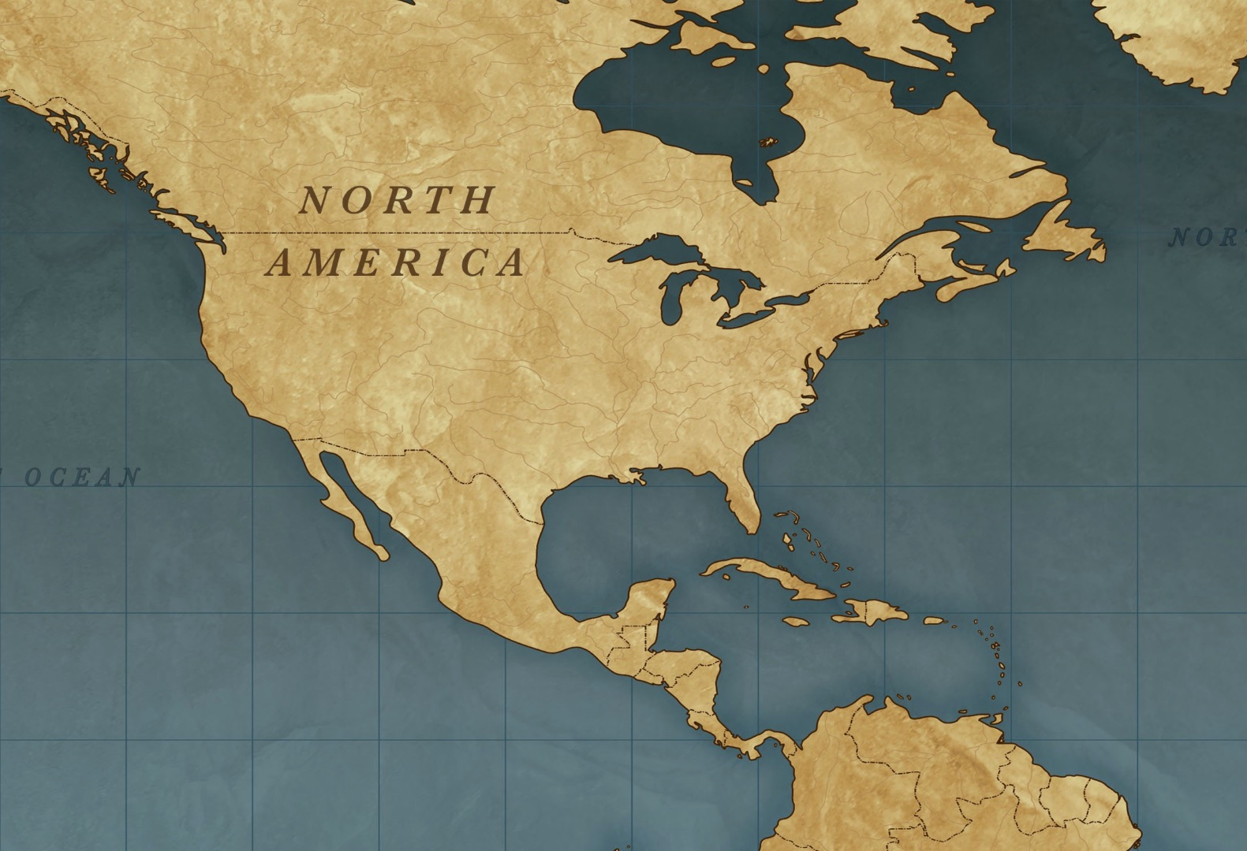

Treaty of Paris Map
U.S.
Spanish
British
Treaty of Paris 1783
Officially ended the Revolutionary War
New American Society
Egalitarian - belief in the equality of people
- ability, effort, virtue defined one’s worth NOT wealth or family
- for only white males
- women, African Americans & Native Americans excluded
Notes:
Treaty of Paris: Peace talks began in Paris in 1782. Representatives of four nations—the United States, Great Britain, France, and Spain—joined the negotiations, with each nation looking out for its own interests.
Britain hoped to avoid giving America full independence.
France supported American independence but feared America’s becoming a major power.
Spain was interested in acquiring the land between the Appalachian Mountains and the Mississippi River.
Many observers expected the clever European diplomats to outwit the Americans at the bargaining table. But the Continental Congress chose amazing team of negotiators—John Adams, Benjamin Franklin, and John Jay of New York. Together the three demanded that Britain recognize American independence before any other negotiations began. Once Britain agreed to full independence, the talks officially opened.
In September 1783, the delegates signed the Treaty of Paris, which confirmed U.S. independence and set the boundaries of the new nation. The United States now stretched from the Atlantic Ocean to the Mississippi River and from Canada to the Florida border.
Some provisions of the treaty promised future trouble. The British made no attempt to protect the land interests of their Native American allies, and the treaty did not specify when the British would evacuate their American forts. On the other side, the Americans agreed that British creditors could collect debts owed them by Americans and promised to allow Loyalists to sue in state courts for recovery of their losses. The state governments, however, later failed to honor this agreement.
The War Becomes a Symbol of Liberty
The American Revolution would inspire the world as both a democratic revolution and a war for independence.
THE IMPACT ON AMERICAN SOCIETY: Revolutionary ideals set a new course for American society. During the war, class distinctions between rich and poor had begun to blur as the wealthy wore homespun clothing and military leaders showed respect for all of their men. These changes stimulated a rise of egalitarianism—a belief in the equality of all people—which fostered a new attitude: the idea that ability, effort, and virtue, not wealth or family, defined one’s worth.
The egalitarianism of the 1780s, however, applied only to white males. It did not bring any new political rights to women. A few states made it possible for women to divorce, but common law still dictated that a married woman’s property belonged to her husband.
Moreover, most African Americans were still enslaved, and even those who were free usually faced discrimination and poverty. However by 1804, many Northern states had taken steps to outlaw slavery.
The Southern states, where slavery was more entrenched, did not outlaw the practice, but most made it easier for slave owners to free their slaves. Planters in the upper South debated the morality of slavery, and some, like George Washington, freed their slaves. In Maryland and Virginia, the number of free blacks increased from about 4,000 to over 20,000 following the war. The slavery debate generally did not reach the Deep South, although some Southern slaveholders did have grave misgivings.
For Native Americans, the Revolution brought uncertainty. During both the French and Indian War and the Revolution, many Native American communities had either been destroyed or displaced, and the Native American population east of the Mississippi had declined by about 50 percent. Postwar developments further threatened Native American interests, as settlers from the United States moved west and began taking tribal lands left unprotected by the Treaty of Paris.

Slide 7

Describe one important thing you learned in class today.
Notes:
Day 4 Exit Ticket

