Slide 1


What was the Northwest Ordinance of 1787 ?
DAY 6
Place Date Here
II. Governing New land
How do we manage new land?
U.S.
Spanish
British
Write your answer in complete sentences or lose credit
Notes:
Established a plan for dividing new territories and statehood
There were three basic stages for becoming a state:
1. Congress would appoint a territorial governor and judges.
2. When a territory had 5,000 voting residents, the settlers could write a temporary constitution and elect their own government.
3. When the total population of a territory reached 60,000 free inhabitants, the settlers could write a state constitution, which had to be approved by Congress before it granted statehood.
The Land Ordinance of 1785 and the Northwest Ordinance of 1787 became the Confederation’s greatest achievements. These laws established a blueprint for future growth of the nation.

Slide 2
Constitutional
Convention

Slide 3
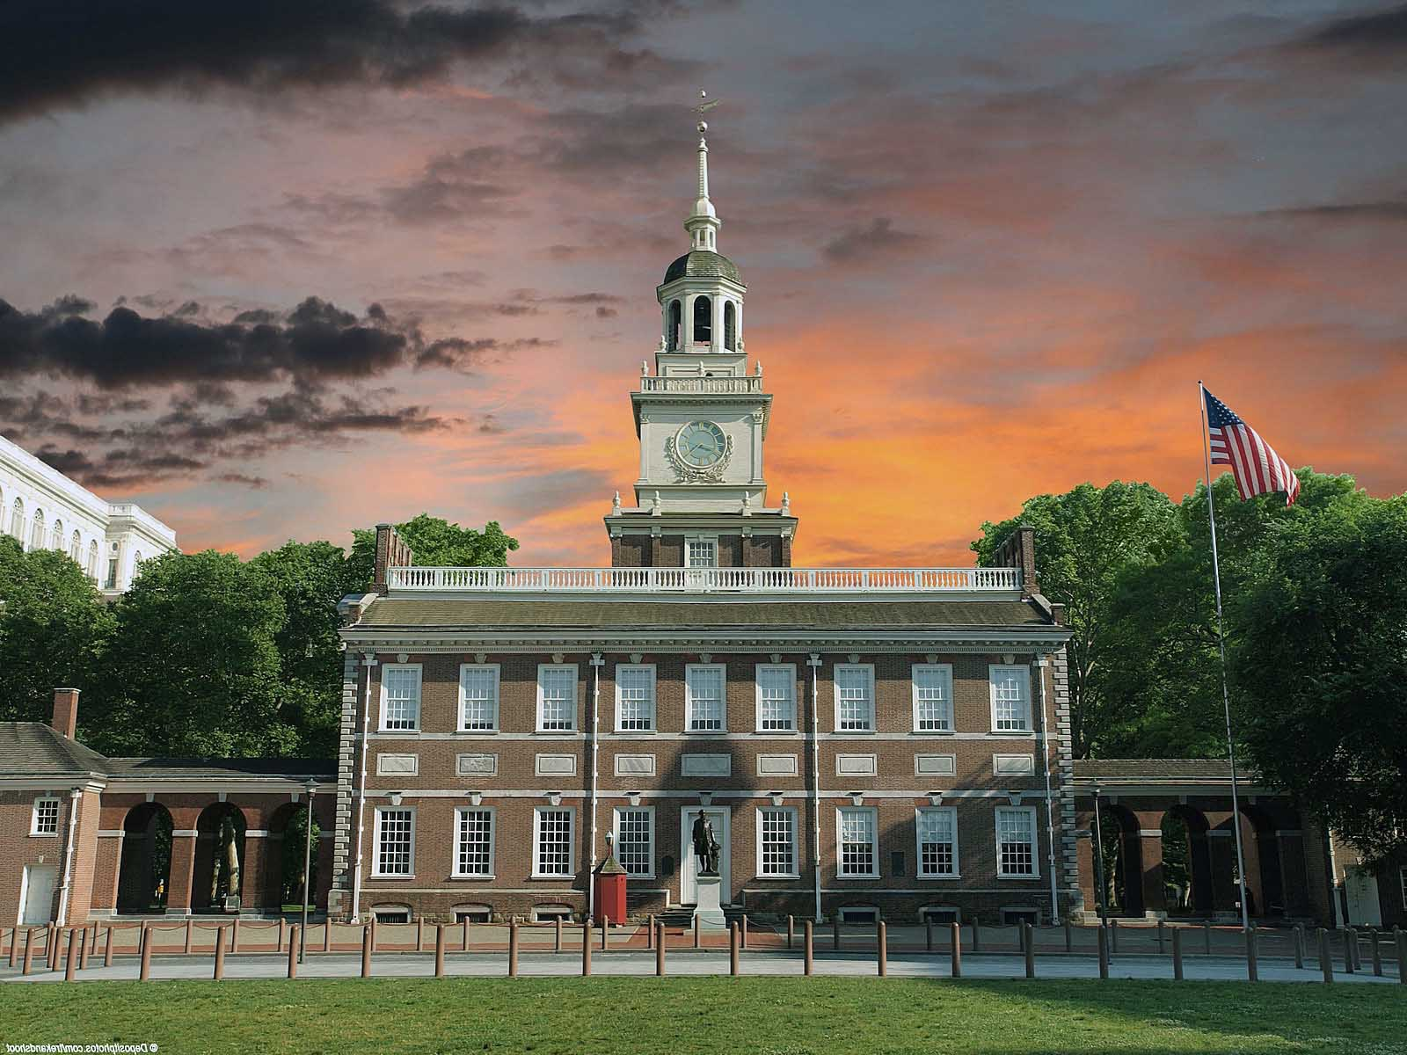
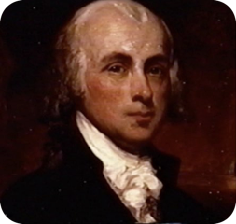
IV. Constitutional convention
May of 1787
Independence Hall, Philadelphia
James Madison - Father of the Constitution
Notes:
The first act of the Constitutional Convention in 1787 was to unanimously elect George Washington as its president. There rose a major division between those who wanted to amend the Articles of Confederation and those who wanted to abandon it all together. Almost everyone wanted a strong national government, but not everyone agreed to start from scratch.
In fact, the delegation was only sent by the states to amend the Articles of Confederation. The Delegates who chose to start from scratch were OVERSTEPPING their authority.
And thus two plans arose. The only man to come with a real plan was young intellectual named James Madison. 36 yrs old. The Plan was the VIRGINIA PLAN and became the focus of the convention. Madison would be called the father of the Constitution.
The second was the THE NEW JERSEY PLAN. This was a challenge to the Virginia Plan.

Slide 4


IV. Constitutional convention
A. VIRGINIA PLAN
B. NEW JERSEY
PLAN
1. bicameral congress - votes based on state pop.
2. Congress -power to tax, & regulate foreign & interstate trade
3. National Gov. - power to VETO any state law
4. Executive Branch & Judicial Branch
1. unicameral congress -
1 state, 1 vote
2. Congress -power to tax, & regulate foreign & interstate trade
3. Executive Branch & Judicial Branch
Notes:
And thus two plans arose. The only man to come with a real plan was young intellectual named James Madison, just 36 years old. The Plan was called the VIRGINIA PLAN and became the focus of the convention. Madison would be called the father of the Constitution.
The second was the THE NEW JERSEY PLAN. This was a challenge to the Virginia Plan.
The Virginia plan proposed a government based on three principles: (1) a strong national legislature with bicameral congress, meaning two chambers, the lower one to be chosen by the people and the upper chamber to be chosen by the lower. The legislature would have the power to bar any state laws it found unconstitutional; (2) a strong national executive to be chosen by the national legislature; and (3) a national judiciary to be appointed by the legislature. In the lower chamber of congress, votes would be based on state populations, the more people in a state, the more legislatures they received. Thus the larger states championed the Virginia Plan.
Questions - Which plan benefits big states? Why?
New Jersey Plan was a response to the Virginia Plan. In the Jersey Plan, each state received one vote. Like the Articles of Confederation, the New Jersey Plan aimed to keep state governments more powerful than the national government. The plan also ensured that heavily populated states would not overpower the others.
Which plan strengthens the National government?
As the summer grew hotter, so did the delegates’ tempers. Soon the convention was deadlocked over the question of the representation of states in Congress. Should the states be represented on the basis of population (favored by the large-state delegations), or should they be represented equally, regardless of population (favored by the small- state delegations)? The debate was bitter, and the convention was in danger of dissolving.
Has there ever been a time when you had to compromise?

Slide 5

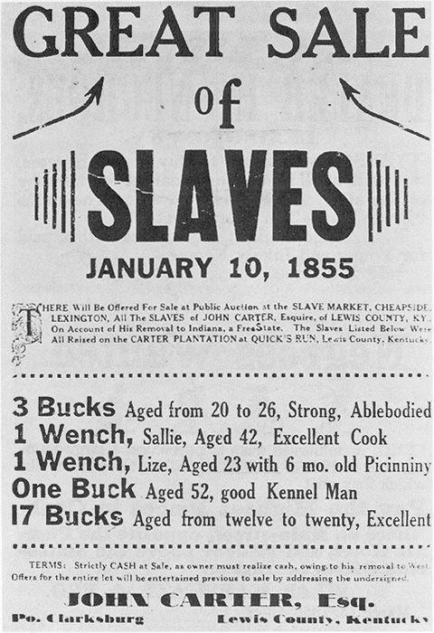

V. compromises
A. The Great Compromise
  AKA Connecticut Plan
- creation of 2 houses of
legislature
- Senate- 2 votes per state, &
  - House of legislature - votes based on pop.
STATES Total Pop. Slaves
CONNECTICUT 237,655 2,648
DELAWARE 59,096 8,887
GEORGIA 82,548 29,264
MARYLAND 319,728 103,036
MASSACHUSETTS 378,556 0
NEW HAMPSHIRE 141,899 157
NEW JERSEY 184,139 11,423
NEW YORK 340,241 21,193
NORTH CAROLINA 395,005 100,783
PENNSYLVANIA 433,611 3,707
RHODE ISLAND 69,112 958
SOUTH CAROLINA 249,073 107,094
VIRGINIA 747,550 292,627
B. Three-Fifths Compromise
3/5 of a state’s slave pop. counted in representing the govt.
Notes:
Great Compromise or the Connecticut Compromise was the answer. The compromise suggested that the legislative branch have two parts:
(1) a House of Representatives, with state representation based on population. All revenue laws—concerning spending and taxes—would begin in this house; and ‘
(2) a Senate, with two members from each state. State legislatures would elect senators. The larger states would have an advantage in the House of Representatives, where representation was to be based on population. The smaller states would be protected in the Senate, where each state would have equal representation
Nevada has 3 representatives in the House - California had 53 representatives. But in the senate, Nevada and California are on equal grounds, each only has two senators or two votes in the senate.
3/5 Compromise: Another issue remained. How do you figure out the number of legislatures of each state? Do you include slaves even though they would not have the right to vote? Or don’t include them at all.
Of course the South wanted to include them. Almost one- third of the people in the Southern states were enslaved African Americans. It would make them more powerful.
The North didn’t want to include slaves at all. It would give the South too much power in the House of Representatives. (For example South Carolina in 1790 had a population of 249,073, 107,094 were slaves. Almost half. South Carolina would almost double their votes if they could count them all.)
The Three-Fifths Compromise settled this deadlock. Instead of counting all of the enslaved people, only three-fifths were to be counted for both tax purposes and for representation.

Slide 6
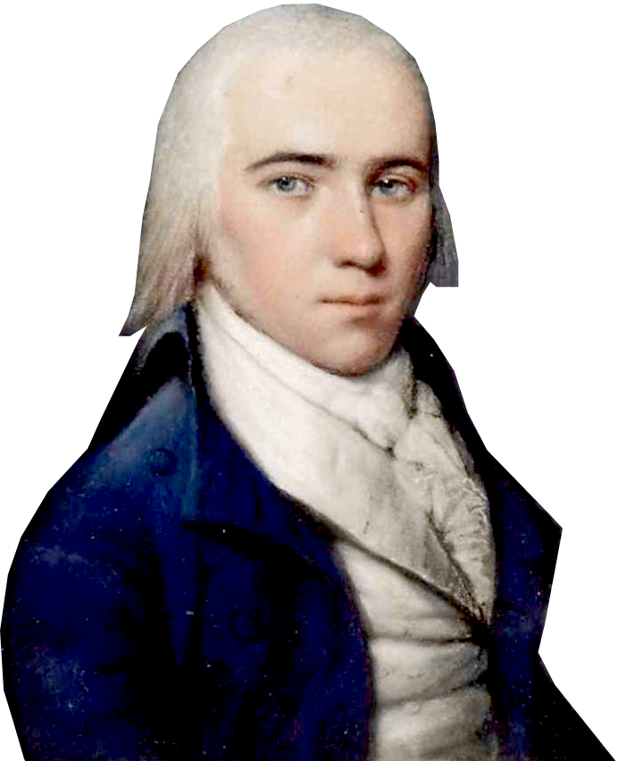
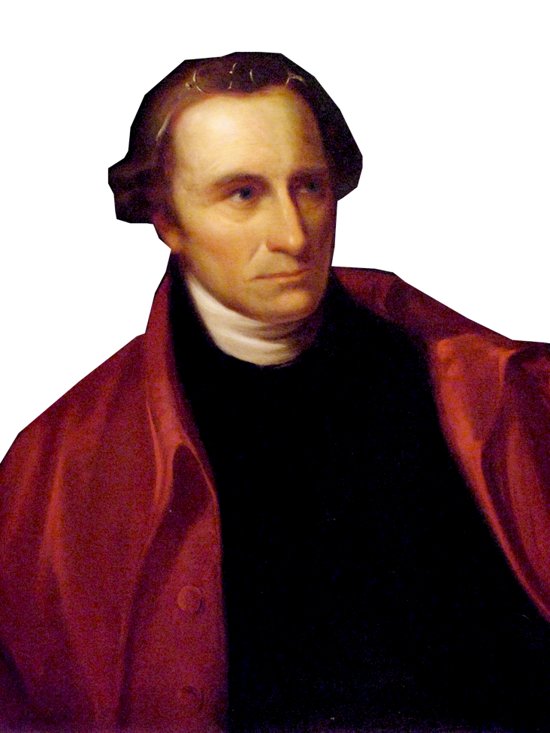
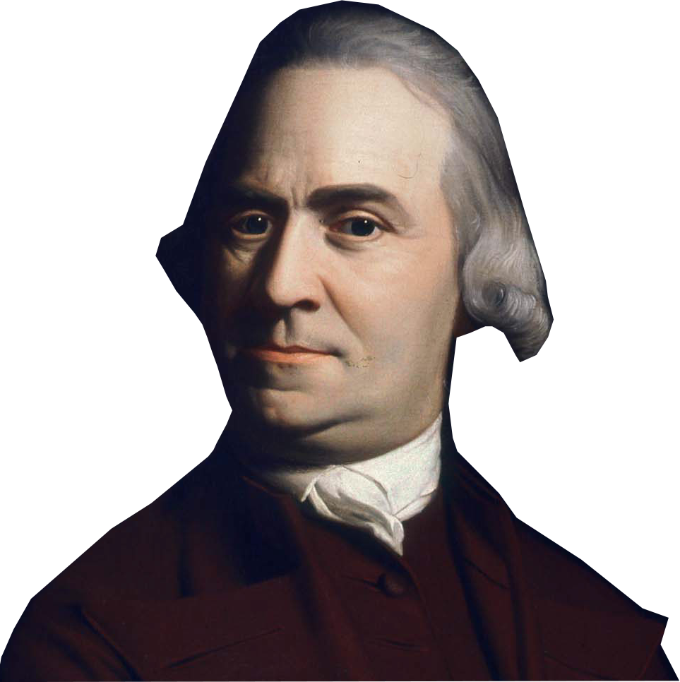



VI. ratifying the Constitution
James Madison • Alexander Hamilton
Samuel Adams • Patrick Henry
B. Antifederalists
  - Against the Constitution
  - Fought for a Bill of Rights
A. Federalists
  - delegates pro Constitution
  - Strong National Govt.
C. Federalists Papers- Essays written to urge delegates to ratify the Constitution. Written secretly by Alexander Hamilton, John Jay, James Madison
Notes:
Not everyone was for the Constitution and for the new Constitution to become law, 9 of the 13 states had to ratify it. There evolves two factions, the Federalists and the Antifederalists.
Those who favored the Constitution were called the Federalists. They included James Madison (shown), George Washington, and Alexander Hamilton. Their support came mainly from merchants and others in the cities and coastal regions.
Antifederalists thought that the Constitution made the National Government too powerful. They didn’t want the states to be under control of this new government. They drew support mostly from the inland farmers and laborers, who feared a strong national government. They fought against the Constitution. There biggest supporter was Patrick Henry (shown here).
The Anti-Federalists criticized the Constitution for having been drafted in secret. They claimed the document was extralegal, not sanctioned by law, because Congress authorized the Convention only to revise the old Articles. They also argued that the Constitution took important powers from the states.
The Anti-Federalists’ strongest argument, however, was that the Constitution lacked a Bill of Rights. The Convention had, in fact, considered adding this kind of bill. But in their discussions, they concluded that it was not necessary to have a bill of rights because the Constitution did not authorize the government to violate the rights of the people.
The Federalists, argued that without a strong national government, anarchy, or political disorder, would win. They claimed that only a strong national government could protect the nation from enemies abroad and solve the country’s internal problems. The Federalists argued that eight states already had such bills in their state constitutions. Eventually, however, the Federalists promised to add a bill of rights as the first order of business when the new government met.
Federalist Papers - The Federalist had a secret weapon, that the antifederalists didn’t have. They had a Powerful Propaganda writer by the name of Publius -(latin for public)who wrote a a series of articles written for the Newspapers of New York, that set out to convince the delegates that a strong Federal government was needed.
Federalist Papers - 85 separate articles were written. It was later found out that Alexander Hamilton, James Madison, and and man by the name of John Jay actually wrote the articles.
--The Federalist essays are important for a couple different reasons - They not only set out to influence the members of the convention to vote for this new constitution, but also to shape future interpretations of the Constitution, thus they are our only real primary source documents that reveal the motivation behind many parts of the Constitution.

Slide 7

VI. ratifying the Constitution
I may disagree with what you say, but I will defend to the death your right to say it.
—Voltaire
Bill of Rights
Formal summary of citizen’s rights & freedoms
Antifederalists feared strong Nat’l Govt would suppress speech, press, religion, trials
many delegates wouldn’t vote for ratification w/o a Bill of Rights
Notes:
Pushing for a Bill of Rights
The proposed U.S. Constitution contained no guarantee that the government would protect the rights of the people or of the states. Some supporters of the Constitution, such as Thomas Jefferson, viewed the Constitution’s lack of a bill of rights—a formal summary of citizens’ rights and freedoms, as a serious drawback to ratification.
Antifederalists argued that since the Constitution weakened the states, the people needed a national bill of rights. They wanted written guarantees that the people would have freedom of speech, of the press, and of religion. They demanded assurance of the right to trial by jury and the right to bear arms.
Federalists argued that the Constitution granted only limited powers to the national government so that it could not violate the rights of the states or of the people. They also pointed out that the Constitution gave the people the power to protect their rights through the election of trustworthy leaders. In the end, though, the Federalists yielded to people’s overwhelming desire and promised to add a bill of rights if the states would ratify the Constitution

Slide 8

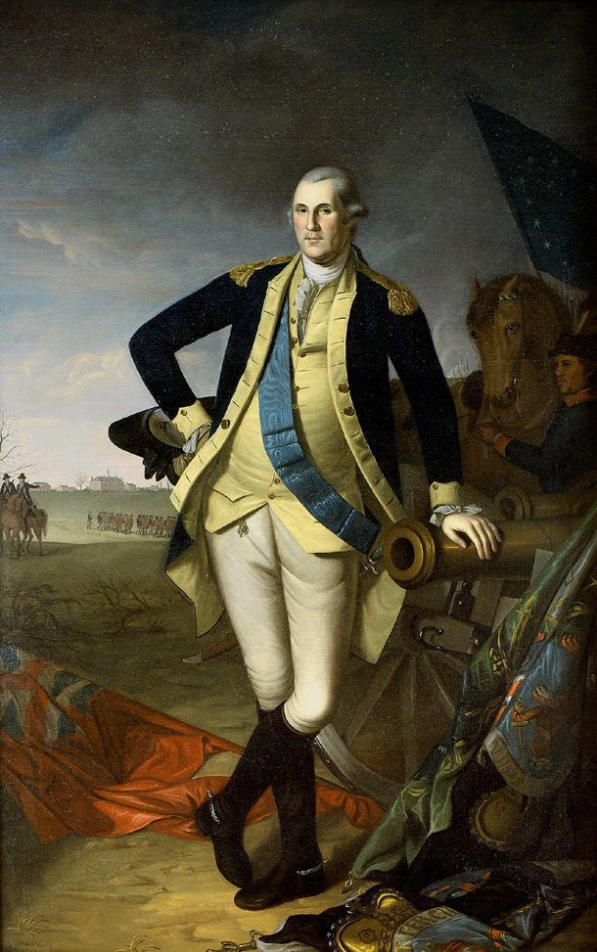
VI. ratifying the Constitution
Ratification of the
Constitution
State Date Vote
Delaware Dec. 7, 1787 30-0
New Jersey Dec. 19, 1787 38-0
Connecticut Jan. 9, 1788 128-40
Why the Feds Won -
1. the Articles had serious probs.
2. Feds had a specific plan - the Constitution
3. Feds were well organized
  4. Compromised w/the Bill of Rights
5. Feds had . . .
Delaware Dec. 7, 1787 30-0
New Jersey Dec. 19, 1787 38-0
Connecticut Jan. 9, 1788 128-40
Georgia Jan. 2, 1788 26-0
Pennsylvania Dec. 12, 1787 46-23
Massachusetts Feb. 6, 1788 187-168
Maryland April 28, 1788 63-11
South Carolina May 23, 1788 149-73
New Hampshire June 21, 1788 57-46
Virginia June 25, 1788 89-79
New York July 26, 1788 30-27
North Carolina Nov. 9, 1789 184-77
Rhode Island May 29, 1790 34-32
George Washington
Notes:
Guess who wins??
Who ratified first?
Delaware, New Jersey & Connecticut ratify quickly. They are small states who can benefit from being apart of a bigger country.
Georgia ratified quickly because they feared war with Native Americans and they could use the backing of giant national government.
Pennsylvania.
Massachusetts narrowly voted to ratify. Maryland and South Carolina followed.
New Hampshire delayed a vote until the Federalists new they had a victory. In June 1788, they became that magic number 9. 9 of the 13 states ratified the constitution.
--Everyone knew the nation would not succeed without the backing of the most populated states of Virginia and New York so real celebrations didn’t begin until they were in.
North Carolina and Rhode Island first rejected the Constitution but reversed itself and voted in favor.
--Why Rhode island? RI was always paranoid that a strong national government would destroy their independence, plus they issued a lot of paper money - they didn’t want their currency to be nullified by federal gov. money. They didn’t even send delegates. But when the rest of the nation voted in, they didn’t think a small sovereign nation would last surrounded by a large United States.
WHY THE FEDERALIST WON!
1. Shay’s Rebellion and the States’ financial debt. showed proof.
2. Madison came to the convention with a plan and the antifederalists had nothing else to offer.
3. Antifederalists were local and state officials who couldn’t coordinate on a national level - the Feds also had the Federalist papers
The Feds had (Click for animation)
4. George Washington was a national hero. He was bigger than Bush, Clinton, Martin Luther King and the Pope put together. One of the antifederalists biggest fears was that the next president would turn into a king or dictator. When General George Washington resigned from the army, and went back to his farm at Mount Vernon, the nation looked at it him in awe. He was a war hero - but not a warrior - He was a farmer, a leader and an American.

Slide 9

What was the Great Compromise?
Notes:
Day 6 Exit Ticket
Compromise that creation of two houses of legislature instead of one
Senate got 2 votes per state, benefitting the small states
House of legislature got votes based on population, benefitting the big states

