Slide 1
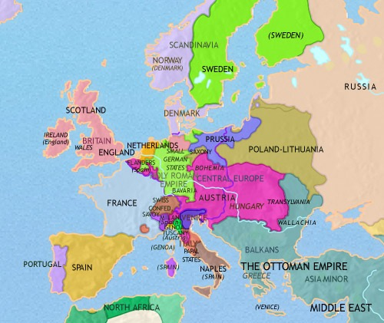
Day 1
Place Date Here
What kind of government was found in most of Europe at this time, including in France before the revolution?
Write in complete sentences or lose credit
Notes:
Day 1

Slide 2
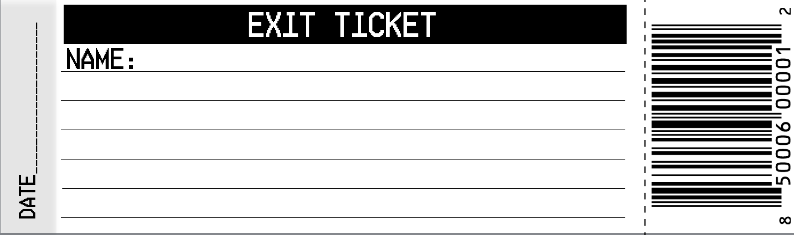
What was the reason behind the Great Fear?
Notes:
Day 1 Exit Ticket
Rumors were spread that the feudal lords or even the king had ordered the military or robbers or to murder peasants.

Slide 3

Day 2
Place Date Here
What were some of the causes of the French Revolution?
Write in complete sentences or lose credit
Notes:
Day 2
Friction between the Third Estate and the First and Second
Poor Harvest
Deficit Spending -
Failure to Reform

Slide 4
Write/ask one question about today’s content—something that has left you puzzled.
Notes:
Day 2 Exit Ticket

Slide 5


Day 3
Place Date Here
What governing body wrote the second constitution, changing the French government to a Democratic Republic and ending the monarchy?
Write in complete sentences or lose credit
Notes:
Day 3
Results - books were published more
1) quickly &
2) less expensively. Ideas could be published
3) uncensored by the church.

Slide 6
What part of today’s lesson is confusing to you?
Notes:
Day 3 Exit Ticket

Slide 7
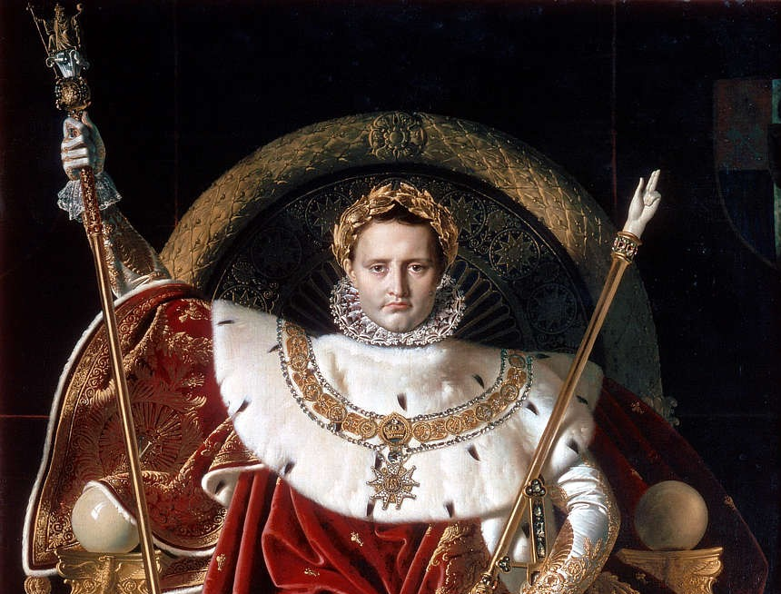
Review
Place Date Here
What are three ways Napoleon impacted France and Europe?
Write in complete sentences or lose credit
Notes:
Day 4 Review
Results - books were published more
1) quickly &
2) less expensively. Ideas could be published
3) uncensored by the church.

Slide 8
When, where and how will you study for the French Revolution exam?
Notes:
Day 4 Exit Ticket

Slide 9
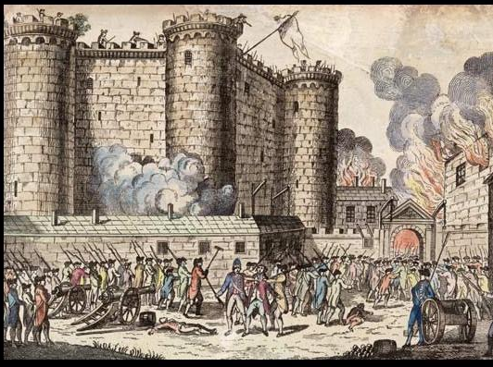
What was the outbreak at the Bastille, and the wave of peasant violence throughout France called?
TEST
Place Date Here
Write in complete sentences or lose credit
Notes:
Day 5 Test
The Great Fear

Slide 10
Name three things you could have done to improve your score on this exam.
Notes:
Day 5 Exit Ticket

Slide 11
Why did the King Louis XVI try to escape to Austria?
Explain Why.
EXTRA
Write your answer in complete sentences or lose credit

