Slide 1
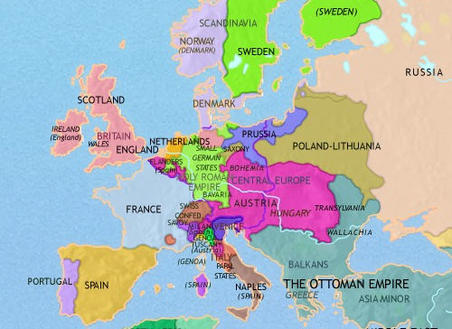
What kind of government was found in most of Europe at this time, including in France before the revolution?
Write in complete sentences or lose credit
Notes:
Day 1
Monarchies – If students are having problems, ask them to think medieval times

Slide 2
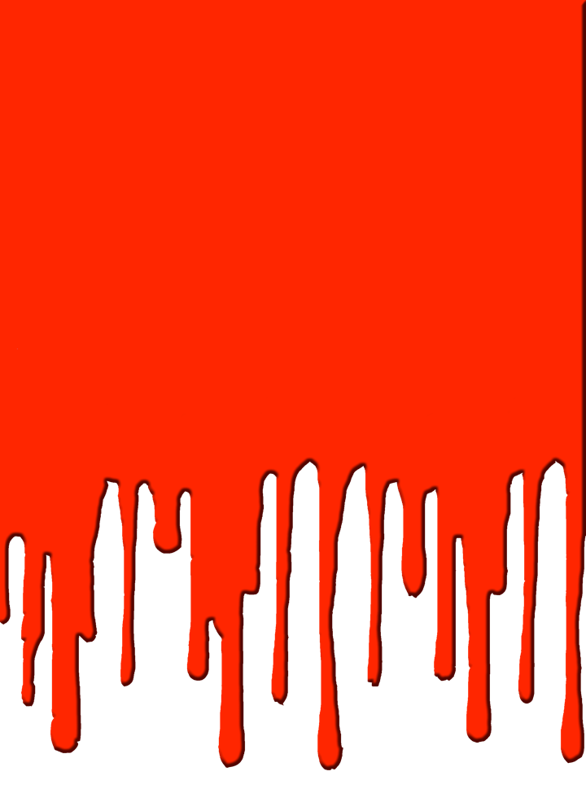


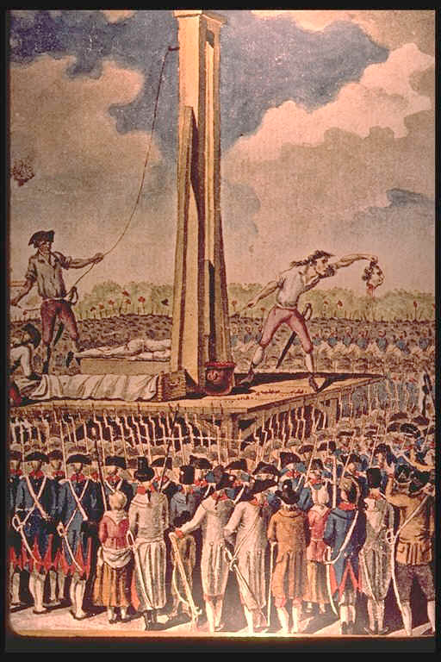
Notes:
Lecture Notes Key: ^ means discuss before notes
v means discuss after notes^

Slide 3

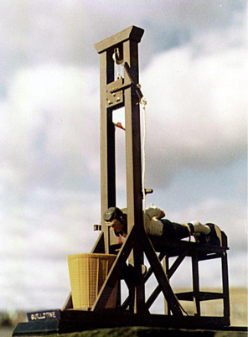
Notes:
Lecture Notes Key: ^ means discuss before notes
v means discuss after notes
The Guillotine - This has become a Symbol of the French Revolution. It’s estimated that during the Revolution over 40,000 people died by the guillotine, including the King of France, King Louis XVI.
---The guillotine was first devised by Doctor Joseph Ignacio Guillotine, who was disturbed by the barbarity of the public executions which was attended by huge crowds. He built this thing in as a more humane from of capital punishment. To him it was better than a execution by a hooded person with an ax. Sometimes an ax took several attempts.
Dr. Guillotine described its a “cool breath on the back of the neck.” He also didn’t lobbied for the demise of public executions. That however didn’t happen.
During the peak of the French Revolution known as "the Terror", over 40,000 people were killed by the guillotine.
--Public executions continued in France until 1939, when Eugene Weidmann became the last victim to be executed in public, a 150 years after Dr. Guillotines lobbying.
----The use of the guillotine occurred on September 10th 1977, when Hamida Djandoubi was executed;
there should have been another in 1981, but the intended victim, Philippe Maurice, was granted clemency. The death penalty was abolished later that year.

Slide 4

I. French Society Divided
The French belonged to 1 of 3 estates, which
determined a person’s legal rights & status.
First Estate 1% of population
Second Estate 2% of population
Third Estate 97% of population
Notes:
In the 1770s, the social and political system of France—the Old Regime, remained in place. Under this system, the people of France were divided into three large social classes, or estates.
The First Estate - The higher Clergy made money from their land as well as a tithe (Tie -th), which is a 10% tax on income from each church member. The money was used for schools and aid to poor people, but much of it paid for rich lifestyles of the clergy.
The Second Estate - They held high posts in government, lived in rich houses. Both of these Estates didn’t have to pay any taxes. However the Third Estate did.

Slide 5

I. French Society Divided
The French belonged to 1 of 3 estates, which
determined a person’s legal rights & status.
A. First Estate - Roman Catholic clergy
(1% of pop.) Controlled 5 - 10% of the land
B. Second Estate - Nobility (2% of pop.) Owned 25% of the land. Income came from feudal dues collected from peasants who lived on & worked their land.
C. Third Estate - Bourgeoisie & Peasants (97% of pop.)
  No voice in govt & many were poor & starved.
Notes:
The First Estate - The higher Clergy made money from their land as well as a tithe (Tie -th), which is a 10% tax on income from each church member. The money was used for schools and aid to poor people, but much of it paid for rich lifestyles of the clergy.
The Second Estate - They held high posts in government, lived in rich houses. Both of these Estates didn’t have to pay any taxes. However the Third Estate did.
The Third Estate - About 97 percent of the people belonged to the Third Estate. The three groups that made up this estate differed greatly in their economic conditions. The first group—the bourgeoisie (BUR•zhwah•ZEE), or middle class—were bankers, factory owners, merchants, professionals, and skilled artisans. Often, they were well educated and believed strongly in the Enlightenment ideals of liberty and equality. Many were inspired by the success of the American Revolution. Although some of the bourgeoisie were as rich as nobles, they paid high taxes and, like the rest of the Third Estate, lacked privileges. Many felt that their wealth entitled them to a greater degree of social status and political power.
The workers of France’s cities formed the second, and poorest, group within the Third Estate. These urban workers included tradespeople, apprentices, laborers, and domestic servants. Paid low wages and frequently out of work, they often went hungry. If the cost of bread rose, mobs of these workers might attack grain carts and bread shops to steal what they needed.
Peasants formed the largest group within the Third Estate, more than 80 percent of France’s 26 million people. Peasants paid about half their income in dues to nobles, tithes to the Church, and taxes to the king’s agents. They even paid taxes on such basic staples as salt. Peasants and the urban poor resented the clergy and the nobles for their privileges and special treatment. The heavily taxed and discon- tented Third Estate was eager for change.

Slide 6
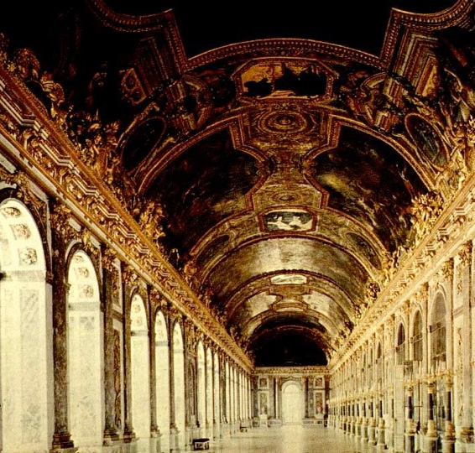
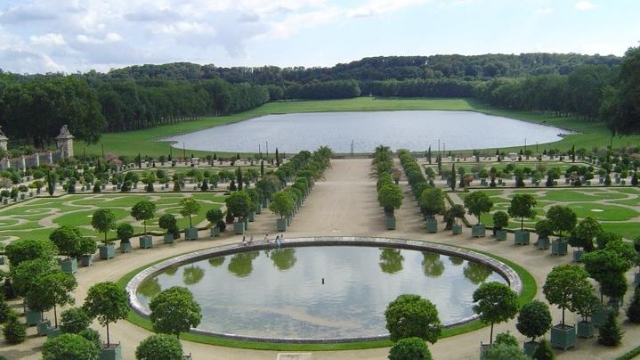
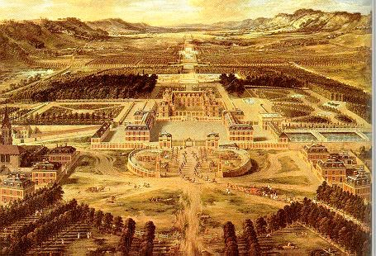
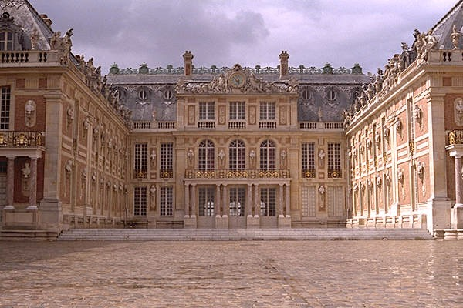
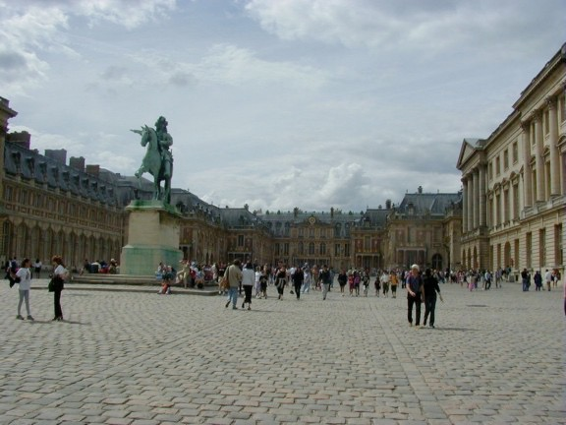
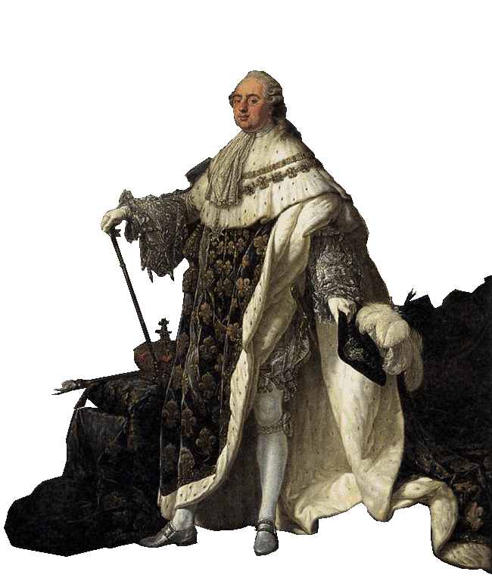
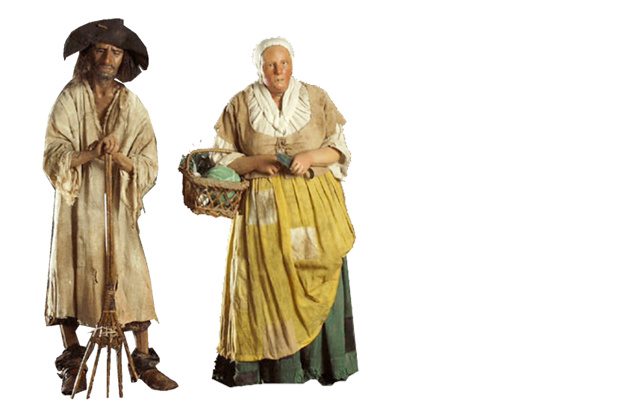
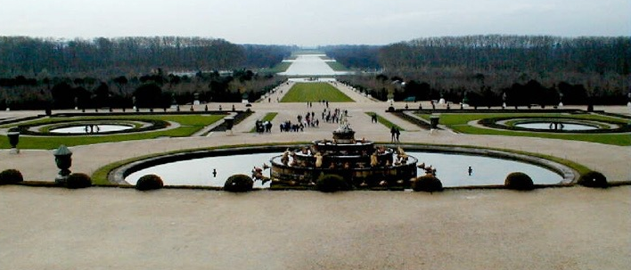
II. Economic Problems
1. Wars & wasteful royal spending broke France
2. French gov. Deficit spending
3. Bad food harvests in late 1780s
Notes:
1. For years, the French government had engaged in deficit spending that is, a government’s spending more money than it takes in. Part of the problem was the extravagant spending of Louis XVI and his queen, Marie Antoinette. Louis also inherited a considerable debt from previous kings. And he borrowed heavily in order to help the American revolutionaries in their war against Great Britain, France’s chief rival. This nearly doubled the government’s debt. The government borrowed more and more money. When a country spends more money than it makes and has to borrow money, it is called deficit spending. In 1786, when bankers refused to lend the government any more money, Louis faced serious problems.
3. Finally, Bad harvests in the late 1780s sent food prices soaring and brought hunger to poorer peasants and city dwellers. The price of bread doubled in 1789, and many people faced starvation.

Slide 7
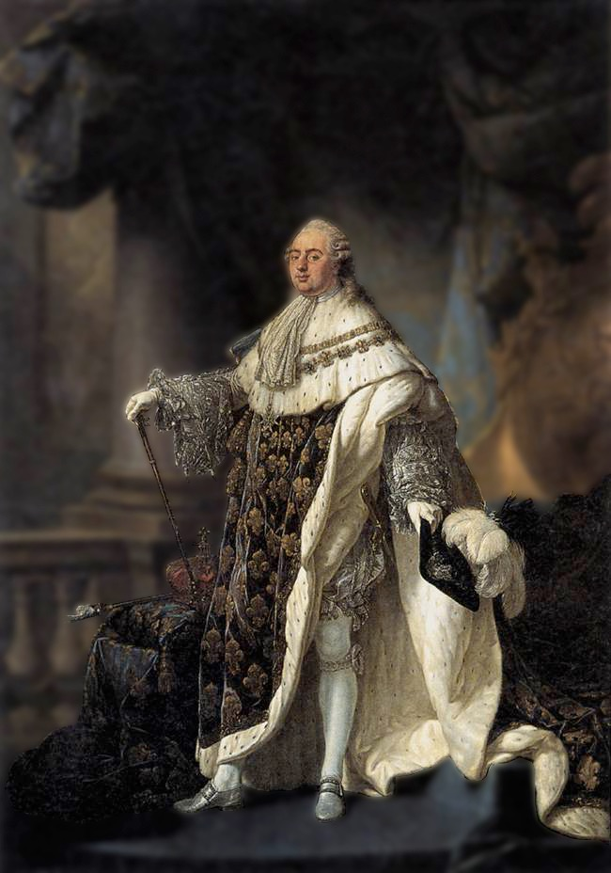

III. Call to Revolt
A. King Louis XVI called the Estates General - to meet in 1789 at Versailles - King’s Palace in France
- Goal: To raise taxes to
pay off debt
Notes:
Louis and Marie - Louis XVI was indecisive and allowed matters to drift. He paid little attention to his government advisers, and had little patience for the details of governing. The queen only added to Louis’s problems. She often interfered in the government, and frequently offered Louis poor advice. Further, since she was a member of the royal family of Austria, France’s long-time enemy, Marie Antoinette had been unpopular from the moment she set foot in France. Her behavior only made the situation worse. As queen, she spent so much money on gowns, jewels, gambling, and gifts that she became known as “Madame Deficit.”
Estates General By1788, France was on the verge of bankruptcy. Bread riots were spreading, and nobles, fearful of taxes, were criticizing the King’s power. A baffled Louis XVI finally summoned the Estates General to meet at Versailles the following year.
The Third Estate delegates, mostly members of the bourgeoisie whose views had been shaped by the Enlightenment, wanted to make changes in the government. They insisted that all three estates meet together and that each delegate have a vote. This would give the advantage to the Third Estate, which had as many delegates as the other two estates combine

Slide 8
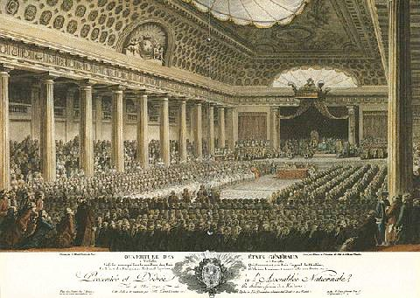
III. Call to Revolt
A. King Louis XVI called the Estates General - to meet in 1789 at Versailles - King’s Palace in France
- Goal: To raise taxes to
pay off debt
B. National Assembly - 3rd Estate’s new name
  demanded more power
  vowed a fair Constitution.
Notes:
Call to revolt
After weeks of stalemate, delegates of the Third Estate took a daring step. Claiming to represent the people of France, they declared themselves to be the National Assembly. They then invited delegates from the other estates to help them write a constitution, a document that describes the basic rules and laws of government.
A few days later, the National Assembly found its meeting hall locked and guarded. Fearing that the king planned to dismiss them, the delegates moved to a nearby indoor tennis court. As curious spectators looked on, the delegates took their famous Tennis Court Oath. They swore “never to separate and to meet wherever the circumstances might require until we have established a sound and just constitution. Soon after, nobles and members of the clergy who favored reform joined the Third Estate delegates. In response to these events, Louis stationed his mercenary army of Swiss guards around Versailles.

Slide 9
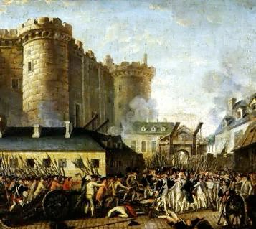
C. King tried to stop the National Assembly - led to. . .
  • a mob overtook the Bastille to steal weapons
  • Great Fear - a peasant revolt, attacking landlords
Painting: The Bastille stormed by Mob
Notes:
Rumors began that King Louie was trying to stop the National Assembly and it’s reforms. Other rumors suggesting royal troops were coming to Paris to attack French citizens. People began to gather weapons in order to defend the city against attack. On July 14, a mob searching for gunpowder and arms stormed the Bastille, a Paris prison. The mob over- whelmed the guard and seized control of the building. The angry attackers hacked the prison commander and several guards to death, and then paraded around the streets with the dead men’s heads on pikes.
The fall of the Bastille became a great symbolic act of revolution to the French people. Ever since, July 14—Bastille Day—has been a French national holiday, similar to the Fourth of July in the United States.
Great Fear Rebellion spread from Paris into the countryside. From one village to the next, wild rumors circulated that the nobles were hiring outlaws to terrorize the peasants. A wave of senseless panic called the Great Fear rolled through France. The peasants, armed with
pitchforks and other farm tools, broke into nobles’ manor
houses and destroyed the old legal papers that bound them to
pay feudal dues. In some cases, the peasants simply burned down the manor houses.

Slide 10

C. King tried to stop the National Assembly - led to. . .
  • a mob overtook the Bastille to steal weapons
  • Great Fear - a peasant revolt, attacking landlords
Notes:
Video Begins Here: Mac users click on black circle on left to view video
Original Video Link: https://vimeo.com/155481563 https://youtu.be/5K5y4aDKWw8
Rumors began that King Louie was trying to stop the National Assembly and its reforms. Other rumors suggesting royal troops were coming to Paris to attack French citizens. People began to gather weapons in order to defend the city against attack. On July 14, a mob searching for gunpowder and arms stormed the Bastille, a Paris prison. The mob over- whelmed the guard and seized control of the building. The angry attackers hacked the prison commander and several guards to death, and then paraded around the streets with the dead men’s heads on pikes.
The fall of the Bastille became a great symbolic act of revolution to the French people. Ever since, July 14—Bastille Day—has been a French national holiday, similar to the Fourth of July in the United States.
Great Fear Rebellion spread from Paris into the countryside. From one village to the next, wild rumors circulated that the nobles were hiring outlaws to terrorize the peasants. A wave of senseless panic called the Great Fear rolled through France. The peasants, armed with
pitchforks and other farm tools, broke into nobles’ manor
houses and destroyed the old legal papers that bound them to
pay feudal dues. In some cases, the peasants simply burned down the manor houses.

Slide 11

What was the reason behind the Great Fear?
Notes:
rumors that the king was going to attack the citizens of Paris

Slide 12
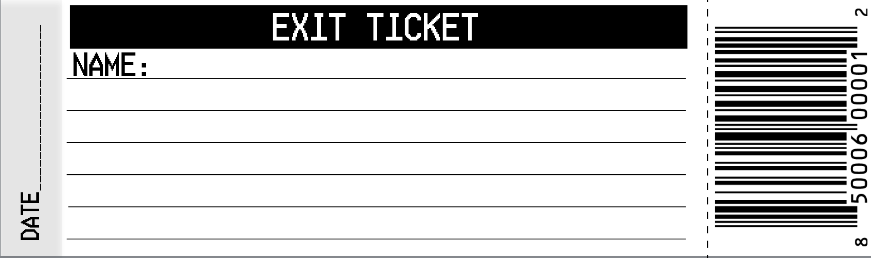
What was the reason behind the Great Fear?
Notes:
Day 1 Exit Ticket
Rumors were spread that the feudal lords or even the king had ordered the military or robbers or to murder peasants.

