Slide 1

Day 2
Place Date Here
What were some of the causes of the French Revolution?
Write in complete sentences or lose credit
Notes:
Day 2
Friction between the Third Estate and the First and Second
Poor Harvest
Deficit Spending -
Failure to Reform

Slide 2
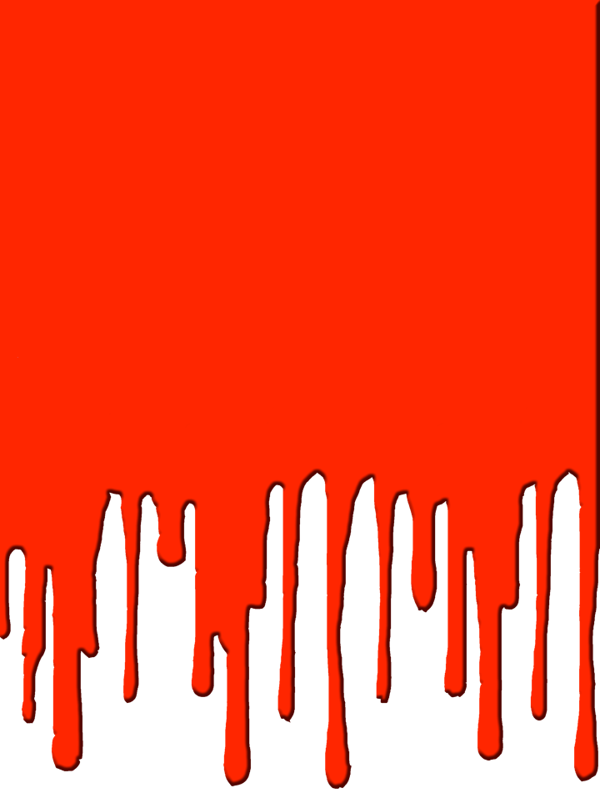



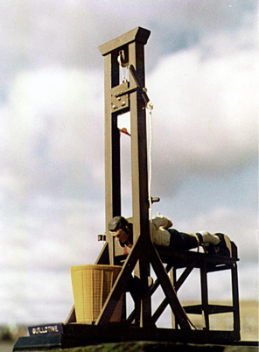
Notes:
Lecture Notes Key: ^ means discuss before notes
v means discuss after notes
The Guillotine - This has become a Symbol of the French Revolution. It’s estimated that during the Revolution over 40,000 people died by the guillotine, including the King of France, King Louis XVI.
---The guillotine was first devised by Doctor Joseph Ignacio Guillotine, who was disturbed by the barbarity of the public executions which was attended by huge crowds. He built this thing in as a more humane from of capital punishment. To him it was better than a execution by a hooded person with an ax. Sometimes an ax took several attempts.
Dr. Guillotine described its a “cool breath on the back of the neck.” He also didn’t lobbied for the demise of public executions. That however didn’t happen.
During the peak of the French Revolution known as "the Terror", over 40,000 people were killed by the guillotine.
--Public executions continued in France until 1939, when Eugene Weidmann became the last victim to be executed in public, a 150 years after Dr. Guillotines lobbying.
----The use of the guillotine occurred on September 10th 1977, when Hamida Djandoubi was executed;
there should have been another in 1981, but the intended victim, Philippe Maurice, was granted clemency. The death penalty was abolished later that year.

Slide 3

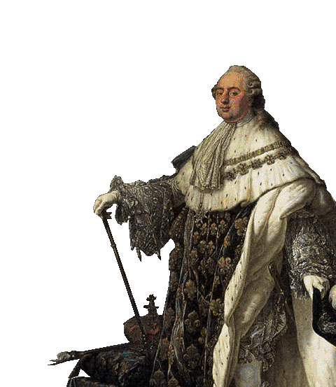
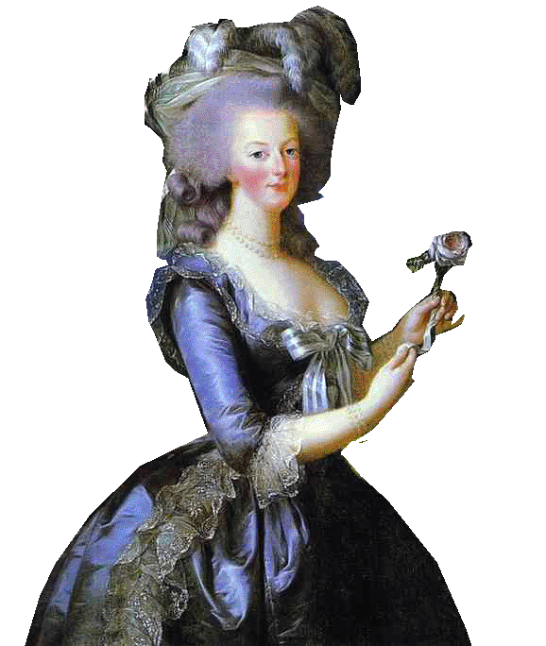
III. Constitutional Government
National Assembly - 1789 -
1. All male citizens be in govt, army, or church office.
2. Declaration of the Rights of Man and of the Citizen
  - equality of all citizens & freedom of speech, press & religion.
3. Constitutional Monarchy -
  Kept king, but limited his powers
Notes:
After the other two estates joined the third estate AKA the National Assembly, the adopted a statement of their new ideals, called the Declaration of the Rights of Man and of the Citizen. In looking at the American Declaration of Independence, the document stated that “men are born and remain free and equal in rights.” These rights included “liberty, property, security, and resistance to oppression.” The document also guaranteed citizens equal justice, freedom of speech, and freedom of religion.
To show equality, National Assembly suggested an end with titles. Titles showed that people were not equal. People were now addressed as Citizen. It ended calling each other Misere, Madam, or Dr.
The assembly took over Church lands and declared that Church officials and priests were to be elected and paid as state officials. Thus, the Catholic Church lost both its lands and its political independence. The rea- sons for the assembly’s actions were largely economic. Proceeds from the sale of Church lands helped pay off France’s huge debt.
Constitution The National Assembly completed its main task by producing a constitution. The Constitution of 1791 set up a limited monarchy in place of the absolute monarchy that had ruled France for centuries. A new Legislative Assembly had the power to make laws, collect taxes, and decide on issues of war and peace. Lawmakers would be elected by tax paying male citizens. The middle-class framers of the constitution protected private property and supported free trade. They compensated nobles for land seized by the peasants, abolished guilds, and forbade urban workers to organize labor unions.
In 1791 Louis XVI & Marie Antoinette decided to disguise themselves & flee to Austria to escape the growing unrest; the king was recognized, arrested, and returned to Paris, where he reluctantly accepted the limited monarchy.

Slide 4
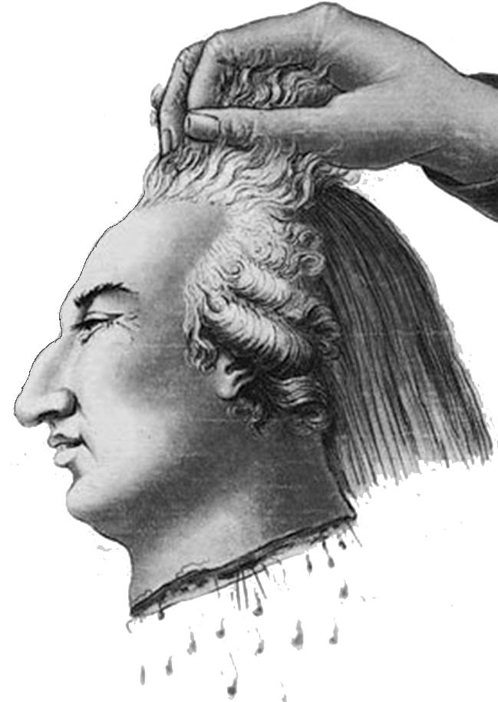
IV. New France & the French Republic
A. National Convention
created a new govt.
- set up. . .
B. Democratic Republic ended the monarchy.
C. King Louis refused the Republic, hence – tried for treason - beheaded
Notes:
Under pressure from radicals in the streets and among its members, the Legislative Assembly set aside the Constitution of 1791. It declared the king deposed, dissolved the assembly, and called for the election of a new legislature. This new governing body, the National Convention, took office on September 21. It quickly abolished the monarchy and declared France a republic. Adult male citizens were granted the right to vote and hold office. Despite the important part they had already played in the Revolution, women were not given the vote.
During the early months of the Republic, the Convention also put Louis XVI on trial as a traitor to France. The king was convicted by a single vote and sentenced to death. In October, Marie Antoinette was also executed. The popular press celebrated her death. The queen, however, showed great dignity as she went to her death. Their son, the uncrowned Louis XVII, died of unknown causes in the dungeons of the revolution.

Slide 5

IV. A New France & the French Republic
B. Democratic Republic ended the monarchy.
C. King Louis refused the Republic, hence - beheaded
Notes:
An embedded link to a 3:57 minute Youtube video clip begins here.
Mac users, click on black circle to open browser and view a 3:57 minute Youtube video clip.
Original link: https://www.youtube.com/watch?v=1gsvoi9t3C8

Slide 6
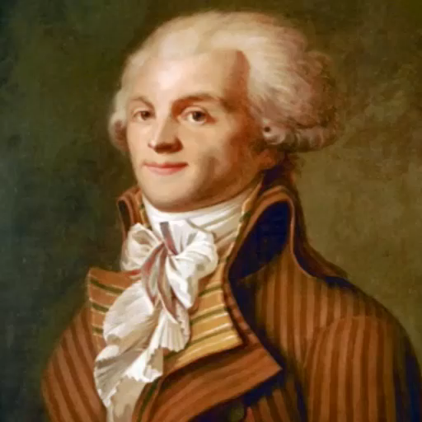
V. Spreading the Revolution
A. Maximilien Robespierre
    (Leader)
    - installs radical changes
    - begins Reign of Terror
B. Reign of Terror - 40,000 people suspected of being traitors, were beheaded.
Notes:
Maximilien Robespierre (ROHBZ•peer), slowly gained power. Robespierre and his supporters set out to build a “republic of virtue” by wiping out every trace of France’s past. They changed the calendar, dividing the year into 12 months of 30 days and renaming each month. This calendar had no Sundays because the radicals considered religion old-fashioned and dangerous. They even closed all churches in Paris, and cities and towns all over France soon did the same.
Reign of Terror - In July 1793, Robespierre became leader of the Committee of Public Safety. For the next year, Robespierre governed France as a dictator, and the period of his rule became known as the Reign of Terror. The Committee of Public Safety’s main goal was to protect the Revolution from its enemies. Under Robespierre, the committee often had these “enemies” tried in the morning and guillotined in the afternoon. Robespierre justified his use of terror by suggesting that it enabled French citizens to remain true to the ideals of the Revolution.
If you were suspected of being against the revolution, if you were overheard criticizing the revolution - you could just be accused and off with your head. If you didn’t use the term citizen when addressing people. 200,000 people were arrested. September to July - In less than a year 40,000 put to death. In the last month 1,300 people were executed - that’s an average of 43 people a day. Even people who had led the revolution were put to death for not being radical enough.

Slide 7
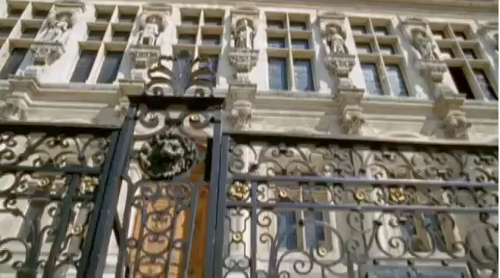
V. Spreading the Revolution
A. Maximilien Robespierre
    (Leader)
    - installs radical changes
    - begins Reign of Terror
B. Reign of Terror - 40,000 people suspected of being traitors, were beheaded.
Notes:
Video Begins Here: Mac users click on black circle on left to view video
Original Video Links: https://youtu.be/rxOfuHhw6zY or https://vimeo.com/155481564
Maximilien Robespierre (ROHBZ•peer), slowly gained power. Robespierre and his supporters set out to build a “republic of virtue” by wiping out every trace of France’s past. They changed the calendar, dividing the year into 12 months of 30 days and renaming each month. This calendar had no Sundays because the radicals considered religion old-fashioned and dangerous. They even closed all churches in Paris, and cities and towns all over France soon did the same.
Reign of Terror - In July 1793, Robespierre became leader of the Committee of Public Safety. For the next year, Robespierre governed France as a dictator, and the period of his rule became known as the Reign of Terror. The Committee of Public Safety’s main goal was to protect the Revolution from its enemies. Under Robespierre, the committee often had these “enemies” tried in the morning and guillotined in the afternoon. Robespierre justified his use of terror by suggesting that it enabled French citizens to remain true to the ideals of the Revolution.
If you were suspected of being against the revolution, if you were overheard criticizing the revolution - you could just be accused and off with your head. If you didn’t use the term citizen when addressing people. 200,000 people were arrested. September to July - In less than a year 40,000 put to death. In the last month 1,300 people were executed - that’s an average of 43 people a day. Even people who had led the revolution were put to death for not being radical enough.

Slide 8
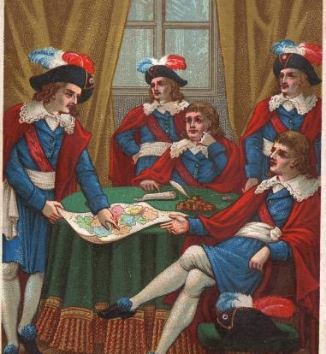
V. Spreading the Revolution
C. The Directory -
    - Govt #3 (1795)
    - weak & corrupt
1795 October 27 The Directory
Notes:
Finally the Reign of Terror came to an end when the government turned on Maximilien Robespierre. He and his close supporters will tried for treason themselves and were put to death by the guillotine.
The Directory In reaction to the Terror, the revolution entered a third stage. Moving away from the excesses of the Convention, moderates produced another constitution, the third since 1789. The Constitution of 1795 set up a five-man Directory and a two-house legislature elected by male citizens of property.

Slide 9
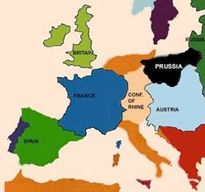
D. War - Kings of Britain, Spain, Austria & Prussia feared the new gov.
    France wanted to spread the revolution by overthrowing ALL kings
    begins war
Notes:
Monarchs and nobles in many European countries who watched France were scared. They feared that similar revolts might break out in their own countries. France believed its enlightenment ideas should spread to the other monarchies. As a result, some countries took action. When Austria and Prussia urged the French to restore Louis to as an absolute monarch, the Legislative Assembly responded by declaring war in April 1792. Early in 1793, Great Britain, Holland, and Spain joined Prussia and Austria against France.
But France was hurting. The new government, The Directory was weak and corrupt. All of France’s enemies, threatened it from all directions. Bad harvests reappeared every few years. People were hungry. The treasury was empty, and different political factions (royalists wanting the brother of the king to return from exile) made further rioting and revolutions a constant threat.
Somebody had to do something. And somebody did. Along came an emperor…Napoleon Click for Next Slide

Slide 10
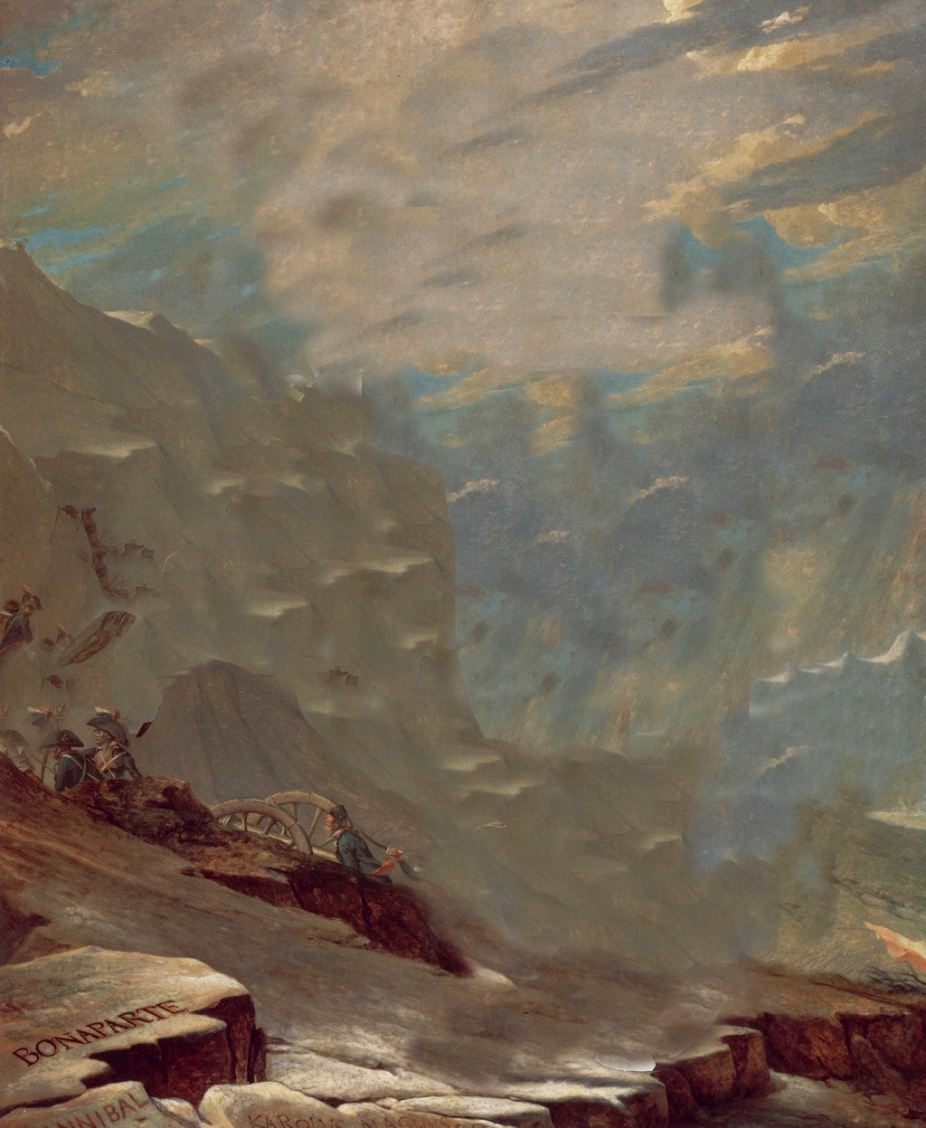
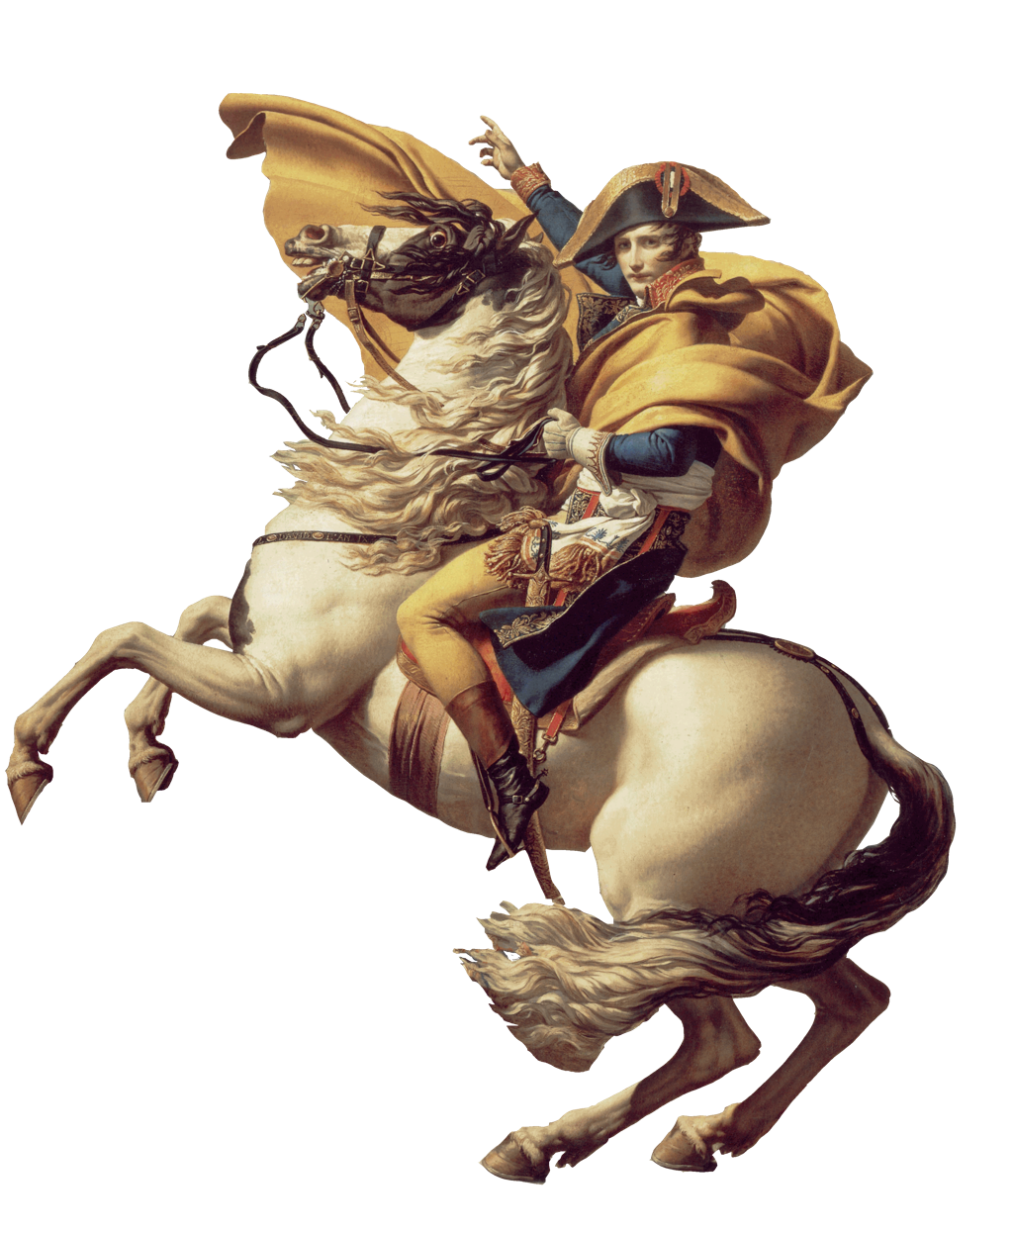
VI. Napoleon Takes Over
A. Napoleon Bonaparte -
Notes:
More on Napoleon, next lesson.

Slide 11

Who created the Committee of Public Safety and used it to begin the Reign of Terror?
Notes:
Maximilien Robespierre

Slide 12

Write/ask one question about today’s content—something that has left you puzzled.
Notes:
Day 2 Exit Ticket

