Slide 1
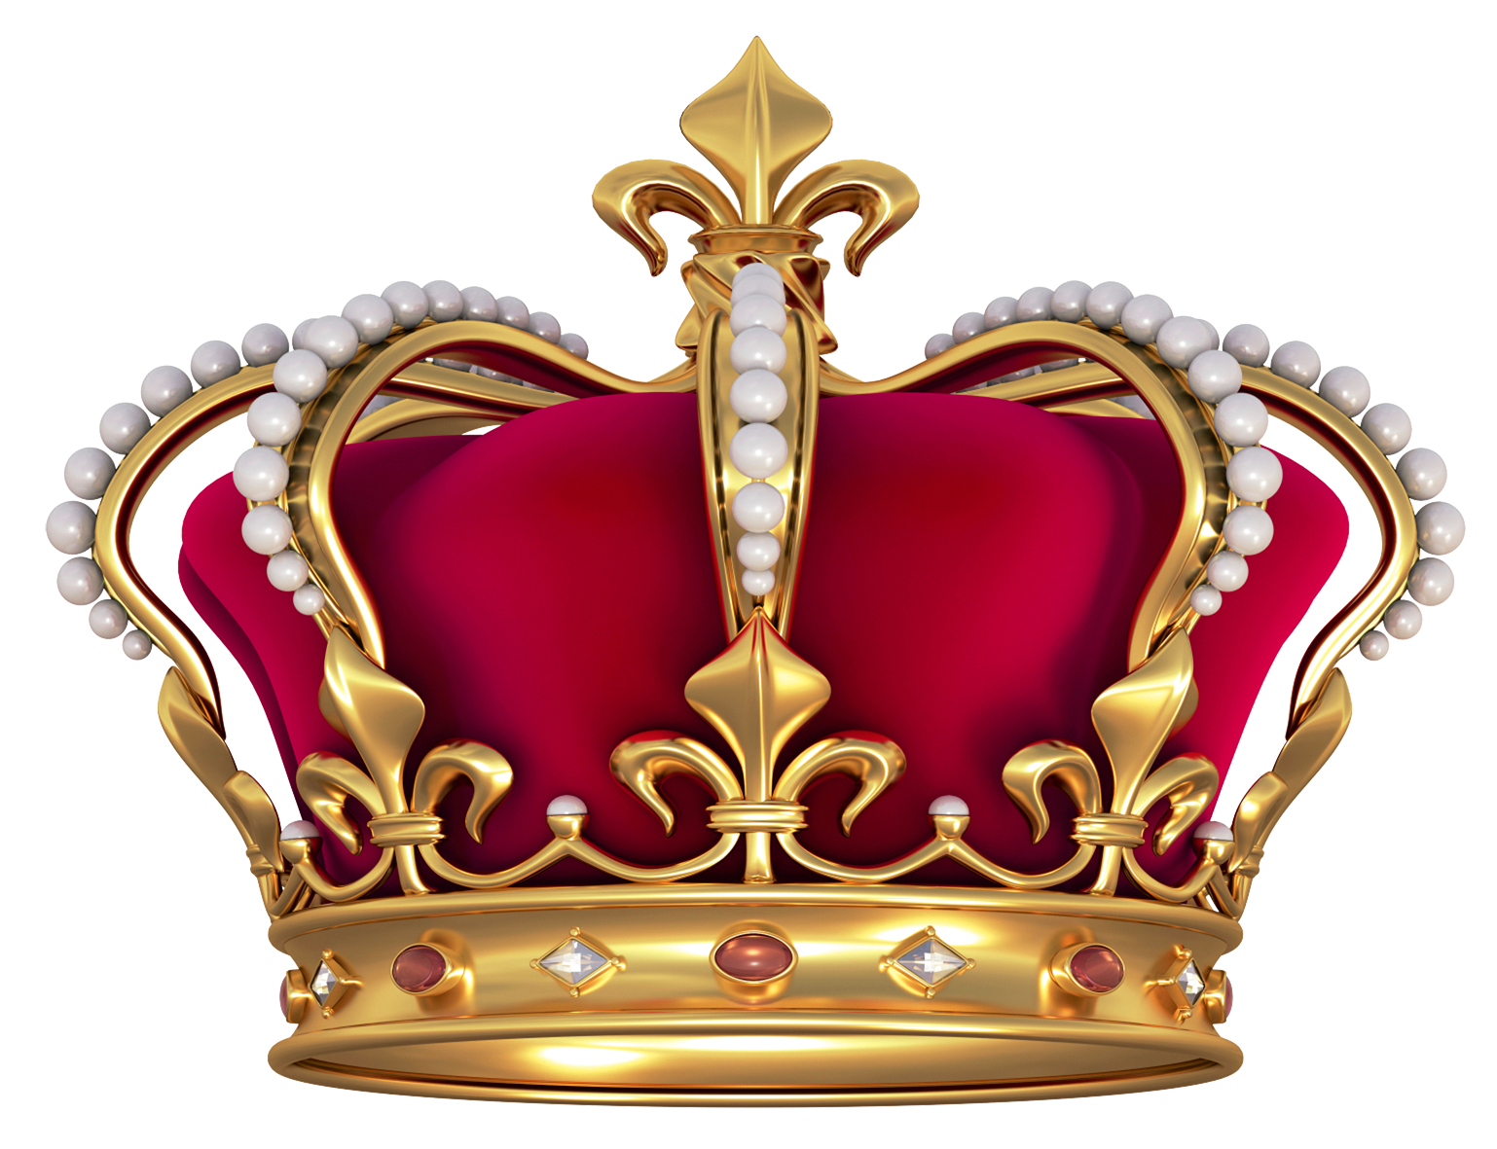

Day 3
Place Date Here
What governing body wrote the second constitution, changing the French government to a Democratic Republic and ending the monarchy?
Write in complete sentences or lose credit
Notes:
Day 3
The National Convention

Slide 2
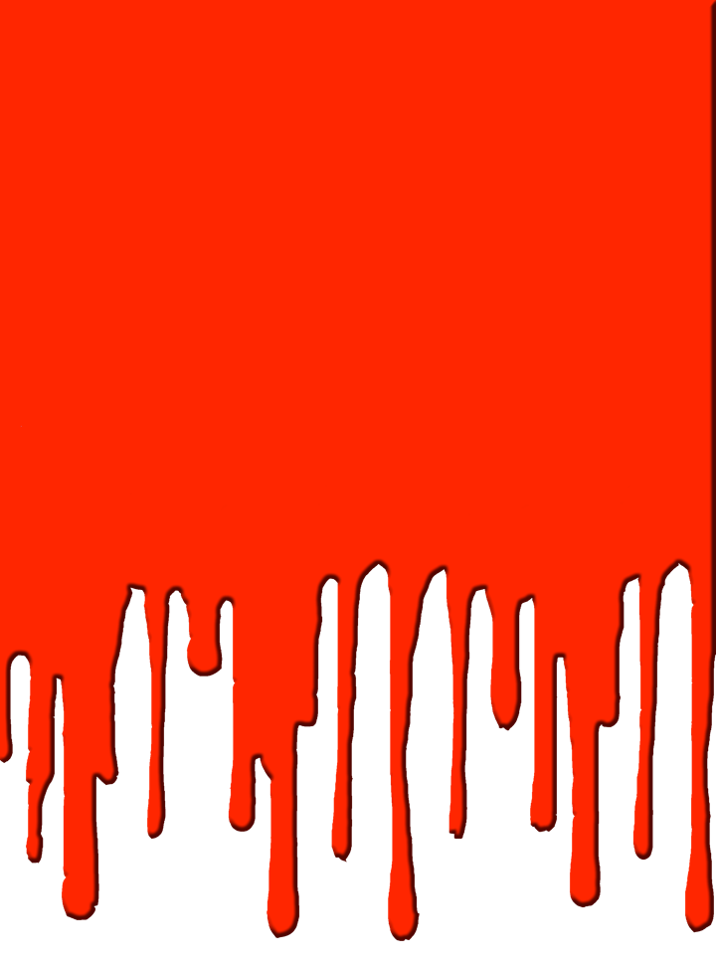



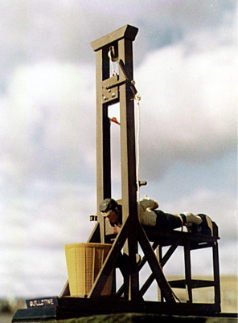
Notes:
Lecture Notes Key: ^ means discuss before notes
v means discuss after notes
The Guillotine - This has become a Symbol of the French Revolution. It’s estimated that during the Revolution over 40,000 people died by the guillotine, including the King of France, King Louis XVI.
---The guillotine was first devised by Doctor Joseph Ignacio Guillotine, who was disturbed by the barbarity of the public executions which was attended by huge crowds. He built this thing in as a more humane from of capital punishment. To him it was better than a execution by a hooded person with an ax. Sometimes an ax took several attempts.
Dr. Guillotine described its a “cool breath on the back of the neck.” He also didn’t lobbied for the demise of public executions. That however didn’t happen.
During the peak of the French Revolution known as "the Terror", over 40,000 people were killed by the guillotine.
--Public executions continued in France until 1939, when Eugene Weidmann became the last victim to be executed in public, a 150 years after Dr. Guillotines lobbying.
----The use of the guillotine occurred on September 10th 1977, when Hamida Djandoubi was executed;
there should have been another in 1981, but the intended victim, Philippe Maurice, was granted clemency. The death penalty was abolished later that year.

Slide 3
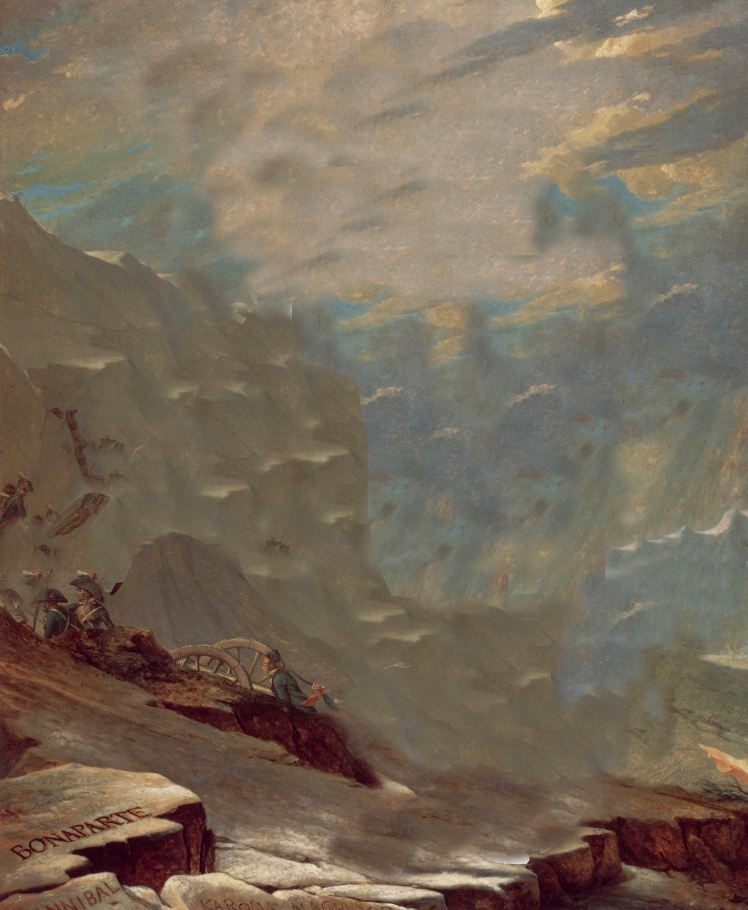
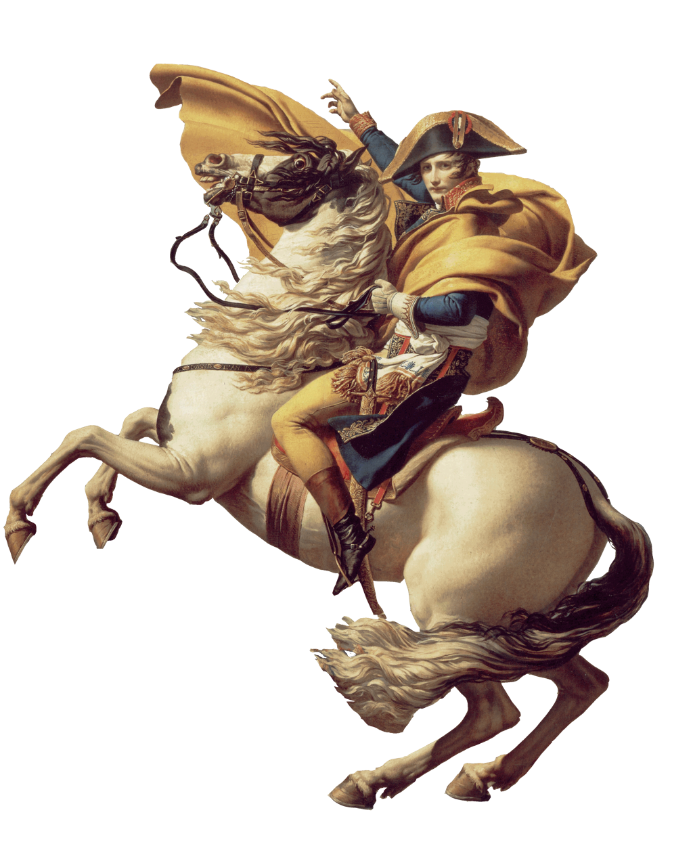
VI. Napoleon Takes Over
A. Napoleon Bonaparte -
General - defeated Austria & northern Italy.
B. His popularity allowed him to overthrow the gov.
  - Proclaimed a new republic; really a dictatorship
C. French liked his strong gov. & peace & order
Notes:
Napoleon Bonaparte was kind of short. He was five feet three inches tall. However, he would come to be recognized as one of the world’s greatest military geniuses, along with Alexander the Great of Macedonia, Hannibal of Carthage, and Julius Caesar of Rome. In only four years, from 1795 to 1799, Napoleon rose from a relatively obscure position as an officer in the French army to become master of France. In 1796, the Directory appointed Napoleon to lead a French army against the forces of Austria and the Kingdom of Sardinia. Crossing the Alps, the young general swept into Italy and won a series of remarkable victories.
Takes Power By 1799, the Directory had lost control of the political situation and the confidence of the French people. Napoleon’s troops surrounded the national legislature and drove out most of its members. The lawmakers who remained then voted to dissolve the Directory. In its place, they established a group of three consuls, one of whom was Napoleon. Napoleon quickly took the title of first consul and assumed the powers of a dictator. A sudden seizure of power like Napoleon’s is known as a coup.
His first task was to get the economy on a solid footing. Napoleon set up an efficient method of tax collection and established a national banking system. Napoleon also took steps to end corruption and inefficiency in government. He fired corrupt officials and set up public schools, in part to educate future effective public officials.

Slide 4
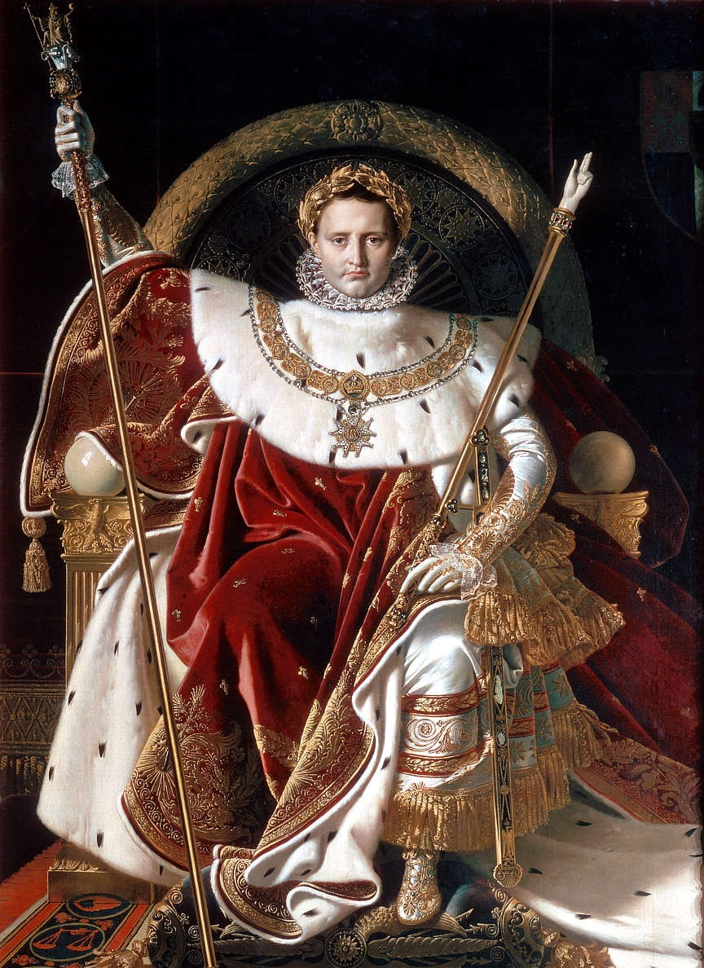
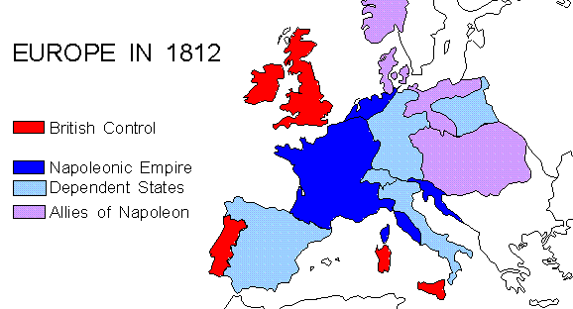
VI. Napoleon Takes Over
D. Crowns himself Emperor
E. Nearly conquered Europe
Notes:
Napoleon Crowned Emperor In 1804, Napoleon decided to make himself emperor, and the French voters supported him. On December 2, 1804, dressed in a splendid robe of purple velvet, Napoleon walked down the long aisle of Notre Dame Cathedral in Paris. The pope waited for him with a glittering crown. As thou- sands watched, the new emperor took the crown from the pope and placed it on his own head. With this gesture, Napoleon signaled that he was more powerful than the Church, which had traditionally crowned the rulers of France.
War on Europe Napoleon had already annexed the Austrian Netherlands and parts of Italy to France and set up a puppet government in Switzerland. Now he looked to expand his influence further. Fearful of his ambitions, the British persuaded Russia, Austria, and Sweden to join them against France.
Napoleon met this challenge with his usual boldness. In a series of brilliant battles, he crushed the opposition. The commanders of the enemy armies could never predict his next move and often took heavy losses.
Although Napoleon controlled most of Europe by 1812, nationalism, motivated by resentment about paying taxes to France and sending soldiers to serve in Napoleon’s armies, helped stir revolts against his French rule.
In 1812 the Spaniards, with the aid of British troops, overthrew their French occupiers and reinstated their old king under a system of limited monarchy. Soon, Prussia joined in the revolt against Napoleon. It Kept Dwindling Down. .
• Russia’s decided to join the movement against Napoleon.
• Napoleon assembled an army of 600,000 soldiers to take on the Russians;the Russians, however, adopted a “scorched‑earth policy.” He gets as far as Moscow, but the entire city is burned down. His troops didn’t have any shelter in the harsh winter. Despite the harsh Russian winter, Napoleon delayed before ordering a retreat; when the weakened French troops finally did withdraw, the Russians attacked them. When it was all over, 400,000 of Napoleons troops were dead of battle wounds, starvation and freezing to death.

Slide 5
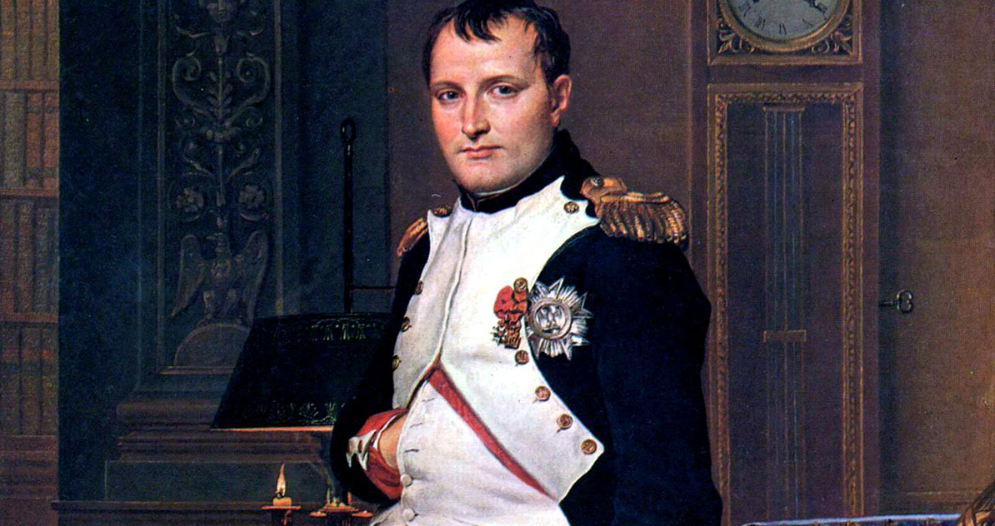
F. 1814, defeated & exiled to Islands of Elba & St. Helena
  G. Napoleon’s Impact
  (1) Napoleonic Code.
  (2) secured the revolution in
France
(3) spread Enlightenment
around Europe
Notes:
The Fall and Rise and Fall Again The victors restored the French throne to Louis XVIII, reduced France’s boundaries to those of 1792. However, he was determined to rule again. Napoleon returned to France 1815, however, the European governments, banned together to defeat Napoleon. In a final battle at Waterloo was defeated; Napoleon was then placed under house arrest on the island of Saint Helena, where he died in 1821.
Push Play for Napoleon Video -
Napoleonic Code - Napoleon had a new law code written up which replaced any of the feudal and royal laws written at that time. It was based on the Enlightenment ideas, such as the equality of all citizens before the law, religious toleration and advancement based on merit or hard work. However, it actually limited liberty and promoted order and authority over individual rights. For example, freedom of speech and of the press, established during the Revolution, were restricted under the code. This law cold is still used today in France.

Slide 6
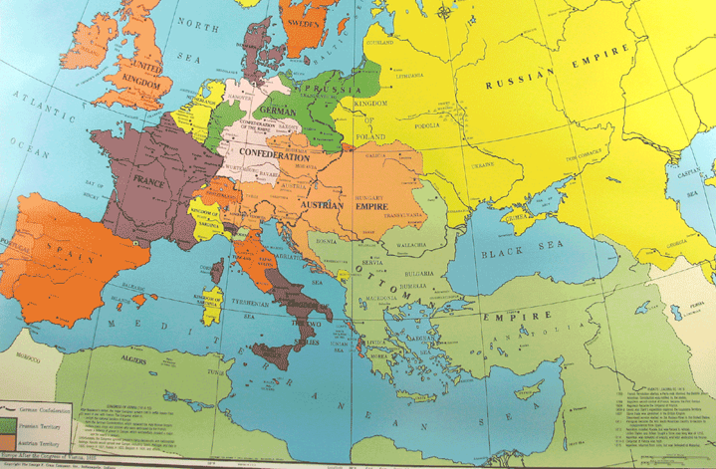
VII. Peace in Europe
A. Congress of Vienna 1815 - the allies redrew map of Europe, & restored the kings who had ruled before Napoleon.
Notes:
After Waterloo, diplomats and heads of state again sat down at the Congress of Vienna. They faced the monumental task of restoring stability and order in Europe after years of revolution and war.
The peacemakers redrew the map of Europe. To contain French ambitions, they ringed France with strong countries. In the north, they added Belgium and Luxembourg to Holland to create the kingdom of the Netherlands. To prevent French expansion eastward, they gave Prussia lands along the Rhine River. They also allowed Austria to reassert control over northern Italy. This policy of containment proved fairly successful in maintaining the peace.
The Congress of Vienna promoted the principle of legitimacy, restoring hereditary monarchies that the French Revolution or Napoleon had unseated. Even before the Congress began, they had put Louis XVIII on the French throne. Later, they restored “legitimate” monarchs in Portugal, Spain, and the Italian states.
They redrew national boundaries without any concern for national cultures. In Germany, they created a loosely organized German Confederation with Austria as its official head. But many Germans who had battled Napoleon were already dreaming of a strong, united German nation.

Slide 7

Notes:
- Passout 03B Napoleon Video Guide.pdf
- click play on video
- Mac users click on black circle
Original links:
https://archive.org/details/napoleon_201909
https://youtu.be/F1OMgrtUqNo
https://vimeo.com/156078112

Slide 8

What was the Napoleonic Code? Why is it important?
Notes:
A law code system that was based on the Enlightenment ideas, such as the equality of all citizens before the law, religious toleration and advancement based on merit or hard work.

Slide 9

What part of today’s lesson is confusing to you?
Notes:
Day 3 Exit Ticket

