Slide 1


PROPAGANDA
Techniques
Used to
Persuade

Slide 2

What is
PROPAGANDA
A message designed to persuade its intended audience to think, believe, or behave in a certain manner.
Sometimes false or misleading, propaganda is often used by mass media & advertising outlets to sway its viewers.

Slide 3



1. BANDWAGON
“Everyone’s using it, so
should you!”
Encouraging people to think or act a certain way because other people are doing it.

Slide 4

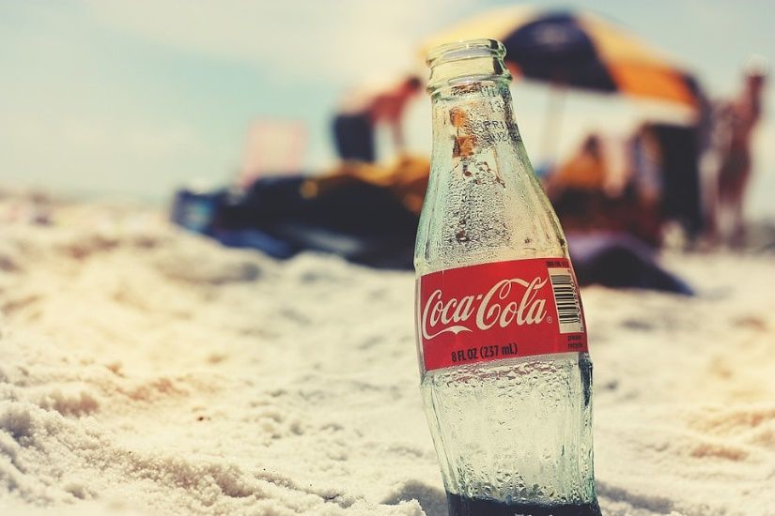
2. TRANSFER
Simm’s
Jewelers
Making a product or idea seem better or worse because it is associated with something that already gives us positive or negative feelings (picturing them together in an ad).
Diamonds for the one you love
Hello
Summer

Slide 5
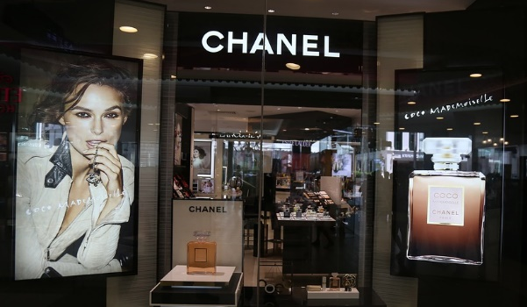

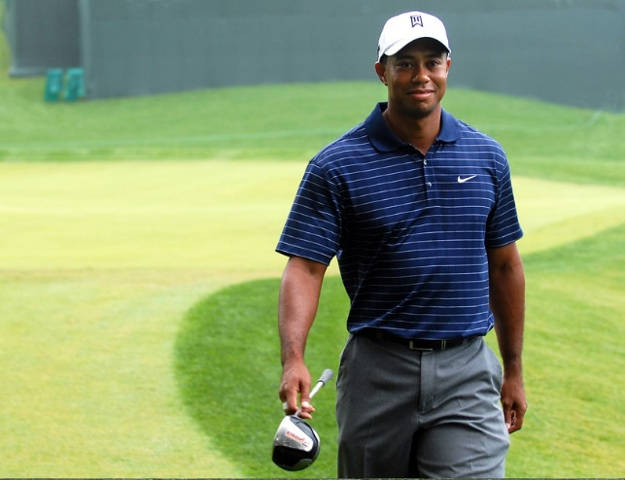

3. TESTIMONIAL
A public figure or celebrity endorses a product or brand.

Slide 6



4. GLITTERING
GENERALITIES
Use of vague words or phrases to evoke powerful emotions (without conveying information).
Links a person or idea to a positive symbol.

Slide 7



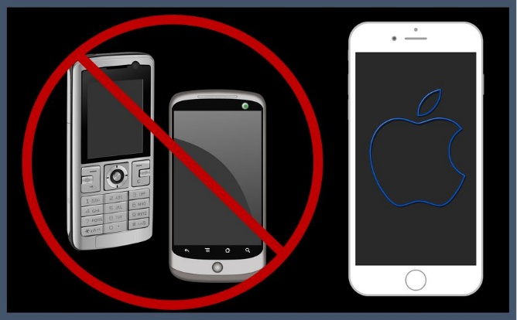
5. NAME-CALLING
Attaching a negative symbol or attribute to the competition in order to create a negative opinion.
The competition

Slide 8
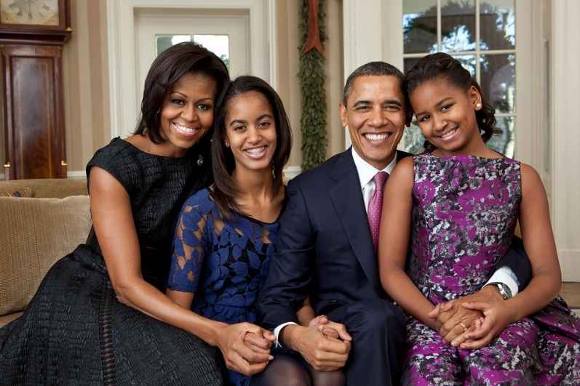

6. PLAIN FOLKS
The speaker presents himself as a regular person (“average Joe”) and can understand the audience’s feelings and concerns.
DeKalb Medical Group
Quality family care is our priority.

Slide 9
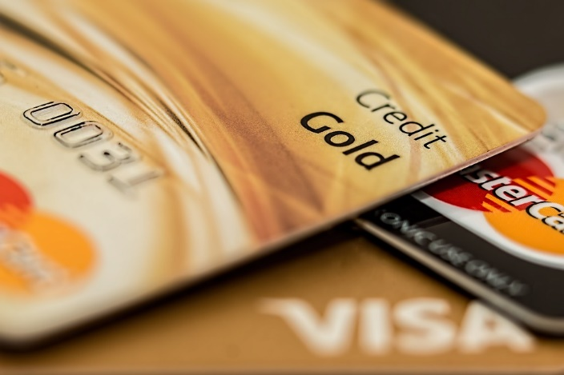
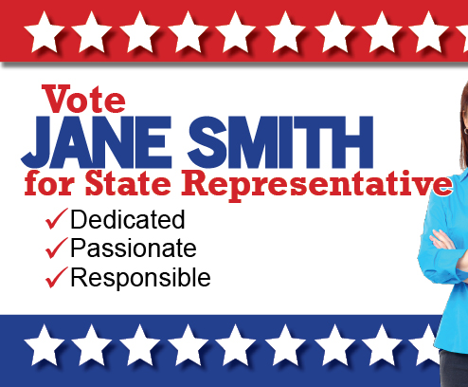
7. CARD STACKING
*0% interest for 18 months
*No limit spending
*Gold status
Manipulating information by omitting facts and presenting only the good information about a product, idea, candidate, etc.
Sally Smith

Slide 10




8. FEAR
Playing on a person’s worst fears; warning that harm or disaster will result if a particular course of action is not followed.

Slide 11
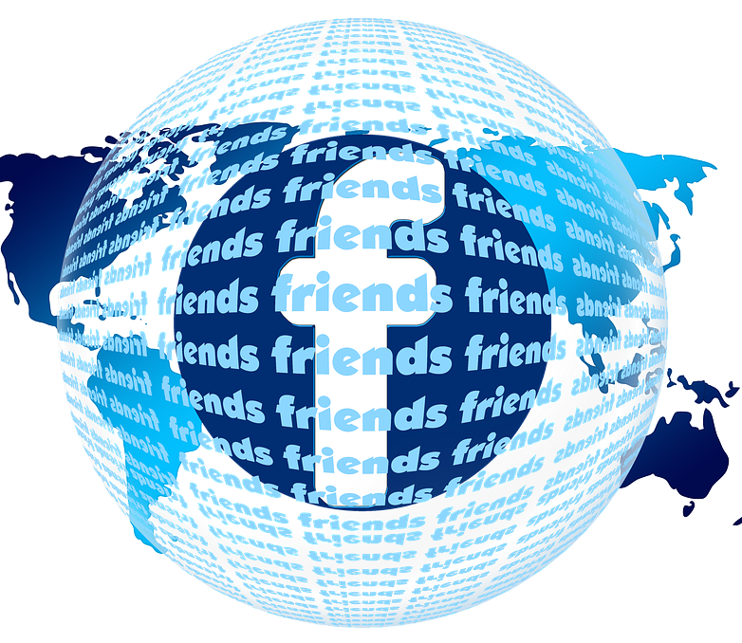

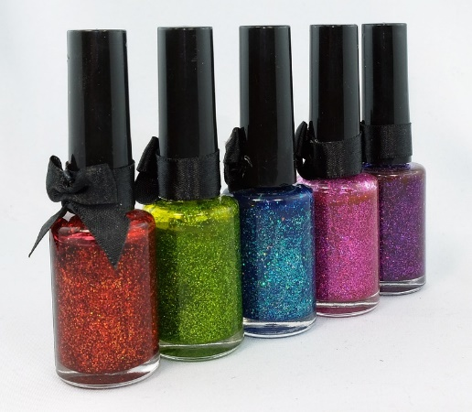
9. REPETITION
Repeating a power statement or word to emphasize or bring attention to the word or statement.
Glitterz
Glitterz
Glitterz
Glitterz
Glitterz
Glitterz

Slide 12
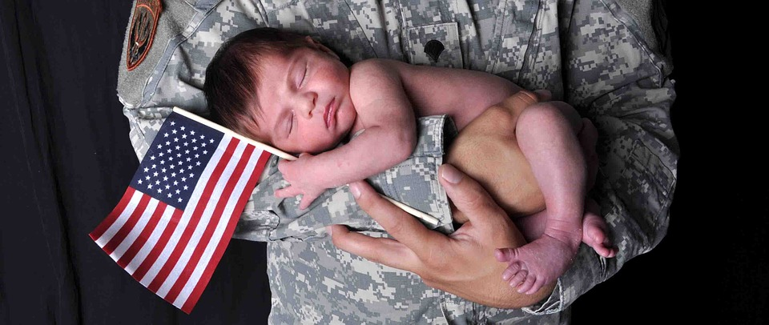
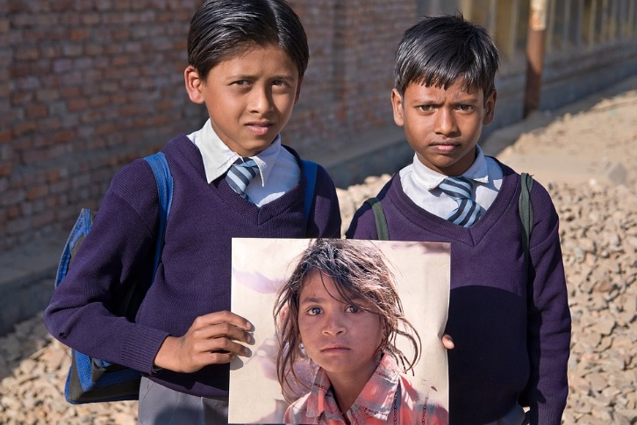

EMOTIONAL APPEAL
Appealing to the
emotions or feelings
of the audience; evoking a
strong positive or negative
attitude toward a person,
group, or idea.
SPCA.ORG

Slide 13

WHO USES PROPAGANDA?
Advertisers
Public speakers
Politicians
Government officials
Where else OR who else have you
seen/heard use propaganda?

