Slide 1
Part 1: Dawn of an Industrial Age

Slide 2
Agriculture Spurs Industry
    In 1750, most people worked the land, using handmade tools
      They lived in simple cottages lit by firelight and candles
        Made their own clothing
        Grew their own food
        Might exchange goods at a weekly outdoor market
    Then, a second agricultural revolution took place that greatly improved the quality and quantity of farm products

Slide 3
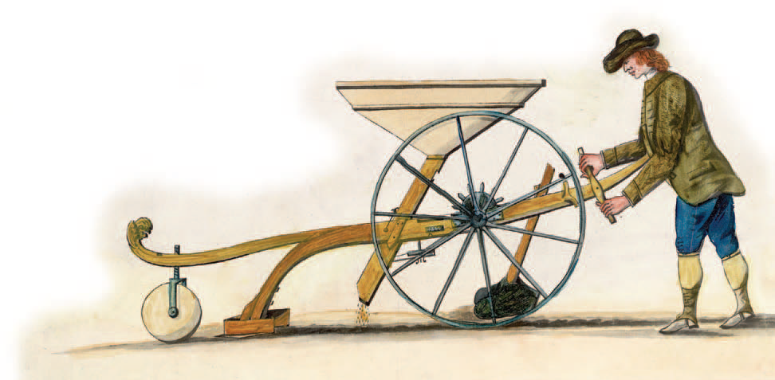
Agriculture Spurs Industry
    Farming Methods Improve
      Jethro Tull invented a new mechanical device, the seed drill, to aid farmers (helped trigger the Industrial Revolution)
        It deposited seeds in rows rather than scattering them wastefully over the land

Slide 4
New Technology Becomes Key
  An Energy Revolution
    During the 1700s, people began to harness new sources of energy
      One power source was coal, used to develop the steam engine
        In 1712, British inventor Thomas Newcomen had developed a steam engine powered by coal to pump water out of mines
          (helped trigger the Industrial Revolution)

Slide 5
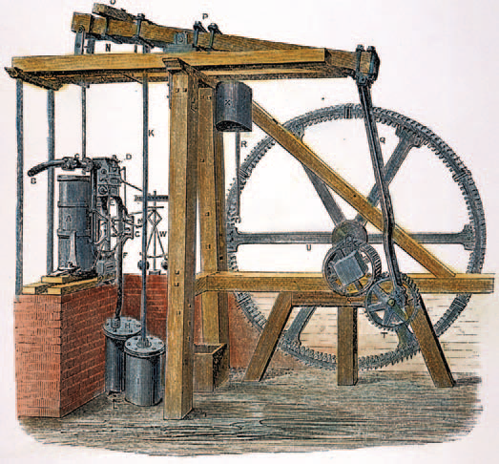
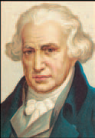
New Technology Becomes Key
      Scottish engineer James Watt looked at Newcomen’s invention in 1764 and set out to make improvements on the engine in order to make it more efficient
        Watt’s engine, after several years of work, would become a key power source of the Industrial Revolution
        The steam engine opened the door not only to operating machinery but eventually to powering locomotives and steamships
          Known as the “Father of the Industrial Revolution”

Slide 6
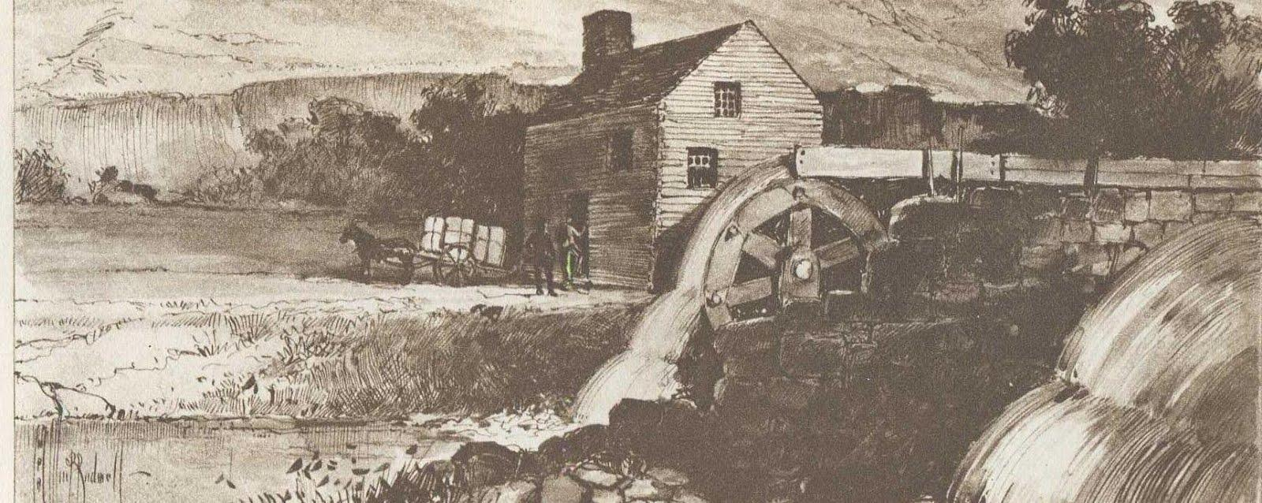
New Technology Becomes Key
      Before long, cotton mills using steam engines were found all over Britain
        Since steam engines were fired by coal, not water, they did not need to be located by rivers

Slide 7
New Technology Becomes Key
  The Quality of Iron Improves
    Coal was a source of fuel in the production of iron
      A material needed for the construction of machines and steam engines
    The Darby family of Coalbrookdale pioneered new methods of producing iron
      In 1709, Abraham Darby used coal instead of charcoal to smelt iron
        Separate iron from its ore
          (helped trigger the Industrial Revolution)

Slide 8
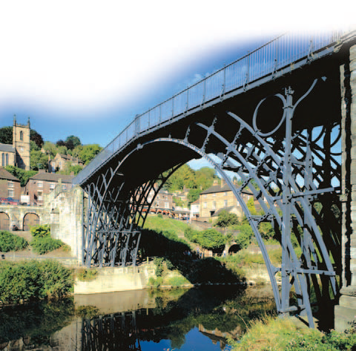
New Technology Becomes Key
    Darby’s experiments led him to produce less expensive and better-quality iron
      Used to produce parts for the steam engines
        Both his son and grandson continued to improve on his methods
        Abraham Darby III built the world’s first iron bridge
    In the decades that followed, high-quality iron was used more and more widely, especially after the world turned to building railroads

Slide 9
Britain Leads the Way
Why Britain?
  The Industrial Revolution began in Great Britain in the 1780’s
    Took several decades to spread to other Western nations
    5 factors contributed to make Great Britain the starting place
      Agrarian revolution
      Increase in population
      Supply of money
      Natural resources
      Vast colonial empire

Slide 10
The Textile Industry Advances
The Textile Industry
  The Industrial Revolution first took hold in Britain’s largest industry—textiles
    In the 1600s, cotton cloth imported from India had become popular
    British merchants tried to organize a cotton cloth industry at home
      They developed the cottage industry
        Raw cotton was distributed to peasant families who spun it into thread and then wove the thread into cloth in their own homes
          Skilled artisans in the towns then finished and dyed the cloth

Slide 11
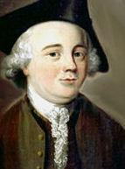
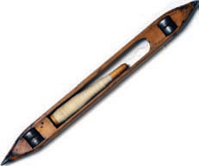
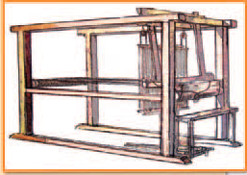
The Textile Industry Advances
  Inventions Speed Production
    Under the cottage industry, production was slow
    As the demand for cloth grew, inventors came up with a string of remarkable devices that revolutionized the British textile industry
      John Kay
        Invented the flying shuttle – 1733
        Enabled weavers to work so fast that they soon outpaced spinners

Slide 12
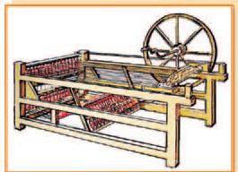
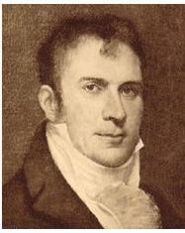
The Textile Industry Advances
      James Hargreaves
        Invented a machine called the spinning jenny – 1764
        Spun many threads at the same time
        Provided more thread so cloth could be produced at a faster rate
        Spinners now produced thread faster than weavers could use it

Slide 13
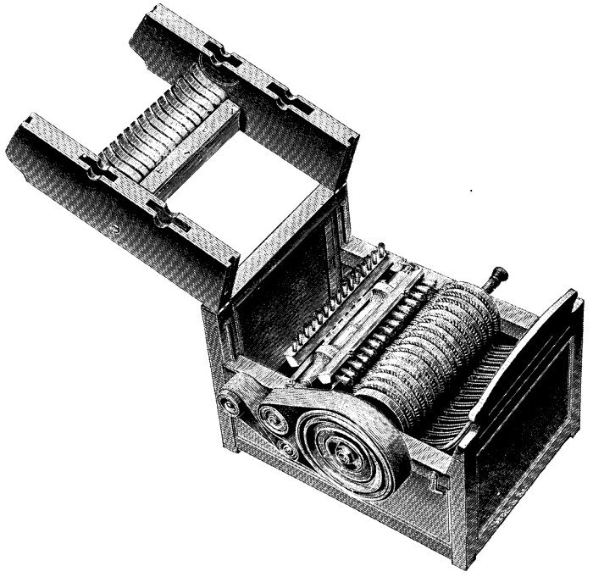
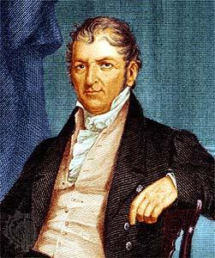
The Textile Industry Advances
      Eli Whitney
        Invented the cotton gin – 1793
        Separated the seeds from the raw cotton at a fast rate
          50 times faster than a human
        Cotton production increased exponentially

Slide 14
The Textile Industry Advances
    Factories Are Born in Britain
      The new machines doomed the cottage industry
        They were too large and expensive to be operated at home
          Instead, manufacturers built long sheds to house the machines
        At first, they located the sheds near rapidly moving streams, harnessing the water power to run the machines
          Later, machines were powered by steam engines
            Will become known as the Factory System

Slide 15
The Transportation Revolution
  Transportation Revolution
    As production increased, entrepreneurs needed faster and cheaper methods of moving goods from place to place

Slide 16
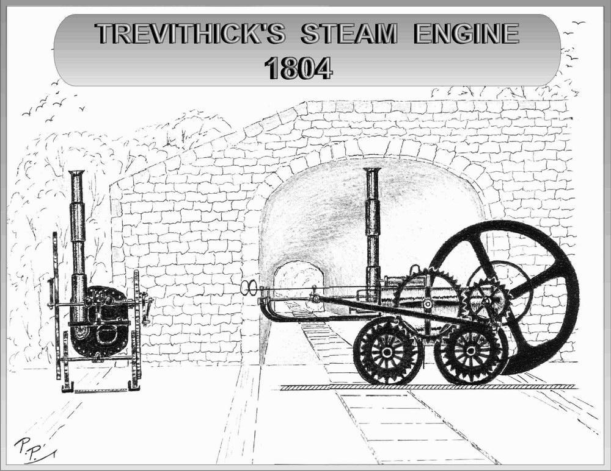
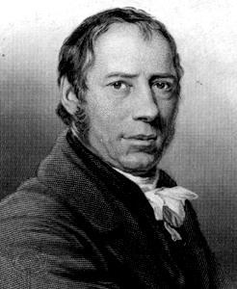
The Transportation Revolution
    Richard Trevithick
      Invented the first steam locomotive – 1804
      Pulled 10 tons of ore and 70 people at 5 mph
        Led to the first real railroad, Stockton & Darlington
        Connected Liverpool to Manchester
      The railroad did not have to follow the course of a river
        Meant that tracks could go places where rivers did not

Slide 17
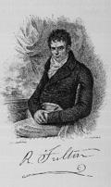
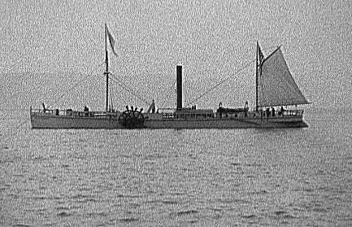
The Transportation Revolution
    Robert Fulton
      Invented the steam boat – 1807
      Attached a steam engine to a ship which propelled it by making a paddle wheel to turn
        Named it the Clermont

