Slide 1
Section 2: Social Impact of the Industrial Revolution

Slide 2
People Move to New Industrial Cities
    For the millions of workers who crowded into the new factories, the industrial age brought poverty and harsh living conditions
    Working people would suffer with:
      Dangerous working conditions
      Unsafe, unsanitary, and overcrowded housing
      Poverty

Slide 3
People Move to New Industrial Cities
  People Move to New Industrial Cities
    The Industrial Revolution brought rapid urbanization, or the movement of people to cities
    What led to urbanization?
      Changes in farming
      Soaring population growth
      Demand for workers

Slide 4
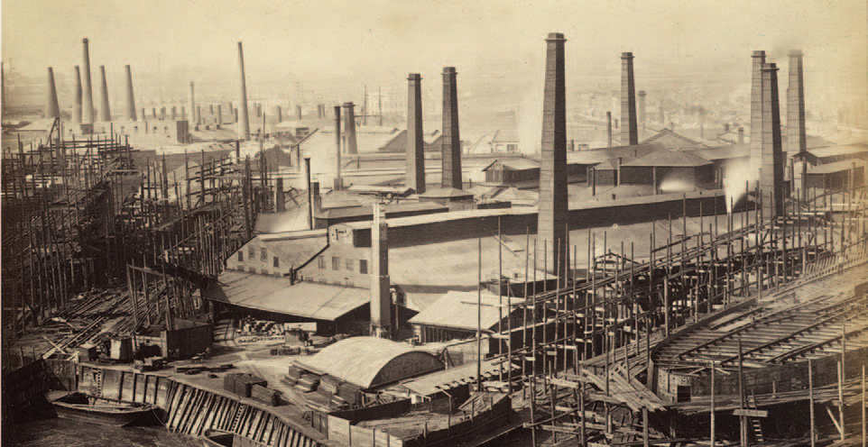
People Move to New Industrial Cities
    Almost overnight, small towns around coal or iron mines mushroomed into cities
    Other cities grew up around the factories that entrepreneurs built in once-quiet market towns

Slide 5
New Social Classes Emerge
    The Industrial Revolution created a new middle class along with the working class
      The Industrial Middle Class
        Those in the middle class owned and operated the new factories, mines, and railroads, among other industries
          Middle-class families lived in well-furnished, spacious homes on paved streets and had a ready supply of water
          They wore fancy clothing and ate well
          Only a few had sympathy for the poor

Slide 6
New Social Classes Emerge
      The Industrial Working Class
        When farm families moved to the new industrial cities, they became workers in mines or factories
          Many felt lost and bewildered
          They faced tough working conditions in uncomfortable environments
        They packed into tiny rooms in tenements, or multistory buildings divided into apartments

Slide 7
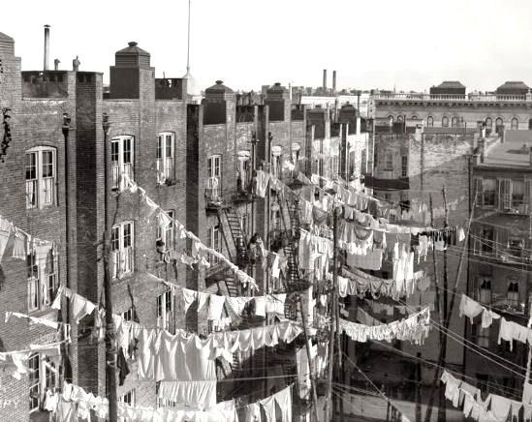
New Social Classes Emerge
        These tenements had no running water, only community pumps
        There was no sewage or sanitation system, so wastes and garbage rotted in the streets
        Sewage was also dumped into rivers, which created an overwhelming stench and contaminated drinking water
          This led to the spread of disease, such as cholera

Slide 8
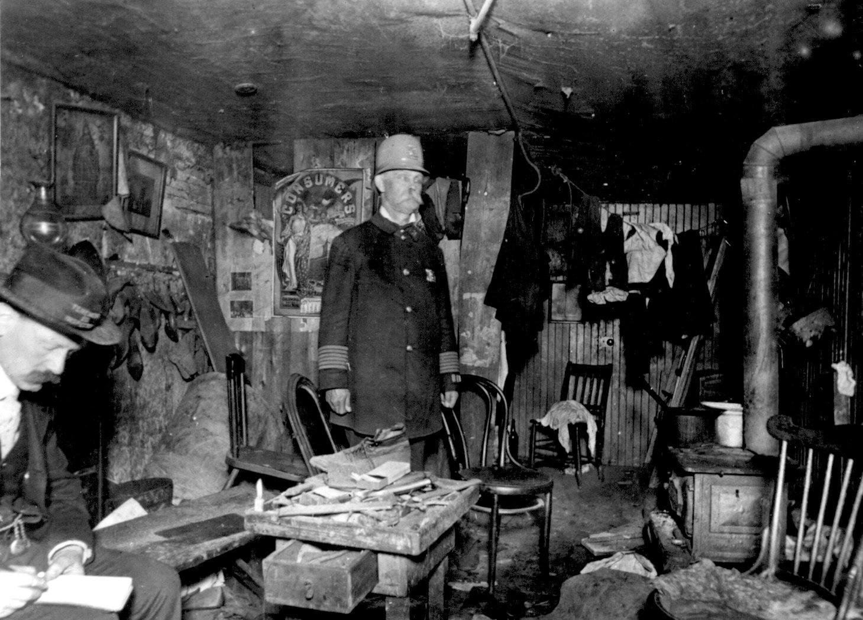
Tenement

Slide 9
Life in Factories and Mines
      Working in a factory system differed greatly from working on a farm
        In rural villages, people worked hard, but their work varied according to the season
        Life was also hard for poor rural workers who were part of the cottage industry, but at least they worked at their own pace
      In the grim factories of industrial towns, workers faced a rigid schedule set by the factory whistle

Slide 10
Life in Factories and Mines
    Working hours were long, with shifts lasting from 12 to 16 hours, six or seven days a week
      Workers could only take breaks when the factory owners gave permission
    Exhausted workers suffered accidents from machines that had no safety devices
      They might lose a finger, a limb, or even their lives
    In textile mills, workers constantly breathed air filled with lint, which damaged their lungs
      Those workers who became sick or injured lost their jobs

Slide 11
Life in Factories and Mines
      Factory work created a double burden for women
        Their new jobs took them out of their homes for 12 hours or more a day
        They then returned to their tenements, which might consist of one damp room with a single bed
          They had to feed and clothe their families, clean, and cope with such problems as sickness and injury

Slide 12
Life in Factories and Mines
  Miners Face Worse Conditions
    The Industrial Revolution increased the demand for iron and coal, which in turn increased the need for miners
      Although miners were paid more, working conditions in the mines were even worse than in the factories
        They worked in darkness, and the coal dust destroyed their lungs
        There were always the dangers of explosions, flooding, and collapsing tunnels
        Women and children carted heavy loads of coal, sometimes on all fours in low passages
        They also climbed ladders carrying heavy baskets of coal several times a day

Slide 13
Life in Factories and Mines
  Children Have Dangerous Jobs
    Factories and mines also hired many boys and girls
    These children often started working at age seven or eight, a few as young as five
    Nimble-fingered and quick-moving, they changed spools in the hot and humid textile mills where sometimes they could not see because of all the dust
    They also crawled under machinery to repair broken threads in the mills

Slide 14
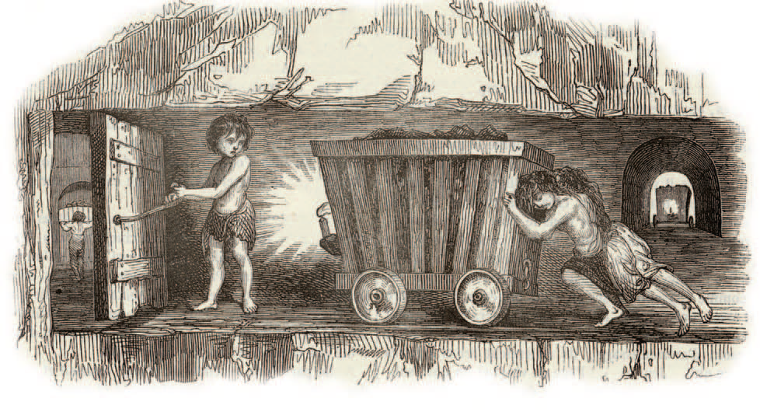
Life in Factories and Mines
    Conditions were even worse for children who worked in the mines
      Some sat all day in the dark, opening and closing air vents
      Others hauled coal carts in the extreme heat
    Because children had helped with work on the farm, parents accepted the idea of child labor
      The wages the children earned were needed to keep their families from starving

Slide 15
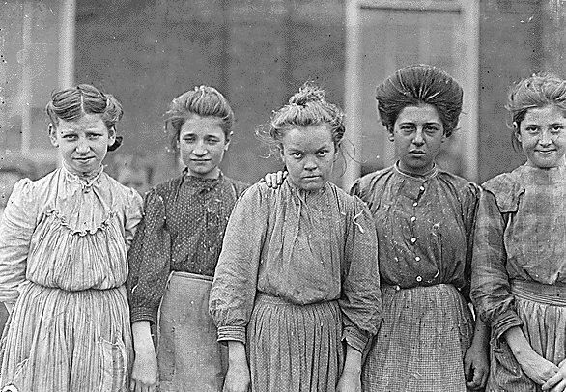
Adolescent girls from Bibb Mfg. Co. in Macon, Georgia

Slide 16
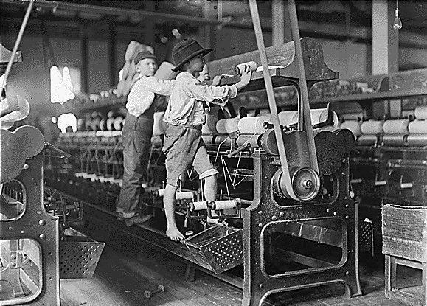
Some boys and girls were so small they had to climb up on to the spinning frame to mend broken threads and to put back the empty bobbins. Bibb Mill No. 1. Macon, Ga.

Slide 17
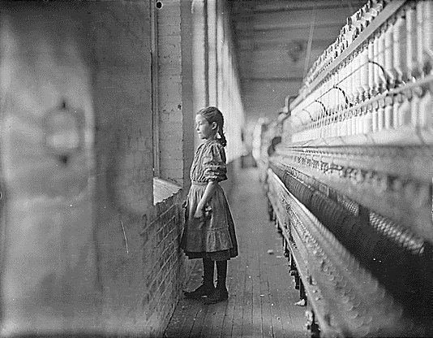
A moments glimpse of the outer world. Said she was 11 years old. Been working over a year. Rhodes Mfg. Co. Lincolnton, N.C.

Slide 18
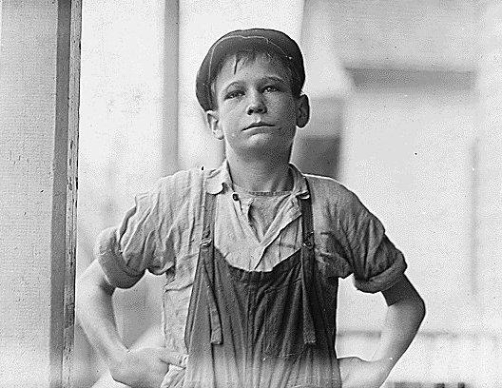
Furman Owens, 12 years old. Can't read. Doesn't know his A,B,C's. Said, "Yes I want to learn but can't when I work all the time." Been in the mills 4 years, 3 years in the Olympia Mill. Columbia, S.C

Slide 19
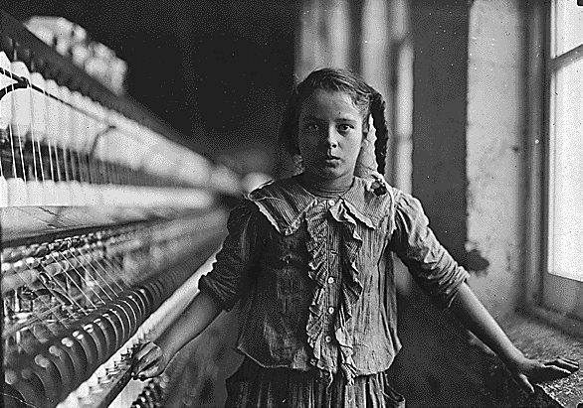
One of the spinners in Whitnel Cotton Mill. She was 51 inches high. Has been in the mill one year. Sometimes works at night. Runs 4 sides - 48 cents a day. When asked how old she was, she hesitated, then said, "I don't remember," then added confidentially, "I'm not old enough to work, but do just the same."

Slide 20
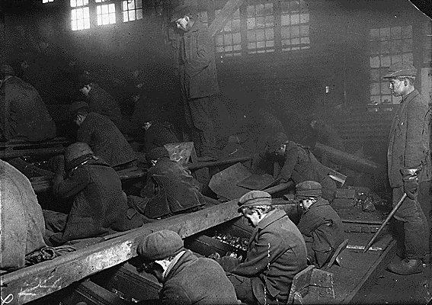
View of the Ewen Breaker of the Pa. Coal Co. The dust was so dense at times as to obscure the view. This dust penetrated the utmost recesses of the boys' lungs. A kind of slave-driver sometimes stands over the boys, prodding or kicking them into obedience. S. Pittston, Pa

Slide 21
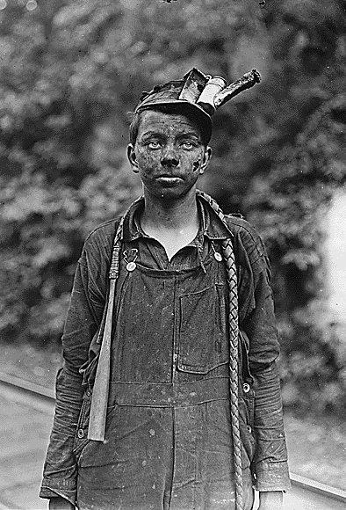
young driver in the Brown mine. Has been driving one year. Works 7 a.m. to 5:30 p.m. daily. Brown W. Va

Slide 22
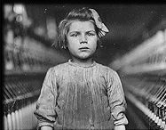
The youngest children in the textile factories were usually employed as scavengers and piecers. Scavengers had to pick up the loose cotton from under the machinery. This was extremely dangerous as the children were expected to carry out the task while the machine was still working.

Slide 23
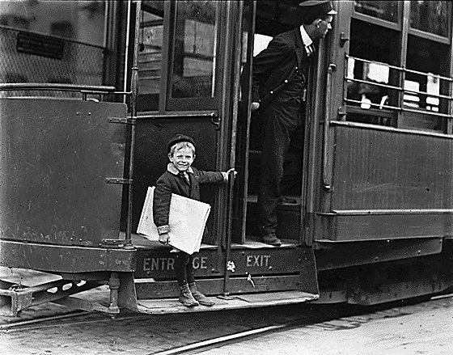
Francis Lance, 5 years old, 41 inches high. He jumps on and off moving trolley cars at the risk of his life. St. Louis, Mo.

Slide 24
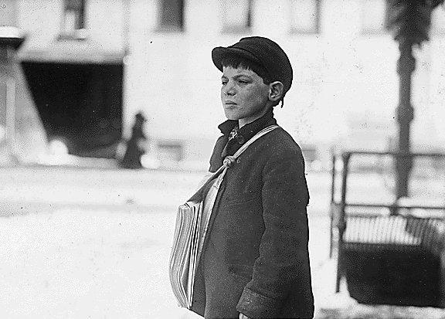
Tony Casale, age 11, been selling 4 years. Sells sometimes until 10 p.m. His paper told me the boy had shown him the marks on his arm where his father had bitten him for not selling more papers. He (the boy) said, "Drunken men say bad words to us." Hartford, Conn.

Slide 25
Life in Factories and Mines
    Child labor reform laws called “factory acts” were passed in the early 1800s
      These laws were passed to reduce a child’s workday to twelve hours and also to remove children under the age of eight or nine from the cotton mills
        Because the laws were generally not enforced, British lawmakers formed teams of inspectors to ensure that factories and mines obeyed the laws in the 1830s and 1840s
        More laws were then passed to shorten the workday for women and require that child workers be educated

Slide 26
The Results of Industrialization
    Since the 1800s, people have debated whether the Industrial Revolution was a blessing or a curse
      The early industrial age brought terrible hardships
      In time, however, reformers pressed for laws to improve working conditions
      Labor unions won the right to bargain with employers for better wages, hours, and working conditions
      Eventually working-class men gained the right to vote, which gave them political power

