Slide 1
Working in Factories

Slide 2
Take up “Industrial Revolution and Great Britain”
1. The development of the machine age in Europe during the 1700s is known as what?
Industrial Revolution
2. List at least 2 reasons as to why the Industrial Revolution began in England/Great Britain
a) Trade overseas made England wealthy
b) Gained control of oversea colonies
3. What did the shortage of wood lead to?
Led to an increased reliance on coal as a fuel

Slide 3
4. What challenge did the miners face in the mines during this time?
Water Seepage
5. What led to the invention of the steam powered pump?
Flooding of coal mines
6. What is “coke” and what was it used for?
A hard, grayish material produced by heating soft coal in an airtight oven; fuel for smelting iron
7. Why were textile machines being invented at this time?
To replace the old system of cloth production

Slide 4
8. What new material was introduced to England and eventually the United States?
Cotton
9. What is known as the “putting out system?
Cottage Industry
10. What led to the development of the “factory system?
The drive to improve and increase cloth production was, therefore, pursued on two fronts- to build faster, more efficient machinery and to rehouse production- not in private homes, but in larger facilities.

Slide 5
Factory simulation
This activity is a great hands-on way to illustrate the difference between the old cottage industry of Great Britain and the new factory system that developed during the Industrial Revolution. Students will “work” to create a notepad that they can actually use and take home. First, we will see how the Cottage Industry system works, and then we will compare it to the factory system.

Slide 6
Cottage Industry
Materials for Cottage Industry Group:
5 Sheets of paper per person
1 pair of scissors
1 ruler
2 writing utensil
1 Stapler (they can all share)
Instructions for Cottage Industry Group:
Each person receives 5 pieces of paper that they are then to cut into 4 equal parts (giving them 20 total), write logos on each piece of paper, stack, and then staple. They have the full 10 minutes to create a perfect notepad. Quality is the goal for this group.

Slide 7
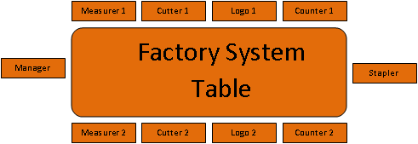
Factory system
Join up with your assigned partner table and await instructions

Slide 8
Factory system
Materials for Factory System
50 sheets of paper
2 pairs of scissors
2 rulers
4 writing utensils
1 Stapler
Instruction for Factory System Group:
The Manager starts off by handing a piece of paper to each Measurer. The Measurer, with a ruler, measures and draws lines dividing the piece of paper into four (4) equal parts. The Measurer passes the paper to the Cutter. The Cutter cuts the paper along the lines and passes the paper to the Logo Maker. The Logo Maker writes a “WH” (World History) on the top center of each piece of paper and passes the paper to the Counter. The Counter counts 20 sheets, stacks them, and passes them to the Stapler. The Stapler will straighten the stack and staple it twice at the top edge. When finished, the Stapler will put the finished product in a nice pile.
Once the Manager has finished handing out the paper, they are free to wander around the table helping anyone who may need it.
The group has 10 minutes to complete this task. 50 sheets of paper will create exactly 10 notepads with 20 pieces of paper in each notepad.
Quantity and quality control are the goals for this group.

Slide 9
Working Conditions
Complete “working conditions” as a table using the primary sources provided.

Slide 10
Document A: Miner Betty Harris, 37, gave testimony to an 1842 Royal Commission investigating conditions in British Mines
I was married at 23, and went into a colliery [coal mine and its connected buildings] when I was married. I can neither read nor write…I am a drawer [worker who pulled coal tubs in a mine; tubs were attached to the drawer’s belt with a chain], and work from 6 in the morning to 6 at night. Stop about an hour at noon to eat my dinner; have bread and butter for dinner; I get no drink…
I have a belt around my waist, and a chain passing between my legs, and I go on my hands and feet. The road is very steep, and we have to hold by a rope; and when there is no rope, by anything we can catch hold of. There are six women and about six boys and girls in the pit I work in; it is very hard work for a woman. The pit is very wet where I work, and the water comes over our clog-tops always, and I have seen it up to my thighs; it rains in at the roof terribly. My clothes are wet through almost all day long…
My cousin looks after my children in the day time. I am very tired when I get home at night; I fall asleep sometimes before I get washed…the belt and chain is worse when we are in the family way [pregnant]. My feller (husband) has beaten me many a times for not being ready.

Slide 11
Document B: German socialist Friedrich Engels, co-founder of Marxism, described industrial Manchester in his book, The Condition of the Working-Class in England in 1844
The first court below Ducie Bridge…was in such a state at the time of the cholera that the sanitary police ordered it evacuated, swept, and disinfected with chloride of lime [bleaching powder]…At the bottom flows, or rather stagnates, the Irk, a narrow, coal-black, foul smelling stream, full of debris and refuse, which it deposits on the shallower right bank…
Above the bridge are tanneries [buildings where skins and hides are tanned], bone mills [mills that convert animal bones into fertilizer] and gasworks, from which all drains and refuse find their way into the Irk, which receives further the contents of all the neighboring sewers and privies [outhouses]…Below the bridge you look upon the piles of debris, the refuse, the filth, and offal from the courts on the steep left bank; here each house is packed close behind its neighbor and a piece of each is visible, all black, smoky, crumbling, ancient, with broken panes and window frames…
Such is the Old Town of Manchester…in defiance of all considerations of cleanliness, ventilation, and health which characterize the construction of this single district, containing at least twenty to thirty thousand inhabitants.

Slide 12
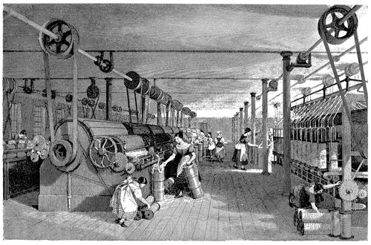
Document C: The picture on the right is a print of a cotton mill that appears in the book History of the Cotton Manufacture in Great Britain (London, 1835), by Edward Baines. The image shows the belts that connected the machines to a pulley system. A steam engine rotated the wheels on the shaft to power the machines. Note how close the female workers’ hands, hair, and clothing are to the rotating gears.

