Slide 2
Section 3: New Ways of Thinking

Slide 3
Socialist Thought Emerges
  The transition to an industrialized society was very hard on workers
    It made their lives difficult and forced them to live in crowded slums
    They had to work long hours at mind-numbing tasks
  Reformers of this era believed that industrial capitalism was heartless and brutal
      They wanted a new kind of society
    Moderates
      Wanted gradual changes such as fewer hours, better benefits and safe working conditions
    Radicals
      Wanted to abolish the capitalist system entirely

Slide 4
Socialist Thought Emerges
  To end poverty and injustice, they offered a radical solution
    Socialism
      The people as a whole rather than private individuals would own and operate the means of production
        Factories, farms, railways, and other large businesses that produced and distributed goods

Slide 5
Socialist Thought Emerges
  Robert Owen
    He believed there was a way he could change society for the better
    These early socialists were called Utopians
      Implied that they were impractical dreamers
    Owen set up his cotton mill in New Lanark, Scotland, as a model village
      Reduced working hours from 17 to 10
      Built homes for workers
      Started a school for children
      Opened a company store where workers could buy food and clothes
    Proved that employers could offer decent living and working conditions and still run a profitable business

Slide 6
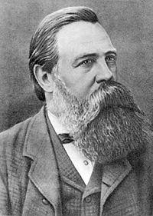
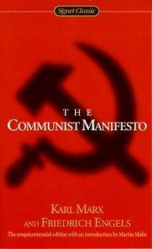
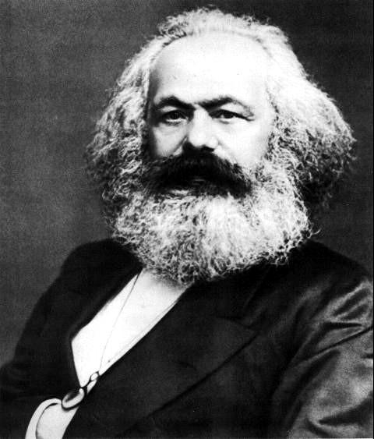
Socialist Thought Emerges
  Karl Marx
    German Philosopher
      Condemned the ideas of the Utopians as unrealistic idealism
    Teamed up with another German socialist, Friedrich Engels, whose father owned a textile factory in England
      Marx and Engels wrote a pamphlet, The Communist Manifesto, published in 1848

Slide 7
Socialist Thought Emerges
  Communism
    A form of socialism in which an inevitable struggle between social classes would lead to the creation of a classless society where all means of production would be owned by the community
      Karl Marx theorized that economics was the driving force in history
      Argued that there was “the history of class struggles” between the “haves” and the “have-nots”
        The “haves” have always owned the means of production and thus controlled society and all it’s wealth
      In industrialized Europe, Marx said, the “haves” were the bourgeoisie
      The “have-nots” were the proletariat
        Working class

Slide 8
Socialist Thought Emerges
    According to Marx, the modern class struggle pitted the bourgeoisie against the proletariat
    In the end, he predicted the proletariat would be triumphant
      Workers would take control of the means of production and set up a classless, communist society
        Such a society would mark the end of the struggles people had endured throughout history, because wealth and power would be equally shared
    Marx hated capitalism
      Believed it created prosperity for only a few and poverty for many
        He called for an international struggle to bring about its downfall
          “Workers of all countries, unite!”

Slide 9
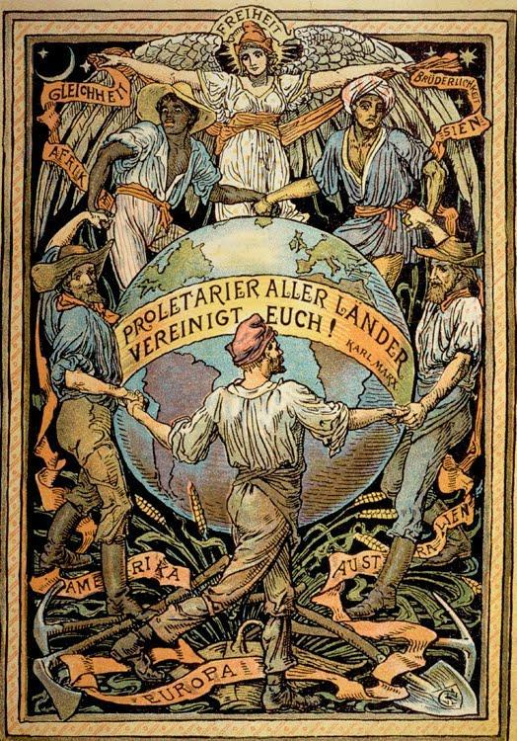

Slide 10
Marx’s Theories
  History did not go by Marx’s plan
    Why didn’t Karl Marx’s ideas take hold?
      Workers could buy more
      Workers gained the right to vote and used it to correct the problems of society
      Remained loyal to their nations rather than ally with workers in other countries to promote revolution

