Slide 1
Section 5: New Science and Ideas

Slide 2
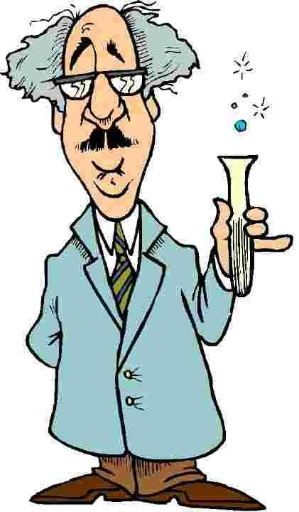
New Science and Ideas
During the 1800’s and early 1900’s, scientific discoveries were beginning to unravel some mysteries

Slide 3
Science Takes New Directions
Debating the Earth’s Age
    The new science of geology opened avenues of debate
  Charles Lyell
    Wrote Principles of Geology
      Offered evidence to show that Earth had formed over millions of years
    His successors concluded that Earth was at least two billion years old and that life didn’t appear until long after earth was forced
      These ideas did not seem to agree with biblical accounts of creation

Slide 4
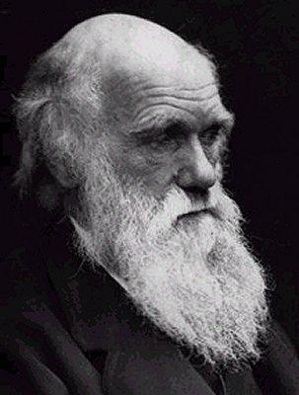
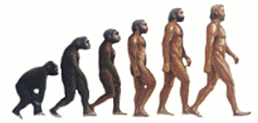
Science Takes New Directions
  Charles Darwin
    Published On the Origin of Species
      Argued that all forms of life, including human beings, had evolved into their present state over millions of years
      To explain the long, slow process of evolution, he put forward the theory of natural selection
        Natural forces “selected” those with physical traits best adapted to their environment to survive and to pass the trait on to their offspring
          Became known as “survival of the fittest”

Slide 5

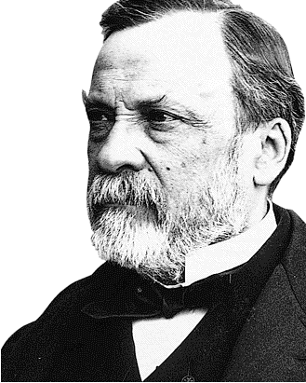
Science Takes New Directions
The Fight Against Disease
  Louis Pasteur
    In 1870, clearly showed the link between microbes and disease
    Went on to develop of vaccines against rabies and anthrax
    Discovered a process called pasteurization that killed disease-carrying microbes in milk

Slide 6
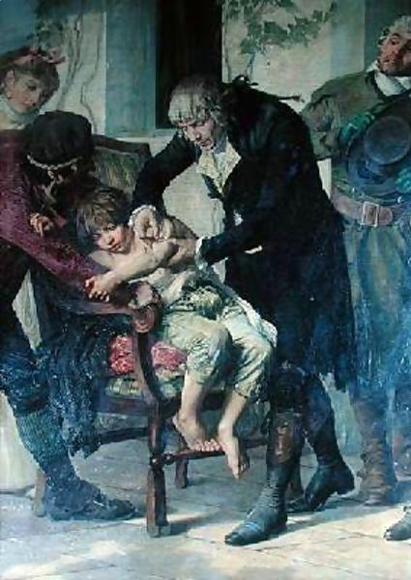
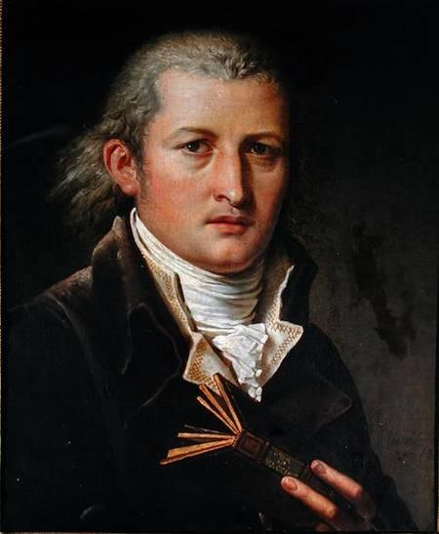
Science Takes New Directions
  Edward Jenner
    Discovered the Smallpox vaccination
    Used a small boy as an experiment

Slide 7
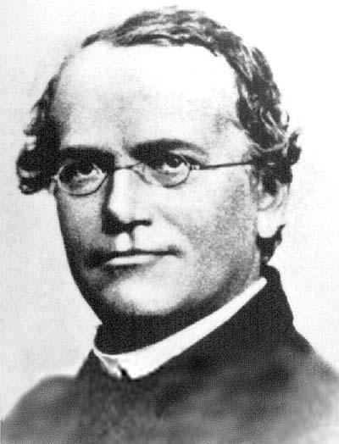
Science Takes New Directions
Gregor Mendel
  Experimented with pea plants
  Concluded that characteristics are passed from one generation to the next by tiny particles called genes
  His work became the basis for genetics
    The science of heredity

Slide 8
Social Sciences
  Other scientists used the scientific method to study human behavior
    Sociology – the study of human behavior in groups
    Psychology – the science of human behavior in individuals

Slide 9
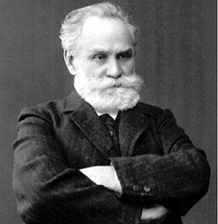
Social Sciences
Ivan Pavlov
  Believed that human actions were unconscious reactions to stimuli and could be changed by training
  Pavlov’s bell

Slide 10
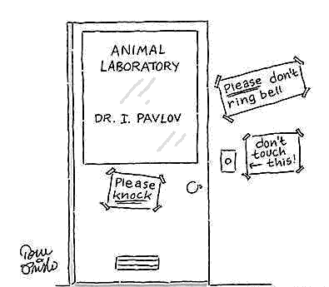

Slide 11
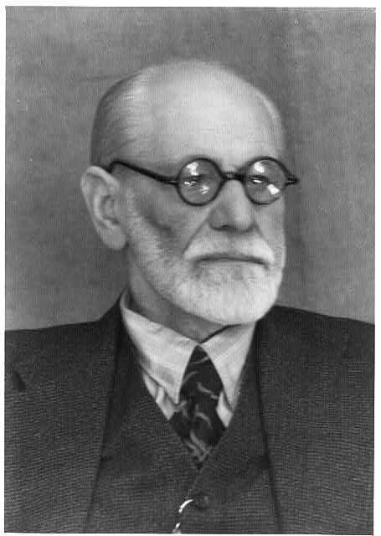
Social Sciences
Sigmund Freud
  Held that an unconscious part of the mind governs human behavior
    Led to psychoanalysis, a method of treatment to discover people’s motives

