Slide 1
Section 4: The Industrial Revolution Spreads

Slide 2
New Industrial Powers Emerge
    The first phase of industrialization had largely been forged from iron, powered by steam engines, and driven by the British textile industry
      By the mid-1800s, the Industrial Revolution entered a second phase
        New industrial powers emerged
        Factories powered by electricity used innovative processes to turn out new products
        As the twentieth century dawned, this second Industrial Revolution transformed the economies of the Western world

Slide 3
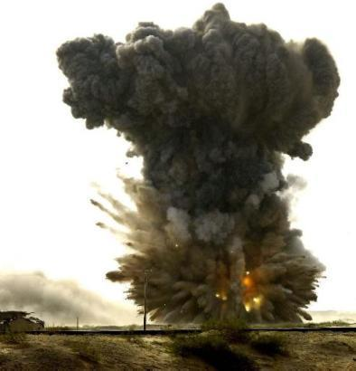
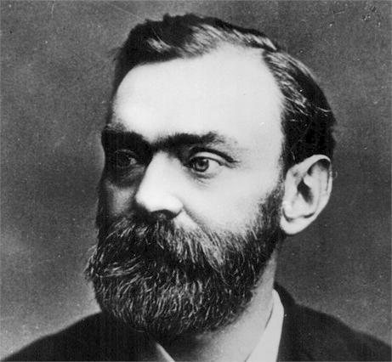
Technology Sparks Industrial Growth
  Alfred Nobel
    Invented dynamite in 1866
      An explosive much safer than others to use at the time
      Widely used in construction and, to Nobel’s dismay, in warfare
        Earned Nobel a huge fortune
        He willed to fund the famous Nobel prizes that are still awarded today

Slide 4
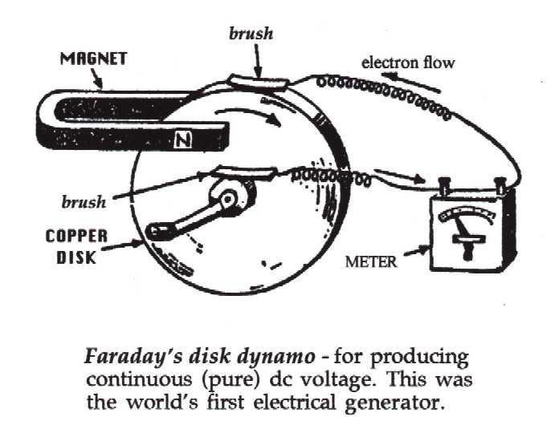
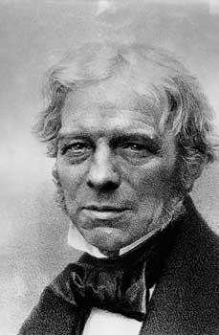
Technology Sparks Industrial Growth
    In the late 1800s, a new power source – electricity – replaced steam as the dominant source of industrial power
  Michael Faraday
    Created the first simple electric motor and the first dynamo
      A machine that generates electricity
        Today, all electrical generators and transformers work on the principle of Faraday’s dynamo

Slide 5
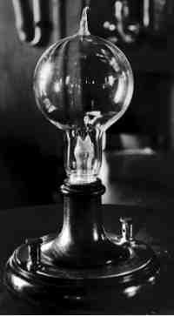
Technology Sparks Industrial Growth
  Thomas Alva Edison
    Made the first electric light bulb
      Soon, Edison’s “incandescent lamps: illuminated whole cities
      The pace of city life quickened, and factories could continue to operate after dark
    By the 1890s, cables carried electrical power from dynamos to factories
    By the time he died, Edison held more than a thousand patents

Slide 6
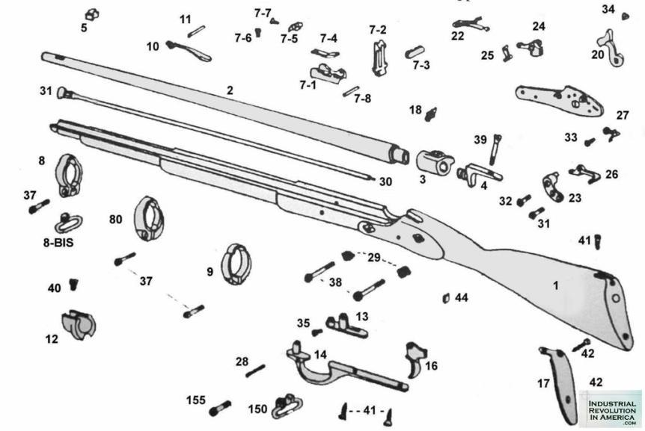
Technology Sparks Industrial Growth
New Methods of Production
    The basic features of the factory system remained the same during the 1800s
    Factories still used large numbers of workers and power-driven machines to mass-produce goods
  Interchangeable Parts
    To improve efficiency, manufacturers designed products with identical components that could be used in place of one another
      Interchangeable parts simplified both the assemble and repair of products

Slide 7
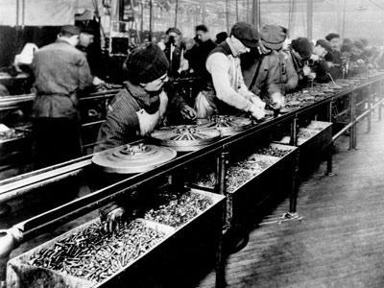
Technology Sparks Industrial Growth
      Assembly Line
        Workers on an assembly line add parts to a product that moves along a belt from one workstation to the next
        A different person performs each task along the assembly line
        This division of labor made production faster and more cheaper, lowering the price of goods
        Also took much of the joy out of the work itself

Slide 8
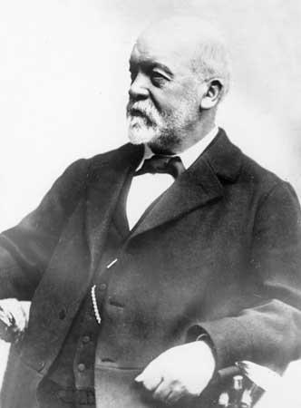
Transportation and Communication
The Automobile Age Begins
  Nikolaus Otto
    Invented a gasoline-powered internal combustion engine
  Karl Benz - 1886
    Received a patent for the first automobile, which had three wheels
  Gottlieb Daimler
    Introduced the first four-wheeled automobile
      People laughed at the horseless carriages, but they quickly transformed transportation

Slide 9
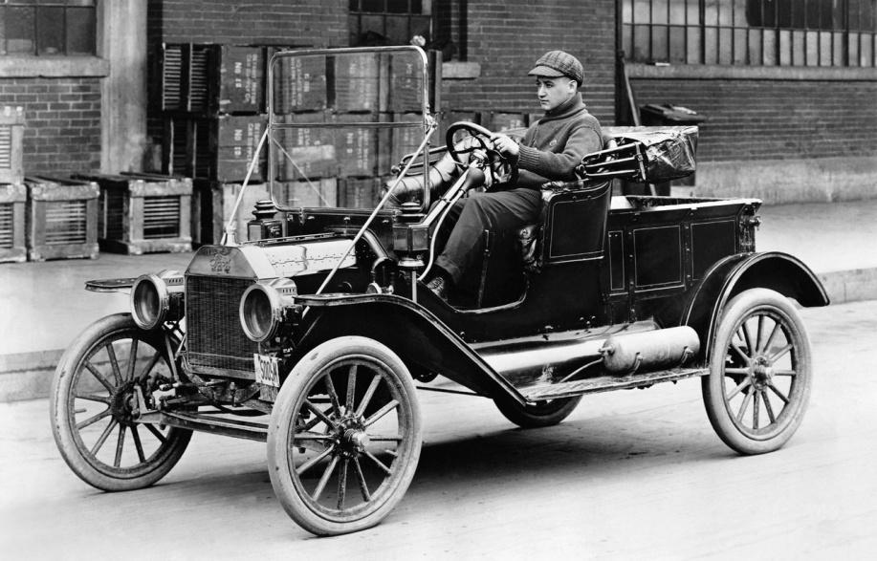
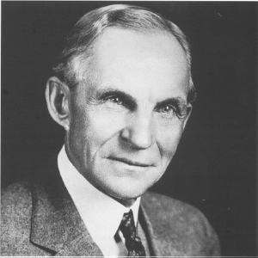
Transportation and Communication
  Henry Ford
    Started making automobiles that reached the breathtaking speed of 25 mph
    In the early 1900s, Ford began using the assembly line to mass-produce cars
    Made famous by his Model T automobile
      Made the US a leader in the automobile industry
      $5 dollar days

Slide 10
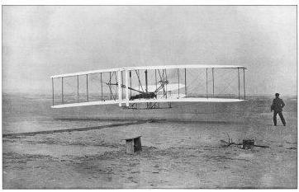
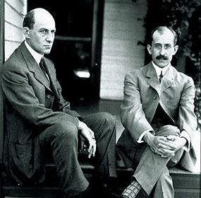
Transportation and Communication
Humans Take Flight
    The internal combustion engine powered more than cars
    Made possible the sustained, pilot controlled flight
  Orville and Wilbur Wright
    Designed and flew a flimsy airplane at Kitty Hawk, NC
    Although their flying machine stayed in flight only a few seconds, it ushered in the air age

Slide 11
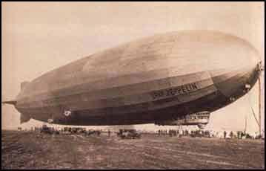
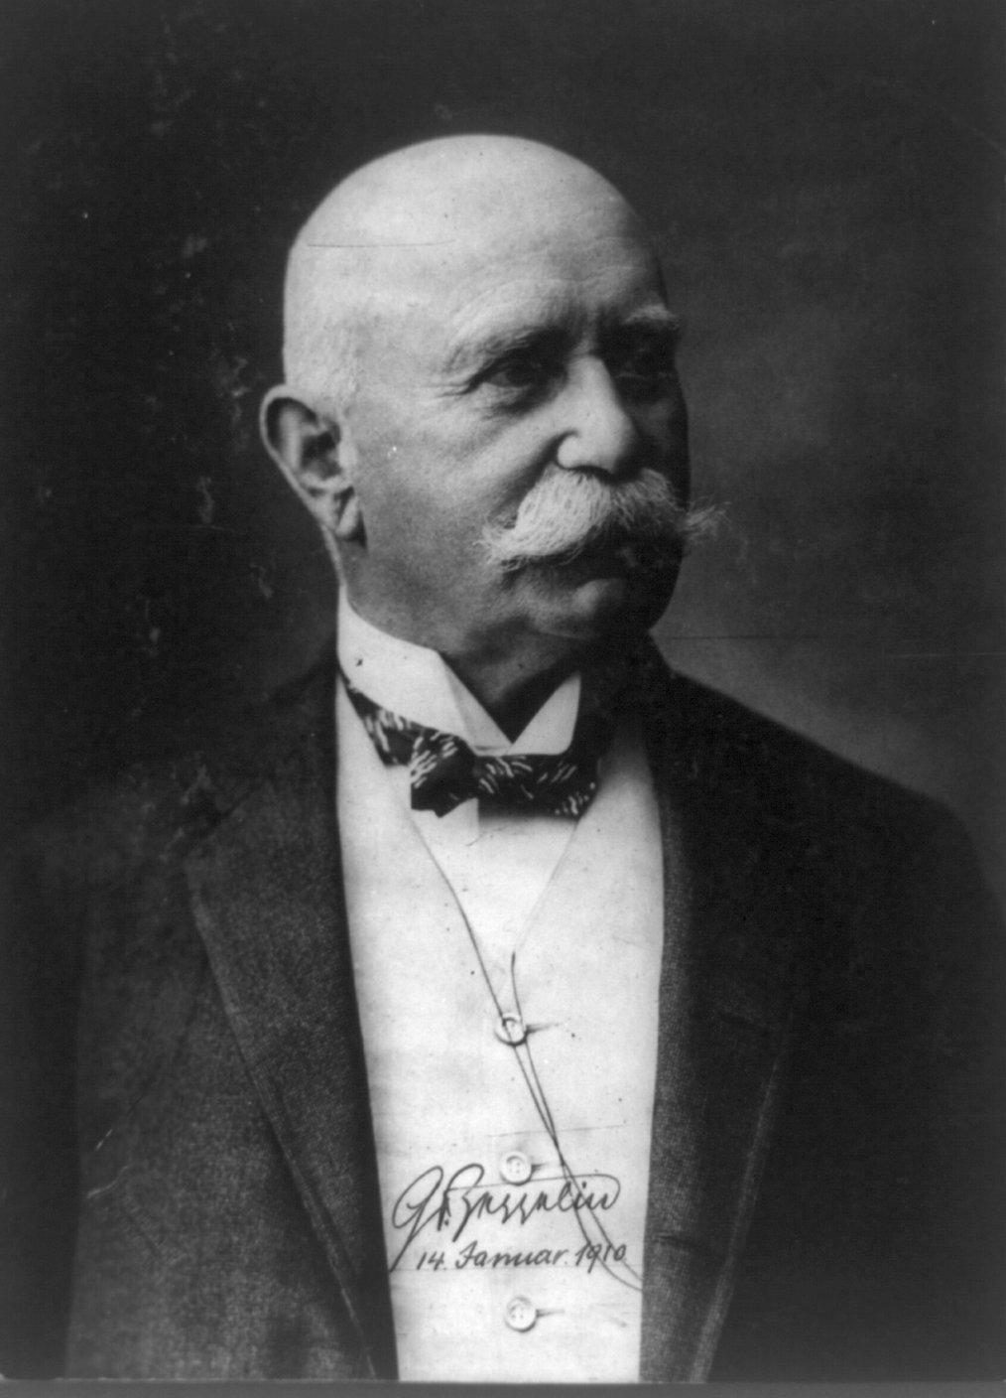
Transportation and Communication
  Ferdinand von Zeppelin
    Inventor of the rigid airship, or dirigible balloon known as a Zeppelin

Slide 12
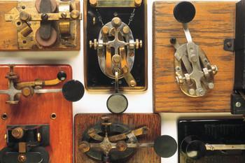
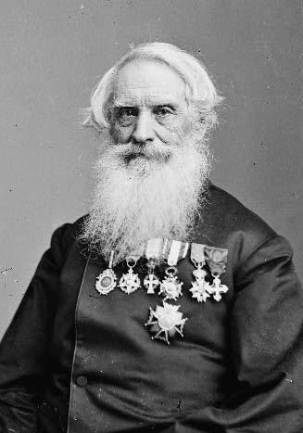
Transportation and Communication
Rapid Communication
    A revolution in communications also made the world smaller
  Samuel F.B. Morse
    Developed the telegraph – 1832
      Could send coded messages over the wires by means of electricity
      First words out of the telegraph – “What hath God wrought?”
    In 1848, a group of newspapers pooled their resources to collect and share news over the telegraph
    This organization was the Associated Press

Slide 13
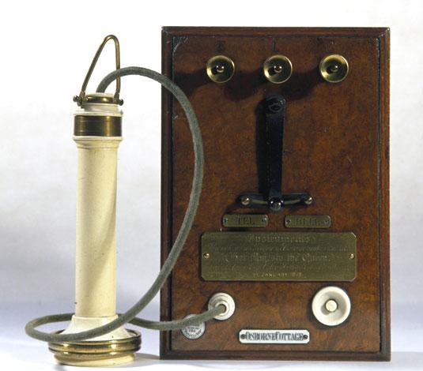
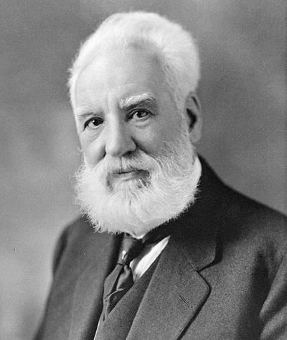
Transportation and Communication
  Alexander Graham Bell
      Invented the telephone – 1876
    Not coast to coast until 1915
      Very slow and expensive

Slide 14
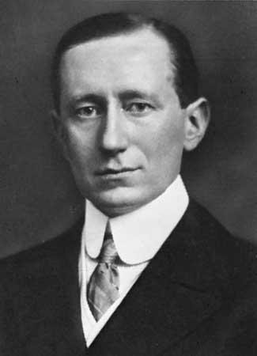
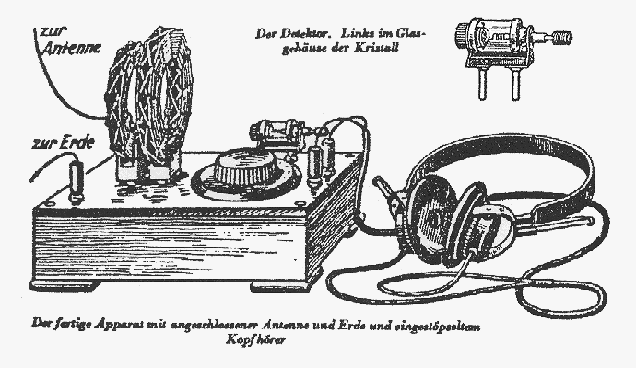
Transportation and Communication
  Guglielmo Marconi
    Invented the radio – 1901
    Sent the first radio waves across the Atlantic
    Radio would become a cornerstone of today’s global communications network

