Slide 2
Take up LTN webquest

Slide 3
Think/Pair/Share
Discuss what you know about the land we are on right now.
Describe a place that is important to you.
Why is this place important to you?
What do you know about Indigneous people’s relationship with the land?
What is a treaty?
Have you heard the word “reconciliation” before? What does it mean in a Canadian context?

Slide 4
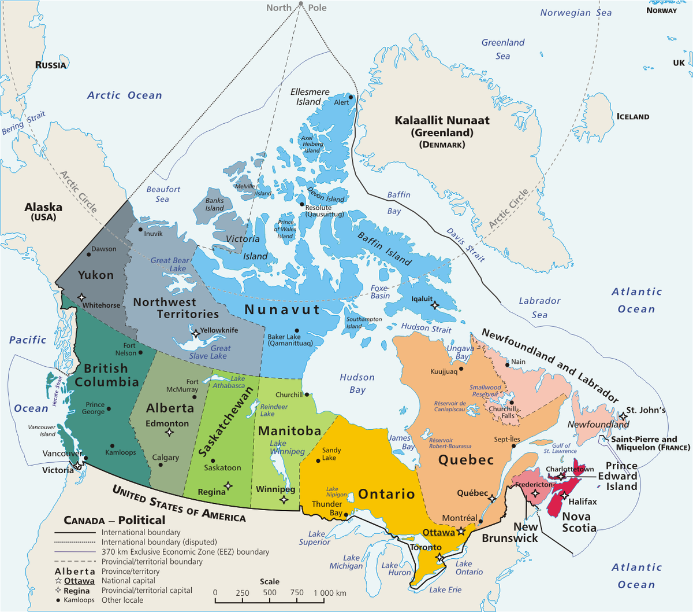
What do you notice about this map?
What information does it give us?
What features does it show?

Slide 5
Native-land.ca
What do you notice about this map?
What information does it give us?
What features does it show?

Slide 6
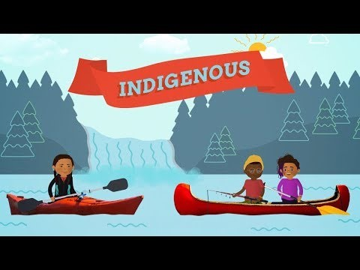
Words matter
First Nations
Metis
Inuit
Indigenous
Nation Specific terms (Lheidli T’enneh, Cree,
Haudenosaunee)

Slide 7
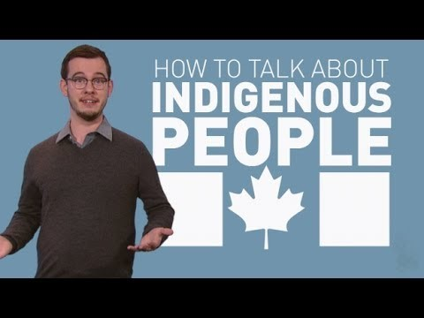
Words matter
First Nations
Metis
Inuit
Indigenous
Nation Specific terms (Lheidli T’enneh, Cree,
Haudenosaunee)

Slide 8
Source Activities
Use the primary and secondary sources to answer questions 1 through 6.
We will be taking up 1-3 in 25 minutes, and taking up 4 – 6 at 11:00am.

