Slide 1
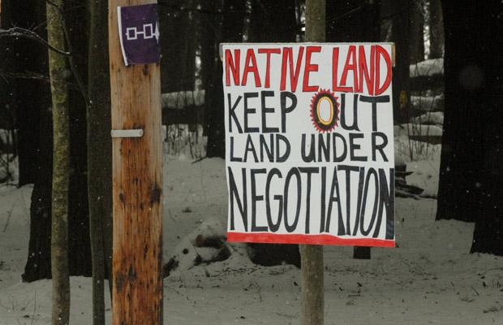
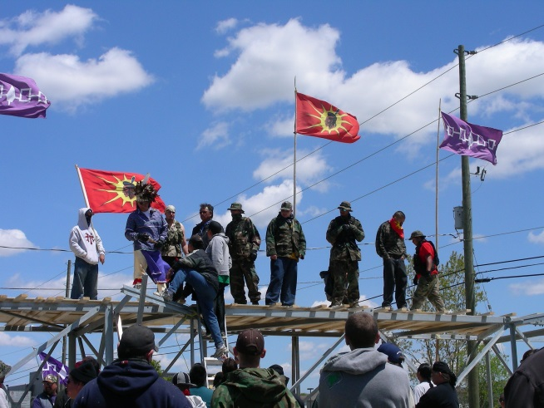
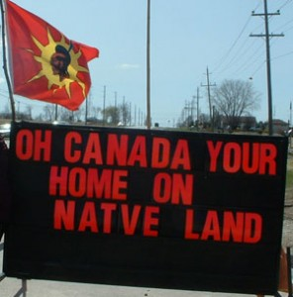
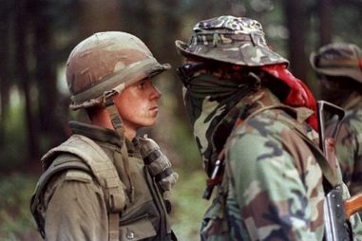
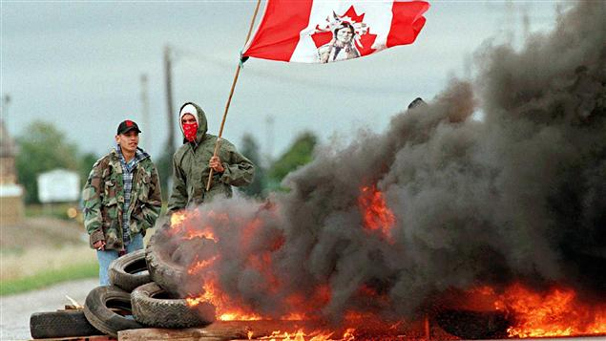
Indigenous Land Claims
- Oka, Ipperwash, & Caledonia -

Slide 2
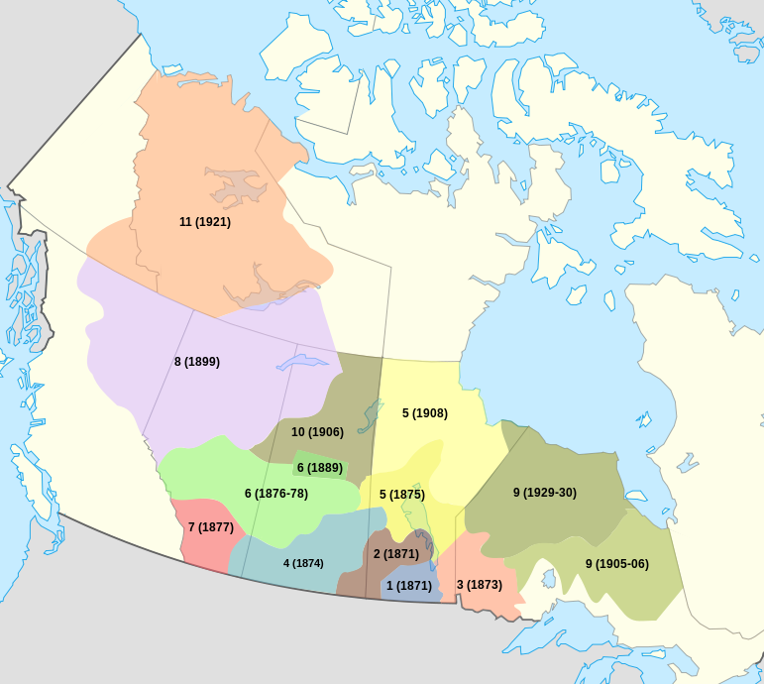
Background:
When the numbered treaties were signed, there were misunderstandings due to language barriers and some of the oral promises made by the government were not honoured
In 1973, the Supreme Court of Canada ruled that Indigenous who had not signed treaties still had some claim to traditional land
In response, Ottawa created an office to deal with Indigneous land claims

Slide 3
Types of Land Claims:
There are two types of land claims that Indigenous groups can file, depending on whether they signed a treaty with the government:
Specific claims can be made when a treaty exists, but Indigenous Nations feel the government (federal or provincial) has violated treaty rights
Comprehensive claims can be made in areas were treaties were not signed

Slide 4
The Land Claim Process
If for any reason the federal government decides a land claim is not valid, the claims process ends without the possibility of appeal (except through the courts)
If the process reaches the negotiation stage, the federal government still controls the pace of negotiation
In successful land claims, the parties usually agree to transfers of specified amounts of cash and land from the government to Indigneous communities

Slide 5
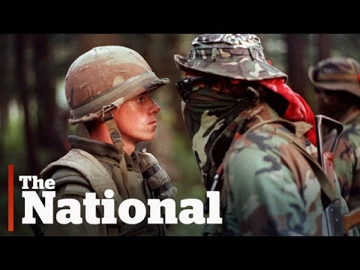
VIDEO: Oka Crisis

Slide 6
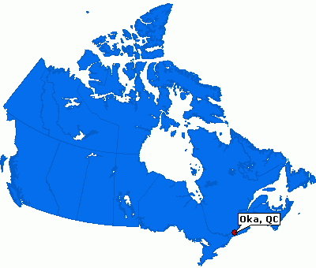
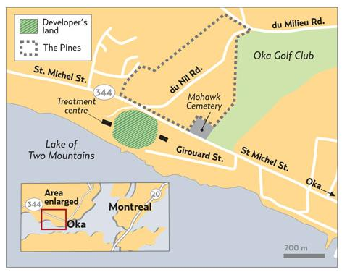
Case Study #1: Oka
In 1959, the town of Oka (in Quebec) built a 9-hole golf course on Mohawk land along the Ottawa River
  France had given this land to Catholic missionaries in 1717
In 1977, the Mohawk filed an official land claim in an attempt to regain the land
The Office of Native Land Claims rejected the Mohawk’s claim, saying that Indigenous people couldn’t prove ownership

Slide 7
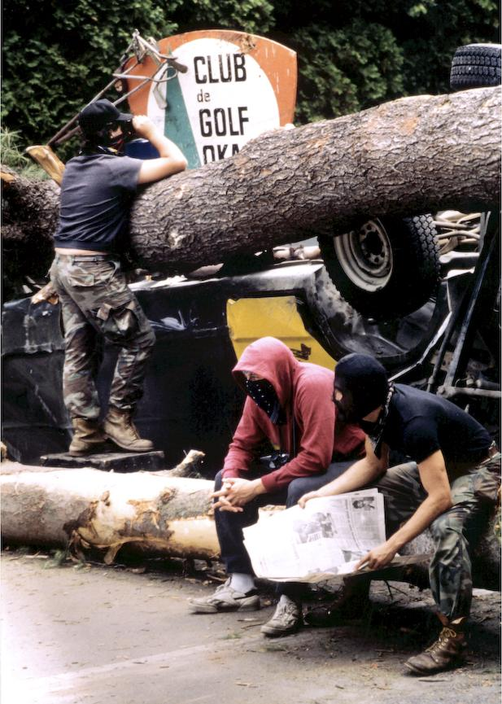
In 1989, the mayor of Oka announced that the golf course was going to be expanded to 18-holes and that luxury condos were also going to be built on the site
The town prepared to take more Mohawk land, levelling an important forest known as “The Pines” and building on top of the band cemetery
On March 10, 1990, Mohawk and their allies began occupying the Pines, protecting their trees and graveyard

Slide 8
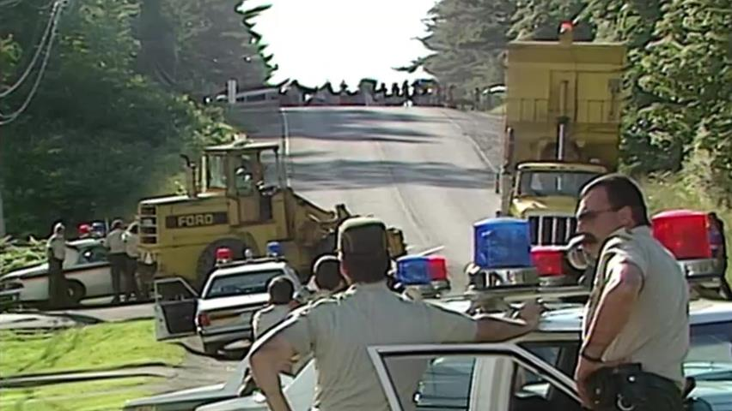
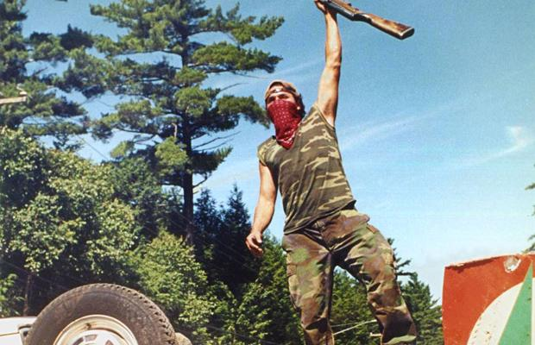
Five months later in July, the standoff became a shooting war
Quebec provincial police were sent in, storming the barricades the Mohawk and their allies had set up with tear gas and flash grenades
Shots were fired (no one knows who shot first)
An officer was fatally wounded, and a Mohawk elder suffered a fatal heart attack

Slide 9
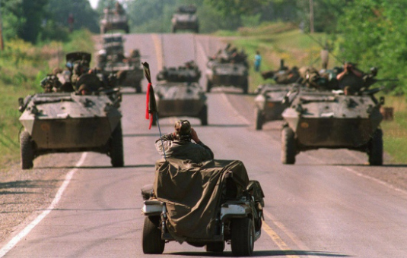
The QPP was reinforced by members of the RCMP, and around 2500 members of the Canadian military
  Who came with jets, tanks, and armored personnel carriers
The Mohawk were joined by other Indigenous people and for 78 days the 2 sides were locked in a standoff

Slide 10
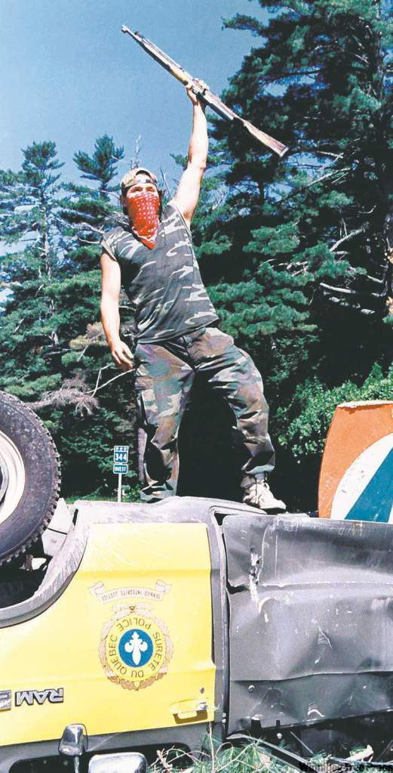
Despite high tensions, no further shots were fired
The crises eventually ended and the golf course expansion was cancelled
The crisis cost well over $200 million and was the first violent conflict between Mohawk and the government in the late 20th century
In 1997, the Department of Indian Affairs quietly purchased the disputed land for $5.2 million and “gave” it to the Mohawk

Slide 11
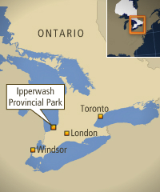
Case Study #2: Ipperwash
In 1942, during WWII, the Canadian government went looking for a place to set up a military-training base and settled on the Stoney Point Ojibway reserve in Ipperwash, Ontario
The government offered the band $15 an acre, but the band refused
Instead, the government confiscated the land with the promise to return it after the war – it didn’t

Slide 12
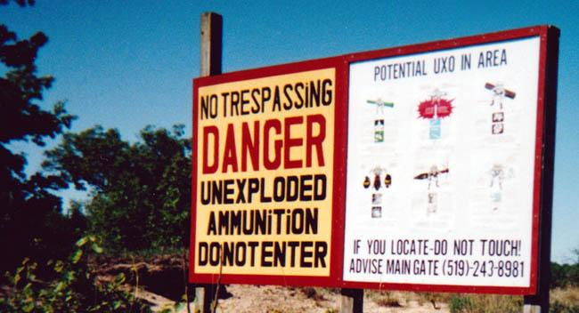
Because the land had been used as a military range, there were unexploded shells in the ground
  The army claimed they did not have money in the budget to clean it up
In Sept, 1995, about 35 Indigenous people took over the park to call attention to the long-standing claim
The protest started peacefully, but grew heated – an OPP cruiser had its window smashed and a band councilor had a rock thrown at his car

Slide 13
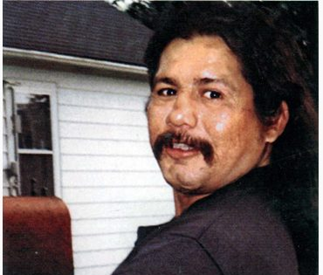
The confrontation came to a head with police firing on a car and a school bus, wounding two of the defenders and killing Dudley George, an Ojibway protestor
According to police officers, there was gunfire from these vehicles but First Nations protesters have insisted they had no weapons in the park that night
The officer who shot George was later convicted of criminal negligence causing death
Dudley George

Slide 14
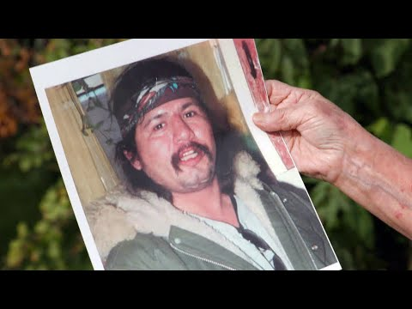
VIDEO: Ipperwash Crisis

Slide 15
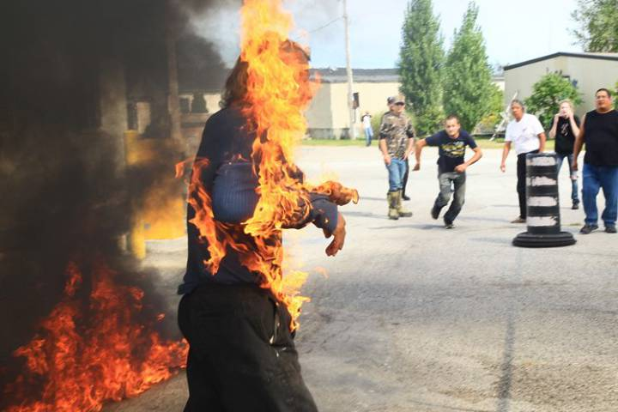
In 2007, the government of Ontario announced its plans to return the land
The settlement was finalized on April 14, 2016
Along with a $95 million payment, the land was signed over to the Kettle and Stony Point First Nation
In September of 2015, Dudley George’s brother Pierre accidentally set himself on fire while protesting the settlement deal

Slide 16

Case Study #3: Caledonia
In 2006, at Caledonia, Ontario, Mohawks took over a housing development to protest the building of new homes on what they considered to be their territory
During the dispute, the provincial government announced it had bought the disputed land from the developer and would hold it in trust until negotiations settled the claim

Slide 17
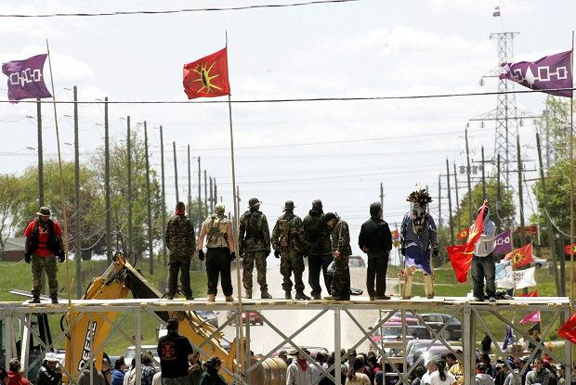
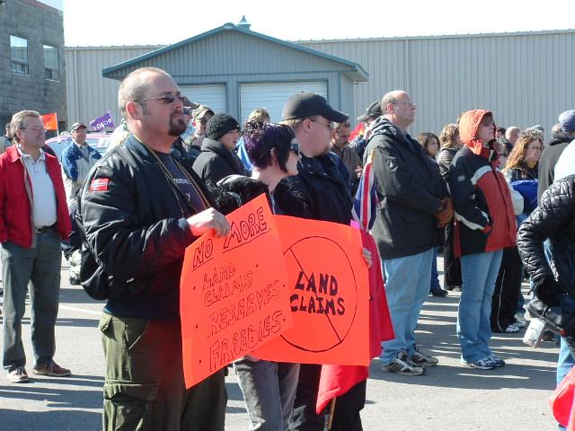
Protests included a blockade of roads and rail lines, damage to a power station resulting in an area blackout and more than $1 million in repairs, and low levels of violence from both sides
  In 2011, the Ontario government agreed to a $20-million settlement – but not for the Mohawks, for the homeowners and businesses affected by the 6-week blockade

Slide 18
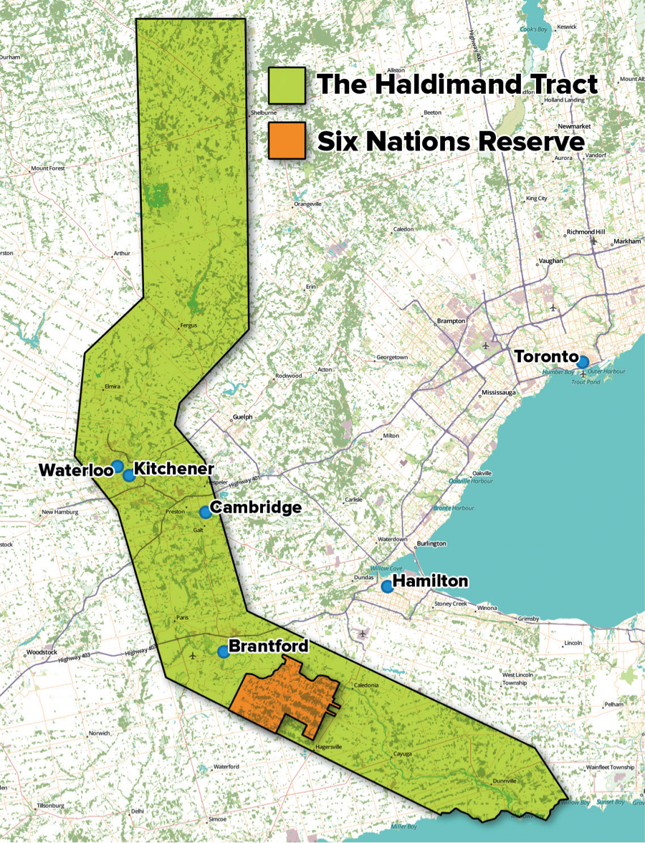
  Caledonia is part of a plot of land originally known as the Haldimand Tract
    Britain granted the land to the Iroquois in 1784 for their help during the American Revolution
    The Mohawk maintain that their title to the land was never relinquished
  The land claim remains unresolved and continues to this day

Slide 19
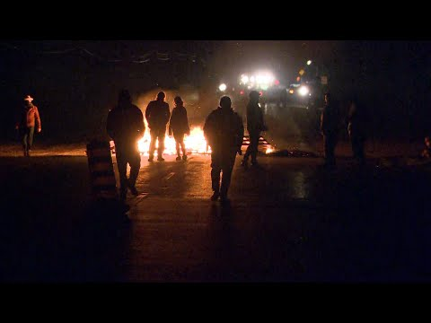
VIDEO: The Caledonia dispute continues (Oct. 2020)

