Slide 1
The Story of Us

Slide 2
Confederation and the Indian Act

Slide 3
Page 22 and 23 of package

Slide 4
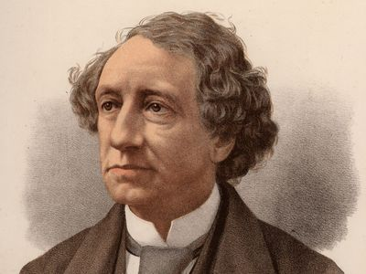
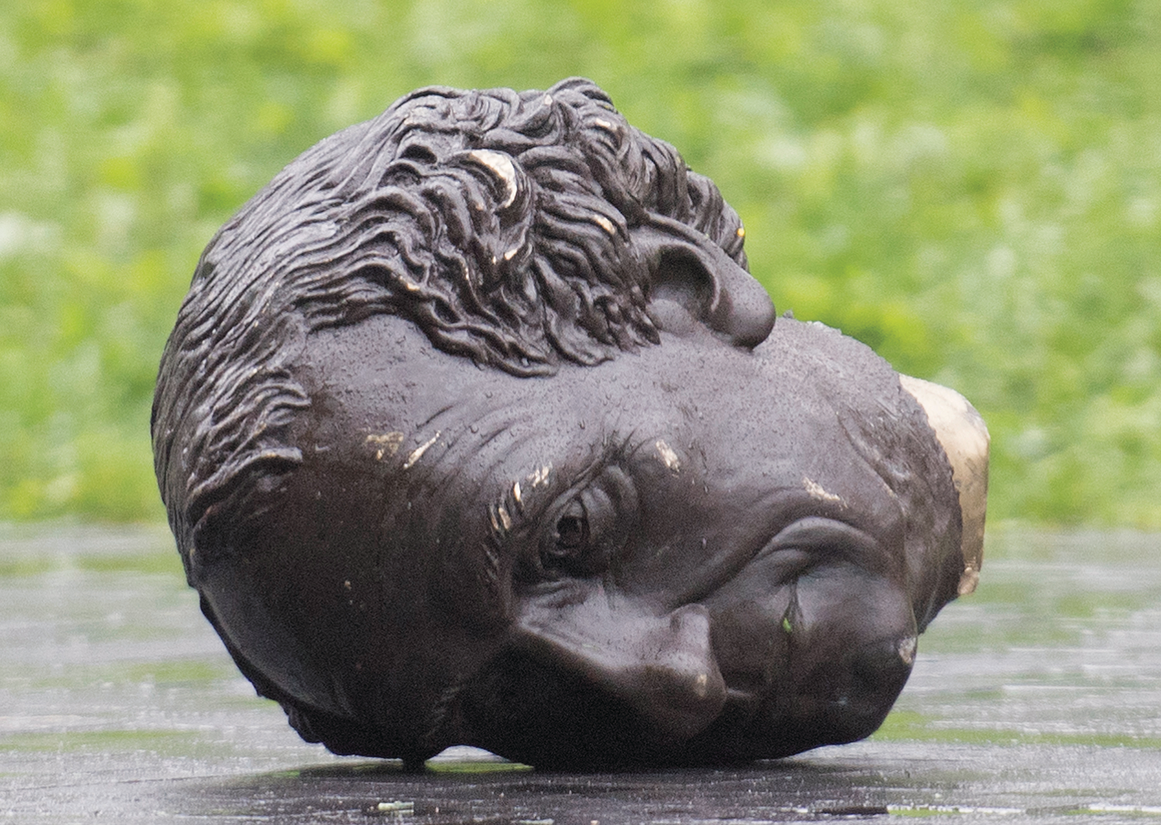
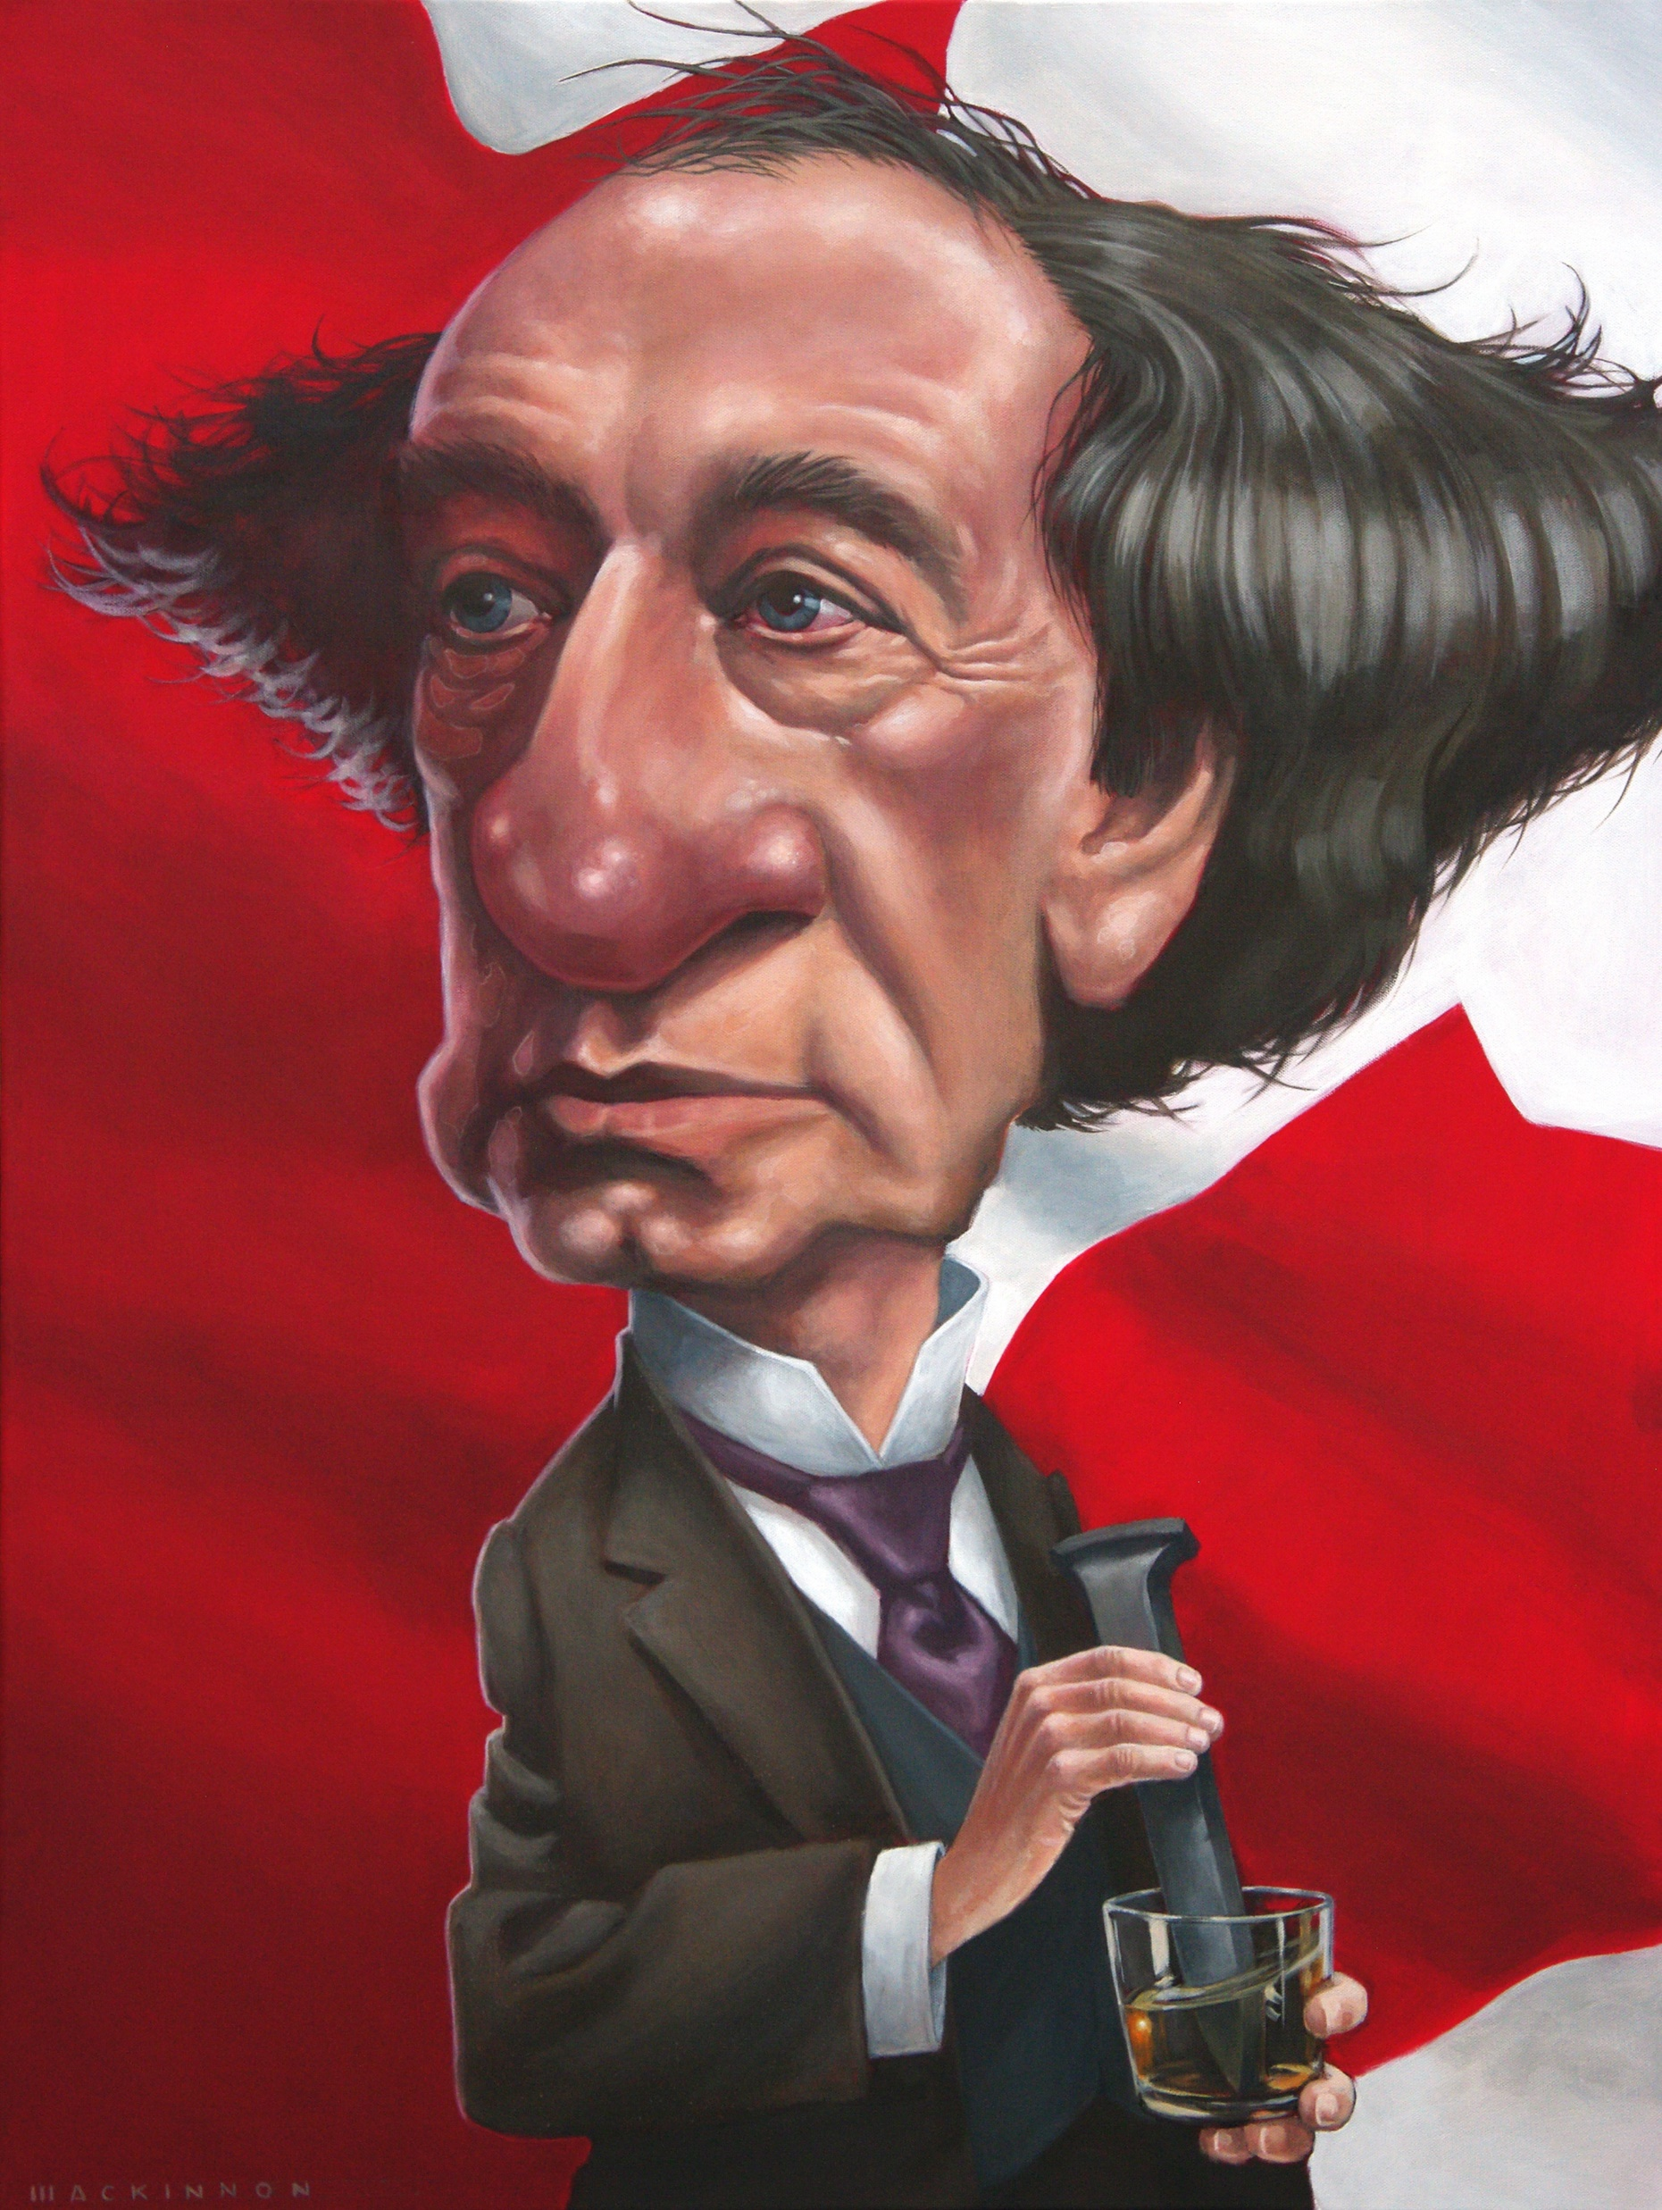

Slide 5
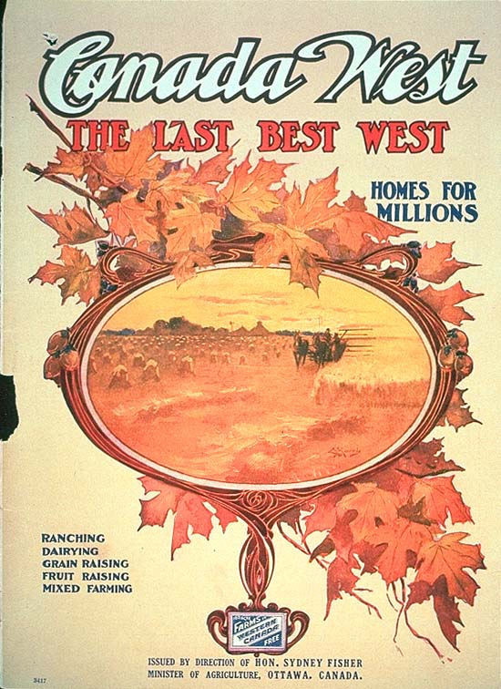

Slide 6
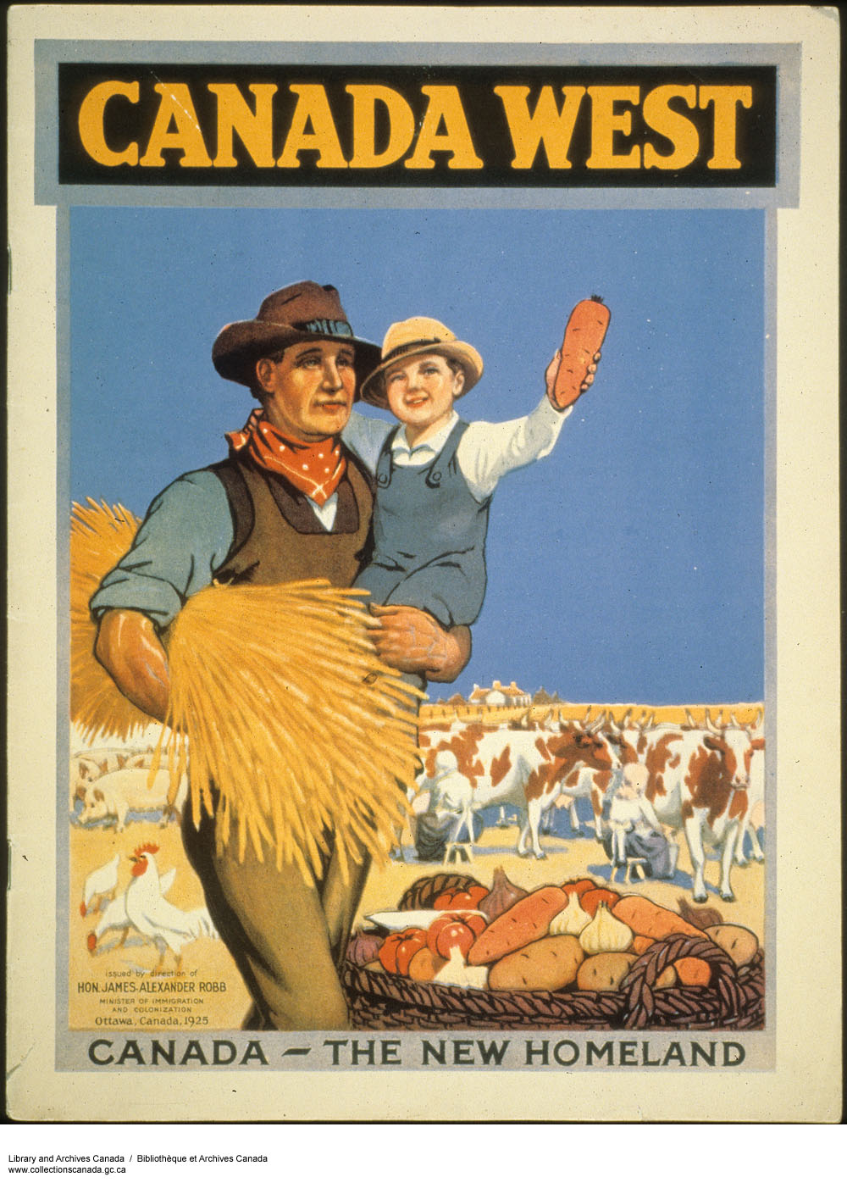

Slide 7
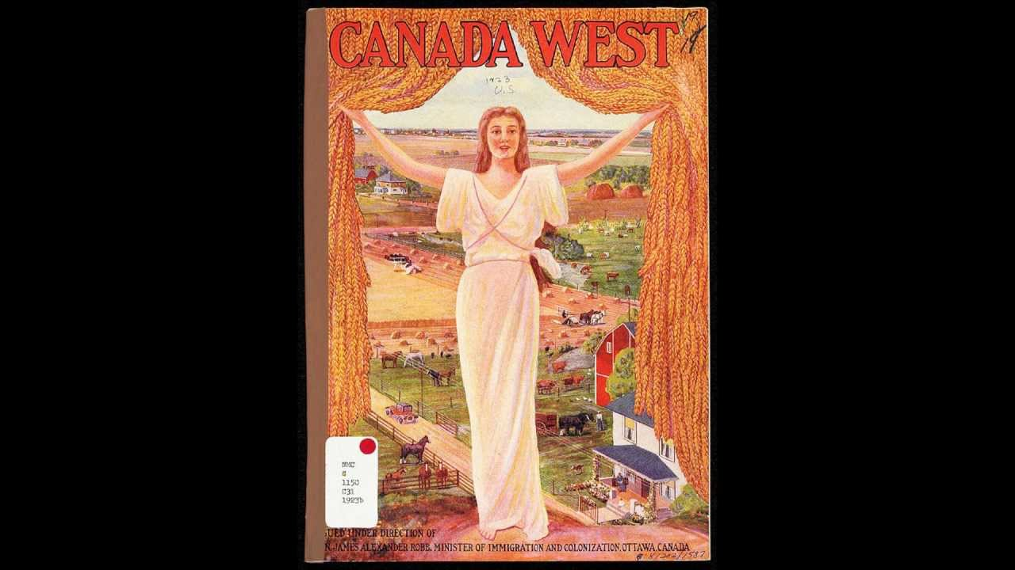

Slide 8
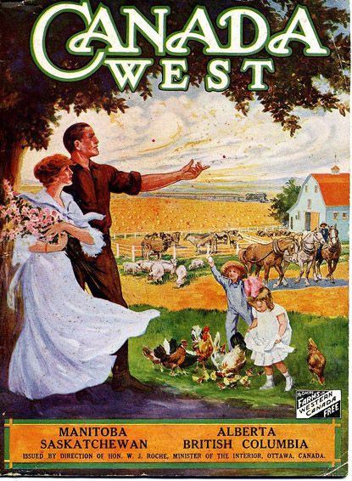

Slide 9
Page 24 of package

Slide 10
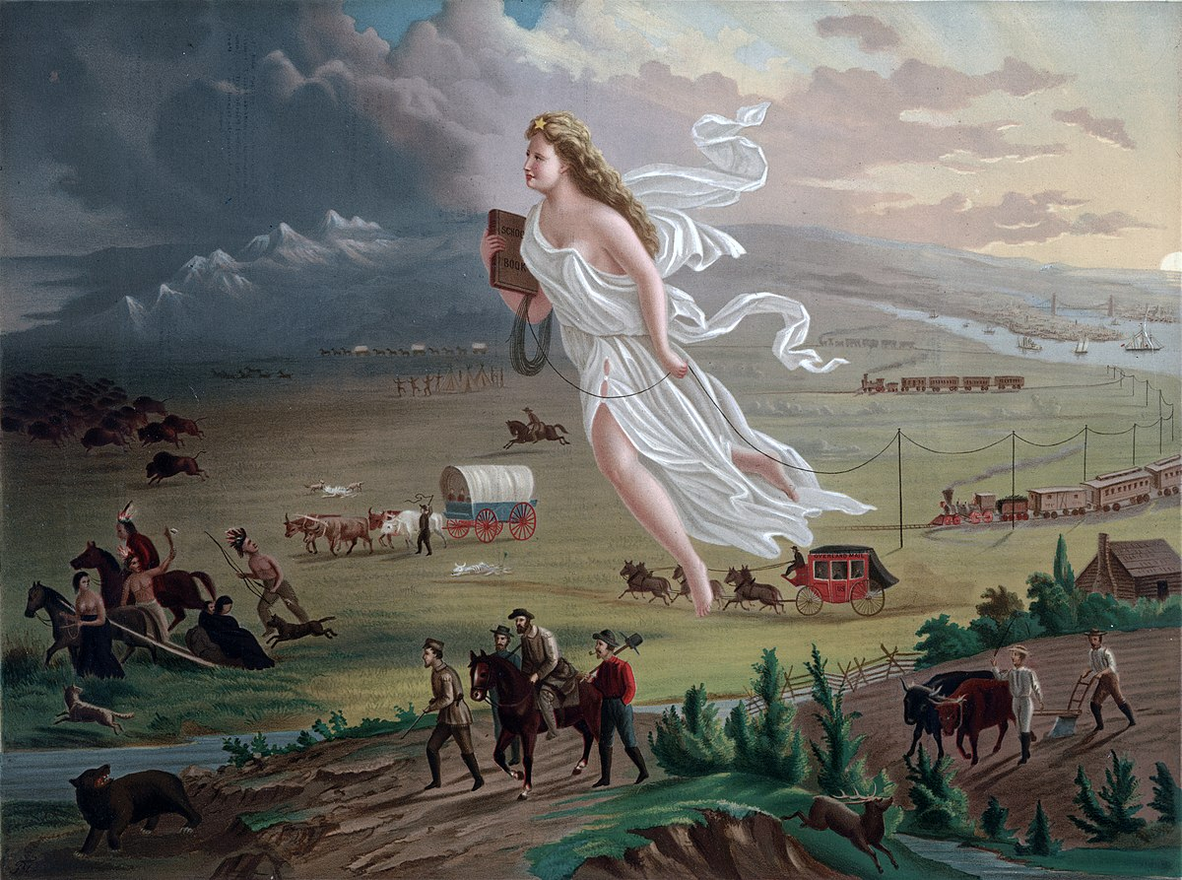

Slide 11
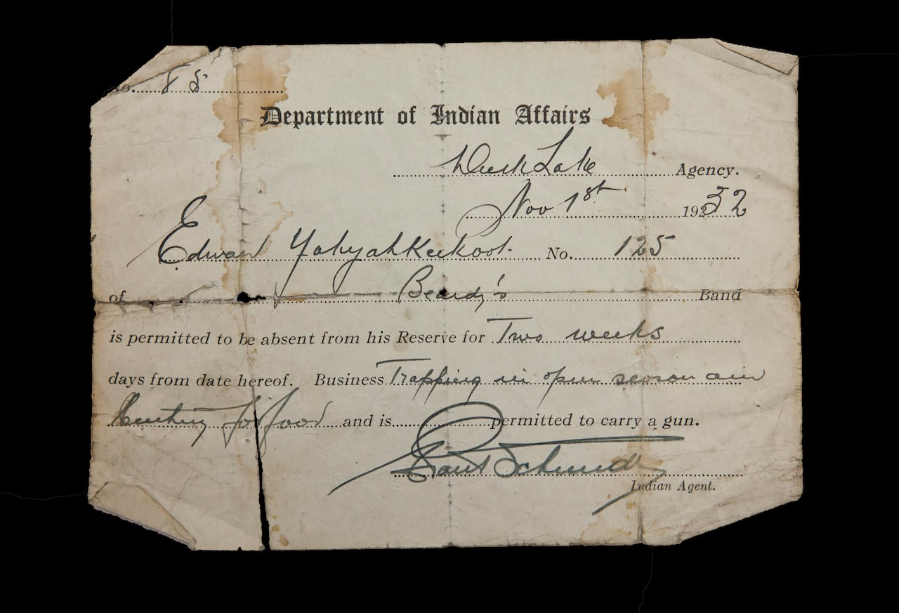
The Indian Act
Designated “status” (you needed status to be recognized by the Canadian Government as an “Indian”)
Created reserves and allowed the government to take over Indigenous territory
Women could gain or lose status with marriage – men could not
Set up the band council system and outlawed traditional governance structures
Established “Indian Agents”

Slide 12
Consequences of the Indian Act (Question 1-5)

