Slide 1
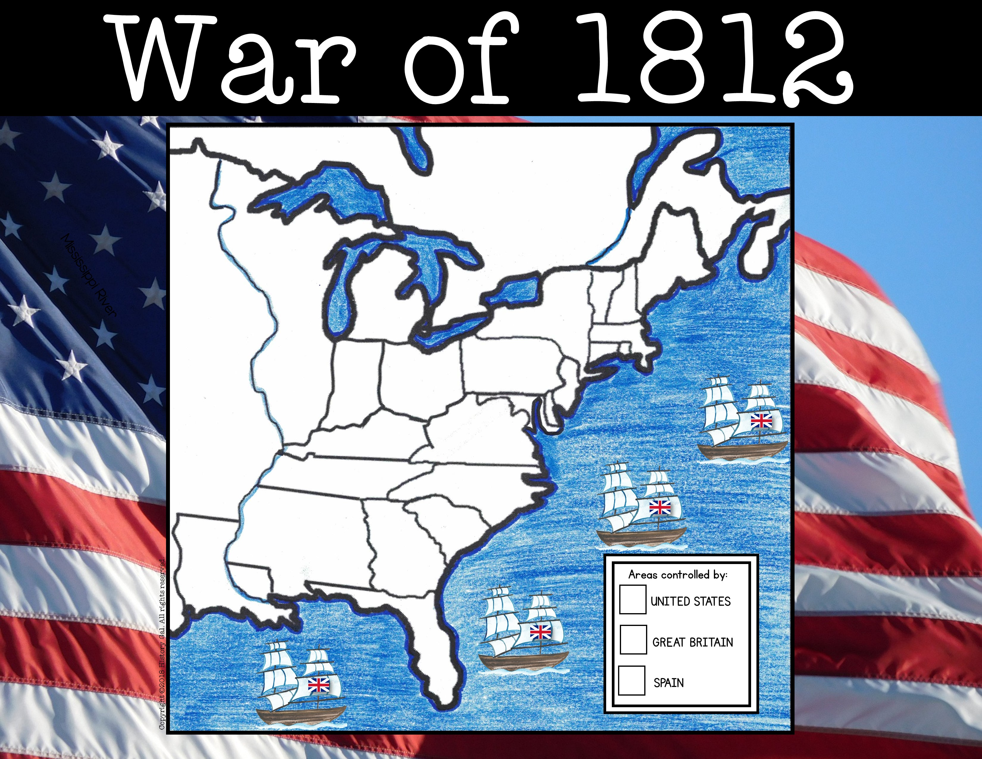
Vermont

Slide 2
New Hampshire
VT

Slide 3

Massachusetts
VT
NH

Slide 4

VT
NH
MA
Connecticut

Slide 5
VT
NH
Rhode Island
MA
CT

Slide 6
New York
VT
NH
MA
CT
RI

Slide 7
VT
New York
NH
MA
CT
RI
New Jersey

Slide 8
VT
New York
NH
MA
Pennsylvania
CT
NJ
RI

Slide 9
VT
New York
NH
MA
PA
CT
NJ
RI
Delaware

Slide 10
VT
New York
NH
MA
PA
CT
NJ
RI
DE
Maryland

Slide 11
VT
New York
NH
MA
PA
CT
NJ
RI
DE
Virginia
MD

Slide 12
VT
New York
NH
MA
PA
CT
NJ
RI
DE
Virginia
MD
North
Carolina

Slide 13
VT
New York
NH
MA
PA
CT
NJ
RI
DE
Virginia
MD
NC
South
Carolina

Slide 14
VT
New York
NH
MA
PA
CT
NJ
RI
DE
Virginia
MD
NC
SC
Georgia

Slide 15
VT
New York
NH
MA
PA
CT
NJ
RI
DE
Virginia
MD
NC
SC
Georgia
Louisiana

Slide 16
VT
New York
NH
MA
PA
CT
NJ
RI
DE
Virginia
MD
Tennessee
NC
SC
Georgia
Louisiana

Slide 17
VT
New York
NH
MA
PA
CT
NJ
RI
DE
Kentucky
Virginia
MD
Tennessee
NC
SC
Georgia
Louisiana

Slide 18
VT
New York
NH
MA
PA
CT
Ohio
RI
NJ
DE
Kentucky
Virginia
MD
Tennessee
NC
SC
Georgia
Louisiana

Slide 19
VT
New York
NH
Indiana Territory
MA
PA
CT
Ohio
RI
NJ
DE
Kentucky
Virginia
MD
Tennessee
NC
SC
Georgia
Louisiana

Slide 20
Illinois Territory
VT
New York
NH
MA
PA
CT
Indiana Territory
Ohio
RI
NJ
DE
Kentucky
Virginia
MD
Tennessee
NC
SC
Georgia
Louisiana

Slide 21
Michigan Territory
Illinois Territory
VT
New York
NH
MA
PA
CT
Indiana Territory
Ohio
RI
NJ
DE
Kentucky
Virginia
MD
Tennessee
NC
SC
Georgia
Louisiana

Slide 22
Illinois Territory
Michigan Territory
VT
New York
NH
MA
Mississippi Territory
PA
CT
Indiana Territory
Ohio
RI
NJ
DE
Kentucky
Virginia
MD
Tennessee
NC
SC
Georgia
Louisiana

Slide 23
Missouri (Unorganized) Territory
Illinois Territory
Michigan Territory
VT
New York
NH
MA
PA
CT
Indiana Territory
Ohio
RI
NJ
DE
Kentucky
Virginia
MD
Tennessee
NC
Mississippi Territory
SC
Georgia
Louisiana

Slide 24
Illinois Territory
Michigan Territory
VT
New York
NH
MA
PA
CT
Missouri (Unorganized) Territory
Indiana Territory
Ohio
RI
NJ
DE
Kentucky
Virginia
MD
Tennessee
NC
Mississippi Territory
SC
Georgia
Louisiana
Spanish Florida

Slide 25
British North America (Canada)
Illinois Territory
Michigan Territory
VT
New York
NH
MA
PA
CT
Missouri (Unorganized) Territory
Indiana Territory
Ohio
RI
NJ
DE
Kentucky
Virginia
MD
Tennessee
NC
Mississippi Territory
SC
Georgia
Louisiana
Spanish
Florida

Slide 26
British North America (Canada)
Illinois Territory
Mississippi
Michigan Territory
VT
New York
NH
MA
PA
CT
Missouri (Unorganized) Territory
Indiana Territory
Ohio
RI
NJ
River
DE
Kentucky
Virginia
MD
Tennessee
NC
Mississippi Territory
SC
Georgia
Louisiana
Spanish
Florida

Slide 27
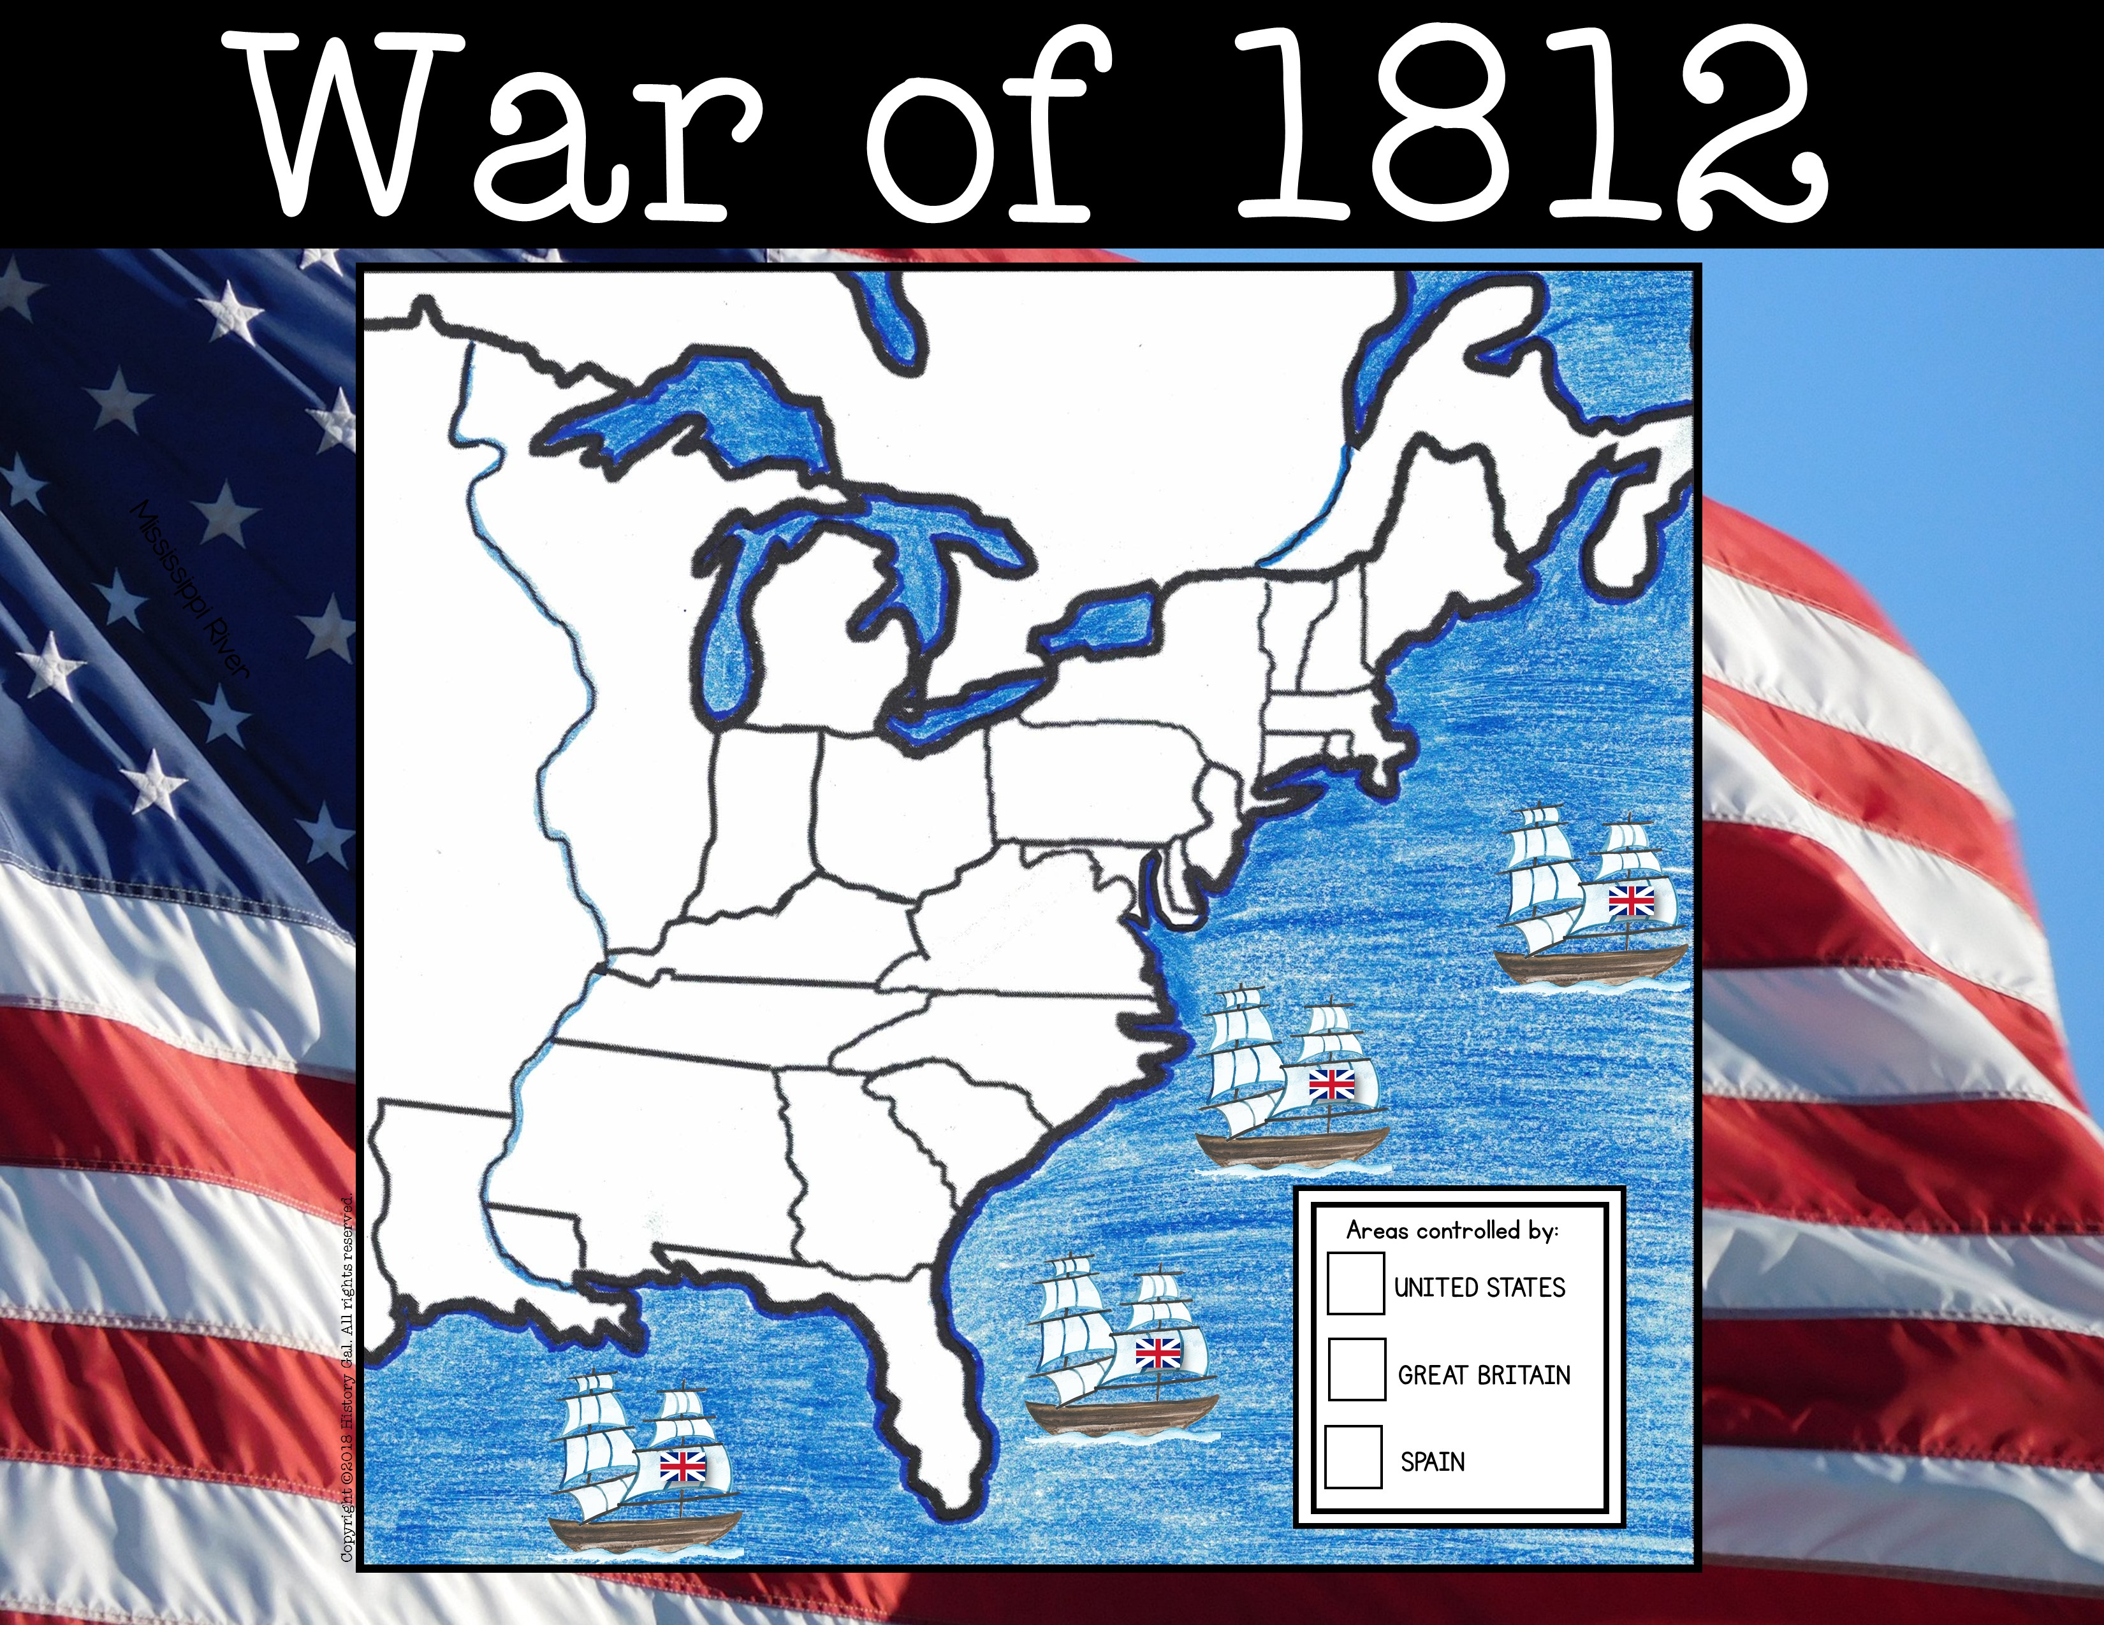
British North America (Canada)
Illinois Territory
Mississippi
Michigan Territory
VT
New York
NH
MA
PA
CT
Missouri (Unorganized) Territory
Indiana Territory
Ohio
RI
River
NJ
DE
Kentucky
Virginia
MD
Tennessee
Atlantic Ocean
NC
Mississippi Territory
SC
Georgia
Louisiana
Spanish
Florida

Slide 28

British North America (Canada)
Illinois Territory
Mississippi
Michigan Territory
VT
New York
NH
MA
PA
CT
Missouri (Unorganized) Territory
Indiana Territory
Ohio
RI
River
NJ
DE
Kentucky
Virginia
MD
Tennessee
Atlantic Ocean
NC
Mississippi Territory
SC
Georgia
Louisiana
Gulf of Mexico
Spanish
Florida

Slide 29
British North America (Canada)
Lake
Superior
Illinois Territory
Mississippi
Michigan Territory
VT
New York
NH
MA
PA
CT
Missouri (Unorganized) Territory
Indiana Territory
Ohio
RI
River
NJ
DE
Kentucky
Virginia
MD
Tennessee
Atlantic Ocean
NC
Mississippi Territory
SC
Georgia
Louisiana
Gulf of Mexico
Spanish
Florida

Slide 30
Lake
Lake
Michigan
Superior
British North America (Canada)
Illinois Territory
Mississippi
Michigan Territory
VT
New York
NH
MA
PA
CT
Missouri (Unorganized) Territory
Indiana Territory
Ohio
RI
River
NJ
DE
Kentucky
Virginia
MD
Tennessee
Atlantic Ocean
NC
Mississippi Territory
SC
Georgia
Louisiana
Gulf of Mexico
Spanish
Florida

Slide 31
Lake
Lake
Huron
Superior
British North America (Canada)
Illinois Territory
Lake
Michigan
Mississippi
Michigan Territory
VT
New York
NH
MA
PA
CT
Missouri (Unorganized) Territory
Indiana Territory
Ohio
RI
River
NJ
DE
Kentucky
Virginia
MD
Tennessee
Atlantic Ocean
NC
Mississippi Territory
SC
Georgia
Louisiana
Gulf of Mexico
Spanish
Florida

Slide 32
British North America (Canada)
Lake
Superior
Lake
Illinois Territory
Lake
Erie
Lake
Huron
Michigan
Mississippi
Michigan Territory
VT
New York
NH
MA
PA
CT
Missouri (Unorganized) Territory
Indiana Territory
Ohio
RI
River
NJ
DE
Kentucky
Virginia
MD
Tennessee
Atlantic Ocean
NC
Mississippi Territory
SC
Georgia
Louisiana
Gulf of Mexico
Spanish
Florida

Slide 33
British North America (Canada)
Lake
Lake
Superior
Lake
Ontario
Illinois Territory
Huron
Lake
Michigan
Mississippi
Michigan Territory
VT
Lake
New York
NH
Erie
MA
PA
CT
Missouri (Unorganized) Territory
Indiana Territory
Ohio
RI
River
NJ
DE
Kentucky
Virginia
MD
Tennessee
Atlantic Ocean
NC
Mississippi Territory
SC
Georgia
Louisiana
Gulf of Mexico
Spanish
Florida

Slide 34
British North America (Canada)
Lake
St. Lawrence
Superior
Lake
River
Illinois Territory
Huron
Lake
Michigan
Lake
Mississippi
Michigan Territory
Ontario
VT
Lake
New York
NH
Erie
MA
PA
CT
Missouri (Unorganized) Territory
Indiana Territory
Ohio
RI
River
NJ
DE
Kentucky
Virginia
MD
Tennessee
Atlantic Ocean
NC
Mississippi Territory
SC
Georgia
Louisiana
Gulf of Mexico
Spanish
Florida

Slide 35
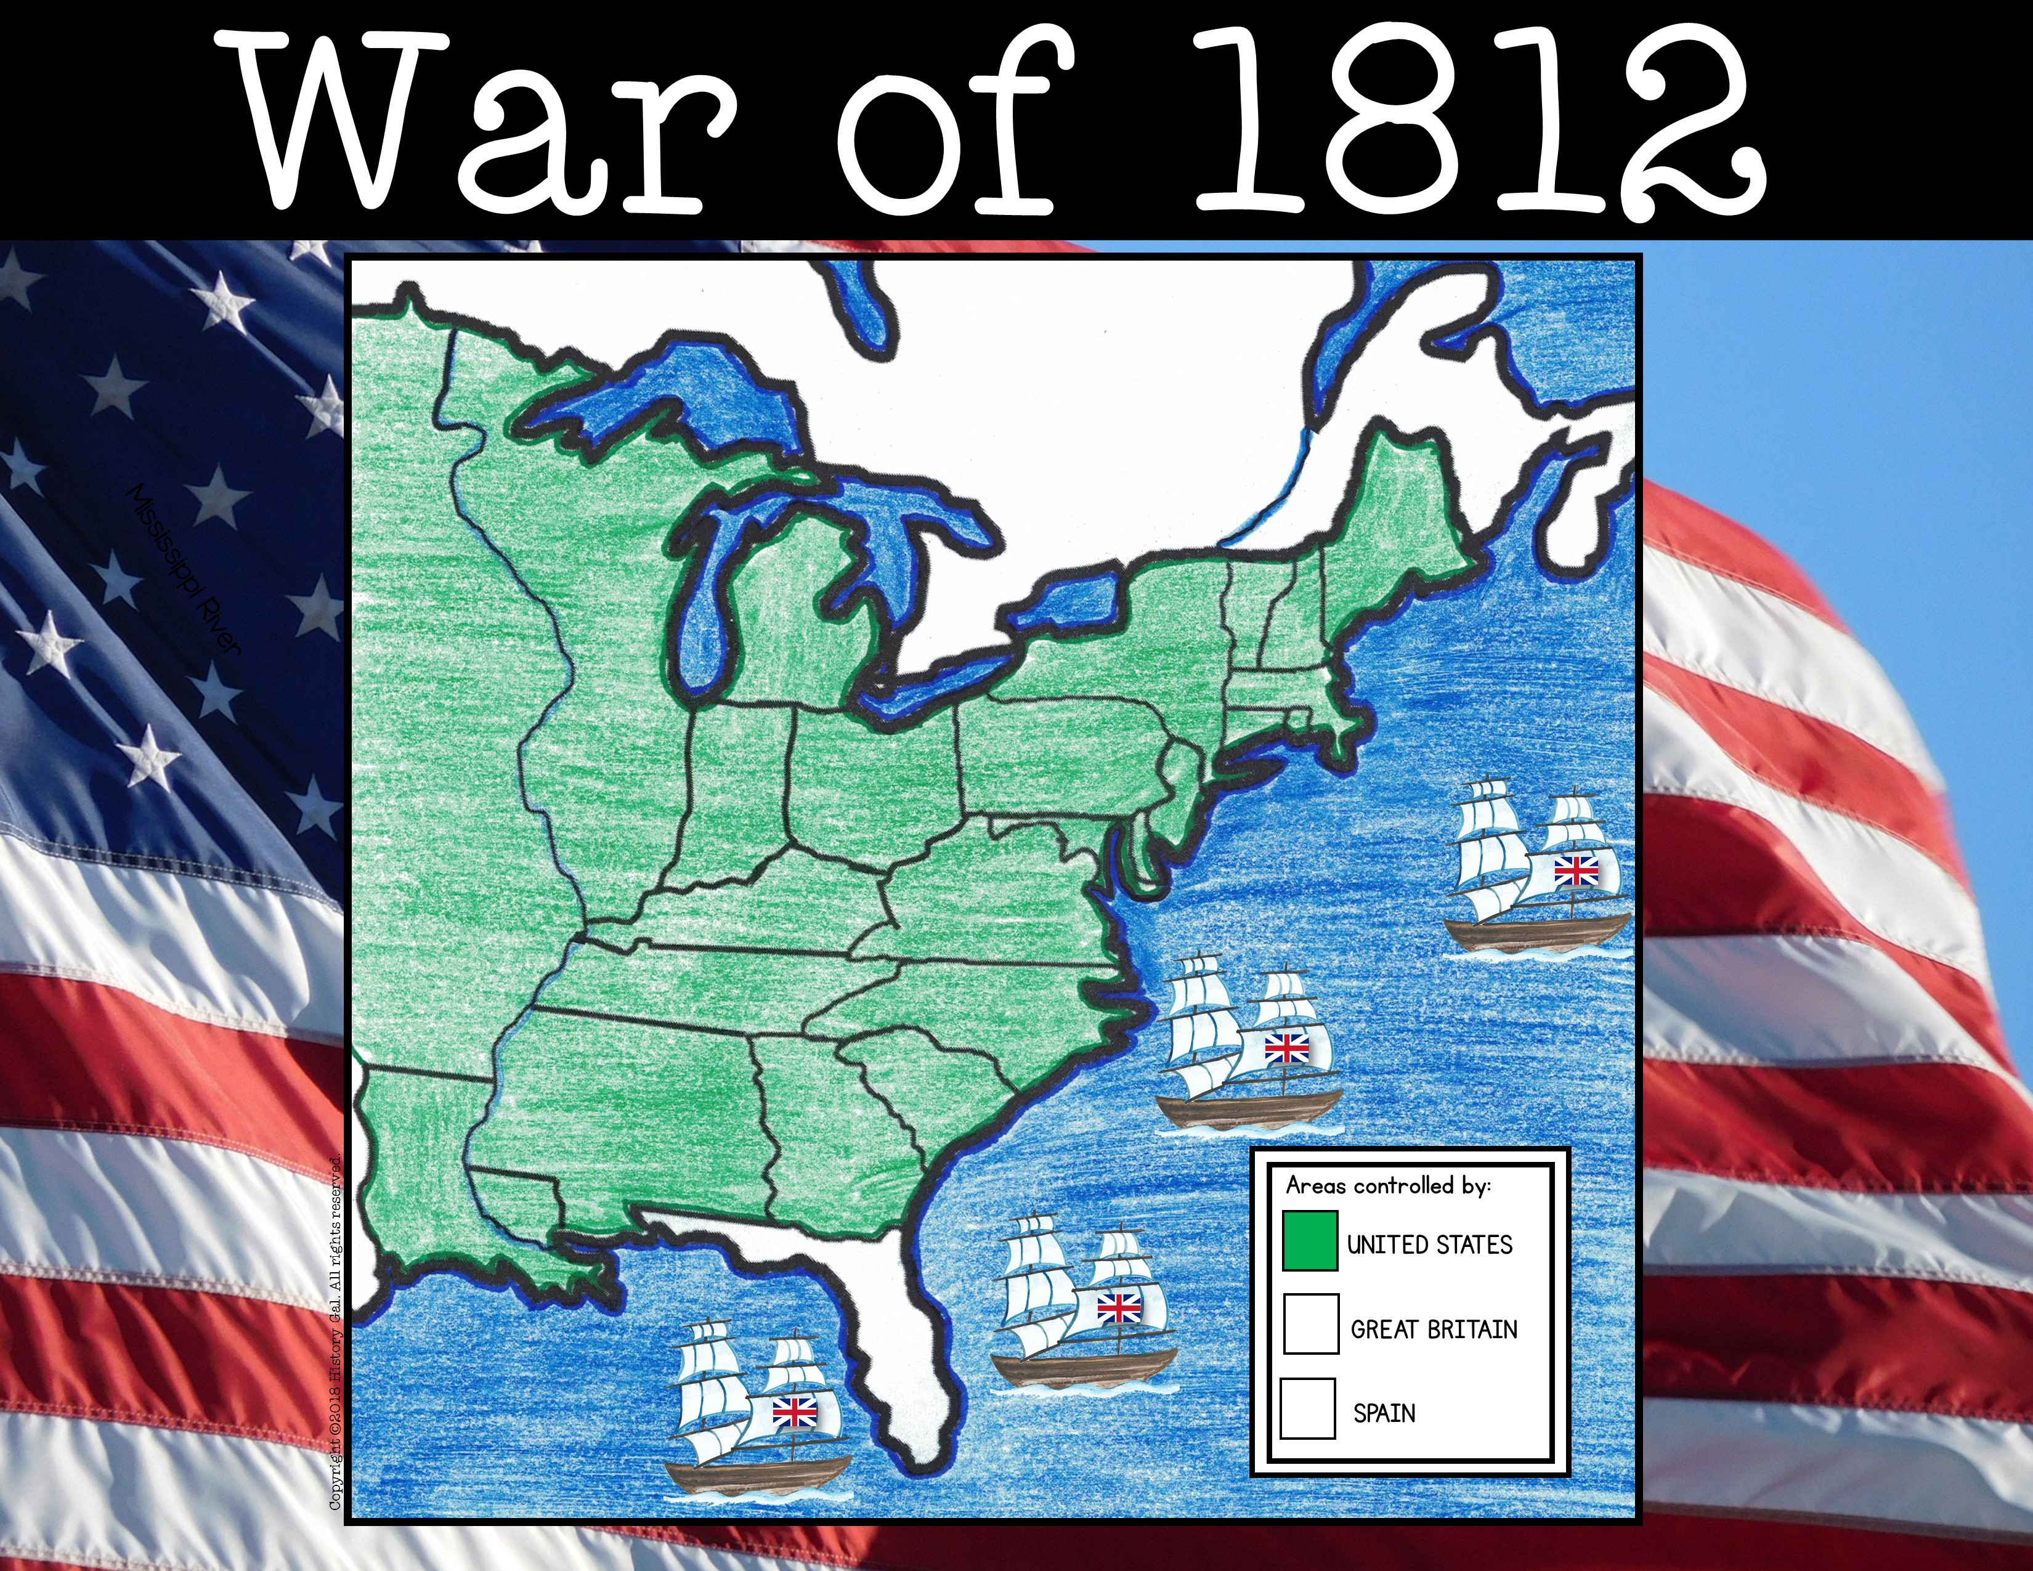
British North America (Canada)
Lake
Superior
Lake
St. Lawrence River
Illinois Territory
Huron
Lake
Michigan
Lake
Mississippi
Michigan Territory
Ontario
VT
Lake
New York
NH
Erie
MA
PA
CT
Missouri (Unorganized) Territory
Indiana Territory
Ohio
RI
River
NJ
DE
Kentucky
Virginia
MD
Tennessee
Atlantic Ocean
NC
Mississippi Territory
SC
Georgia
Louisiana
Gulf of Mexico
Spanish
Florida

Slide 36
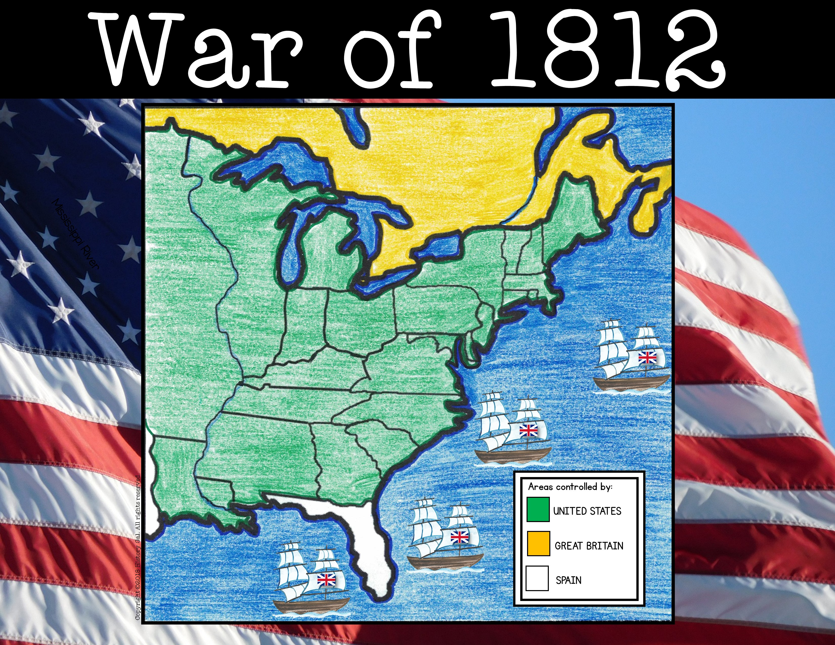
British North America (Canada)
Lake
Superior
Lake
St. Lawrence River
Illinois Territory
Huron
Lake
Michigan
Lake
Mississippi River
Mississippi
Michigan Territory
Ontario
VT
Lake
New York
NH
Erie
MA
PA
CT
Missouri (Unorganized) Territory
Indiana Territory
Ohio
RI
River
NJ
DE
Kentucky
Virginia
MD
Tennessee
Atlantic Ocean
NC
Mississippi Territory
SC
Georgia
Louisiana
Gulf of Mexico
Spanish
Florida

Slide 37
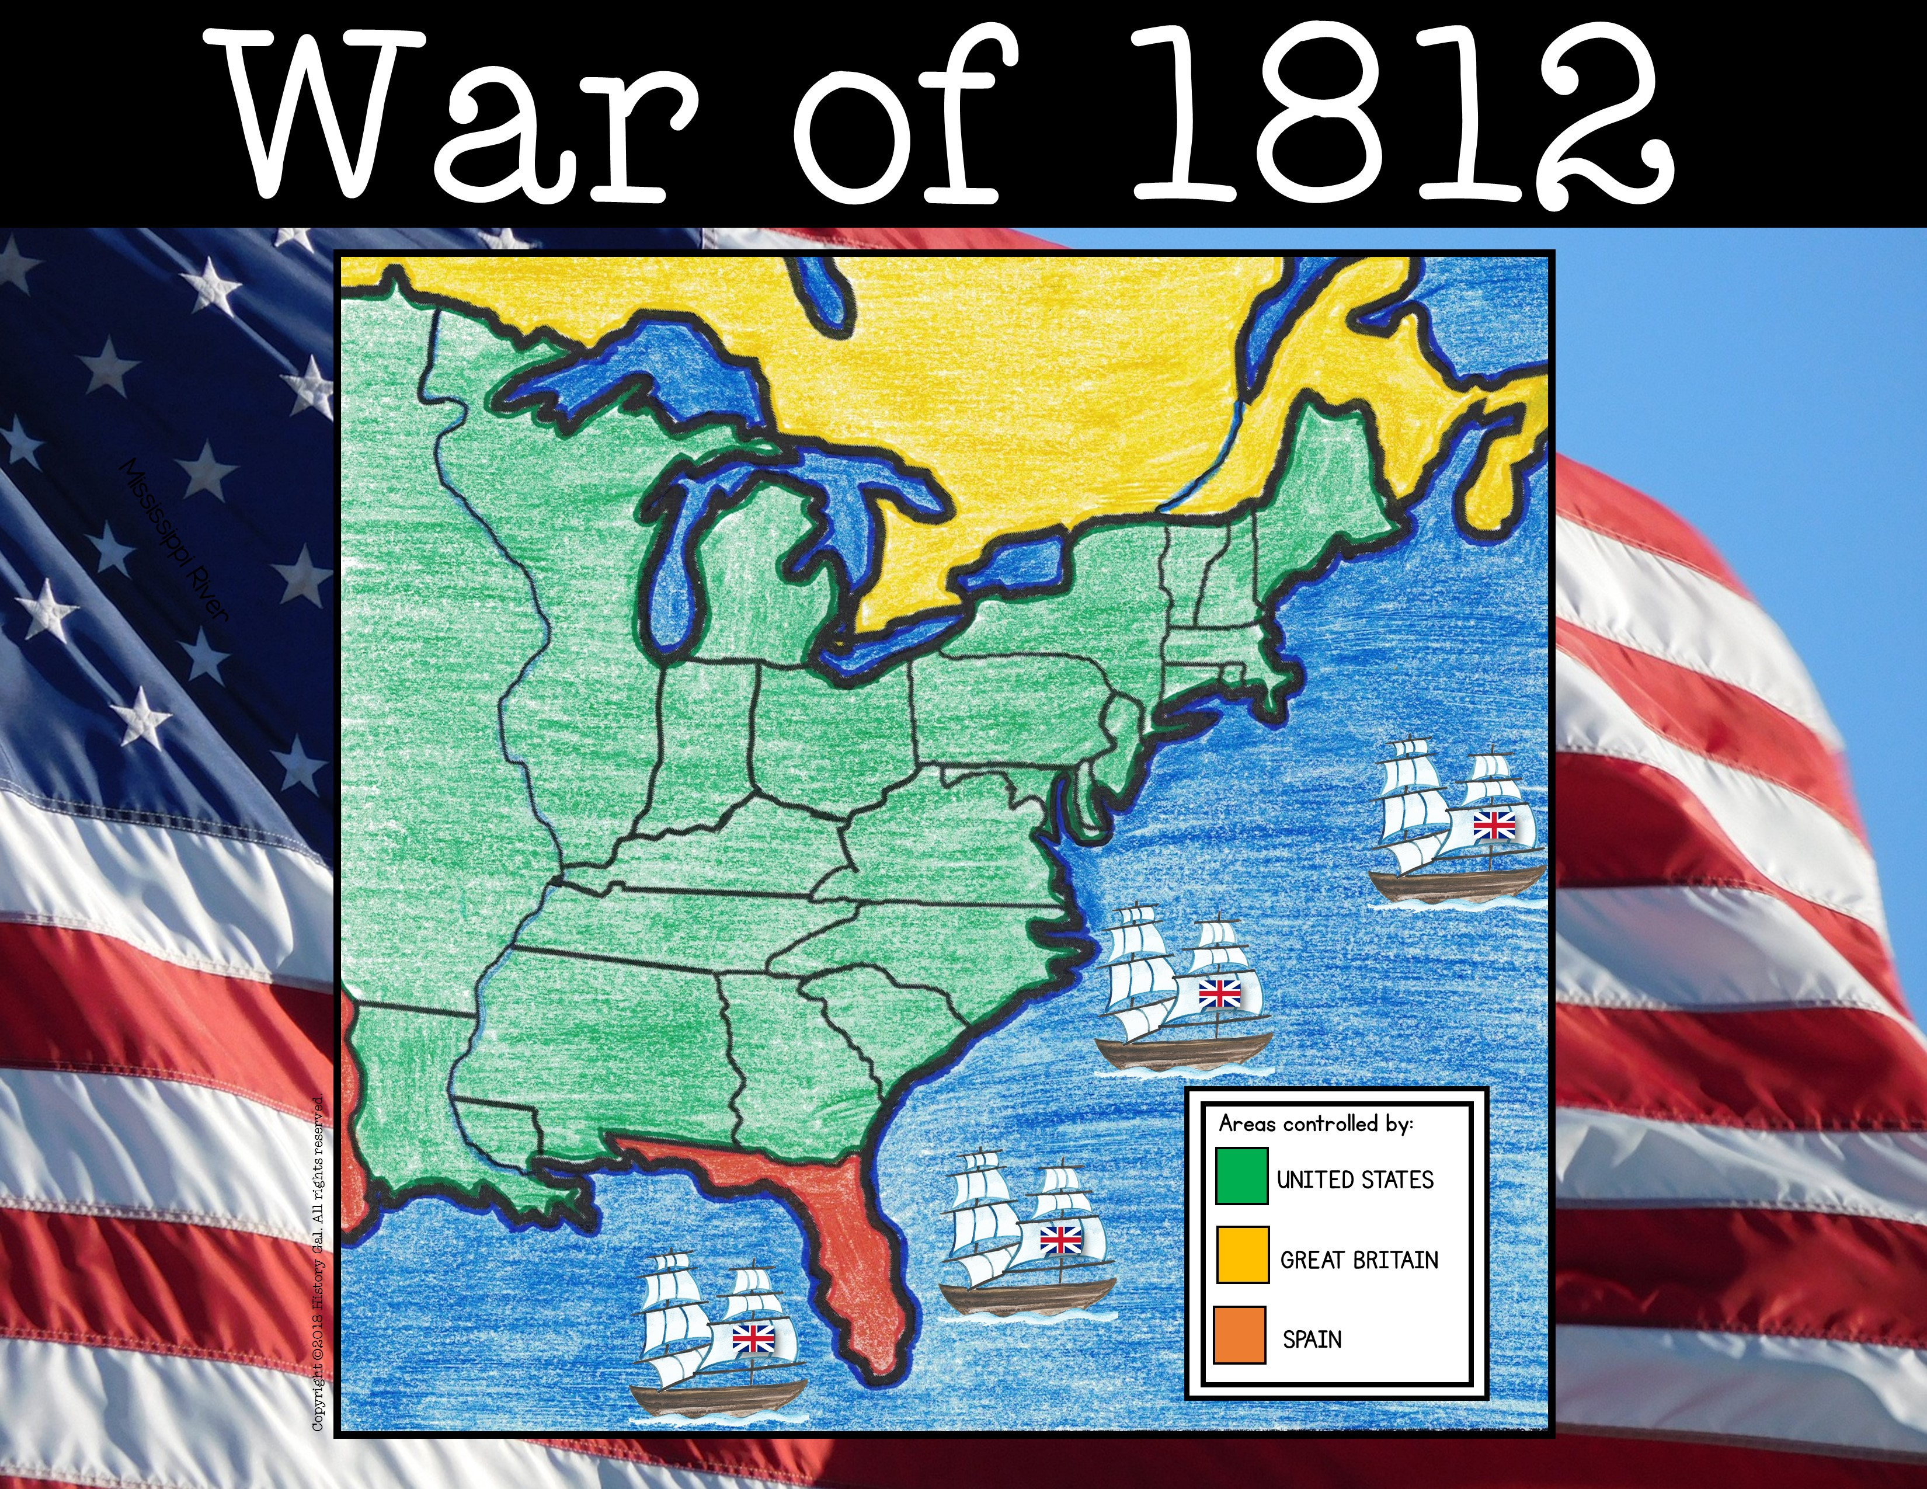
British North America (Canada)
Lake
Superior
Lake
St. Lawrence River
Illinois Territory
Huron
Lake
Michigan
Lake
Mississippi
Michigan Territory
Ontario
VT
Lake
New York
NH
Erie
MA
PA
CT
Missouri (Unorganized) Territory
Indiana Territory
Ohio
RI
River
NJ
DE
Kentucky
Virginia
MD
Tennessee
Atlantic Ocean
NC
Mississippi Territory
SC
Georgia
Louisiana
Gulf of Mexico
Spanish
Florida

Slide 38
British North America (Canada)
Lake
Superior
Lake
St. Lawrence River
Illinois Territory
Huron
Lake
Michigan
Lake
Mississippi
Michigan Territory
Ontario
VT
Lake
New York
NH
Erie
MA
PA
CT
Missouri (Unorganized) Territory
Indiana Territory
Ohio
RI
River
NJ
DE
Kentucky
Virginia
MD
Tennessee
Atlantic Ocean
NC
Mississippi Territory
SC
Georgia
August 15-16, 1812: BATTLE OF FT. DETROIT –
won by Great Britain
Louisiana
Gulf of Mexico
Spanish
Florida
Battle of Ft. Detroit

Slide 39
British North America (Canada)
Lake
Superior
Lake
St. Lawrence River
Illinois Territory
Huron
Lake
Michigan
Lake
Mississippi River
Mississippi
Michigan Territory
Ontario
VT
Ft. Detroit
Lake
New York
NH
Erie
MA
PA
CT
Missouri (Unorganized) Territory
Indiana Territory
Ohio
RI
River
NJ
DE
Kentucky
Virginia
MD
Tennessee
Atlantic Ocean
NC
Mississippi Territory
SC
Georgia
August 19, 1812:
USS CONSTITUTION VS HMS GUERRIERE –
won by United States
Louisiana
Gulf of Mexico
Spanish
Florida
USS Constitution

Slide 40
British North America (Canada)
Lake
Superior
Lake
St. Lawrence River
Illinois Territory
Huron
Lake
Michigan
Lake
Mississippi
Michigan Territory
Ontario
VT
Ft. Detroit
Lake
New York
NH
Erie
MA
USS Constitution vs. HMS Guerriere
PA
CT
Missouri (Unorganized) Territory
Indiana Territory
Ohio
RI
River
NJ
DE
Kentucky
Virginia
MD
Tennessee
Atlantic Ocean
NC
Mississippi Territory
SC
Jan. 22, 1813:
BATTLE OF FRENCHTOWN (Raisin River) –
won by Great Britain
Georgia
Louisiana
Gulf of Mexico
Spanish
Florida
Little Raisin Battlefield Park

Slide 41
British North America (Canada)
Lake
Superior
Lake
St. Lawrence River
Illinois Territory
Huron
Lake
Michigan
Lake
Mississippi
Michigan Territory
Ontario
VT
Ft. Detroit
Lake
New York
NH
Frenchtown
Erie
MA
USS Constitution vs. HMS Guerriere
PA
CT
Missouri (Unorganized) Territory
Indiana Territory
Ohio
RI
River
NJ
DE
Kentucky
Virginia
MD
Tennessee
Atlantic Ocean
NC
Mississippi Territory
SC
Georgia
April 27, 1813: BATTLE OF YORK (Toronto) –
won by United States
Louisiana
Gulf of Mexico
Spanish
Battle of York
Florida

Slide 42
British North America (Canada)
Lake
Superior
Lake
St. Lawrence River
Illinois Territory
Huron
Lake
Michigan
York
Lake
Mississippi
Michigan Territory
Ontario
VT
Ft. Detroit
Lake
New York
NH
Frenchtown
Erie
MA
USS Constitution vs. HMS Guerriere
PA
CT
Missouri (Unorganized) Territory
Indiana Territory
Ohio
RI
River
NJ
DE
Kentucky
Virginia
MD
Tennessee
Atlantic Ocean
NC
Mississippi Territory
SC
September 10,1813: BATTLE OF LAKE ERIE –
won by United States
Georgia
Louisiana
Gulf of Mexico
Spanish
Battle of Lake Erie
Florida

Slide 43
British North America (Canada)
Lake
Superior
Lake
St. Lawrence River
Illinois Territory
Huron
Lake
York
Michigan
Lake
Mississippi River
Mississippi
Michigan Territory
Ontario
VT
Ft. Detroit
Lake
New York
NH
Frenchtown
Erie
MA
USS Constitution vs. HMS Guerriere
Lake Erie
PA
CT
Missouri (Unorganized) Territory
Indiana Territory
Ohio
RI
River
NJ
DE
Kentucky
Virginia
MD
Tennessee
Atlantic Ocean
NC
Mississippi Territory
SC
Georgia
Oct. 5, 1813: BATTLE OF THAMES RIVER –
won by United States
Louisiana
Death of Tecumseh
Spanish
Remember the Raisin!
Gulf of Mexico
Florida
Battle of the Thames

Slide 44
British North America (Canada)
March 27, 1814:
BATTLE OF HORSESHOE BEND
(part of the Creek Wars) –
won by United States
Lake
Superior
Lake
St. Lawrence River
Illinois Territory
Huron
Lake
Michigan
York
Lake
Mississippi River
Mississippi
Michigan Territory
Ontario
VT
Creek Wars
Ft. Detroit
New York
Lake
Thames River
NH
USS Constitution vs. HMS Guerriere
Frenchtown
Erie
MA
Legacy of War of 1812
Lake Erie
PA
CT
Missouri (Unorganized) Territory
Indiana Territory
Ohio
RI
River
NJ
DE
Kentucky
Virginia
MD
Tennessee
Atlantic Ocean
NC
Mississippi Territory
SC
Georgia
Louisiana
Gulf of Mexico
Spanish
Florida

Slide 45
British North America (Canada)
Lake
Superior
Lake
St. Lawrence River
Illinois Territory
Huron
Lake
Michigan
York
Lake
Mississippi River
Mississippi
Michigan Territory
Ontario
VT
Ft. Detroit
New York
Lake
Thames River
NH
USS Constitution vs. HMS Guerriere
Frenchtown
Erie
MA
Lake Erie
PA
CT
Missouri (Unorganized) Territory
Indiana Territory
Ohio
RI
River
NJ
DE
Kentucky
Virginia
MD
Tennessee
Atlantic Ocean
NC
Mississippi Territory
SC
Horseshoe Bend
Georgia
Louisiana
August 24, 1814:
BATTLE OF WASHINGTON, D.C. (Bladensburg)-
Gulf of Mexico
Spanish
Florida
won by Great Britain
Burning of Washington, D.C.)

Slide 46
British North America (Canada)
Lake
Superior
Lake
St. Lawrence River
Illinois Territory
Huron
Lake
Michigan
York
Lake
Mississippi River
Mississippi
Michigan Territory
Ontario
VT
Ft. Detroit
New York
Lake
Thames River
NH
USS Constitution vs. HMS Guerriere
Frenchtown
Erie
MA
Lake Erie
PA
CT
Missouri (Unorganized) Territory
Indiana Territory
Ohio
RI
River
NJ
Washington D.C.
DE
Kentucky
Virginia
MD
Tennessee
Atlantic Ocean
NC
Mississippi Territory
SC
Horseshoe Bend
Georgia
Louisiana
September 11, 1814:
BATTLE OF LAKE CHAMPLAIN (Plattsburgh) –
won by United States
Gulf of Mexico
Spanish
Florida
Battle of Lake Champlain

Slide 47
British North America (Canada)
Lake
Superior
Lake
St. Lawrence River
Illinois Territory
Huron
Lake
Lake Champlain
Michigan
York
Lake
Mississippi
Michigan Territory
Ontario
VT
Ft. Detroit
New York
Lake
Thames River
NH
USS Constitution vs. HMS Guerriere
Frenchtown
Erie
MA
Lake Erie
PA
CT
Missouri (Unorganized) Territory
Indiana Territory
Ohio
RI
River
NJ
Washington D.C.
DE
Kentucky
Virginia
MD
Tennessee
Atlantic Ocean
NC
Mississippi Territory
SC
Horseshoe Bend
Georgia
Louisiana
Sep 12-15, 1814: BATTLE OF BALTIMORE –
won by United States
Gulf of Mexico
Spanish
Florida
Battle of Baltimore through the Eyes of Francis Scott Key

Slide 48
British North America (Canada)
Lake
Superior
Lake
St. Lawrence River
Illinois Territory
Huron
Lake
Lake Champlain
Michigan
York
Lake
Jan 8-26, 1815: BATTLE OF NEW ORLEANS –
won by United States
Mississippi
Michigan Territory
Ontario
VT
Mississippi River
Ft. Detroit
New York
Lake
Thames River
NH
USS Constitution vs. HMS Guerriere
Frenchtown
Erie
MA
Lake Erie
PA
CT
Missouri (Unorganized) Territory
Indiana Territory
Ohio
Baltimore
RI
Andrew Jackson and the Battle of New Orleans
River
NJ
Washington D.C.
DE
Kentucky
Virginia
MD
Tennessee
Atlantic Ocean
NC
Mississippi Territory
SC
Horseshoe Bend
Georgia
Louisiana
Gulf of Mexico
Spanish
Florida

