Slide 1
Social Identity

Slide 2
An individual’s social identity indicates who they are in terms of the social groups to which they belong. Social identity groups are usually defined by some physical, social, and mental characteristics of individuals. Examples of social identities are race/ethnicity, gender, social class/socioeconomic status, sexual orientation, (dis)abilities, and religion/religious beliefs.

Slide 3
Race and Ethnicity
Race is a socially constructed concept that refers to groups of people who are categorized by physical characteristics (e.g., skin color/complexion, facial features). Individuals may racially identify with a single race or as bi- or multiracial. It is important to note racial groups are not monoliths (which means “all the same”) and that the significance and meaning of race varies across individuals within each racial group.
Ethnicity, a related socially-constructed concept often used interchangeably with race, refers to a group individuals who share characteristics such as ancestry/heritage, country of origin, language, religion, forms of dress, and food.

Slide 4
Gender and Sex
Gender identity refers to an individual’s sense of self as a man, a woman, a combination of both, or neither and influences how individuals think and act according to their gendered selves
Sex typically refers to biology and is often categorized and male, female, or intersex
Cisgender refers to people whose gender identity matches their sex
Transgender refers to people whose gender identity does not match their sex

Slide 5
Socio-Economic Status
Socioeconomic status is a position in a socially-ranked system determined by an individual’s education, income, and occupation/occupational prestige. A student’s socioeconomic status is usually linked to their parent(s)/guardian(s) level of education, income, and occupational prestige.

Slide 6
Sexual Orientation
The Human Rights Campaign defines sexual orientation as an “inherent or immutable enduring emotional, romantic or sexual attraction to other people.” When people think of sexual orientation it is often in relation to the lesbian, gay, bisexual, queer, and other non-heterosexual identities (LGBQ+*) community. However, sexual orientation also refers to the attraction between individuals of the opposite sex and/or gender (i.e., heterosexual/straight individuals).

Slide 7
(dis)ability
According to the U.S. Department of Education, a person with a disability has a physical or mental impairment that substantially limits one or more major life activities of that person; has a record of such an impairment; or is regarded as having such an impairment.
Disability can refer to physical, mental, learning, or cognitive limitations
If you do not have a disability you’re “abled-bodied” (physical) or neurotypical (mental)

Slide 8
Religion
Religious identity is one’s sense of group membership and attachment to a religion and the significance of this membership to one’s self-concept
Certain religious beliefs may include wearing certain items or having certain routines/traditions/ceremonies

Slide 9
Other social identities
Age (young, middle aged, elderly)
Relationship to land (Indigenous, settler)
Citizenship status
Language
Marital status
Body size

Slide 10
The social groups people belong to influence how other people see them and how they are treated by society at large. Much of this treatment is based in stereotypes.
For example, if we think about someone who believes Indigenous people, how could that impact the way he treats Indigenous people?

Slide 11
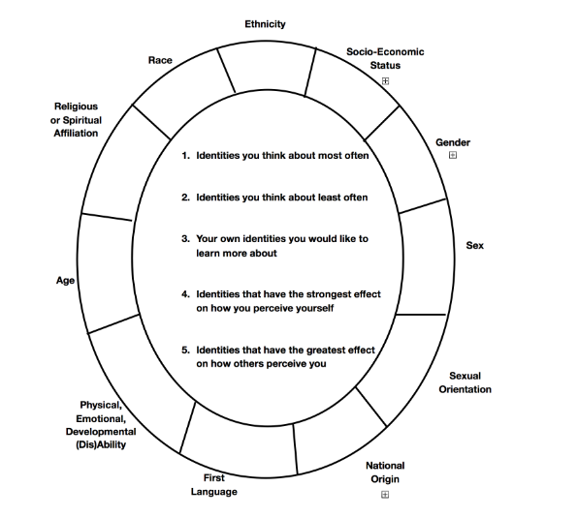
What social identity do you have?
Fill out the wheel based on your experience.
In point form, record your thoughts about the 4 questions.
Small group: Do you notice commonalities in your groups between what identities you think about the most and which you think about the least?

Slide 12
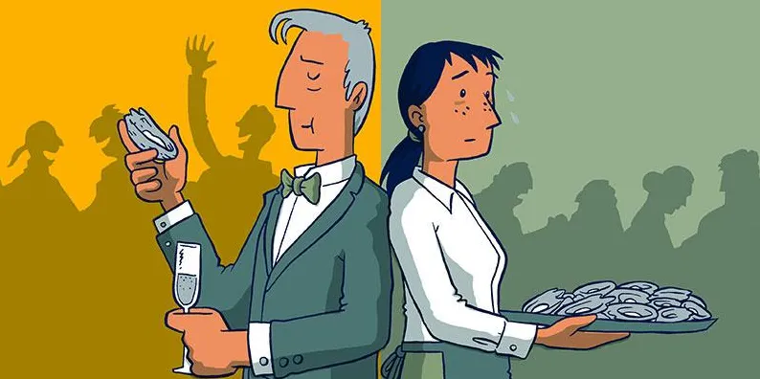
On a Plate by Toby Morris
https://www.rnz.co.nz/news/the-wireless/373065/the-pencilsword-on-a-plate

Slide 13
What advantages did Richard have that Paula did not?
What advantages did Richard have that Paula did not?
How did these advantages affect Richard’s success?
Did Richard notice how the privilege’s he has have impact his life?

Slide 14
As a teenager, what kind of things in your life are considered privileges?

Slide 15
Privilege
A special right, advantage or immunity granted only to a particular person or group
  Privilege can be earned, or unearned
Privilege is often invisible (or hard to see) for those who have it
  A fish does not always notice all the time that it is in water
  We humans often times don’t notice that we are in air
  https://www.youtube.com/watch?v=hD5f8GuNuGQ

Slide 16
What privilege is not…
An “on/off” switch: nobody is completely privileged and nobody isn’t privileged at all. Everyone will have different areas in their life where they have privilege and where they don’t.
  For example, we live in Canada, and that’s a privilege. However, most of our parents have to work for a living.
Something that makes you a bad person. Very few people can control what privileges they have.
Something that means you have never struggled or have had everything come easy for you. Everyone works hard in their lives.

Slide 17
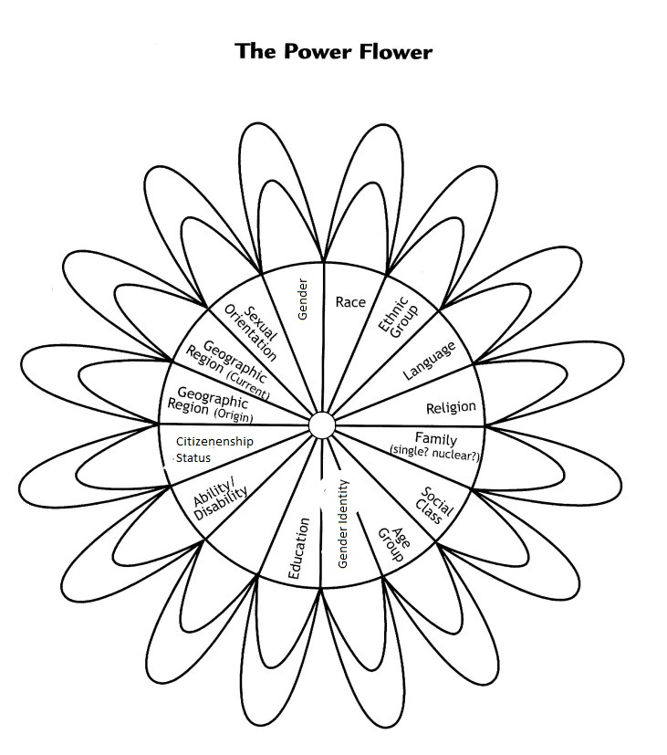
The Wheel: Independent
Reflect on your identity in each category and if its something that has been a barrier to your accessing opportunities or has negatively impacted how people treated you.
If you feel that this section of your identity has been a barrier or has negatively impacted how others have treated you, colour the outside of the petal.
If you feel like this identity has provided opportunities for you, or positively influences the way people treat you, or if you don’t feel it has any impact at all, colour the inside of the petal.

Slide 18
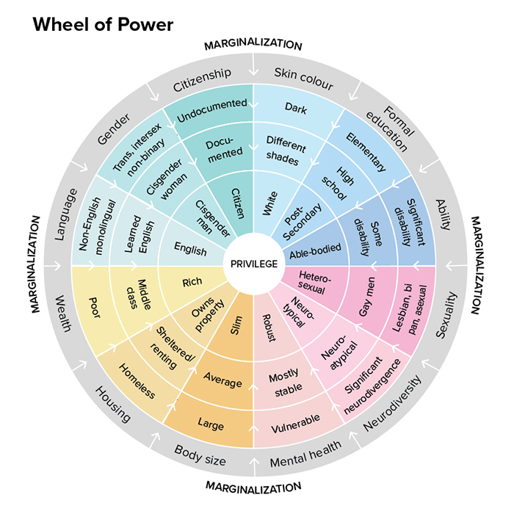
This wheel is how people often categorize identities.
What do you think is in the centre of this wheel?

Slide 19
Privilege Questionnaire
Get a blank piece of paper and a pen/pencil.
For each question I read out, place a check mark on your paper if the statement applies to you, an “X” is it does not, or a question mark if you don’t know.

Slide 20
My Parents worked jobs that allowed them to be home in the evenings and weekends

Slide 21
I am able to move through the world without fear of sexual assault

Slide 22
I can show affection for my romantic partners in public without fear of ridicule or violence

Slide 23
I have never been diagnosed with a physical, mental, or learning disability.

Slide 24
My first language is English

Slide 25
I come from a supportive family environment

Slide 26
I can easily find the kinds of hair products I need and/or cosmetics that match my skin color

Slide 27
I grew up in a two parent home

Slide 28
My parents are saving for my education

Slide 29
I can easily access medical care when needed

Slide 30
I don’t think twice about calling the police when trouble occurs

Slide 31
I do not have to take out loans to attend college or university

Slide 32
I feel comfortable walking alone at night

Slide 33
My school’s breaks accommodate my religious holidays

Slide 34
I will not have to work if I go to college or university

Slide 35
I am confident that my parents would be able to help me if I were going through financial hardship

Slide 36
If I am stopped by the police, I can be confident it is not about my race

Slide 37
My parents or guardians attended post secondary school

Slide 38
I am being taught my culture and the history of my ancestors in my classes

Slide 39
I was able to take family vacations as a child

Slide 40
I have never been uncomfortable hearing a joke or statements related to my race, gender, sexual orientation

Slide 41
My parents read to me growing up

Slide 42
My house has more than fifty books in it

Slide 43
I have never been the only person of my race, gender, or sexual orientation in a classroom

Slide 44
My parents fe(e)d me healthy meals

Slide 45
I am comfortable that I can share my feelings without being made fun of for being emotional

Slide 46
There are people who work for my family (like nannies, maids, gardeners, etc)

Slide 47
I have never been ashamed of the condition of my house, clothes, or possessions

Slide 48
My parents took me to galleries, plays, or art exhibits growing up

Slide 49
I am covered by my parents extended health benefits

Slide 50
My parents own our house

Slide 51
I can turn on the television or open to the front page of the paper and see people of my race widely represented.

Slide 52
If a store clerk is watching me, I can be confident they are not doing it based on my race

Slide 53
I am generally able to avoid unsafe areas

Slide 54
My family does not to use social assistance

Slide 55
Growing up, the families in media looked like my family

Slide 56
I do not need to “come out” about my sexual orientation

Slide 57
The sexual health education I had include information about my sexual orientation and gender identity.

Slide 58
I am not likely to be sexually harassed at work

Slide 59
I will not be expected to sacrifice my careers when I have a family

Slide 60
My elected representatives are mostly people of my own gender.

Slide 61
If I have children and pursue a career, no one will think I'm selfish for not staying at home.

Slide 62
I wont be overlooked for a job because I may choose to have children after being hired

Slide 63
I am allowed to vote for a government that makes choices for me.

Slide 64
I am not dependent on another for financial support

Slide 65
I can expect privacy from those around me, including my parents.

Slide 66
I know my ideas wont be dismissed due to my age

Slide 67
I have autonomy over my body

Slide 68
My family came to Canada voluntarily

Slide 69
My parents and I were able to go to school in our own communities and learn our culture

Slide 70
Table Talk
Was there anything on your sheet that surprised you?
What other questions could you ask? (list 2)

Slide 71
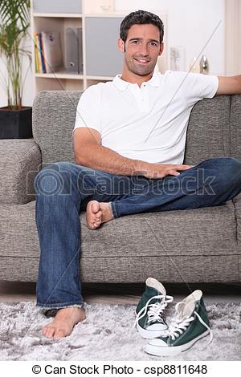
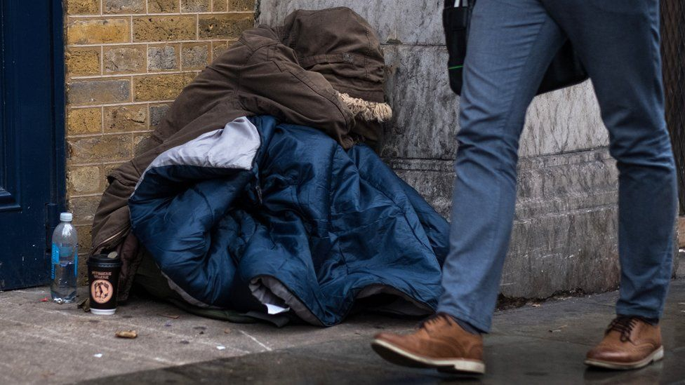
Privilege and our outlook on things
For each of the following slides, thing about how the two people’s opinions may differ on the issue and why.
For example: How might there two people feel differently about the issue of affordable housing in Vancouver?

Slide 72
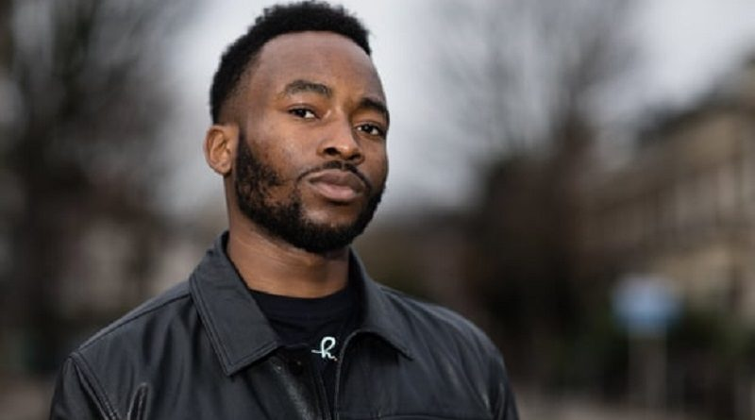
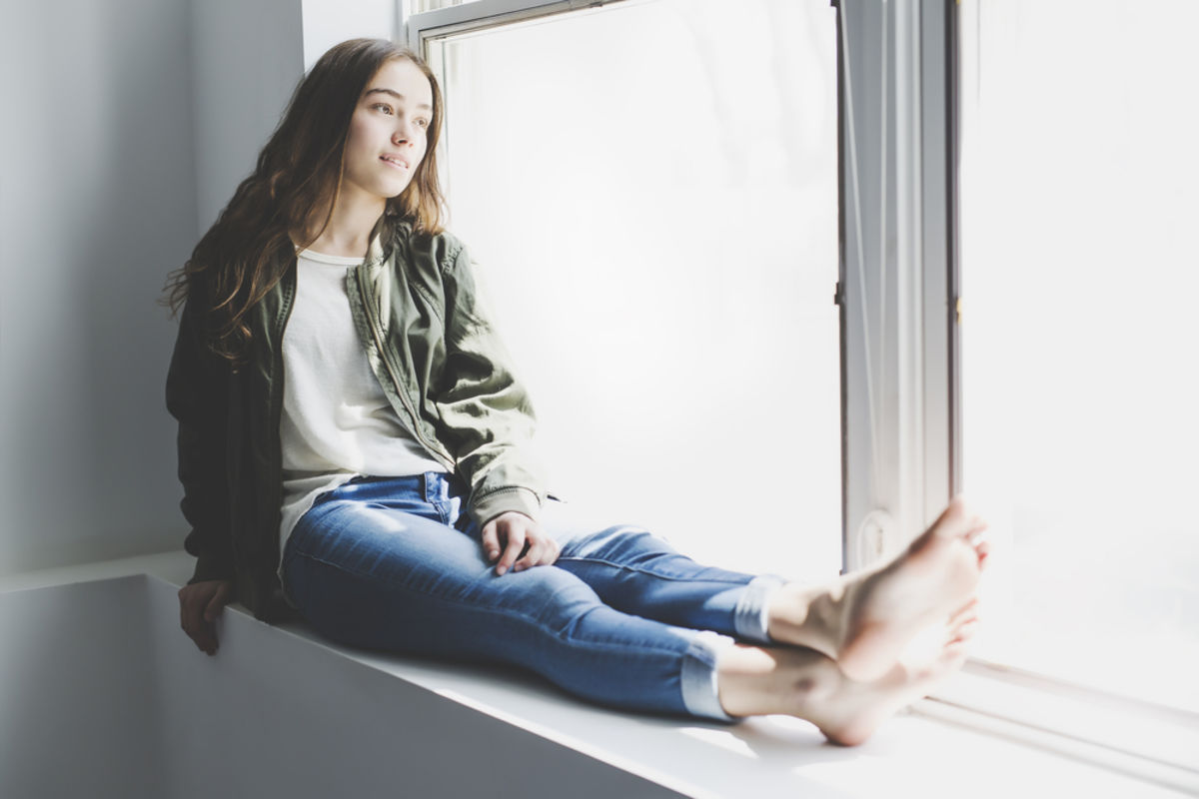
Issue: Police Brutality against BIPOC people

Slide 73
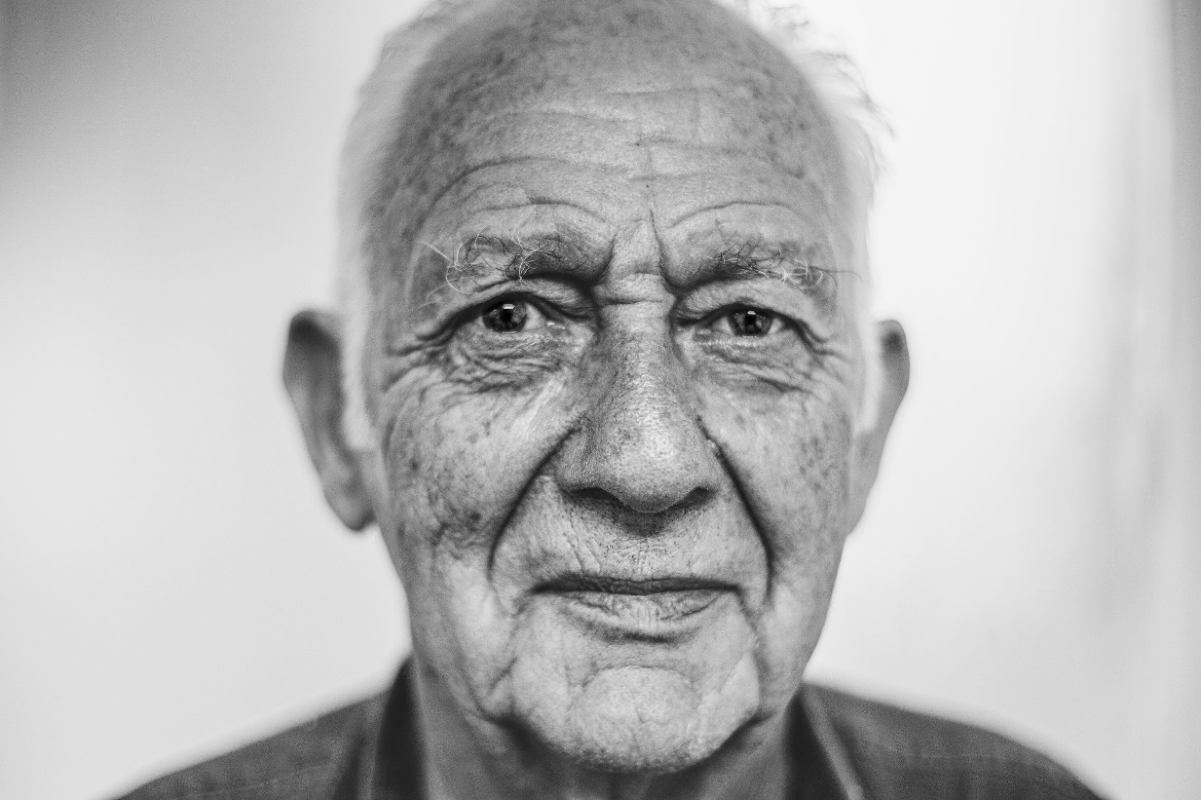
Issue: Access to reproductive healthcare

Slide 74
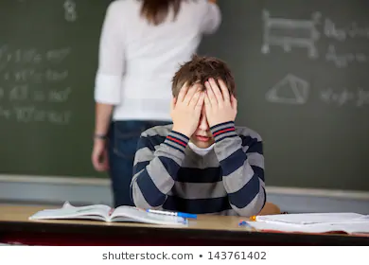
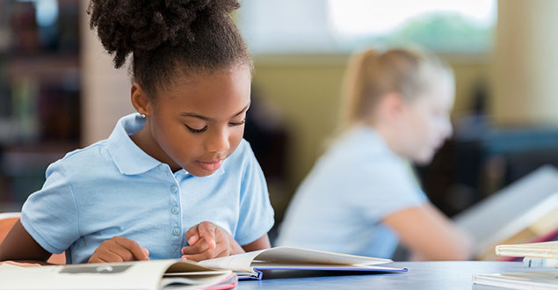
Issue: Support for students with learning disabilities in public school
Reads one grade about her grade level
Diagnosed with dyslexia; struggles with reading

Slide 75
Issues: Mills shutting down in northern BC

Slide 76
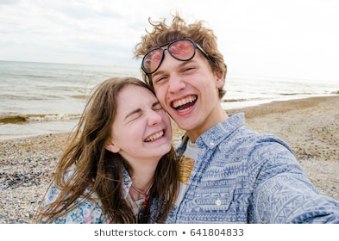
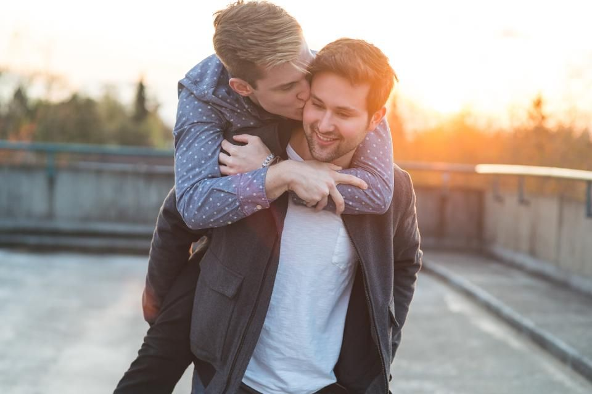
Issue: Inclusive sexual health education

Slide 77
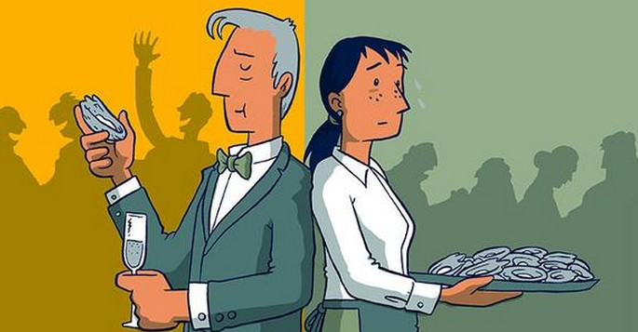
Ticket out the door
Thinking back to these two characters and their experiences growing up, how may their views differ when it comes to using tax money to help those living in poverty? Remember to explain your thinking!
What I’m looking for: Can you recognize how social position and social privileges influence thoughts and feelings about the world?

Slide 78
Privilege Walk
What did you feel like being in the front of the group? In the back? In the middle?
What were some factors that you have never thought of before?
What question made you think most? If you could add a question, what would it be?
What do you wish people knew about one of the identities, situations, or disadvantages that caused you to take a step back?
How can your understanding of your privileges or marginalizations improve your existing relationships with yourself and others?

