Slide 1
Stereotypes

Slide 2
Either in discussion with a partner or in writing: Think about a situation when someone made a judgment about you or acted unfairly toward you because of your age, skin color, clothes you were wearing, gender, the way you speak, where you live, how much money your family has, or some other reason.
How did you know that you were being unfairly judged?
What words or actions were directed at you because of assumptions or stereotypes?
Why do you think those assumptions were made about you?
How did the experience make you feel?
How do you think you should have been treated in that situation?

Slide 3

Do you think this is true?
“The single story creates stereotypes, and the problem with stereotypes is not that they are untrue, but that they are incomplete. They make one story become the only story.”
― Chimamanda Ngozi Adichie

Slide 4
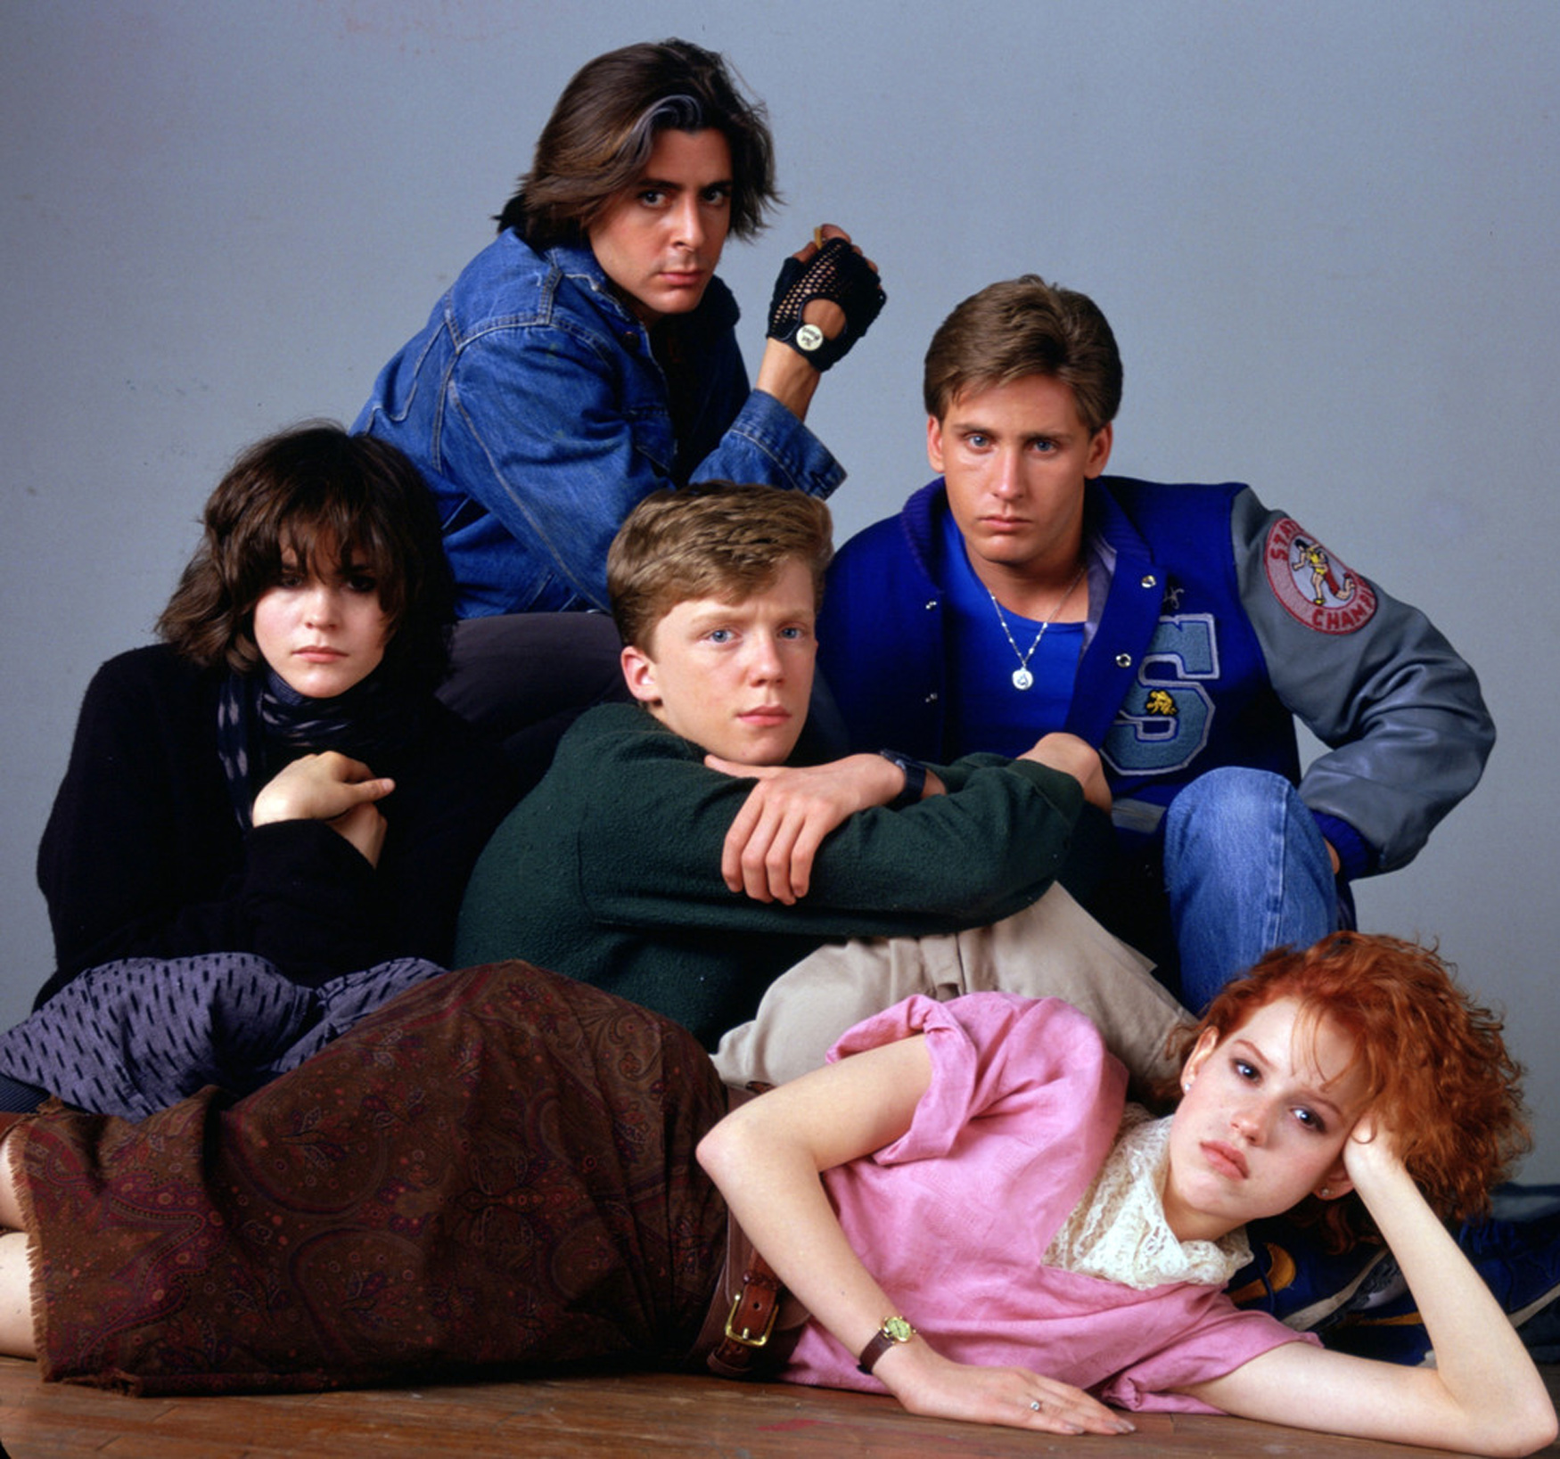
What stereotypes come to mind when you think of….
A jock
A nerd

Slide 5
How can we define stereotype?
Brainstorm as a group of four then write it on the board.
What commonalities do your definitions have?

Slide 6
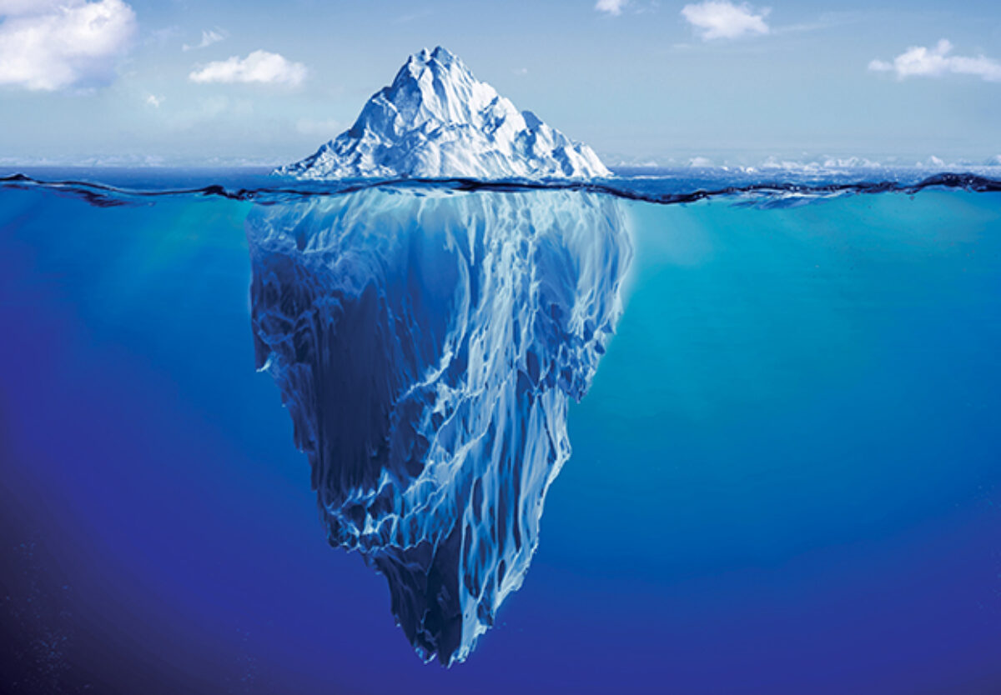
“The single story creates stereotypes, and the problem with stereotypes is not that they are untrue, but that they are incomplete. They make one story become the only story.”
While there are some folks who will fit a stereotype, we often only see the stereotype (the tip of the iceberg) and not all the other parts of the story that contribute to it).
Despite the stereotype, Indigenous people tend to binge drink at same rates as white Americans and most Indigenous people choose to abstain from alcohol all together
“Rates of heavy drinking — sustained binge-drinking — were comparable: About 8.3 percent of Native Americans and 7.5 percent of whites [Americans].
When it came to abstaining from alcohol, 60 percent of Native Americans didn’t have a drink during the previous month, compared to 43 percent of whites.”
-Washington Post
Stereotype that “Indigenous people drink more than others”
Lack of culturally appropriate healing resources
Intergenerational Trauma
Self-medication
Indian Act, reserves, and residential schools
Pop culture representation
Forced relocation and disconnect from traditional territories
colonialism
Continued removal of children
From parents and communities

Slide 7
“The single story creates stereotypes, and the problem with stereotypes is not that they are untrue, but that they are incomplete. They make one story become the only story.”
While there are some folks who will fit a stereotype, we often only see the stereotype (the tip of the iceberg) and not all the other parts of the story that contribute to it).
“Women are better caregivers”
Gender as barrier to jobs, housing, etc.
Mothers being single parents
Gender Stereotypes
Devaluing of “womens work” (e.g., childcare, nursing)
Pop culture representation (competent mom; dumb dad eg simpsons, family guy)
Expectation that women will be primary care giver
Parental leave strictly for women

Slide 8
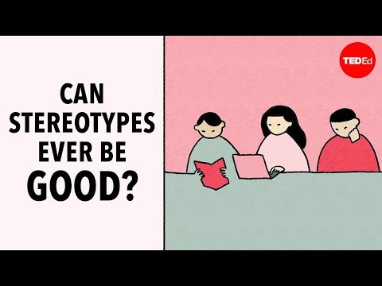

Slide 9
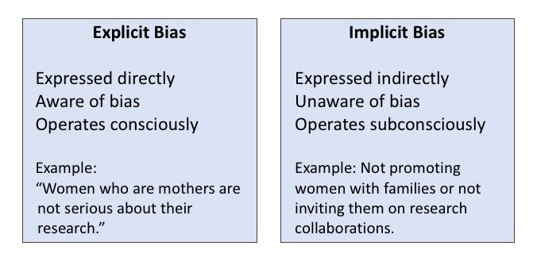
What are the impact of stereotyping?
External Impact:
  When assumptions and stereotypes influence our attitudes, we may find that making a fair judgement about someone or something is difficult. This influence on judgement is called a "bias.” These biases can impact how you treat and behave towards other people.
  Bias can intentional or unintentional. You do not need to MEAN to treat someone different for it to be bias. Unintentional bias call “implicit bias”

Slide 10
Internal Impacts
WATCH THIS VIDEO!
https://www.facinghistory.org/resource-library/video/how-stereotypes-affect-us-and-what-we-can-do
“Stereotype threat is a situational predicament in which people are or feel themselves to be at risk of conforming to stereotypes about their social group.”
“People experience stereotype threat several times a day. And the reason is that we have a lot of identities. Our gender, our race, our age. And about each one of those identities that I mentioned, there are negative stereotypes. And when people are in a situation for which a negative stereotype about one of their identities is relevant to the situation, relevant to what they're doing, they know they could be possibly judged or treated in terms of that stereotype. They don't know whether they are or not, but they know they could be.”

Slide 11
Stereotypes lead to bias and prejudice
The difference between bias and stereotype is that a bias is a personal preference, like or dislike, especially when the tendency interferes with the ability to be impartial, unprejudiced, or objective. On the other hand, a stereotype is a preconceived idea that attributes certain characteristics (in general) to all the members of class or set.
If you think that all Asians are smart, or white men can't dance, that is a stereotype. But if you want to hire an Asian for a job that also has an equally qualified black applicant because you think blacks are not as smart as Asians, you are biased.

Slide 12
Complete the “Comfort in Social Situations Survey” form individually and the respond to the discussion questions.

Slide 13
Class Discussion:
Think about your own social group memberships. How do you think the answers for each section would be different for dominant group members (e.g., a White person answering the questions in Section A or a heterosexual answering the questions in Section C) compared to minority group members (e.g., a disabled person answering the questions in Section D)?

Slide 14
Class Discussion:
What does it mean if someone reports feeling uncomfortable in the situations described on the questionnaire? Does it suggest that the person is biased against certain social groups? Why or why not?
What can you do to address the biases you may have against other groups?

Slide 15
Discrimination
So far we’ve just talked about things that go on in people’s head, but our thoughts influence our actions
prejudice is a negative attitude, and discrimination is acting on that negative attitude.

Slide 16
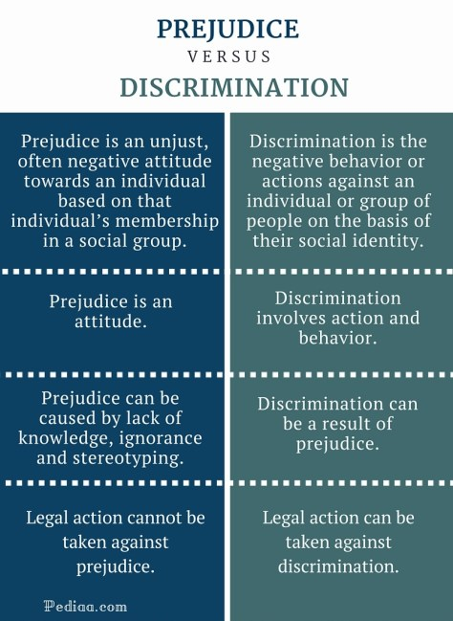

Slide 17
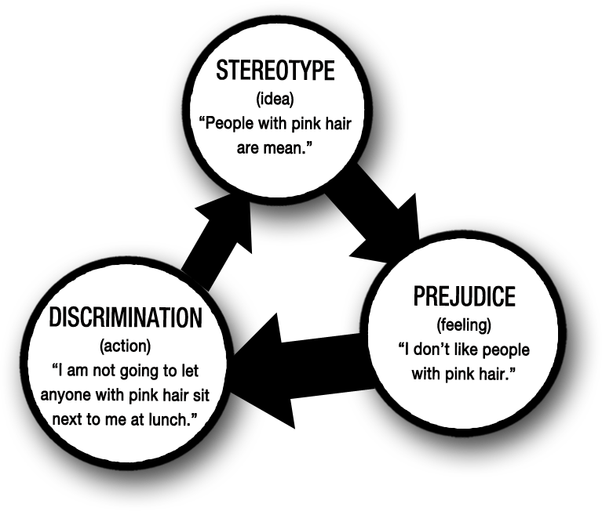

Slide 18
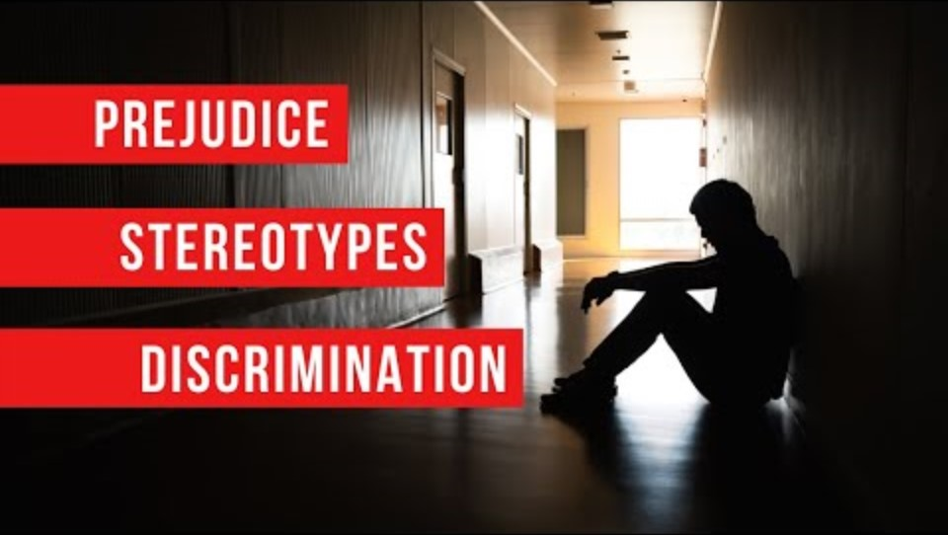

Slide 19
Discrimination vs Oppression
Discrimination is individual
Oppression is prolonged and systemic

Slide 20
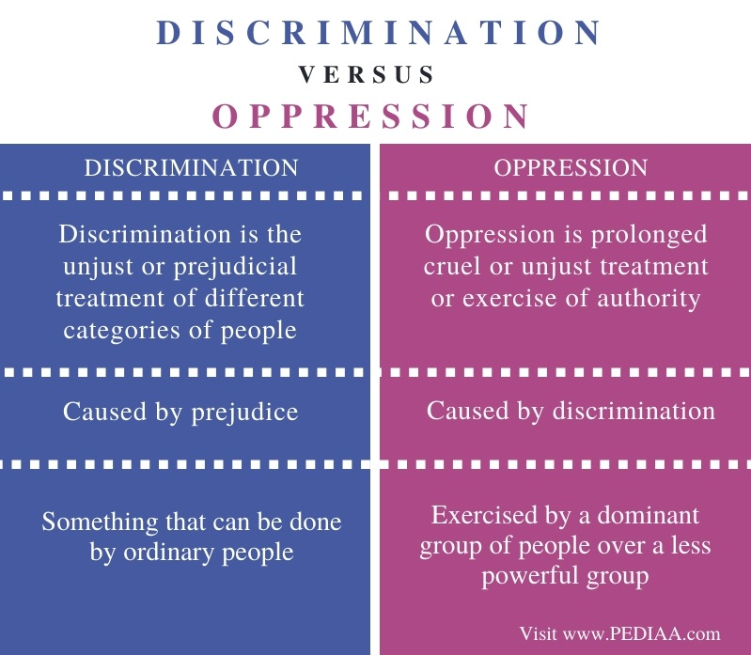

Slide 21
Oppression
Refers to the injustices and disadvantages some individuals or groups suffer as a consequence of intentional or unintentional practices within a society.

Slide 22
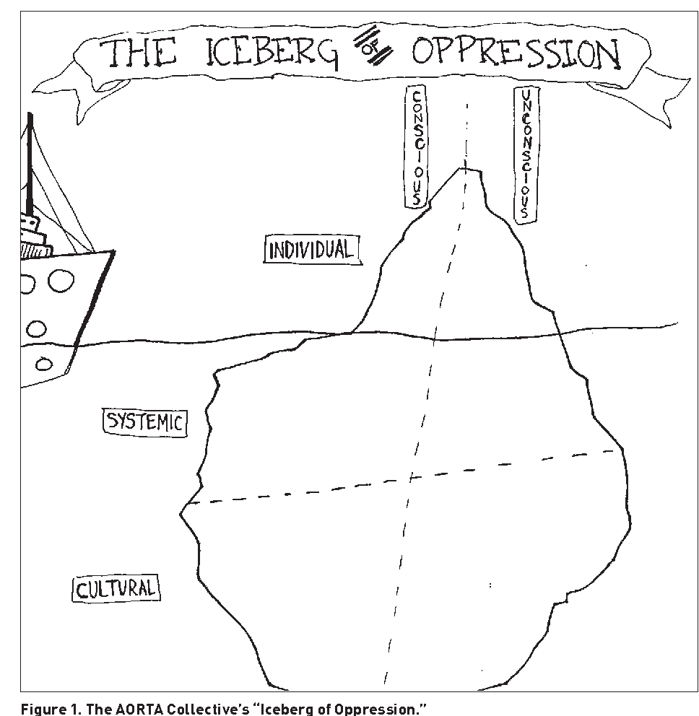
Copy the iceberg on your own sheet of paper and fill out with examples discussed in class.

Slide 23
Individual Oppression
Conscious
Unconscious
When someone purposefully and knowingly treats someone else differently based on identity
Based in explicit bias
For example: someone using a homophobic slur against someone else or making homophobic comments
When someone unknowingly treats someone else differently based on identity
Based in implicit bias
For example: a mechanic shop owners rejecting all applications from women

Slide 24
Systemic Oppression
Conscious
Unconscious
When systems (e.g., education, justice system, healthcare) has policies and procedures that disadvantage one group over another intentionally
Less visible than individual oppression
For example: A Toronto principal circulates a list of Black students to teachers (true story: https://www.cbc.ca/news/canada/toronto/etobicoke-school-black-list-1.4724307)
When systems (e.g., education, justice system, healthcare) has policies and procedures that disadvantage one group over another unintentionally
Less visible than individual oppression
For example: The Toronto School District was found to regularly stream Black students into class below their academic ability, which impacts where they can go for post secondary (https://www.cbc.ca/news/canada/toronto/study-black-students-toronto-york-university-1.4082463)

Slide 25

Cultural Oppression
Conscious
Unconscious
When culture (e.g., TV, literatue, movies, societal norms) treat marginalized groups in a way that enforces stereotypes and oppressions intentionally
For example: Using stereotypical images in advertising
When culture (e.g., TV, literatue, movies, societal norms) treat marginalized groups in a way that enforces stereotypes and oppressions unintentionally
For example: the bumbling dad stereotype where fathers are often portrayed as imcompetent
View list of media here: https://tvtropes.org/pmwiki/pmwiki.php/Main/BumblingDad

Slide 26
Iceberg of oppression
In a group of 2 or 3, get a big sheet of paper and some markers. Draw the iceberg of oppression on your paper. Then, choose one of the following issues and give examples of oppression in each quadrant of the iceberg
Racism
Homophobia
Sexism

