Slide 1
Peacemaking
Peacekeeping
Peacebuilding

Slide 2
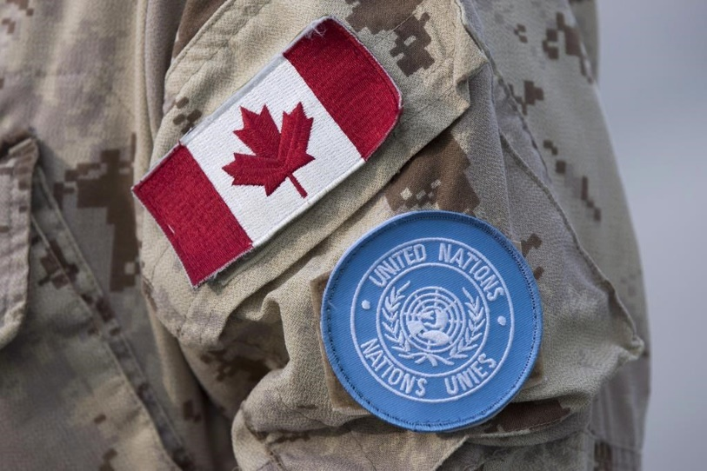
Canadian Peacekeeping
Canada has a very positive image around the world in regards to dealing with conflict.
As a nation we have been involved in numerous peacekeeping missions.
Our efforts have helped resolve conflict and save lives.

Slide 3

Changes in Defense Policy
Following WW II, Canada had the third largest navy in the world and gained military status as a middle power.
During the 1960s under Prime Minister Lester B. Pearson Canada restructured its military.
The navy, army and air force were all combined into one defense force under a central command.

Slide 4
Trudeau Era and the Military
Trudeau continued the trend towards peacekeeping rather than military strength.
In the early 1970s Trudeau made changes:
  Withdrawal of 50% of Canadian troops from NATO commitments in Europe
  Funding freeze
  Decrease armed forces from 110 000 to 80 000
  Canada would not allow nuclear missiles (Bomarcs) on Canadian soil
  Greater French-Canadian presence in armed forces
  Established diplomatic ties with communist China and Cuba

Slide 5
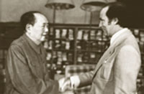
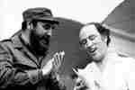
Controversy and Trudeau
Trudeau and Communist Leader of China Mao Zedong
Trudeau and Communist Leader of Cuba Fidel Castro

Slide 6

Canadian Involvement in Peacekeeping
Since the 1960s Canada has used its Armed Forces in a number of United Nations sponsored peacekeeping missions.
Canada has participated in more peacekeeping missions than any other nation.

Slide 7
Peacekeeping Missions
Below are a few of the peacekeeping missions Canada has taken part in:
Kashmir Region from 1949 to 1979
Indochina 1954 to 1973
Yom Kippur War of 1973
Afghanistan (88-90)
Cyprus
Nicaragua
Rwanda

Slide 8
Recent Missions: Somalia
In 1992, Canadian troops took part in UN mission to stop the civil war in Somalia.
They were unable to stop the war, but provided necessary aid to those in need.
This mission also put a black mark on Canadian Armed Forces after a Somalian was tortured and killed by several Canadian soldiers this became known as the Somalia Affair.

Slide 9
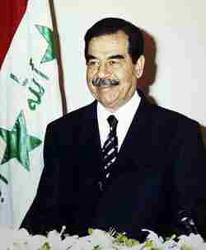
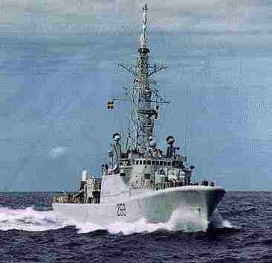
Recent Missions: Gulf War
In 1990 Saddam Hussein’s Iraqi Army invaded neighbouring Kuwait.
The UN authorized the use of military force to remove the Iraqi troops after Hussein refused to comply.
Canada supplied 4500 troops, participated in air attacks and controlled nearby shipping lanes.

Slide 10
Recent Mission: Yugoslavia
After the fall of communism in USSR, fighting broke out in Yugoslavia (1991) between Serbs, Croats, Bosnians (Serbs and Croats) and Muslims.
Canadian troops supported the NATO led force.
Canadians would also help in NATO led attack on Yugoslavia in 1999 after Serbs invaded Kosovo and committed genocide (ethnic cleansing).

Slide 11
Recent Mission: Afghanistan
Following the terrorist attacks of 911 the Canadian Armed Forces took part in a NATO led invasion of Afghanistan to root out Al-Queda and the Taliban government. This was not a United Nations sponsored mission and thus not a peacekeeping mission.

Slide 12
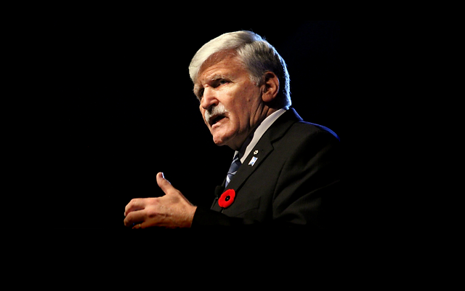
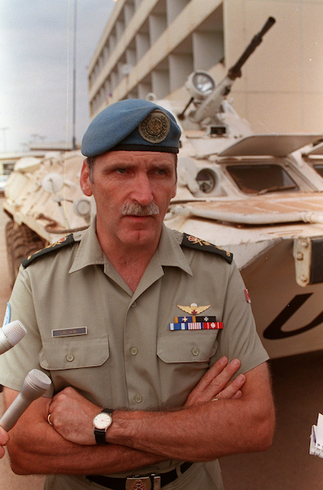
Romeo Dellaire

Slide 13
The Future of the Canadian Peacekeeping Forces
Canada continues to be known for its peacekeeping status.
Recent funding increases have given the Canadian Forces increased ability to provide help in areas of need (eg. Haiti and the Philippines).

