Slide 1
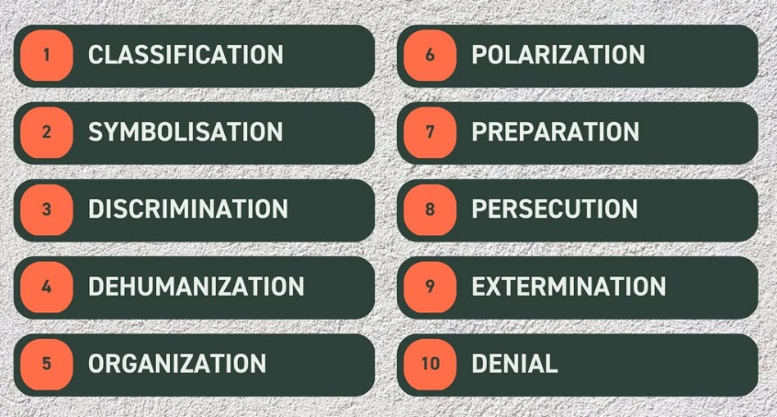
Rwandan Genocide Assessment
Learning Objectives Assessed:
Make reasoned ethical judgments about controversial actions in the past or present after considering the context and standards of morality
identify methods and approaches used to promote social justice and evaluate their success
Review the ten stages of genocide.
For each stage, explain how it applied to the Rwandan Genocide.
When you’re finished, answer the three questions and submit them with your pyramid:
  Could an event like the Rwanda Genocide happen today? Explain.
  How does the pyramid of hate inform our understand of Genocide? How can we use it to prevent another genocide from occurring?
  Evaluate Rwanda’s path to reconciliation? Is it successful? Why or why not?

