Slide 1
Introduction to Gender Unit
Day 1

Slide 2
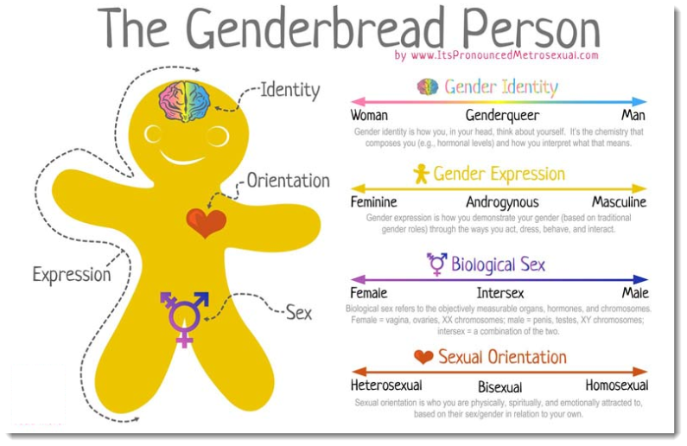

Slide 3
The gender binary is the classification of gender into two distinct, opposite forms of masculine and feminine, whether by social system, cultural belief, or both simultaneously.
However, there is growing recognition of gender as bimodal or a spectrum rather than a binary.

Slide 4
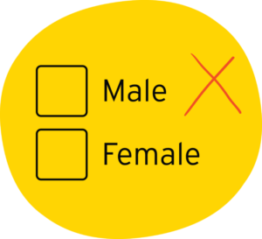
Binary
Binary means there are two categories and everyone fits into on of those two categories.

Slide 5
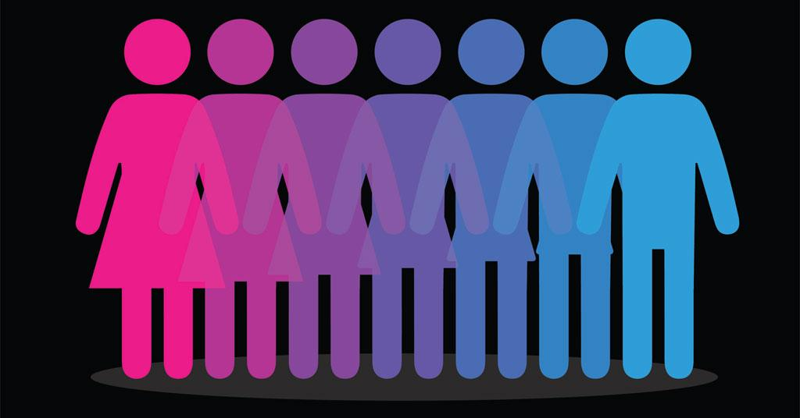
Spectrum

Slide 6
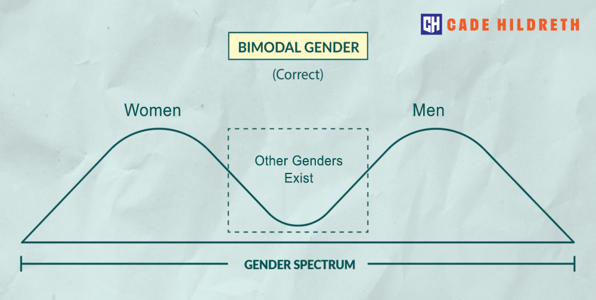
Bimodal

Slide 7
We’re going to look at how this gender binary impact our everyday lives

Slide 8


In your table groups
Grab two pieces of paper and, on each piece, draw a rectangle that leaves room to write on both the inside and the outside.
Label one box with this symbol → and the other with this
symbol →

Slide 9
As a group
With your table, brainstorm the stereotypes that we have for men and women, as you do this, write down the ideas your brainstorm on the inside of the box.
Thinking about what ideas we have of what makes someone “Masculine” and what makes someone “feminine”
Relationships, jobs, clothing, activities, sports, personality traits, etc

Slide 10
Day 2

Slide 11
Take up as a class
Share out
Where do we learn this ideas from?

Slide 12
In your groups
On the outside of your box, think about the way people who don’t meet these expectations are treated. What are they called by other people?
What patterns or connections do you see?

Slide 13
Theories of Gender – video and questions
Gender Essentialism
  Gender is the same as sex and based in biological criteria (e.g., what genitals you have and your chromosomes)
  attributes distinct, intrinsic qualities to women and men.
  holds that there are certain universal, innate, biologically (or psychologically) based features of gender that are at the root of many of the group differences observed in the behavior of men and women

Slide 14
Day 2

Slide 15

AGREE OR DISAGREE
TRUE
FALSE

Slide 16
My gender has little or no impact on my everyday life
AGREE
DISAGREE

Slide 17
People have expected me to act a certain way because of my gender
AGREE
DISAGREE

Slide 18
I have been discouraged from participating in something because of my gender
AGREE
DISAGREE

Slide 19
I have avoided certain activities or conversations because they do not conform to stereotypes of my gender
AGREE
DISAGREE

Slide 20
Feminism is needed in 2022 to ensure gender equity
AGREE
DISAGREE

Slide 21
Women have lower wages than men because women work in easier jobs
AGREE
DISAGREE

Slide 22
Gender equality will come at a high cost for men
AGREE
DISAGREE

Slide 23
There is too much emphasis on violence against women and girls and not enough attention given to violence against men and boys.
AGREE
DISAGREE

Slide 24
Gender roles are important and exist for a reason
AGREE
DISAGREE

Slide 25
Choose one of the statements and write a persuasive paragraph defending your position:
My gender has little or no impact on my everyday life
People have expected me to act a certain way because of my gender
I have been discouraged from participating in something because of my gender
I have avoided certain activities or conversations because they do not conform to stereotypes of my gender
Feminism is needed in 2022 to ensure gender equity
Women have lower wages than men because women work in easier jobs
Gender equality will come at a high cost for men
Gender roles are important and exist for a reason
There is too much emphasis on violence against women and girls and not enough attention given to violence against men and boys.
PUT THIS IN YOUR PORTFLIO WITH THE TITLE “AGREE/DISAGREE”

