Slide 1
Tuesday, May 26

Slide 2
What would happen if money disappeared tomorrow?

Slide 3
Find a partner and brainstorm five items you both used before coming to school today

Slide 4
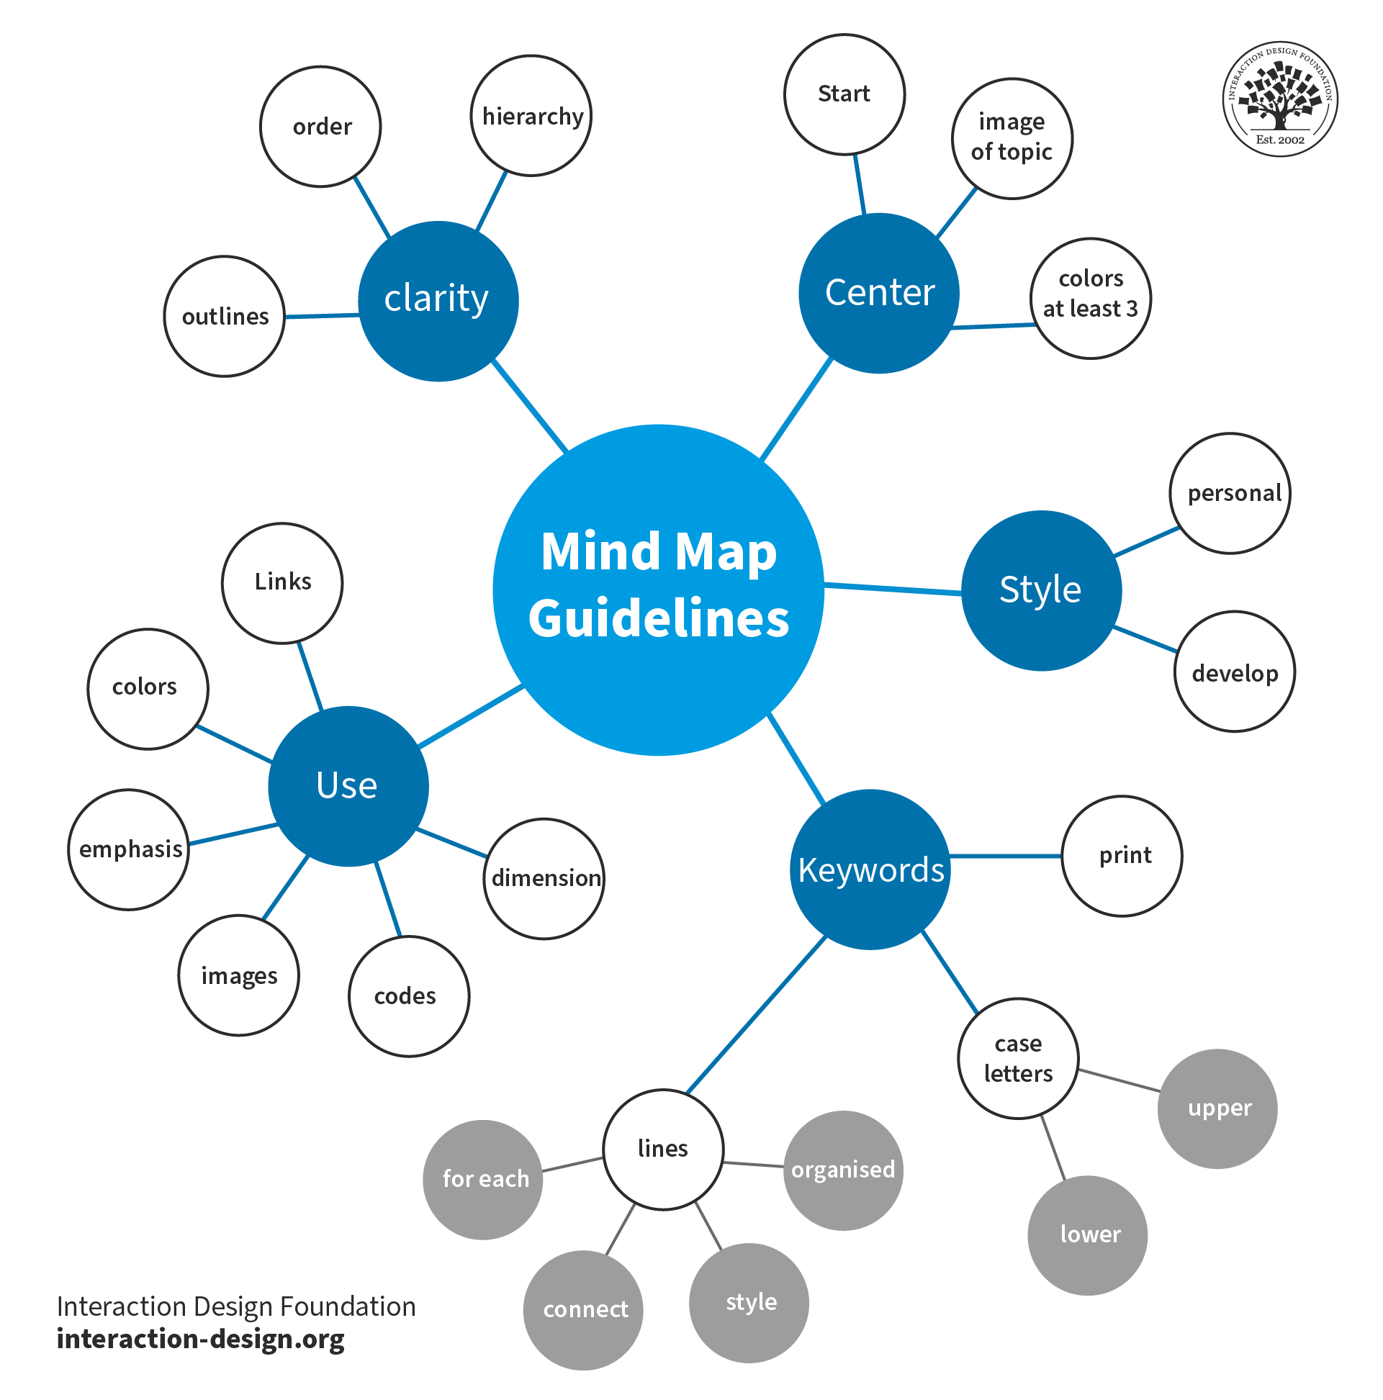
Economic Web
As a class, map out:
Who made it?
What resources were needed?
How did it get here?
Who worked on it?
Who profits from it?
Choose one of the items you used this morning and brainstorm the answer to these questions in a mind map

Slide 5
What is the Economy?
An economy is:
  The system people use to produce, distribute, and consume goods and services.

Slide 6
The Economy involves three parts:
Produce:
  Making things or providing services
  Examples:

Slide 7
The Economy involves three parts:
Distribute
  Moving goods/services to people

Slide 8
The Economy involves three parts:
Consume
  Using or buying goods/services

Slide 9
streaming music

Slide 10
building houses

Slide 11
teaching

Slide 12
eating food

Slide 13
Shipping

Slide 14
Public Services

Slide 15
Public healthcare

Slide 16
Farming

Slide 17
Getting a Haircut

Slide 18
Tik Tok Influencer

Slide 19
Stores

Slide 20
Online Delivery

Slide 21
Farming

Slide 22
Key Vocabulary
Term | Simple Definition | Example
Goods | Physical items people buy/use | Shoes, food, phones
Services | Work done for others | Teaching, haircuts, healthcare
Resources | Things used to make goods/services | Wood, oil, labour, time
Trade | Exchanging goods/services | Buying groceries
Consumer | Someone who buys/uses | Students buying lunch
Producer | Someone who makes/provides | Farmers, companies
Worker | A person who does labour or provides services | Teacher, cashier, nurse
Owner | A person who owns a business or company | Restaurant owner, CEO, shop owner

Slide 23
The economy is not just “the stock market” or “money.”
Economies are about relationships, work, resources, and decision-making.

Slide 24
Simulation

Slide 25
A large coastal city has suddenly experienced a major fuel shortage after a natural disaster damaged transportation routes and fuel delivery systems.
Fuel is now extremely limited.

Slide 26
Step 1: Assign Roles
You will each get a piece of paper with a job on it.

Slide 27
Step 2: Initial Response
How does the fuel shortage affect you directly?
  What problems does it create?
  What do you need from other people in order to continue functioning?
  Who depends on you?
  Students write short notes.

Slide 28
Step 3: Economic Chain Reaction
Example
Truck Driver
“We cannot get enough fuel to make deliveries.”
This affects:
grocery stores not receiving food
hospitals receiving fewer supplies
gas stations running low
factories missing materials
Bigger impacts:
food shortages
rising prices
panic buying
people missing work
Now that you understand how the fuel shortage affects your own role, your job is to figure out how those problems spread throughout the rest of society.
You will share how you role is impacted. As your classmates share, think about how what is happening with their role impact your own role.

Slide 29
What You Should Think About
As you listen to others, ask yourself:
Who depends on me?
Who do I depend on?
What happens if my job cannot function properly?
What goods or services stop moving?
Who gets affected next?
Which problems become most serious over time?

Slide 30
Exit Ticket
  In your own words, what is an economy?
  Is the economy more about money or about relationships? Explain.

