Slide 1
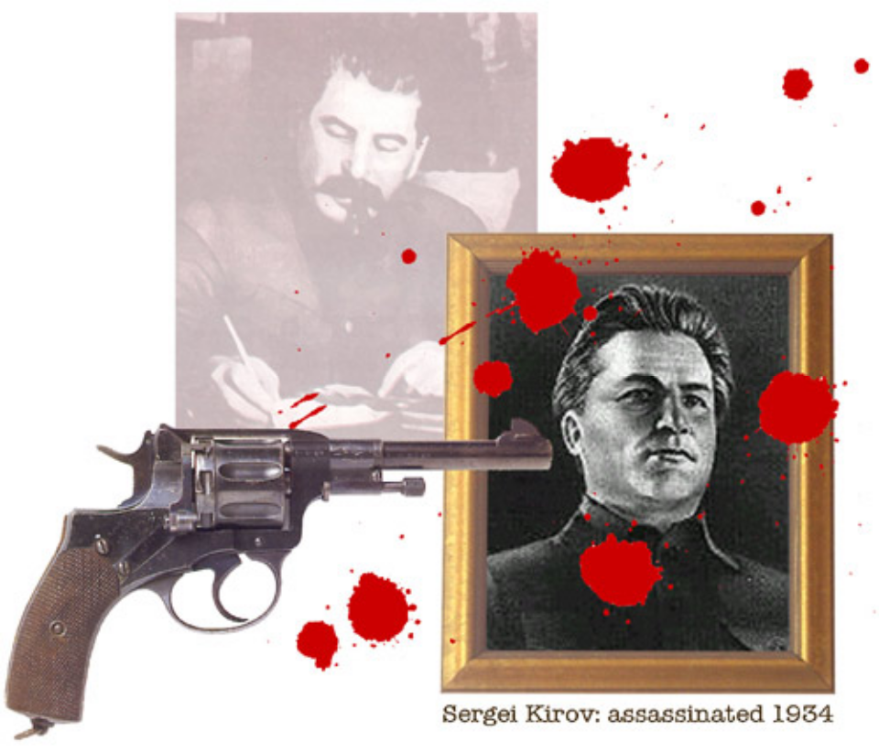
The USSR Under Stalin
Stalin’s Purges

Slide 2
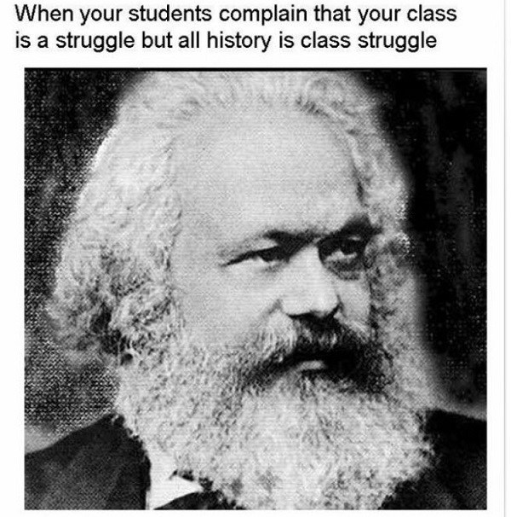
What we know so far?

Slide 3
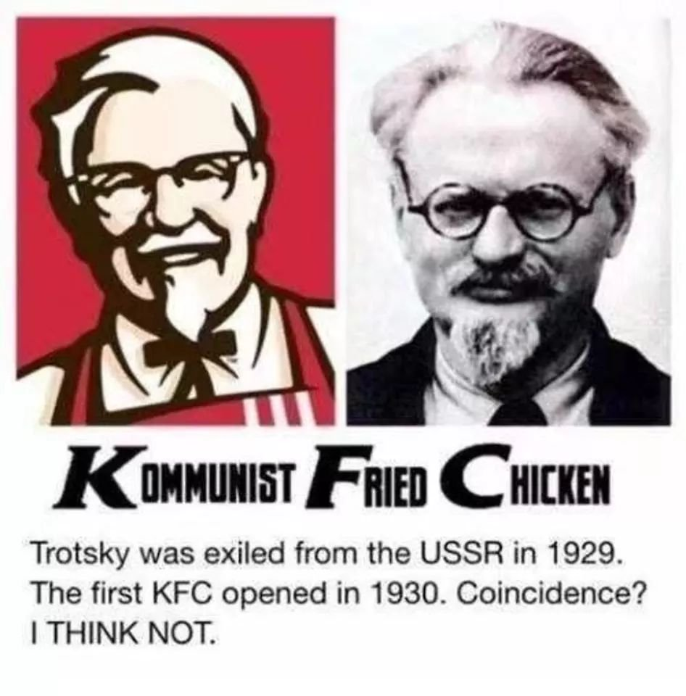

Slide 4
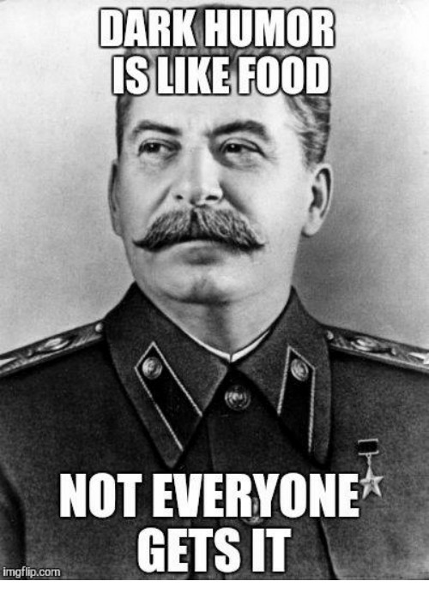

Slide 5
A. Background
The most famous aspect of Stalin's USSR was the Terror.
Wanted to be an autocrat
  Paranoid others trying to depose him
Consolidated power with
  NKVD (secret police)
  public 'show trials'.
  ‘Gulag' - system of slave labour camps

Slide 6
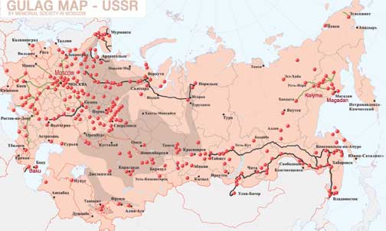

Slide 7
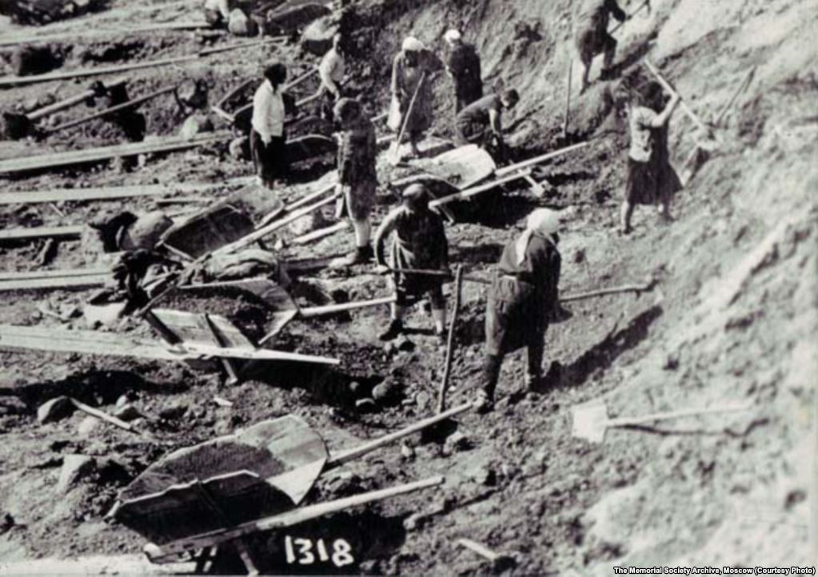
Gulags
GULAG stands for Glavnoe Upravlenie ispravitel’no-trudovykh LAGerei (Main Administration of Corrective Labor Camps),
Around 2-3 million people die in the Gulags
  Could be as high as 8 million
High death rate due to:
  Constant violence
  Extreme climate
  Hard labor
  Meager food rations
  Unsanitary conditions

Slide 8
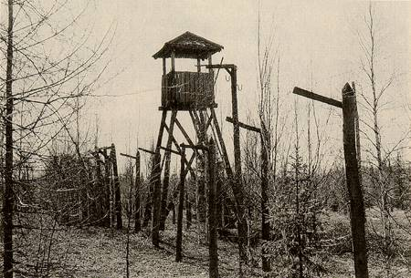

Slide 9
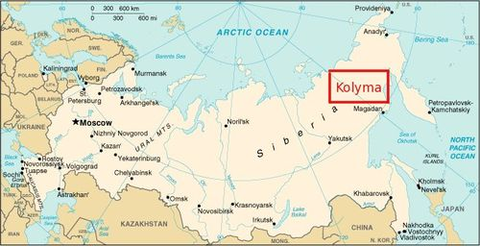
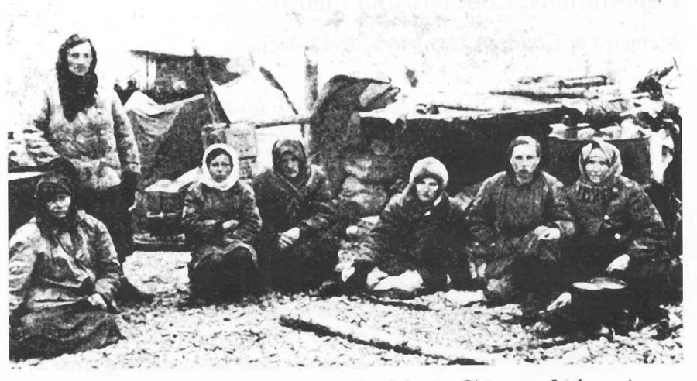
Kolyma
Probably the worst of the labour camps was at Kolyma.
  Located in north-eastern Siberia
  Temperatures drop to -67 degrees during the winter
  About 30% die each year

Slide 11
B. Reasons For the Terror
Whole Country
    Stalin believed that Russia had to be united with him as leader if it was to be strong
Urgency
    Stalin believed Russia had only 10 years to catch up with the western world before Germany invaded.
      Eliminate barriers
      Meeting goals are more important than individuals
Political Opposition
    Did not take criticism well
      Forced to pause plans
      Peasant revolts - collectivization
      Worker revolts – long hours, low wages, poor working conditions, lack of goods.
      People unhappy with Gosplan aggressiveness and NKVD

Slide 12
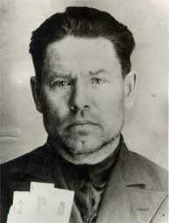
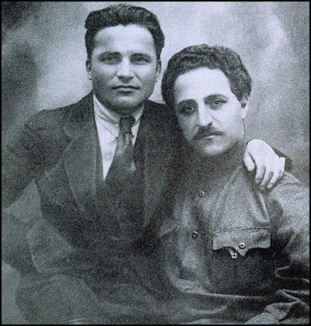
B. Reasons For the Terror
Political Opposition
  1930
    Stalins rivals re-elected to CC
    Bukarin, Rykov, Tomsky
  Ryutin affair
    Sparked by collectivization famine and deaths
    called for the removal of Stalin based on Lenin’s testament
    Verified his belief of plots against him
      made Stalin increasingly paranoid (seeing plots everywhere)
    Launched brutal repression of all opposition real or imagined

Slide 13
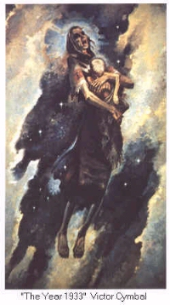
C. Chronology of the Purges
The - 3 phases (in general)
1st: The Kulaks and low level party members
2nd: 1934 - purge of party
3rd: - 1937 purge of military

Slide 14
D. The First Phase 1930–33
This included the Kulaks who resisted collectivization
  10 million
Low level party members
  400 000

Slide 15
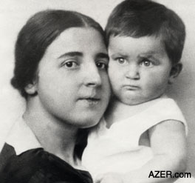
Stalin’s Family

Slide 16
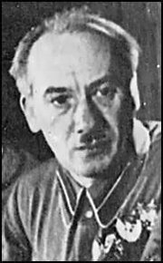
E. Phase Two: The Great Purge, 1934–39
Secret Police
    NKVD
      enlarged
      job to root out and destroy opposition
      to terrorize ordinary people into silence
    sometimes secret police officers spied on each other!
Genrikh Yagoda

Slide 17
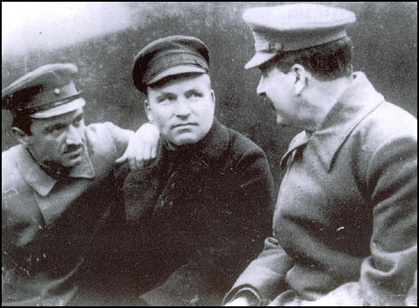
Sergei Kirov
Kirov loyally supported Stalin
  In 1926 he was appointed head of the Leningrad party organization.
  He joined the Politburo in 1930
Kirov started to become more popular
  1934 congress
  Charismatic, good speaker, ethnic Russian
  Called for party reconciliation
Kirov is like a son to Stalin
  Asks him stay in Moscow
  Kirov refuses

Slide 18
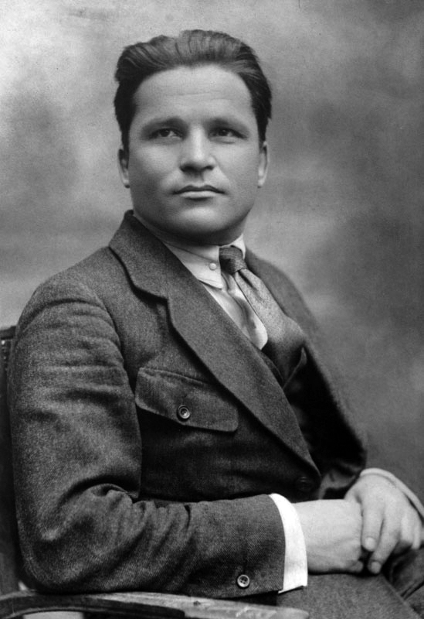
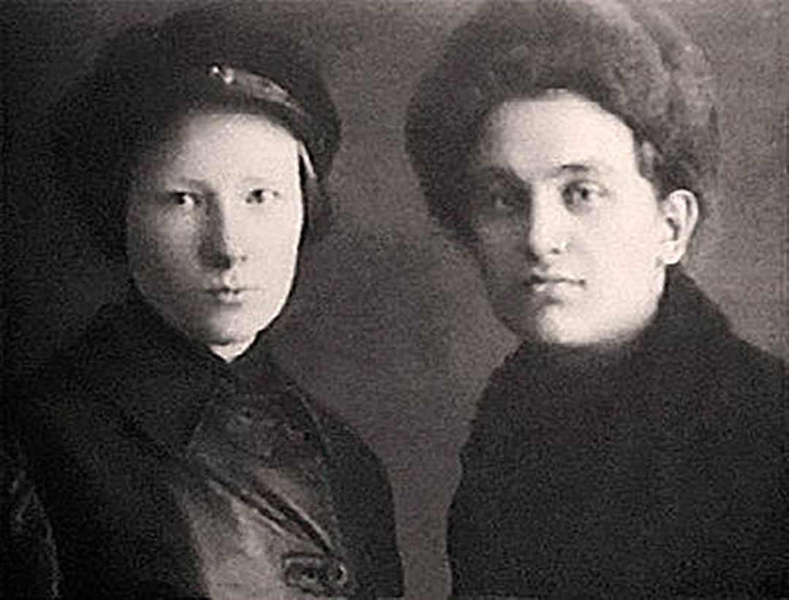
The excuse: the
  1934 murder of Sergei Kirov (chief of the Leningrad Communist Party)
    evidence indicates that this could have been set up.
http://www.indepthinfo.com/kirov/murder.shtml
Sergei Kirov, 1934

Slide 19
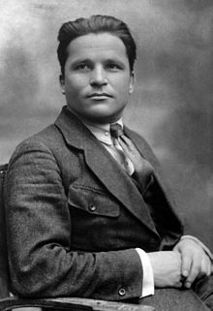
Purge of the Government
The death of Kirov sparks this purge
  Leonid Nikolayev kills him
Stalin asks the Politburo for their support to purge the party so that certain elements could be removed
The first to be rounded up were the Trotskyites
  They are put into prisons run by the NKVD
  Stalin signed a decree that made families liable for the crimes committed by their husband or father.
    Children as young as 12 could be executed.

Slide 20
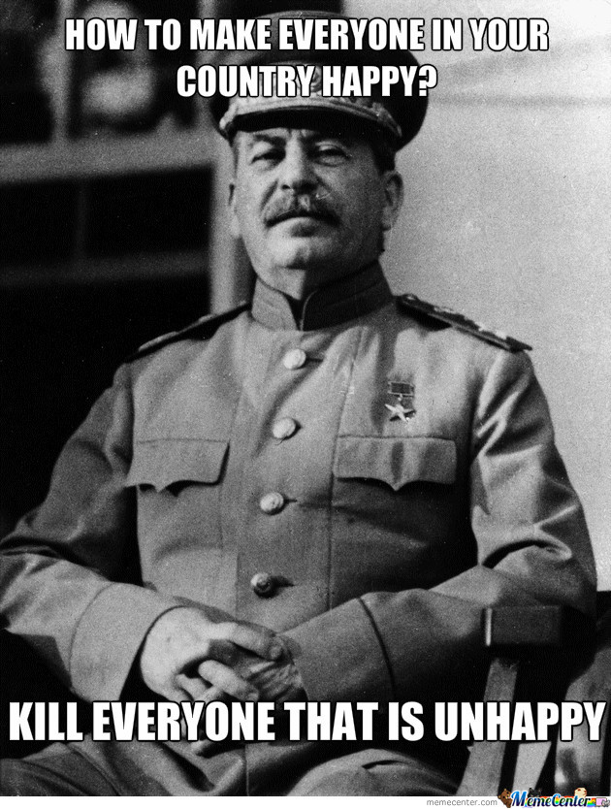

Slide 21
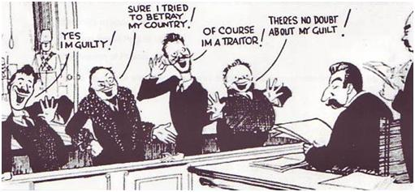
First Show Trial - August 1936
Stalin wanted to keep his purges ‘legitimate’
  He gave major figures the opportunity of a trial
    These were dubbed “Show Trials”
The first trial of the so-called "Trotskyite-Kamenevite-Zinovievite-Leftist-Counter-Revolutionary Bloc”

Slide 22
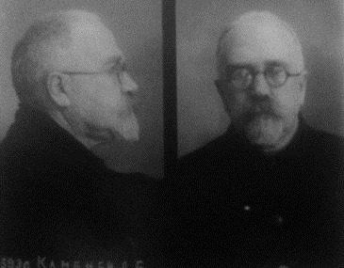
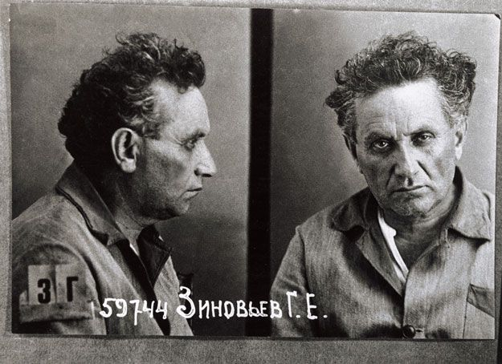
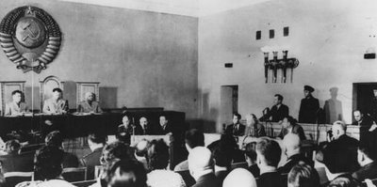
Kamenev and Zinoviev were promised their lives if they plead guilty… but they refuse
  Stalin then threatens their families
They had allegedly plotted and carried out the assassination of Kirov and planned the assassination of Stalin
  all under the direct instructions of Trotsky
They are both executed after the trial
  Stalin did not keep his promise about their families

Slide 23
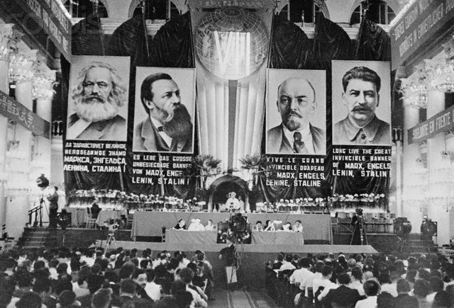
Second Show Trial - January 1937
Involved 17 lesser figures known as the "anti-Soviet Trotskyite-center"
  13 are executed and the rest are sent to labour camps… where they die
It was the duty of every good communist to be "watchful" for "saboteurs", often there was benefit to the accusers. This included kids turning in parents.

Slide 24
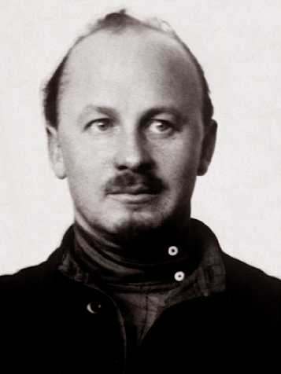
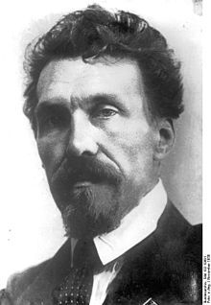
The Third Trial - March 1938
Probably the most famous of the trials
  Bukharin and Rykov trial- Trial of the Twenty-One
His trial is interesting because he pleads guilty after denying all the acts he was accused of
Of the 15 members from the first Bolshevik government
  10 had been executed
  4 had died

Slide 25
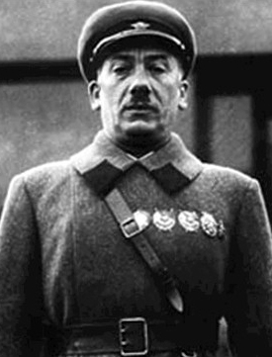
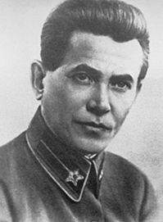
    Even the head of the NKVD, Yagoda, and his senior staff were shot
      (on orders of new NKVD director Nikolai Ivanovich Yezhov)

Slide 26
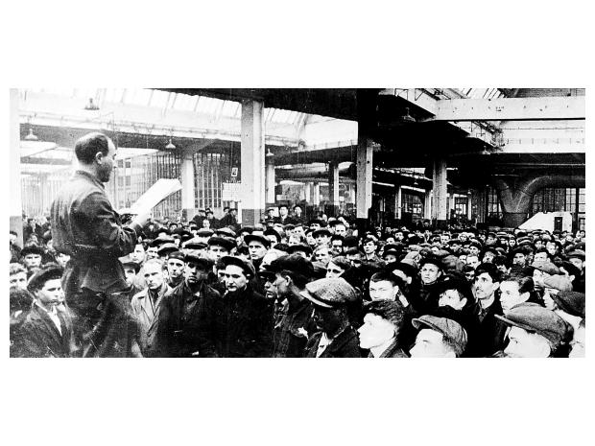
A Show Trial in Moscow

Slide 27
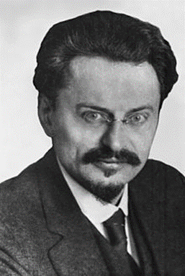
Many party members charged with
  conspiracy to kill Kirov
many confessed to a conspiracy with Trotsky
Why confess to false charges?
    to save lives of families
    Torture
    believed their deaths were in the interests of the country
    some were relieved to have the process over
      many trials were rehearsed and when a Judge recognized fabricated evidence, many accused still wanted to confess

Slide 28
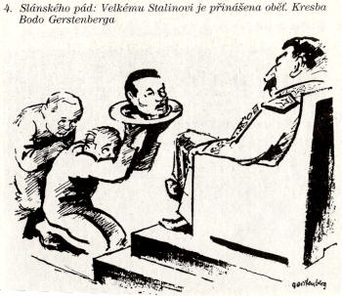

Slide 29
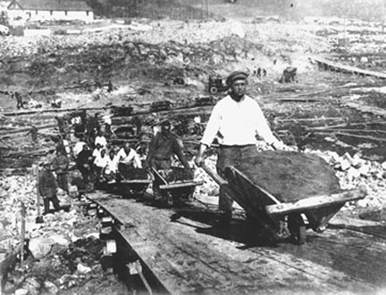
many were arrested and without a trial
  Many sent to Gulags
  Many shot
prisoners called "zeks“
      estimated about 17-25 million political prisoners were used to help industrialize the USSR

Slide 30
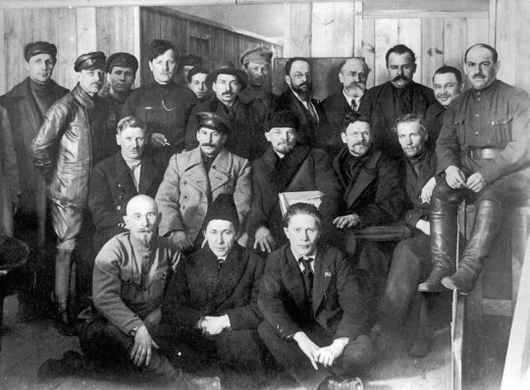
by 1940, only one of the original governing Bolsheviks was left alive: Stalin

Slide 31
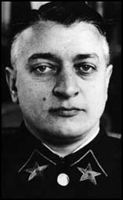
F. Phase Three: The Purge of Military (1937-38)
Afraid of a military coup
done to remove any remaining source of opposition to Stalin
      (remember Kronstadt?)
most famous victim
  Commander-in-Chief Marshall Tukhachevsky – a hero of the civil war

Slide 32
In all:
3 out of 5 full marshals purged
3 out of 4 full generals
12 lieutenant-generals
60 out of 67 corps commanders
136 out of 199 divisional commanders
Total: about 1/2 of all officers disappeared
  50000

Slide 33
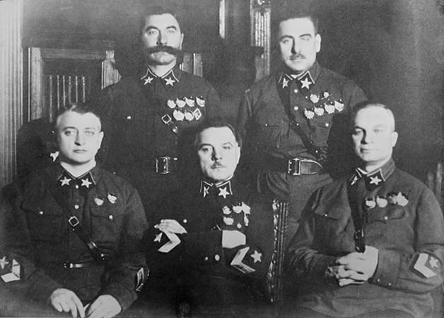
The first five Marshals of the Soviet Union in November, 1935. (l-r): Mikhail Tukhachevsky, Semyon Budyonny, Kliment Voroshilov, Vasily Blyukher, Aleksandr Yegorov. Only Voroshilov and Budyonny survived the Great Purge.

Slide 34
the Red Army was weakened enough that Nazis forces (during Operation Barbarossa) easily swept aside the Red Army as they advanced during the early months of the operation in WWII

Slide 35
G. Stalin’s Other Purges
The Church:
  Religious leaders imprisoned; churches closed down.
Ethnic groups:
  Stalin enforced ‘Russification’ of all the Soviet Union.
Ordinary people:
  20 million Russians were sent to the camps
Intelligencia
  Apparatchiks (party members loyal to Stalin) got all the new flats, jobs, holidays etc.

Slide 36
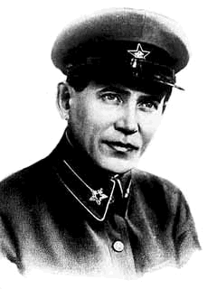
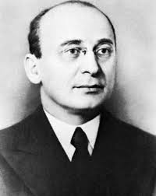
Nikolai Ivanovich Yezhov
People's Commissar for State Security
January 27, 1937 – November 25, 1938
Takes blame for purges
Replaced by Lavrenty Beria

Slide 37
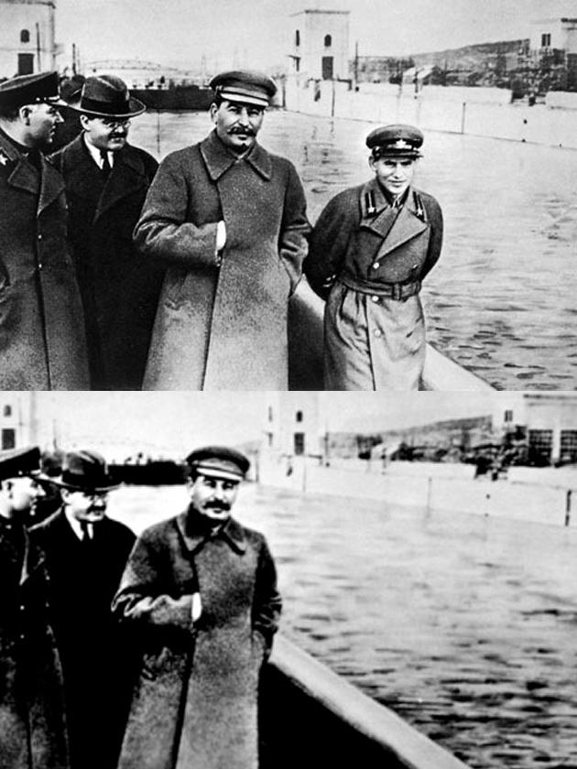
Outcome
An average estimate is that in the Soviet Union:
  500,000 – 1,000,000 were executed in 1937-39
  Somewhere between 8 and 12 million were sent to labor camps (1937-39)
    Only 30% return home

Slide 38
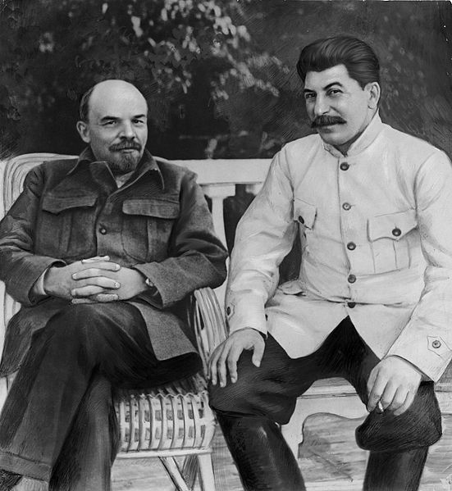

Slide 39
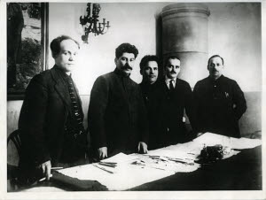
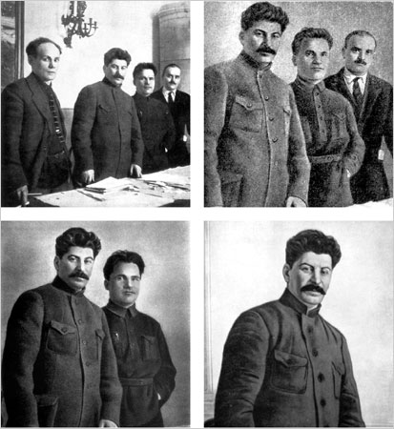

Slide 40
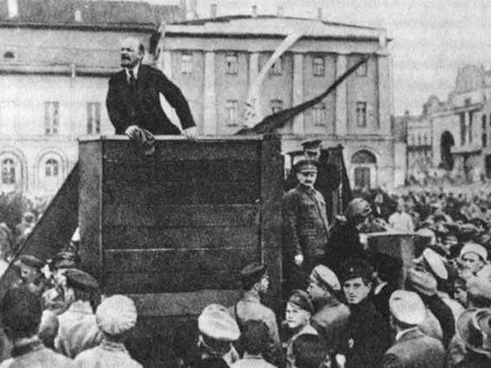

Slide 41
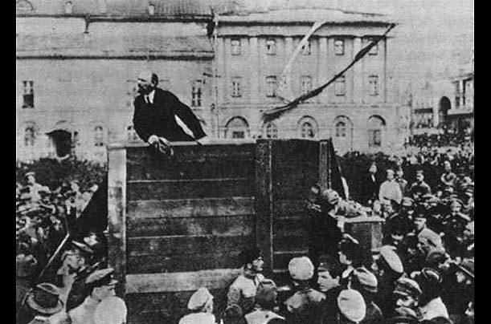

Slide 42
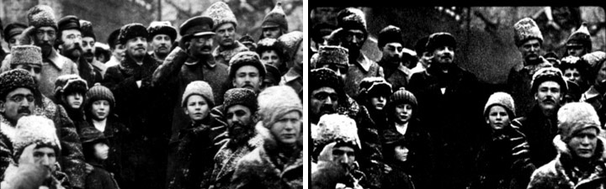

Slide 43
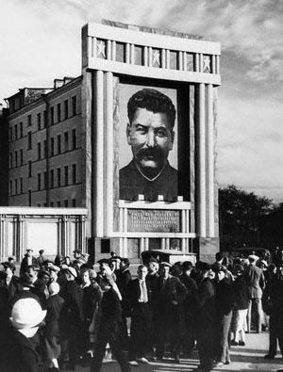
H. The Cult of Stalin Emerges
Censorship of anything that might reflect badly on Stalin
  Propaganda everywhere - pictures, statues, continuous praise and applause
Places named after him

Slide 44
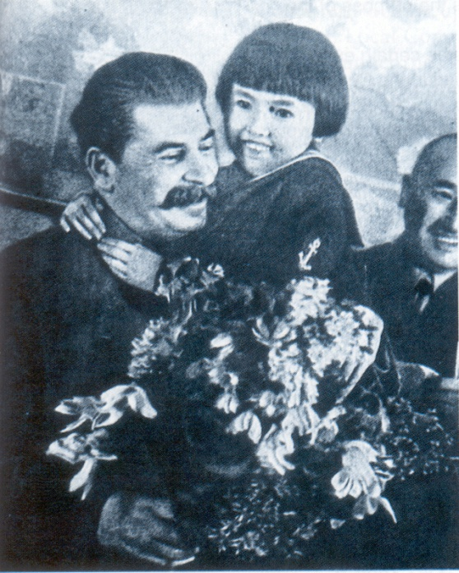
Mothers taught their children that Stalin was ‘the wisest man of the age’
History books and photographs were changed to make him the hero of the Revolution, and obliterate the names of purged people (e.g. Trotsky).

Slide 45
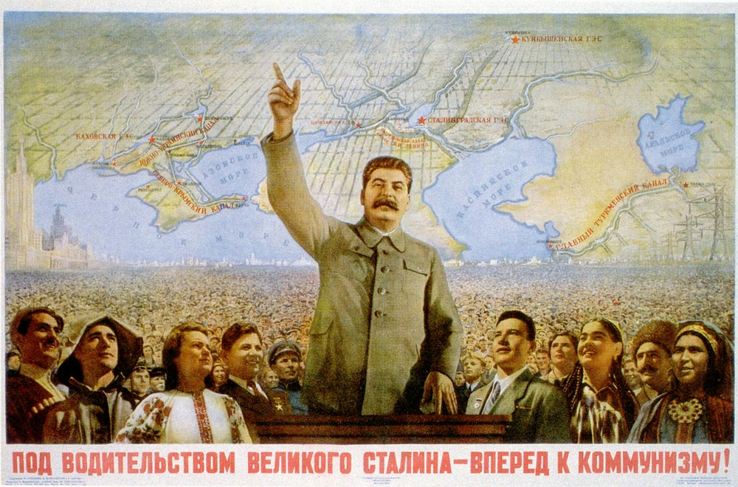
In The end, everyone either loved Stalin or ceased to exist

Slide 46
At the end of the conference, a tribute to Comrade Stalin was called for.
Of course, everyone leapt to his feet.
However, who would dare to be the first to stop – after all, NKVD men were in the hall waiting to see who quit first. And in that obscure hall, unknown to the Leader, the applause went on – 6, 7, 8 minutes! They couldn’t stop now till they collapsed of heart attacks!
Aware of the falsity of the situation, after 11 minutes, the director of the paper factory sat down in his seat.
And, oh, a miracle took place! Everyone else stopped dead and sat down.
That, however, was how they found who the independent people were.
And that was how they set about eliminating them.
They easily pasted 10 years in a labour camp on him.

