Slide 1
The Origins of Communism
Today, we learn:
-to define Communism as a concept.
-the origins of Communism
-understand Communism in relation to alternative ideologies.

Slide 2
IDEOLOGY:
A system of ideas and ideals, especially one that forms the basis of economic or political policy.
AKA: The Big Idea

Slide 3
Global Forces definition:
“A political and economic system based on community or state ownership of wealth, property, and the means of production, with each person working for the common good according to ability and receiving according to need.

Slide 4
The Communist Manifesto
WHERE and WHEN?
Where: Published in UK in the German Language.
When: 1848.
What: The book that outlined the basic principles of Communism, outlined why the authors felt it was necessary, and explained the steps to starting Communism.

Slide 5
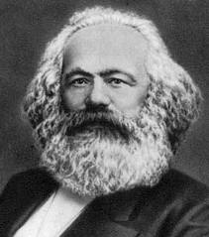
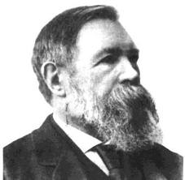
The Authors
Karl Marx
Friedrich Engels

Slide 6
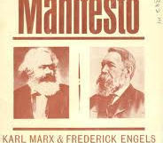
Communism is often referred to as Marxism…why? Why not Engelism?
Engels said the book was “essentially Marx’s work” and that “the basic thought…belongs solely and exclusively to Marx.”
Therefore, Engels helped, but Karl Marx is considered the father of Communism.
His book would be controversial, but influenced people like Vladimir Lenin and Leon Trotsky, who will play a role in the Russian Revolution.

Slide 7
Marx outlined three basic “laws”
Economic determinism
  history is driven by who owns what.
    Causes conflict between classes
  Historical change is due to economic relationships
  Economic conditions x is the most determining factor in causing behavior y
i.e. Arab Spring
i.e. Ukraine

Slide 8
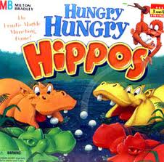
Hungry, hungry people

Slide 9
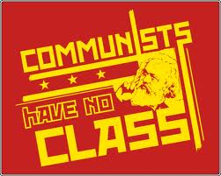
Class Warfare – have always been conflict between “haves” and the “have-nots”.
  Human nature fuels greed
Exploitation: - Capitalism can only thrive on the exploitation of the working class
People are not free:
  Workers are forced to sell their labour to survive
Believed in one final conflict – industrial workers (proletariat) would triumph over the bourgeoisie (capitalists) – society would become classless
  Establish a classless, stateless social organization
  Based on COMMon ownership of the means of production (labour, tool, natural resources, capital)
  People to contribute what they could and get what they needed.
  When everyone had what they needed – no need for police or gov’t. The State would wither away.
Communism is Inevitable – like a scientific law – this will happen and it cannot be changed.

Slide 10
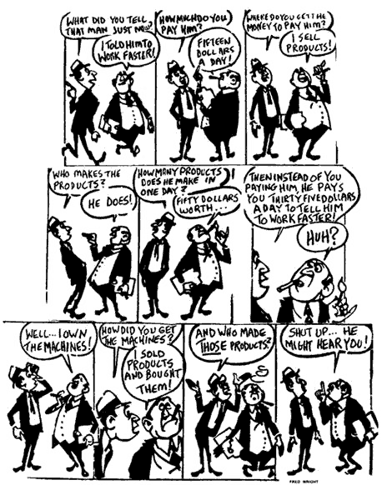

Slide 11
Karl Marx’s Top Ten Tenets of Communism (As outlined in the Manifesto):
Central State Banking System
Government-controlled free education
  reduced child labour
Government-controlled labour
Government ownership of transportation and communication vehicles
Government ownership of agricultural means and factories
More equitable population distribution (facilitate better use of the land)
Property rights confiscation
Heavy income tax on everyone
Elimination of inheritance rights
Regional planning

Slide 12
This might sound like a good idea from the ground up, but how do you turn an existing society to Communism?
Marx outlined 3 phases:
Phase 1: A revolution must take place to overthrow government.
Phase 2: A dictator or elite leader(s) must gain total control over the proletariat, including personal choices like education, religion, employment, and marriage. Collectivization of property and wealth.
Phase 3: Achievement of utopia, opposition destroyed, full control of production.

Slide 13
PHASE 1:
OVERTHROW GOVERNMENT.
PHASE 2:
INSTALL DICTATOR.
PHASE 3:
ACCEPTANCE OF NEW ORDER.

Slide 14
As a Russian peasant, which ideology appeals to you the most, and why?

Slide 15
In practice
the state has NOT “withered away”
Typically communists set up a one party dictatorship
- communism had not taken hold in industrial societies with large proletariats (industrial workers), poor, peasant based societies - eg. Russia, China, Cuba, Vietnam
- In communist countries re-distribution of wealth has been done through the state, which owns virtually all “means of production”, ie. industry and agriculture, and redistributes wealth through state services.
- most communist states have improved the standard of living for most people with better education, food, housing and health care for “the masses”. However rights and freedoms (in the western sense) are limited.

