Slide 2
What is a revolution?
On your own, write what you think the definition of “Revolution” is.
Put all your definitions in the middle of your table
As a table, come up with one definition
Send one person from your table to write your definition on the board.

Slide 3

Revolutions 101
Vocab Words
Dissident: someone who pushes back against a government or policy
Feudal(ism): a social system in medieval Europe based peasants working the land in exchange for military protection
Monarchy: a government system based around having a King or Queen
Republic: A state in which supreme power is held by the people and their elected representatives

Slide 4
Part 1: Do as a class

Slide 5
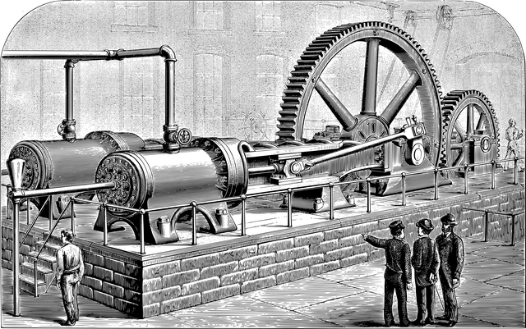
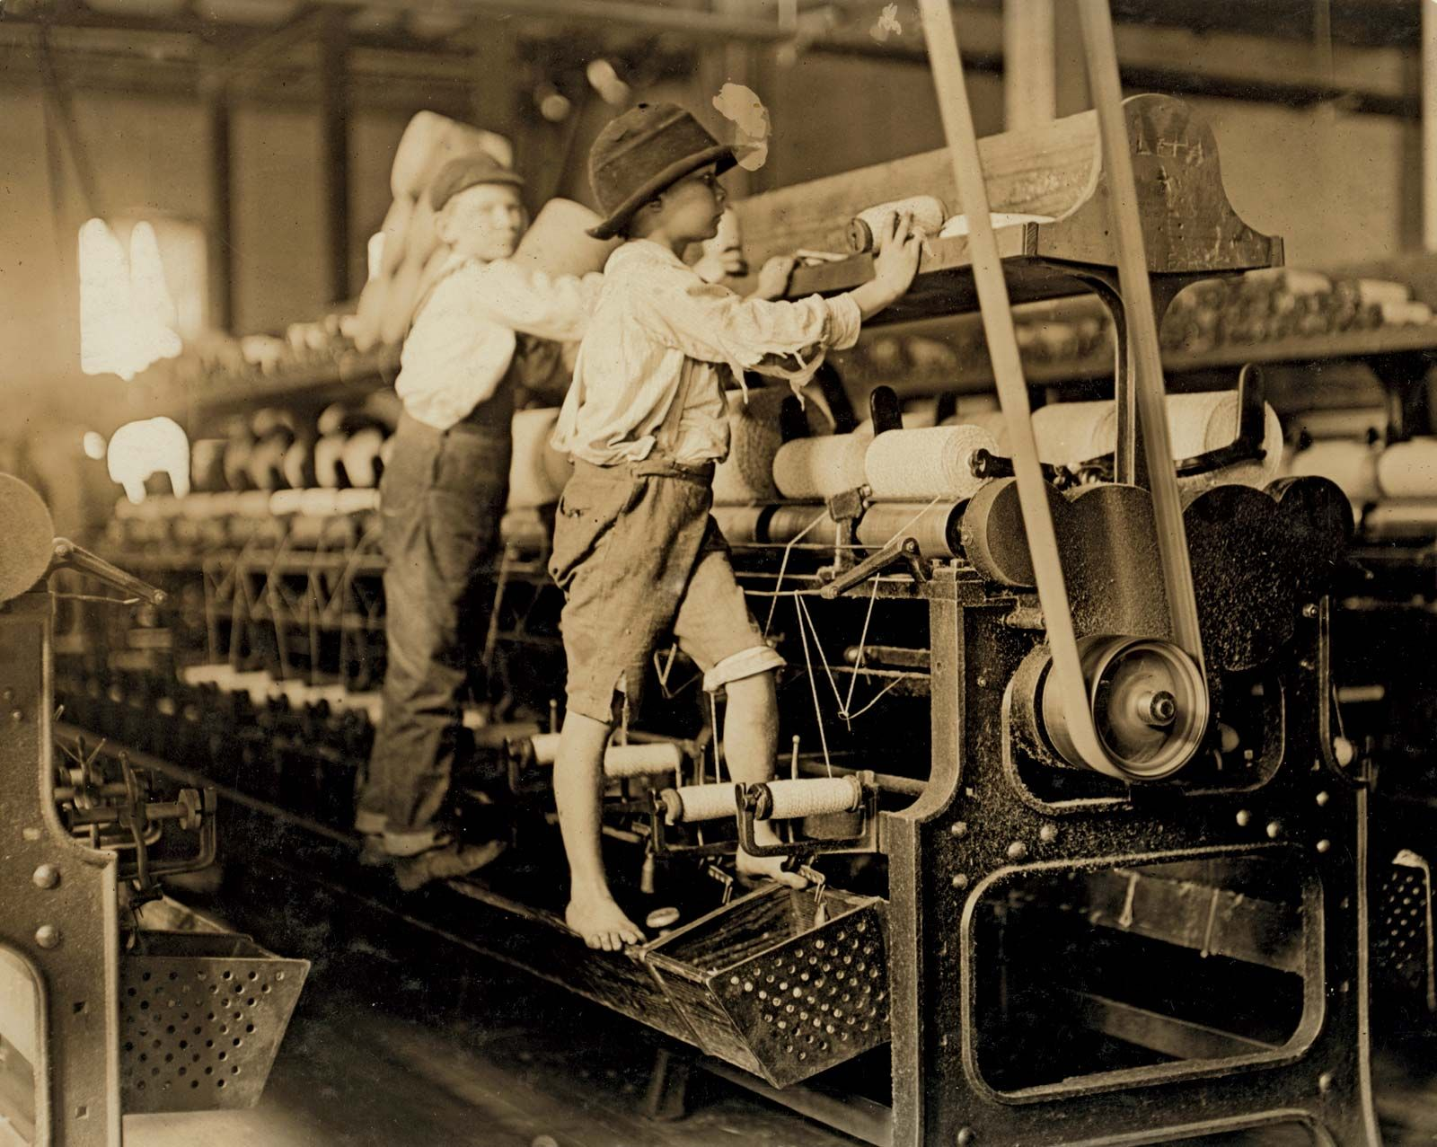
The term "revolution" can refer to many types of massive change that affect society in profound ways. For example, the British Agricultural Revolution, which happened between the 16th and 19th centuries, refers to a time of extraordinary agricultural output, mostly due to better farming methods and mechanization. Doesn't sound like it would have much impact beyond the fields? Not so: this upturn in agricultural success supported a huge population growth, which freed a lot of workers to leave farming and pour into the workforce, eventually sparking the Industrial Revolution and early 19th century international phenomenon, saw manual labor being replaced by mechanized tools, thus profoundly changing the way the world worked, traveled, and lived.

Slide 6
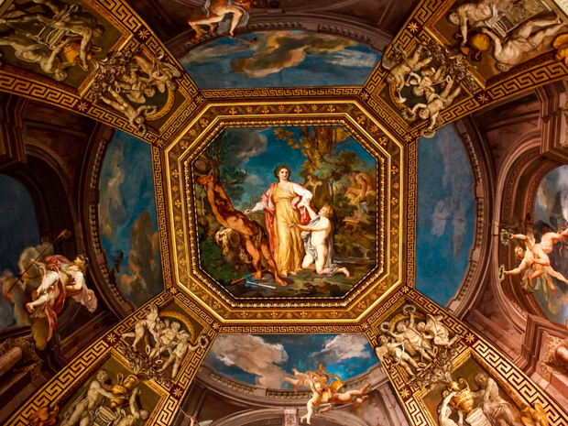
The concept of revolution also reaches into other areas of daily life. The Italian Renaissance of the 15th century was a time when the way in which the Western world created art, wrote poetry, designed architecture, and even absorbed knowledge, was overhauled, kicking off what is often labeled as the beginning of the "modern" epoch.

Slide 7
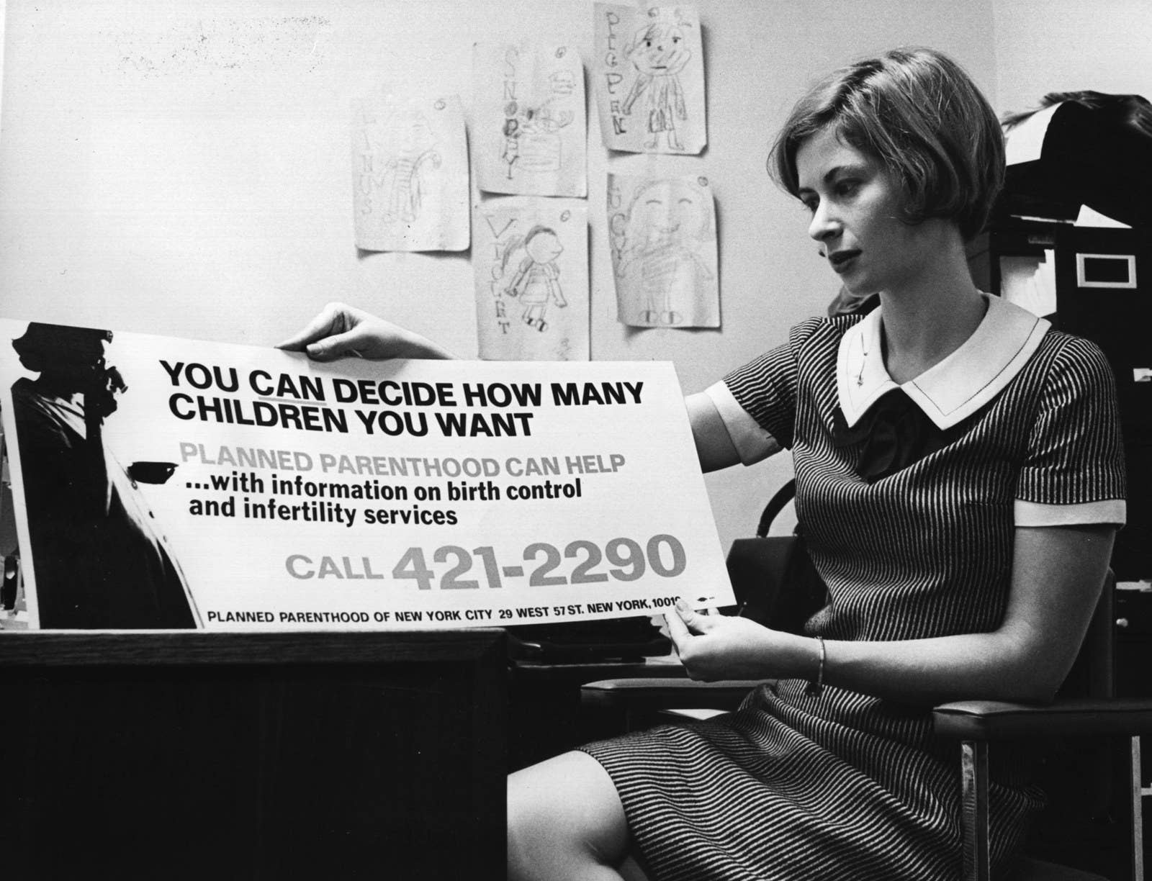
Social revolutions include the Sexual Revolution, when the invention of the birth control pill in 1960 offered women access to reliable contraception. Social scientists theorize that this pharmaceutical development impacted sexual behavior, attitudes, and more throughout the Western world, and redefined women's views of education and career.

Slide 8

Finally, the computer was developed during the Digital Revolution, which refers to an ongoing technical transformation that began in the early 1980s. The plummeting cost and rapid improvement of digital devices made these tools more widely available, affecting the way we do our jobs, entertain ourselves, and even communicate with one another.

Slide 9
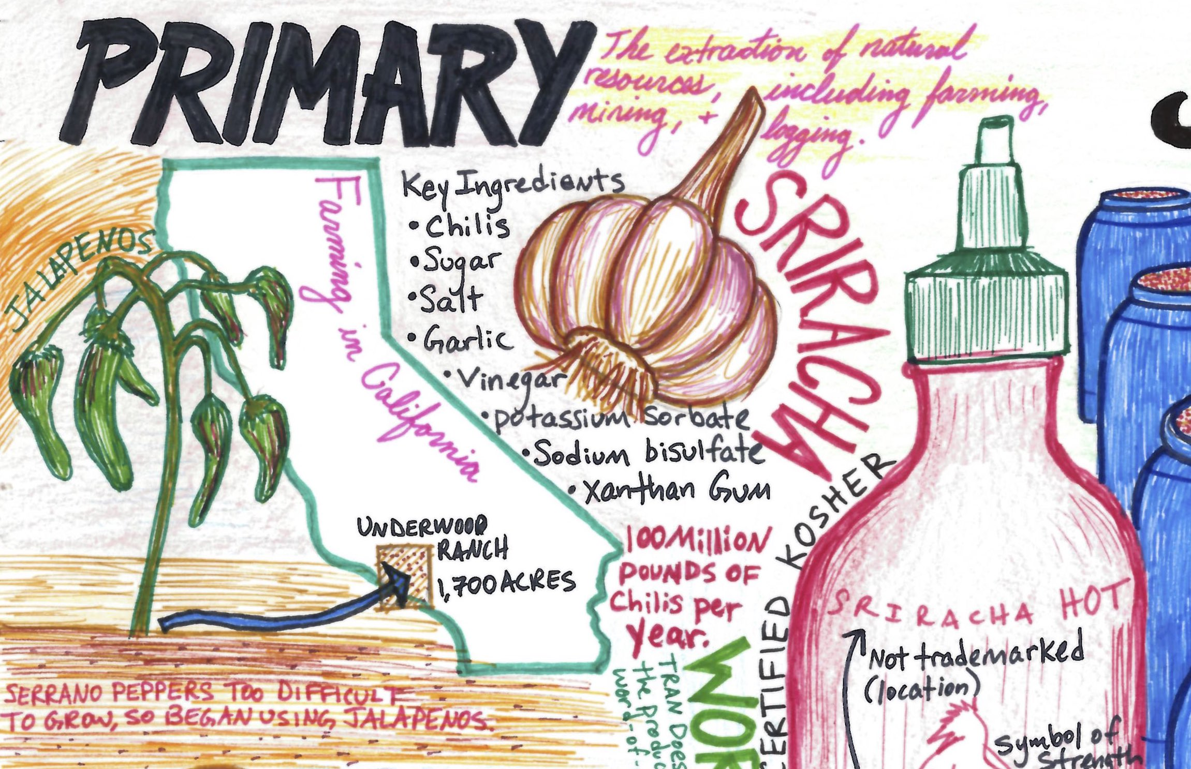
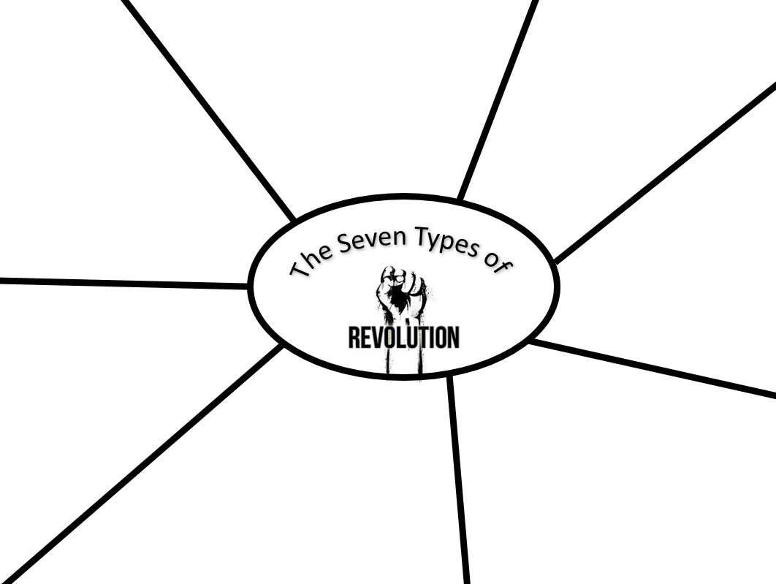
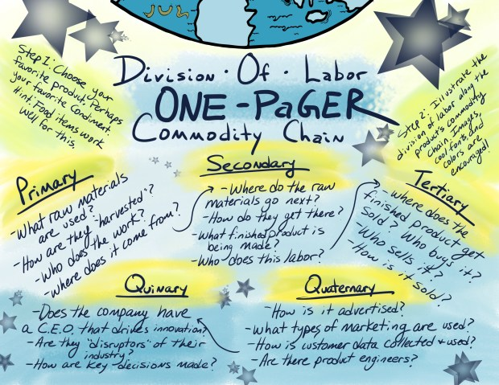
Part 2: Do Independently

