Slide 1
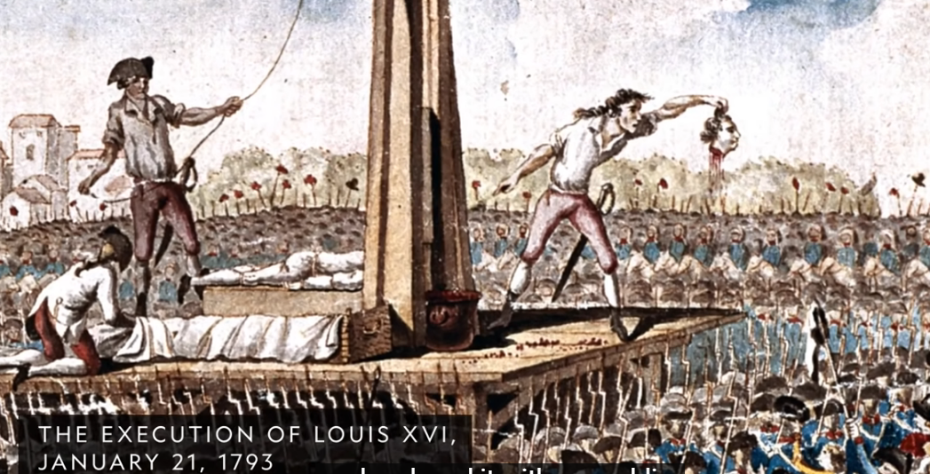

Slide 2
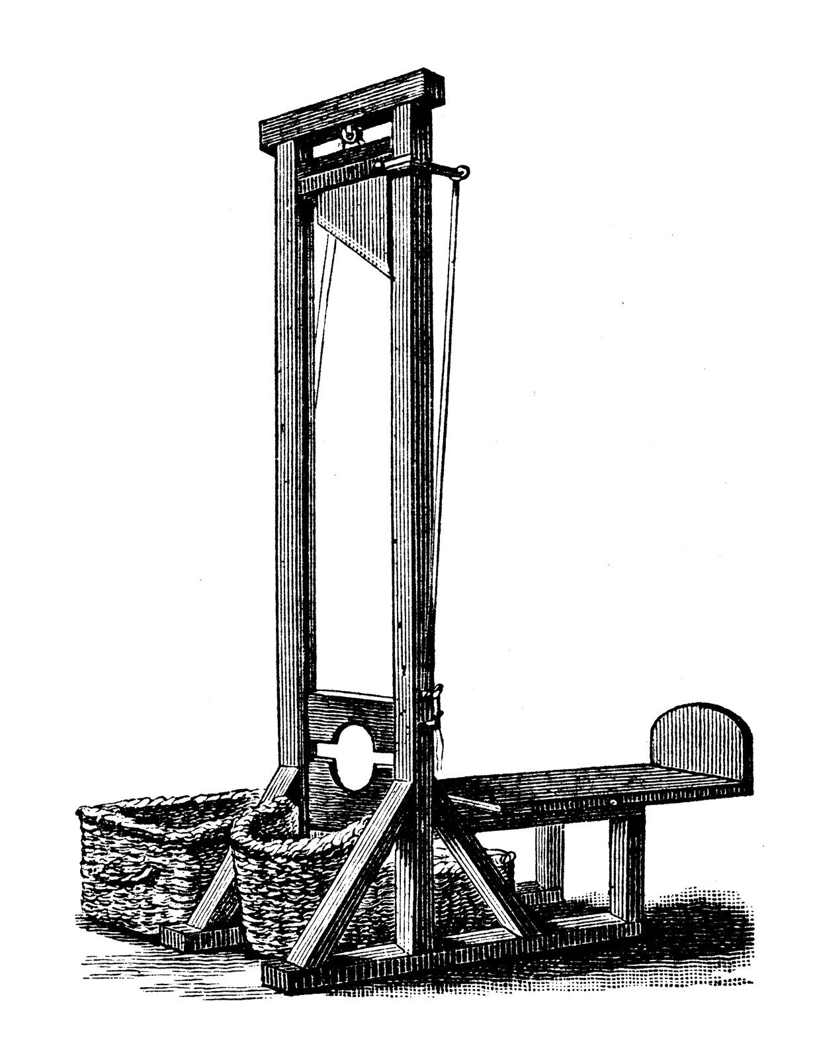
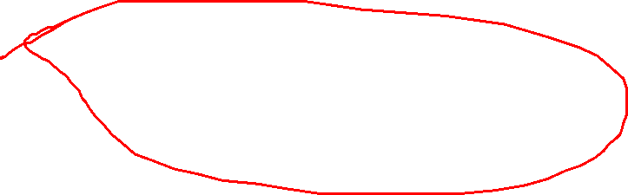
What is a “symbol”?

Slide 3
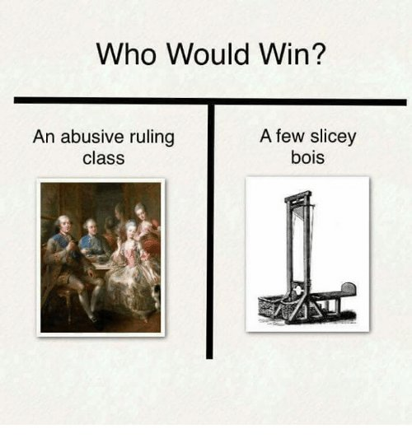

Slide 4
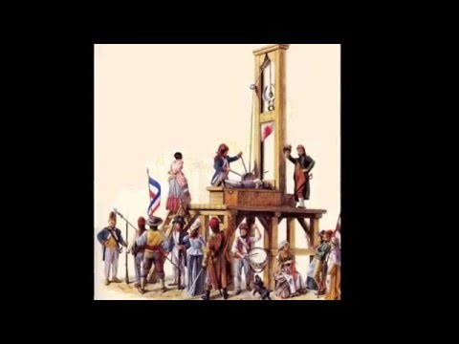

Slide 5
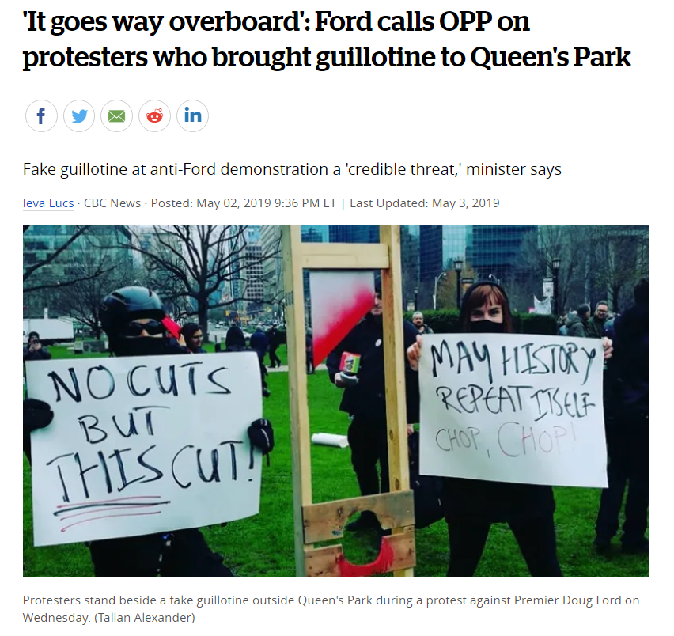

Slide 6
https://www.youtube.com/watch?v=jgGp7Zvz5QA&feature=youtu.be

Slide 7
Why is the guillotine a symbol of revolution?
Why do you think guillotines were such public spectacles?
What do you think will be the “Symbol” of Canada in 2022? Why?
Hand in when done and don’t forget your name.

