Slide 1

Timeline
1867 - 1908

Slide 2
July 1st 1867 Confederation of Canada
The day that the British Colonies in Nova Scotia, New Brunswick, Ontario, and Quebec joined together to be called Canada.

Slide 3
1868 Canada First is Founded
The movement promotes a British Protestant ideology as central to the Canadian identity
White Christians are what Canada needs and is built on kind of campaign.
How they were trying to attract more people to move to Canada
'Canada First' was the name and slogan of a movement to promote nationalist sentiment.
Its founding members were Charles Mair, Henry Morgan, William Foster, G.T. Denison and R.G. Haliburton.

Slide 4
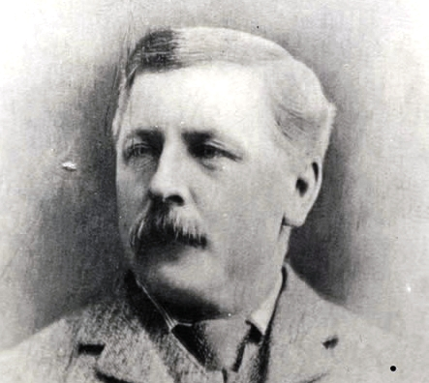
Charles Mair
1868 – November
The Toronto Globe publishes a letter by Charles Mair containing offensive, racist comments about Metis women.
“backbiting … half-breed women … with no coat of arms but a totem”

Slide 5
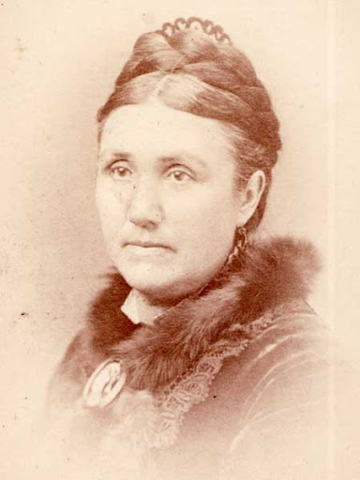
Annie Bannatyne
1869 – February (4 months later…)
Annie Bannatyne horsewhips Charles Mair for writing racist comments about Metis women in the paper.
Annie married a businessman and was highly educated.
Worked for charity and and created the Winnipeg General Hospital
Later that month, a letter signed “L.R.” is published in Le Nouveau Monde criticizing Mair and Canadian attitudes towards the Metis.

Slide 6
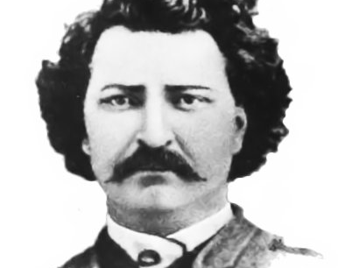
1869 - December (about a year later…)
A provisional government is established, with Louis Riel as secretary, to negotiate the Red River Colony’s relationship to Canada
Louis is a Metis man who witnessed Annie Bannatyne whip Charles Mair and was inspired to fight for his peoples' rights in the new Canada being formed.
He wrote that letter in the paper and signed it “L.R.”

Slide 7
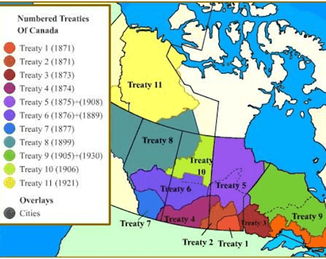
1871-1875
The first five numbered treaties are signed
treaty making was a way to make settlements of the West and the assimilation of Indigenous peoples into Euro-Canadian society
These secure much of Rupert’s Land (Hudson Bay) and the Northwest Territories as Crown property and guarantee federal responsibility for the well-being of the territories’ Indigenous inhabitants - basically kicking them out of this important fur trade route.

Slide 8
The Indian Act
1876
Government law stating where an indigenous person could live, travel and forcing their children to school.
The Indian Act is passed, paving the way for reserves and residential schools

Slide 9
1884-1885
Canadian encroachment upon Metis and First Nations’ lands on the Western Prairies leads to the Northwest Resistance
The resistance took place in what is now Alberta and Saskatchewan.
It was fought between the Métis and First Nations allies against settlers and the federal government.
The government won. Hundreds died. (Our version of civil war which happened in the US between 1861-1865)

Slide 10
Execution of Louis Riel
1885
The Canadian Government executes Louis Riel for treason.
They hung him for fighting for Indigenous peoples right to land and to maintain their culture.

Slide 11
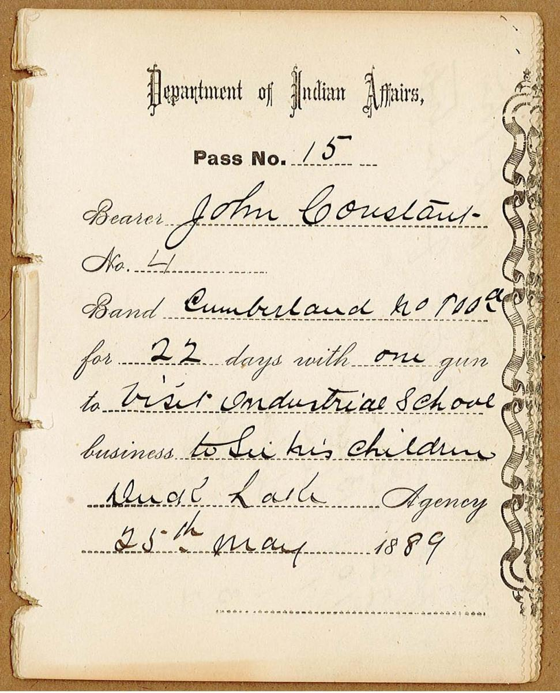
Pass System
1885
After the war and the government had won
Canada introduces the pass system, confining Indigenous people to their reserves unless they have written permission to leave from the Indian Agent.
Though it never became a law, the pass system restricted Indigenous freedom in the Prairie West during the late 19th and early 20th centuries.
  Impacted who they could get food from, where to sell their goods, how to go to traditional gatherings together
It was not removed from the Indian Act until 1995

Slide 12
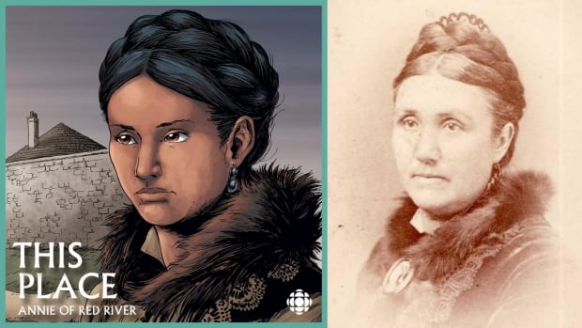
1908
Annie Bannatyne passes away in rural Saskatchewan.
Her actions inspired this story and most importantly inspired Louis Riel.

