Slide 1
The Algonquin people

Slide 2
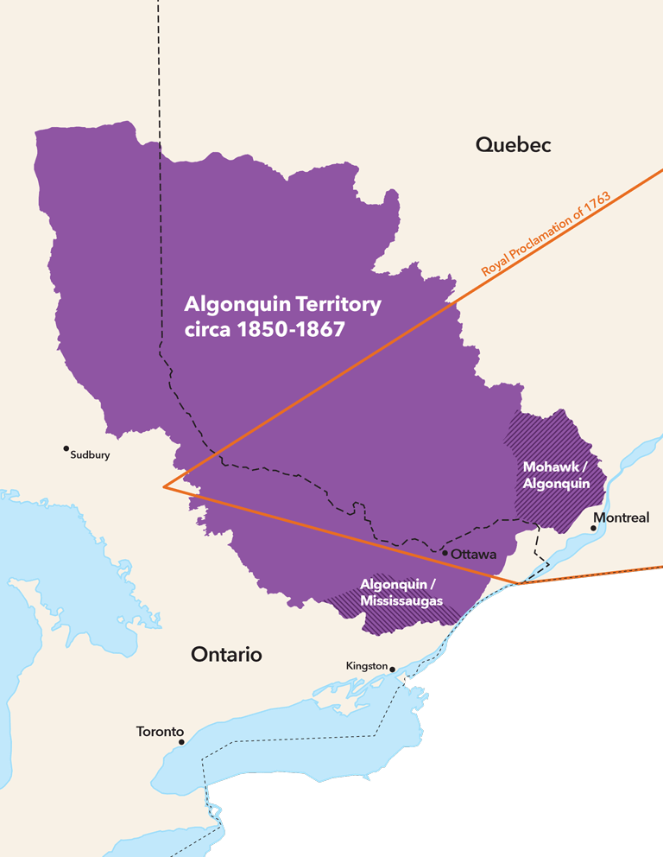
Algonquin and their traditional territory
The land stretches across the Ottawa valley, lying on both sides of the Ontario-Quebec border.

Slide 3
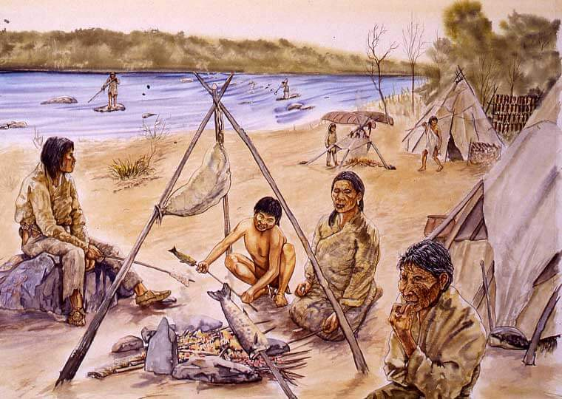
Algonquin lifestyle
The traditional Algonquin lifestyle was a semi-nomadic way of life.
Centered on fishing,
Trapping
Gathering along the watersheds on the Ottawa river.

Slide 4
Algonquin spirited beliefs
The Algonquin people believe in a supreme creator and central life force called Kitchi Manitou (or Kitchi Manido)
There are water spirits called the memegwesi.
Powerful thunderbirds called Onimiki.

Slide 5
Works cited
Spirited beliefs: https://www.native-languages.org/algonquin-legends.htm
Traditional territory: https://www.canadashistory.ca/explore/politics-law/algonquin-territory
Lifestyle: https://www.quebec.ca/en/government/quebec-at-a-glance/first-nations-and-inuit/profile-of-the-nations/algonquin

