Slide 1
Bella Coola
By:Liv

Slide 2
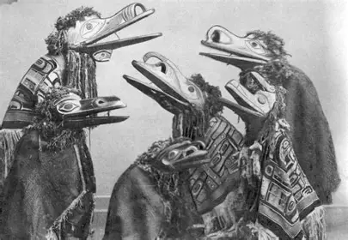
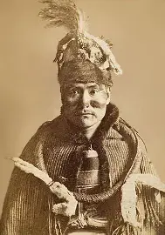
Origin..
The Nuxalk people, originate in Bella Coola BC Canada
Population before contact, was 35,000
https://en.wikipedia.org/wiki/Nuxalk

Slide 3
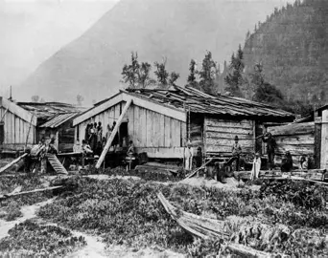
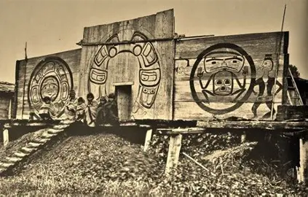
Lifestyle..
Villages organized into kinships led by chiefs
Architecture, consists of longhouses, communal dwellings, and ceremonial spaces
https://firstnationshistory.com/?s=Nuxalk

Slide 4
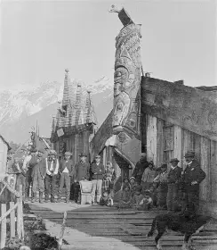
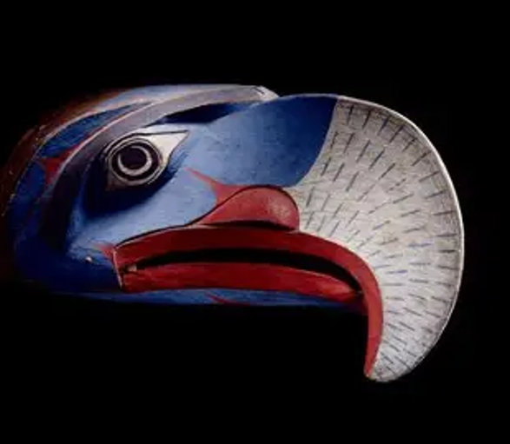
Culture
Heavily rooted in nature
Seasonal ceremonies
Potlatch was banned by the Indian Act
https://thecanadianencyclopedia.ca/en/article/nuxalk-bella-coola

Slide 5
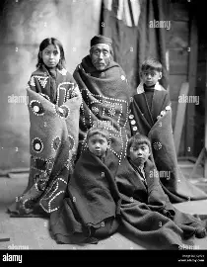
First contact
In 1864 First contact was made.
Mass death due to smallpox epidemic.
By 1902 estimated 302 survived
https://firstnationshistory.com/?s=Nuxalk

Slide 6
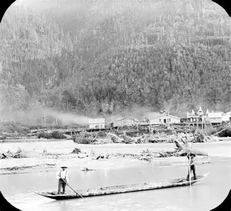
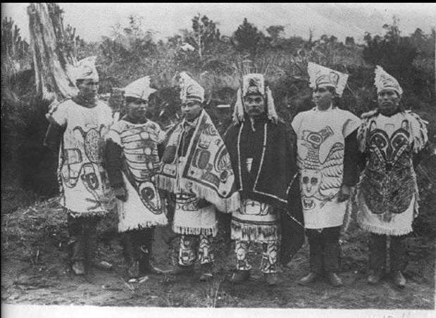
History..
Nuxalk people were scattered throughout territory
Relocated alone to survive
Forcibly removed Potlatch was
banned by the Indian Act
https://firstnationshistory.com/?s=Nuxalk

Slide 7
Works Cited
Bouchard, Randy, Kennedy, Dorthy, “Nuxalk (Bella Coola)”, The Canadian Encyclopedia, https://thecanadianencyclopedia.ca/en/article/nuxalk-bella-coola published 2006
“Nuxalk”, Wikipedia, https://en.wikipedia.org/wiki/Nuxalk last accessed October 6th, 2026,
“WEST COAST – NUXALK”, First Nations History, https://firstnationshistory.com/?s=Nuxalk, published 2024,

