Slide 1
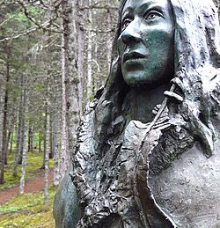

Beothuk Presentation
​

Slide 2
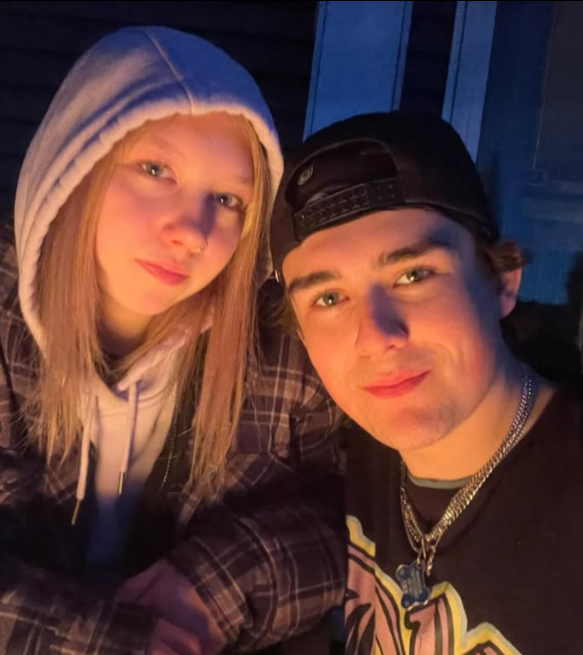
By Rowan Siebert and Tayah Billard

Slide 3
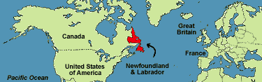

Who are the Beothuks?
The Beothuk people are a small tribe who inherited island of Ktaqnkuk in Newfoundland on the East Coast of Canada they are also known as the Red Indians.

Slide 4
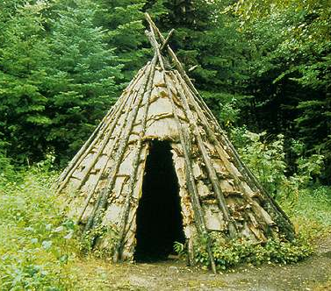
Lifestyle
The Beothuk did not participate in traditional trade they gathered their own food and tools
They lived in cone shaped wigwams or sometimes Mammatikes and slept in deep trenches

Slide 5
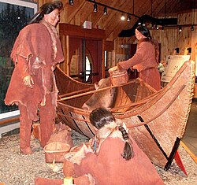
Beothuk culture
Beothuk spoke Algonquian language
smeared crushed red ochre powder on them selves
The Beothuk centered around a self-sufficient way of living
Lived with 35 to 55 people per band
The didn't have formal chiefs instead bands designated leaders based on wisdom and life experience.

Slide 6
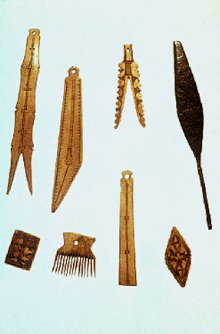
History and modern context
The eauropian colonization led to the beothuks extinction in 1829.
Archaeological evidence, such as tools, weapons and household items, indicates that the Beothuk inhabited Newfoundland long before European colonization
after the Europeans’ arrival, the Beothuk were forced to move away from their coastal homelands and ancestral fishing camps to inland territories

Slide 7
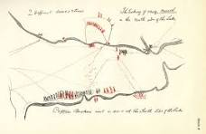
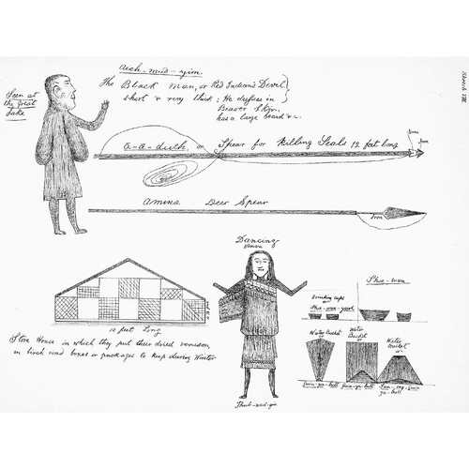
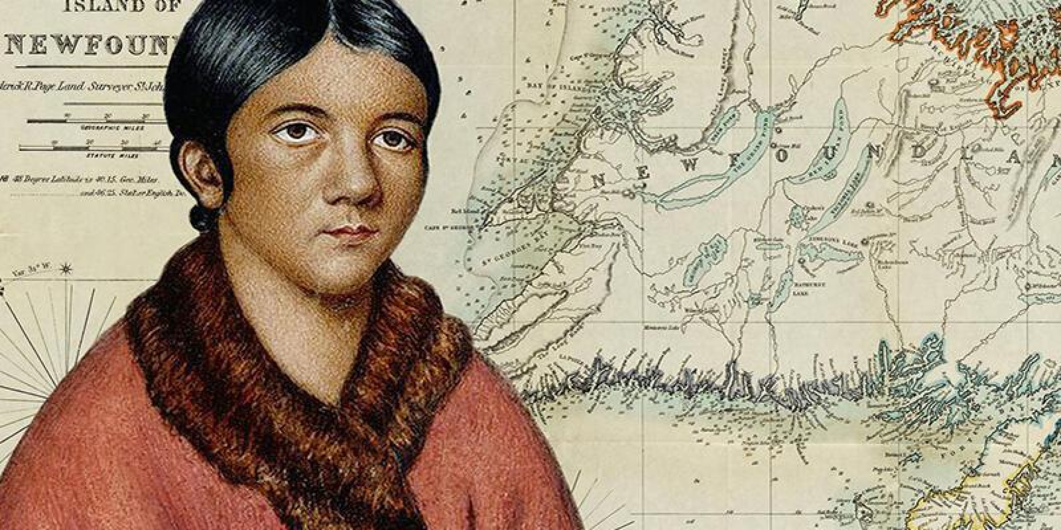

Slide 8
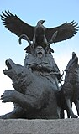
Pop quiz
1) Where is Beothuk from?
2) did Beothuk participate in trade?
3) what language did they speak?
This Photo by Unknown Author is licensed under CC BY-SA

Slide 9
Works Cited
“Beothuk” Encyclopedia.com, https://www.encyclopedia.com/international/encyclopedias-almanacs-transcripts-and-maps/beothuk assessed 1 October 2026
“Beothuk” Wikipedia, Wikimedia Foundation, https://en.wikipedia.org/wiki/Beothuk, Accessed 1 October 2026
“Beothuk Housing” HERITAGE. https://www.heritage.nf.ca/articles/indigenous/beothuk-housing.php Accessed 1 October 2026
“Beothuk People” Brittanica, Brittanica Editors. https://www.britannica.com/topic/Beothuk Accessed 1 October 2026
Tuck, James A.. "Beothuk". The Canadian Encyclopedia, 12 September 2025, Historica Canada thecanadianencyclopedia.ca/en/article/beothuk. Accessed 06 October 2026.

