Slide 1
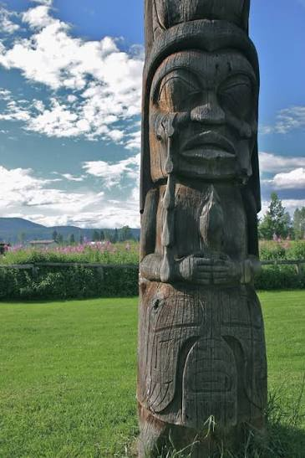
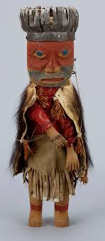
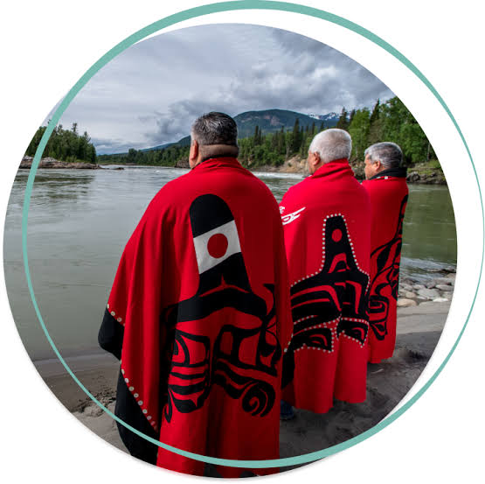
All about the Gitxsan people
By Branen.E

Slide 2
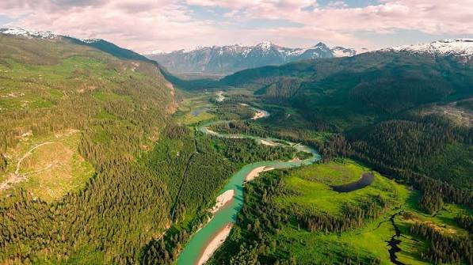
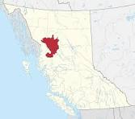
THe Gitxsan territory
This indigenous group looks after about 35 000 square kilometers of unceded land around the Skeena river in British Columbia. This land consists of rugged mountains with deep valleys on one end, and on the other side is thick rain forests and the very well-known Skeena river, as well as the Nass river. This means some of the best salmon fishing (mostly chinook) in the world which keeps the Gitxsan nation fed (Gitxsan today article).

Slide 3
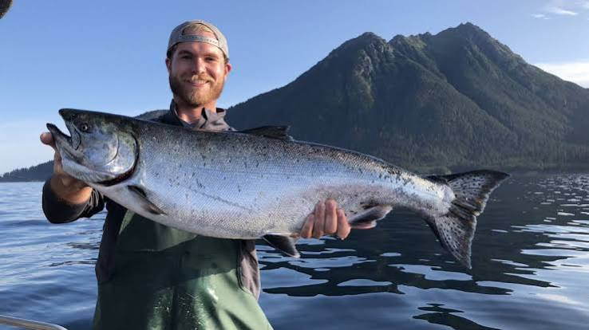
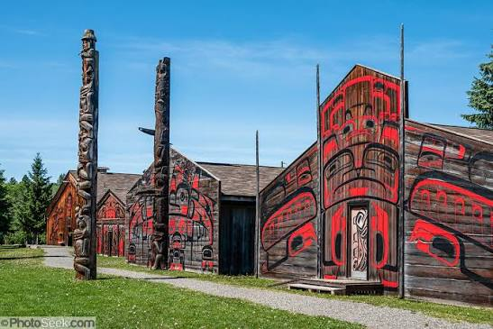
Gitxsan way of life
Most Gitxsan people live in a very beautiful part of the province with all the resources they need. They use red cedar from the forest to build wooden longhouses which gives a home for the people in that housing group. The Gitxsan do not live with just 3-4 people per house. They live In a housing group with more people known as a Wilp. Year round they eat almost nothing but salmon, in the summertime salmon is roasted on a fire and eaten fresh and for the winter it is canned in huge numbers to be preserved. They also cooked with lots of Oolichan grease, a fat rendered down from the Oolichan fish. This provides the essential fats that a person needs in their diet (Gitxsan, Powell, Jensen, Pedersen).

Slide 4
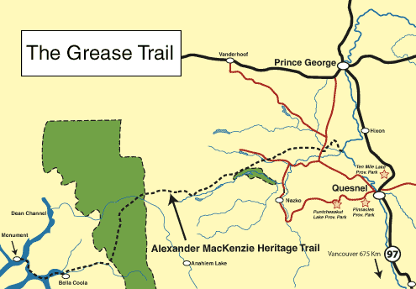
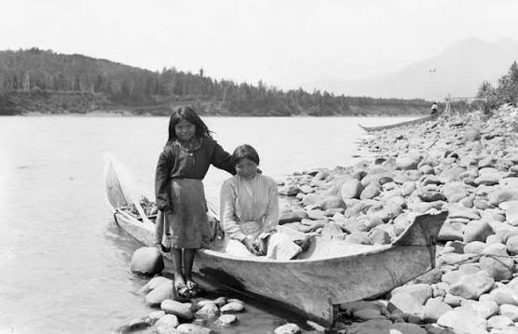
Gitxsan trade
Like everyone else, the Gitxsan needed a way to trade their goods for better resources. The Gitxsan people travelled on trails from the Skeena all the way to the pacific northwest as well as the pacific coast, These are better known as grease trails. The Gitxsan traded things like furs, canned salmon, and wild berries to the people on the coast. The people on the coast traded Oolichan grease to the Gitxsan nation and that’s how the grease trails came to be. The Oolichan grease was so valuable to the gitsxan people because of the food that they had available like salmon and berries did not have the fat content that people need in their diet (Gitxsan, Powell, Jensen, Pedersen).

Slide 5
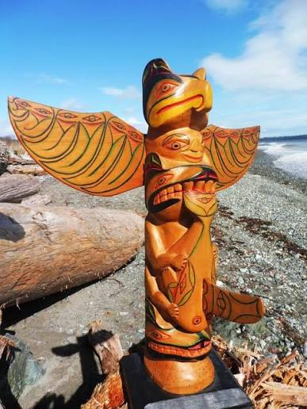
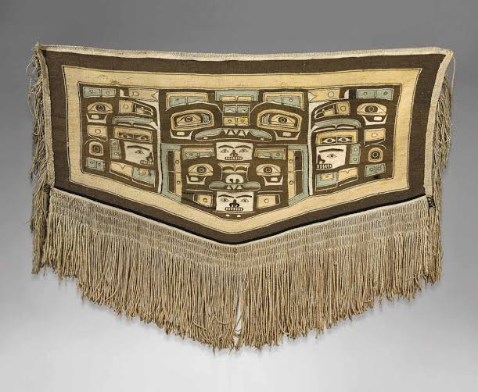
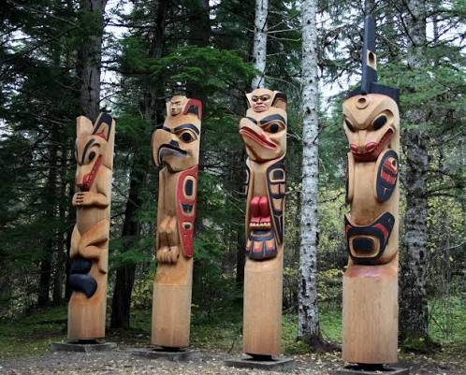
CUlture
The gitsxan people like to express their culture in many different ways, and it is very important to the Gitxsan people. One of the most popular ways is by creating cultural artwork, the Gitxsan make things like traditional blankets called Chillkat Blankets, they carve massive detailed totem poles and even carve their own spoons out of sheep horns. The Gitxsan also have their own traditional language which is Gitxsanimaax, this helps them express their own culture even more. (our language)

Slide 6
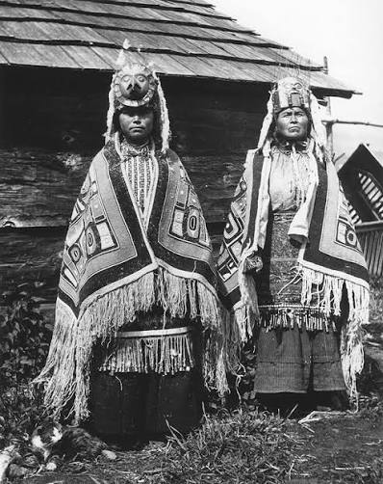
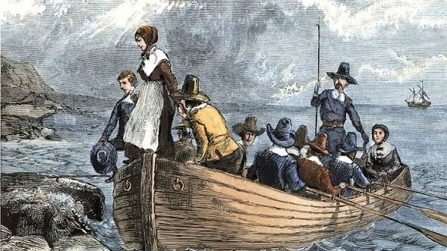
The Gitxsan history
The Gitxsan people have been on that part of the land for a long time, archeologist evidence shows up to 10 000 years ago there is traces of indigenous people being on the skeena. In the late 1700s Europeans started looking and mapping out that chunk of land and in 1822 Europeans made first contact with the Gitxsan peoples. In 1822 Europeans came up the Skeena river for the first time and brought goods like furs to trade with the Gitxsan, from then on fur traders, gold prospectors, and fisherman kept coming up the Skeena into these people territory. Although unlike other groups the Gitxsan never signed a treaty, so ever since 1822 they have been resisting European settlers. (indigenous tourism BC)

Slide 7
Works cited
Powell, Jensen, Pedersen, Gitxsan, https://thecanadianencyclopedia.ca/en/article/Gitksan, Sept 20 2023, accessed Oct 5 2026
Gitxsan today, Gitxsan huwilp government, https://gitxsan.ca/, accessed Oct 4 2026
Our language, Gitxsan huwilp government, https://gitxsan.ca/, accessed Oct 5 2026
Indigenous tourism BC, In northern bc learn about the Gitxsan, July 16 2018, https://www.indigenousbc.com/stories/in-northern-bc-learn-about-the-gitxsan/, accessed Oct 5 2026
Any information not cited is from prior knowledge in BC first peoples last year

