Slide 1
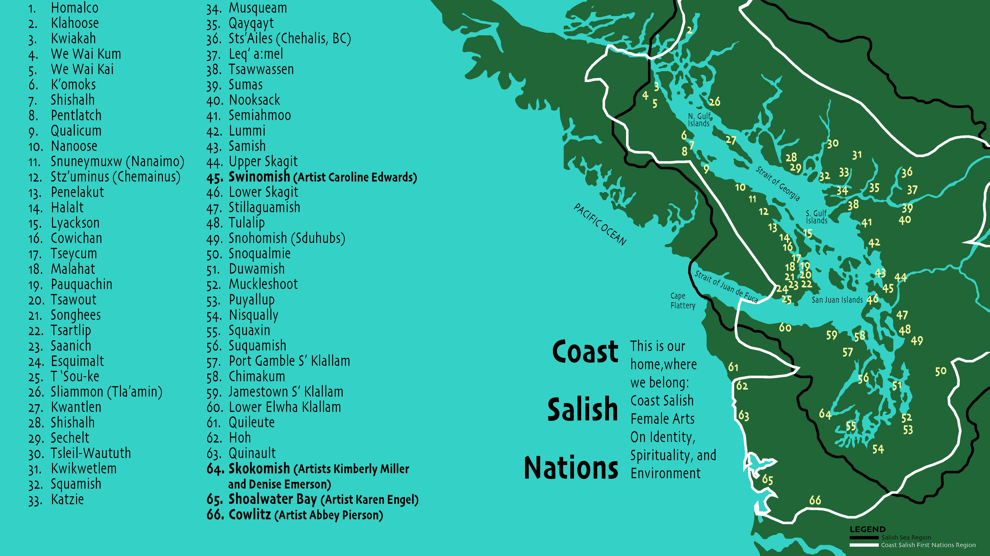

Slide 2
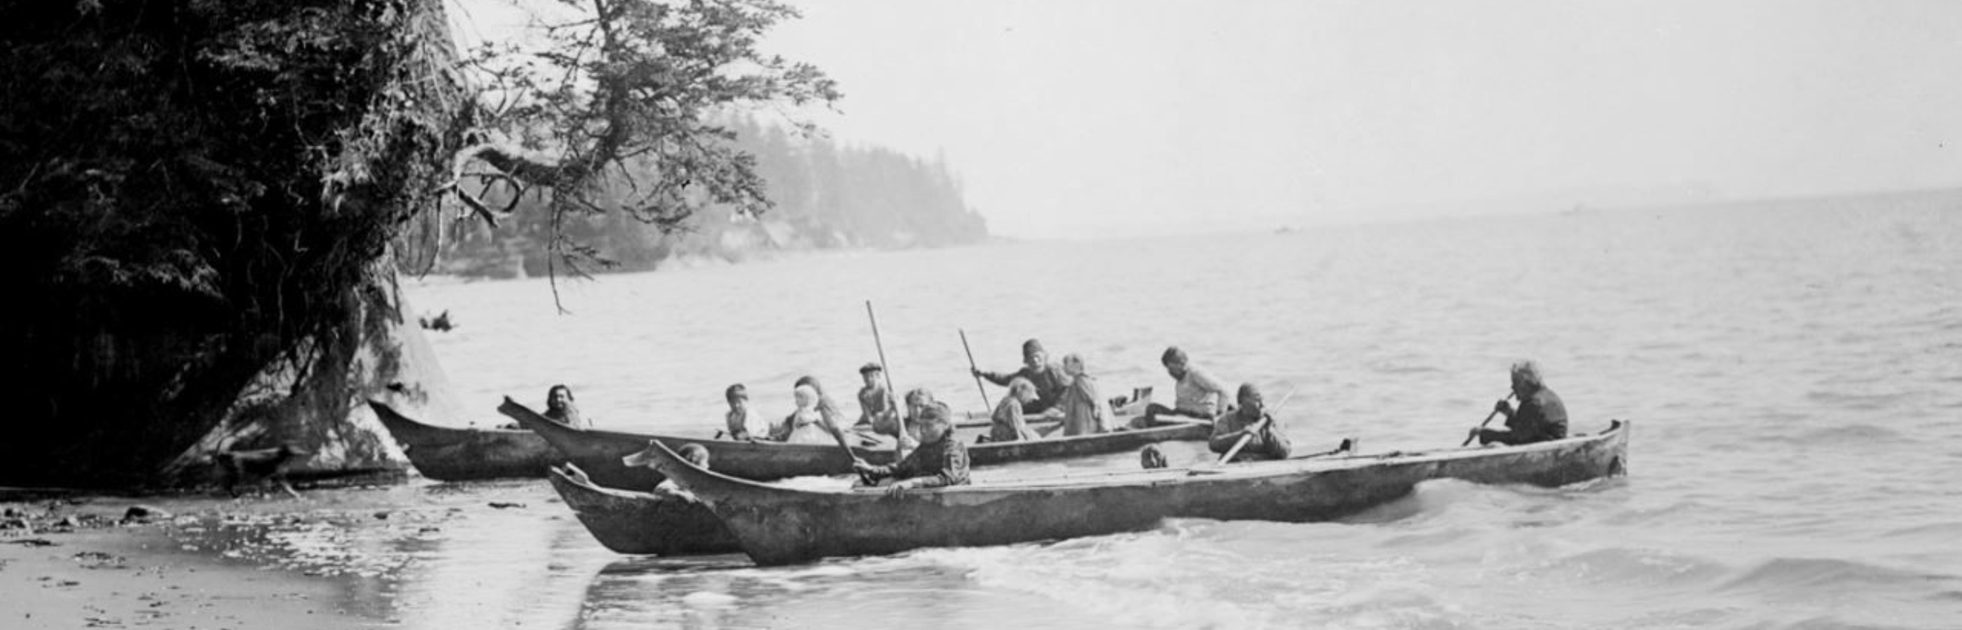
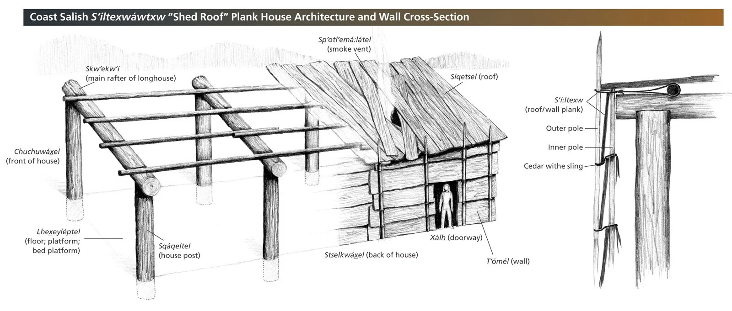
Traditional life
Transportation
Coast Salish people became skilled at navigating the waterways they made large cones from the carder wood that can hold a lot of people for travelling. Then smaller cones for fishing
(Weebly)
Coast Salish people often live in permanent villages during the winter.
During the summer they lived in temporary camps for harvesting food.
They also lived in shed-roofed houses called plank houses that was made from cedar wood.
(spirit of the west coast)

Slide 3
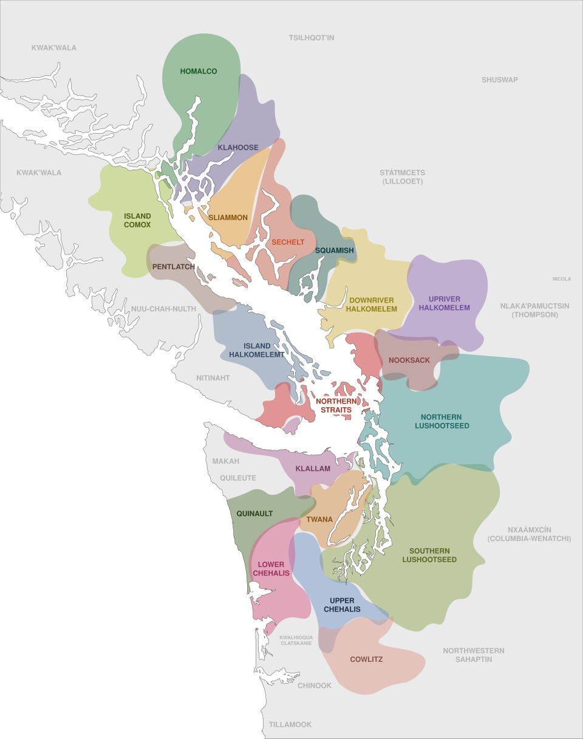
Where did coats Salish people traditionally live?
Related to indigenous people of specific Northwest coast, living in British Columbia and u.s states of Washington and Oregon.
Territory claimed by Coast Salish peoples span from the Northern limit of the Salish sea on the inside of Vancouver island.
The peoples cover most of southern Vancouver island, all of the lower mainland and most of the pudget sound.
(Wikipedia)

Slide 4
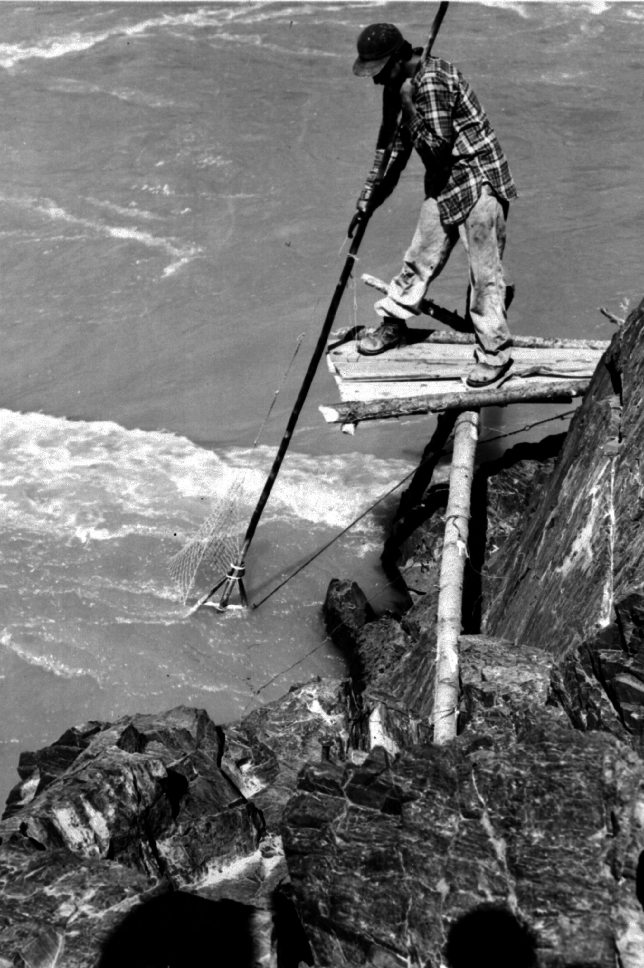
History
Fishing has and will always be an important part of the Salish people's history, Aswell as the harvesting of fruit and vegetables
Salish people's language is part of Salishan linguistic family
Many of the Salish languages were endangered due to federal policy, such as residential schools
This decreased number of speakers
These days their language is taught at universities, high schools, and colleges
(Canadian encyclopedia)

Slide 5
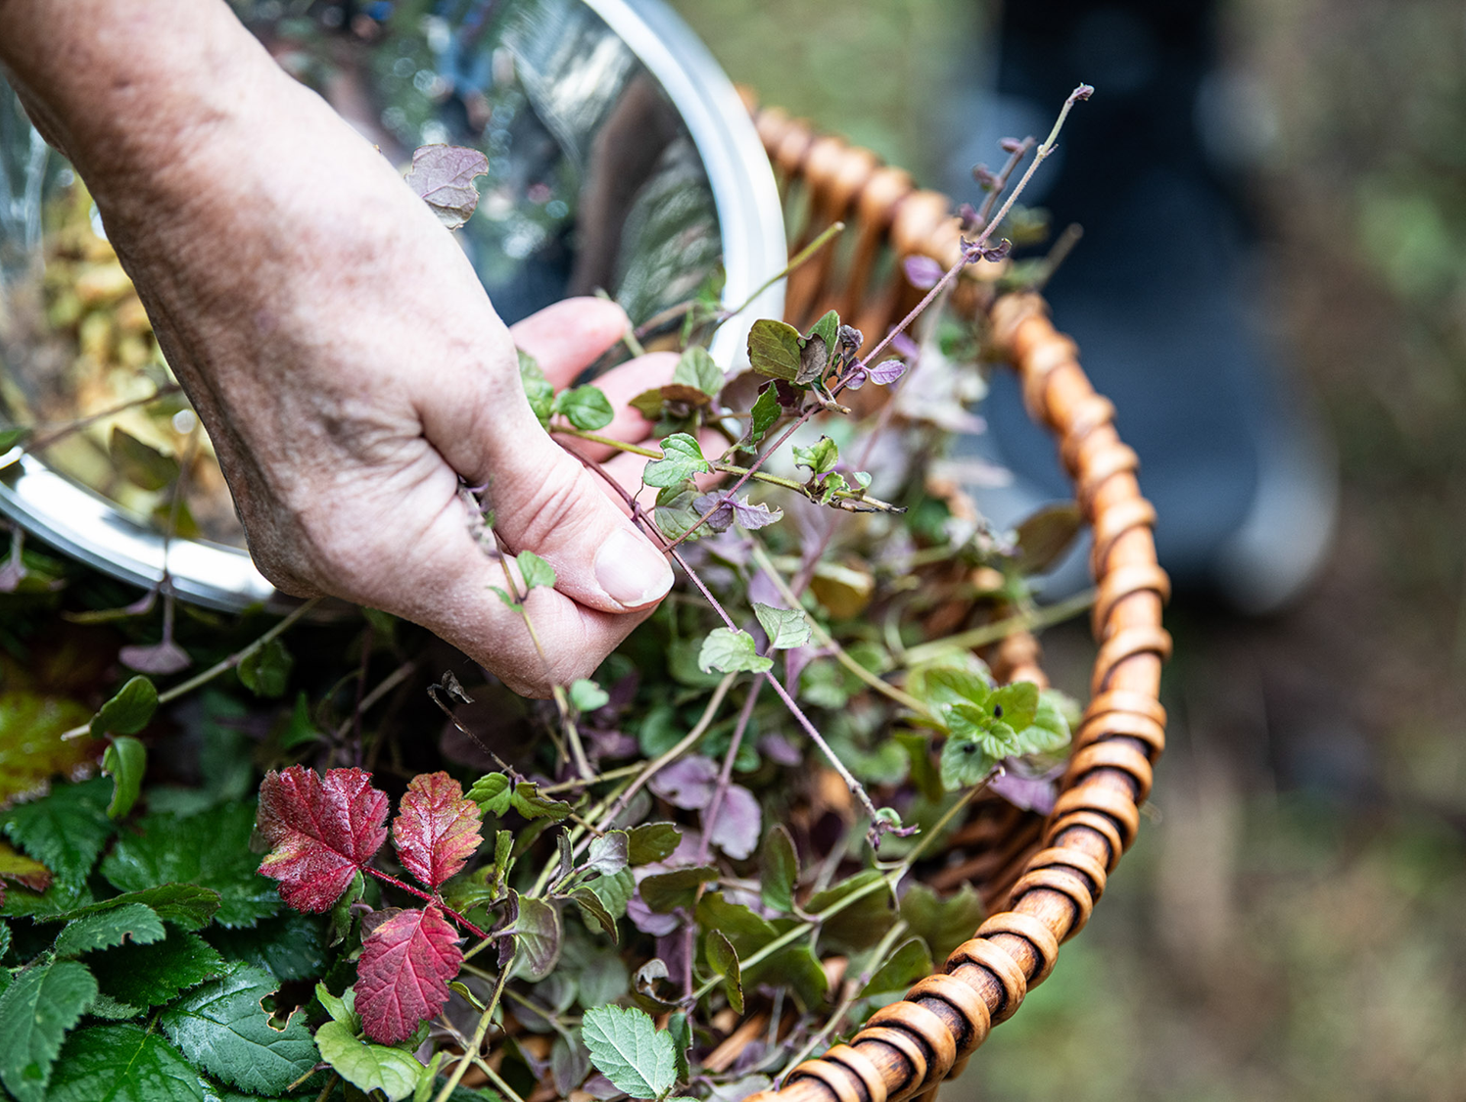
Traditional coast Salish foods
Plants they harvest: Mountain ash, bearberry, wild blackberry, horsetail, bracken fern, bullwhip kelp, thimbleberry, lady fern, salmonberry, huckleberry, gooseberry, nettle, wild rose, wild onion, wild carrots, strawberry, dogwood, sprue, ect..
Mammals: bears, bobcats, deer, snowshoe hare, lynx, beaver, coyote, cougar, sea lion, moose, ect..
Fish/ shellfish: codfish, wolf eel, pacific hake, pacific herring, most kinds of salmon, trout, softshell clams, butter clams, oyster drill, mussels, pacific octopus, ect..
(burkemuseum)
Most of the plants they harvest were used for medicines/ teas

Slide 6
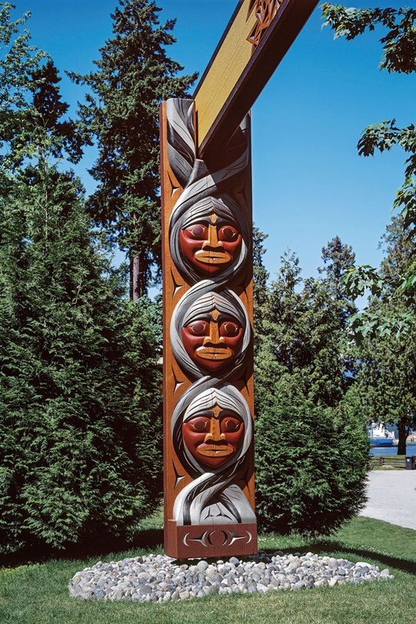
Salish peoples Art and Crafts
The peoples made house posts that were crafted for significant or special events like potlatches or completion of long houses.
These had meaning to the individually or family
Designs were found on spindle whorls and grave boxes, but the coast Salish art forms were not as developed as other nations were
Their crafts consisted of weaving plain white blankets for everyday use, designed ones were more for showing class or style
They used tuffs of hair from mountains goats or dogs used on spindle whorls
Many baskets made from cedar wood
(coast salish peoples)

Slide 7
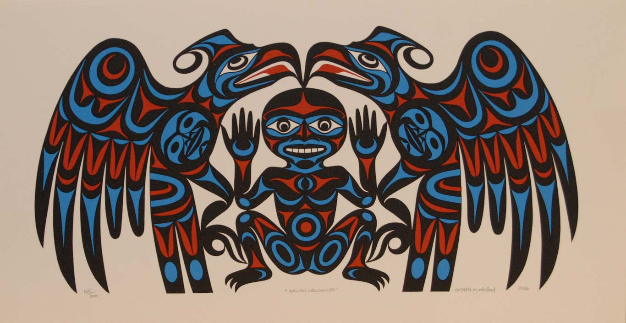
Spiritual beliefs
- The Coast Salish people are very spiritual people.
-Life was centered on spirit power and beliefs of a creator, more nature focused and connections to guardian spirits.
- Survived through oral histories.
- The old man the in sky- tale on how he created the world, animals, humans.
-Highlights important creatures+ elements of nature- salmon and deer
(coast salish peoples)

Slide 8
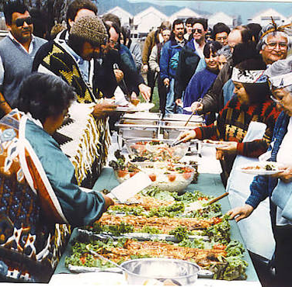
Ceremonies
In the summer, the Salish peoples did potlatches that were celebrated and it demonstrated the person who was hosting's status and wealth
These were used to celebrate marriages, memorial, coming on age etc.
Also, summertime gaming events were also something they did such as slahal (bone and stick games)
(coast salish peoples)

Slide 9
Work Cited
Logan Grant.”The Coast Salish Peoples culture” Weebly.com, 2016, 2016, https://coastsalishpeoples.weebly.com/culture. Assessed October 5th^{th} 2026
Dorothy Kennedy, Randy Bouchard. “Coast Salish” The Canadian Encyclopedia, July 25th 2019,
https://thecanadianencyclopedia.ca/en/article/coastal-salish. Accessed October 6th^{th} 2026
Burke Museum “Traditional Coast Salish food list” The burke Museum, September 14th 2013,
https://www.burkemuseum.org/news/traditional-coast-salish-foods-list. Accessed October 7th 2026
Spirit of the west coast art gallery“Spirit of the west coast art gallery” 2026 https://spiritsofthewestcoast.com/. Accessed October 3rd 2026
Wikipedia “Coast Salish Peoples” Wikipedia, 4th October 2026, https://en.wikipedia.org/wiki/Coast_Salish_peoples#/media/File:Coast_Salish_language_map.svg accessed October 8th 2026

