Slide 1
Coast Salish
Alex

Slide 2
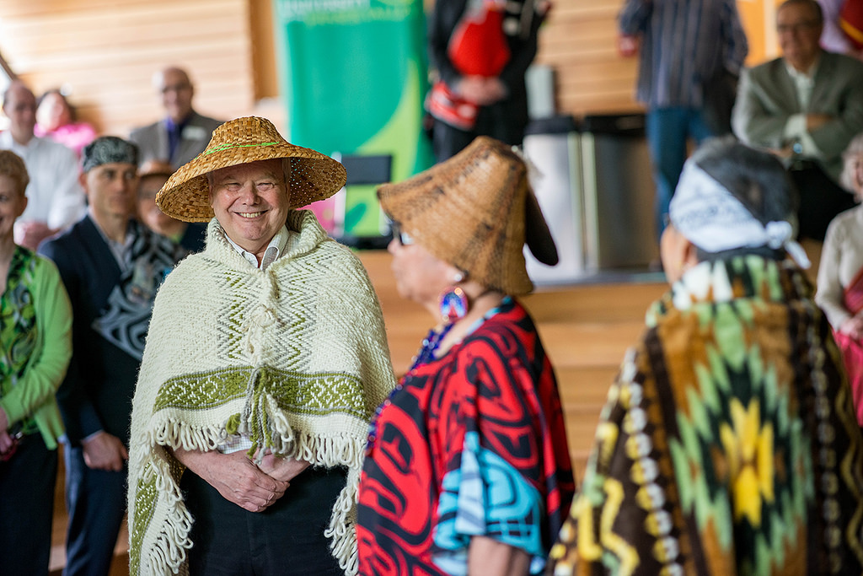
Who are the Coast Salish?
- A large group of indigenous people of the pacific northwest
- They are groups of indigenous people who are deeply connected to the water, land, family, food and traditions.
Notes:
The coast salish are not just one small distinct group of people. There are many distinct salish nations who all have their own languages, traditions, history and community.

Slide 3
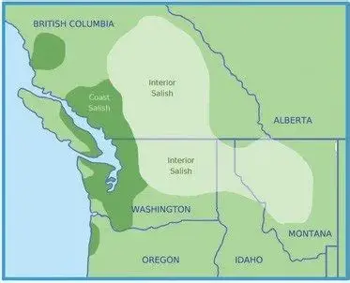
Where is their traditional territory?
- Many regions of the pacific northwest
Mainly reside by oceans, rivers, mountains, and wetlands.
(Wikipedia)
Notes:
Some regions include the lower mainland, bits of Vancouver island, western Washington etc. Coast salish have lived in the same region for thousands of years dating back like 9000 years

Slide 4
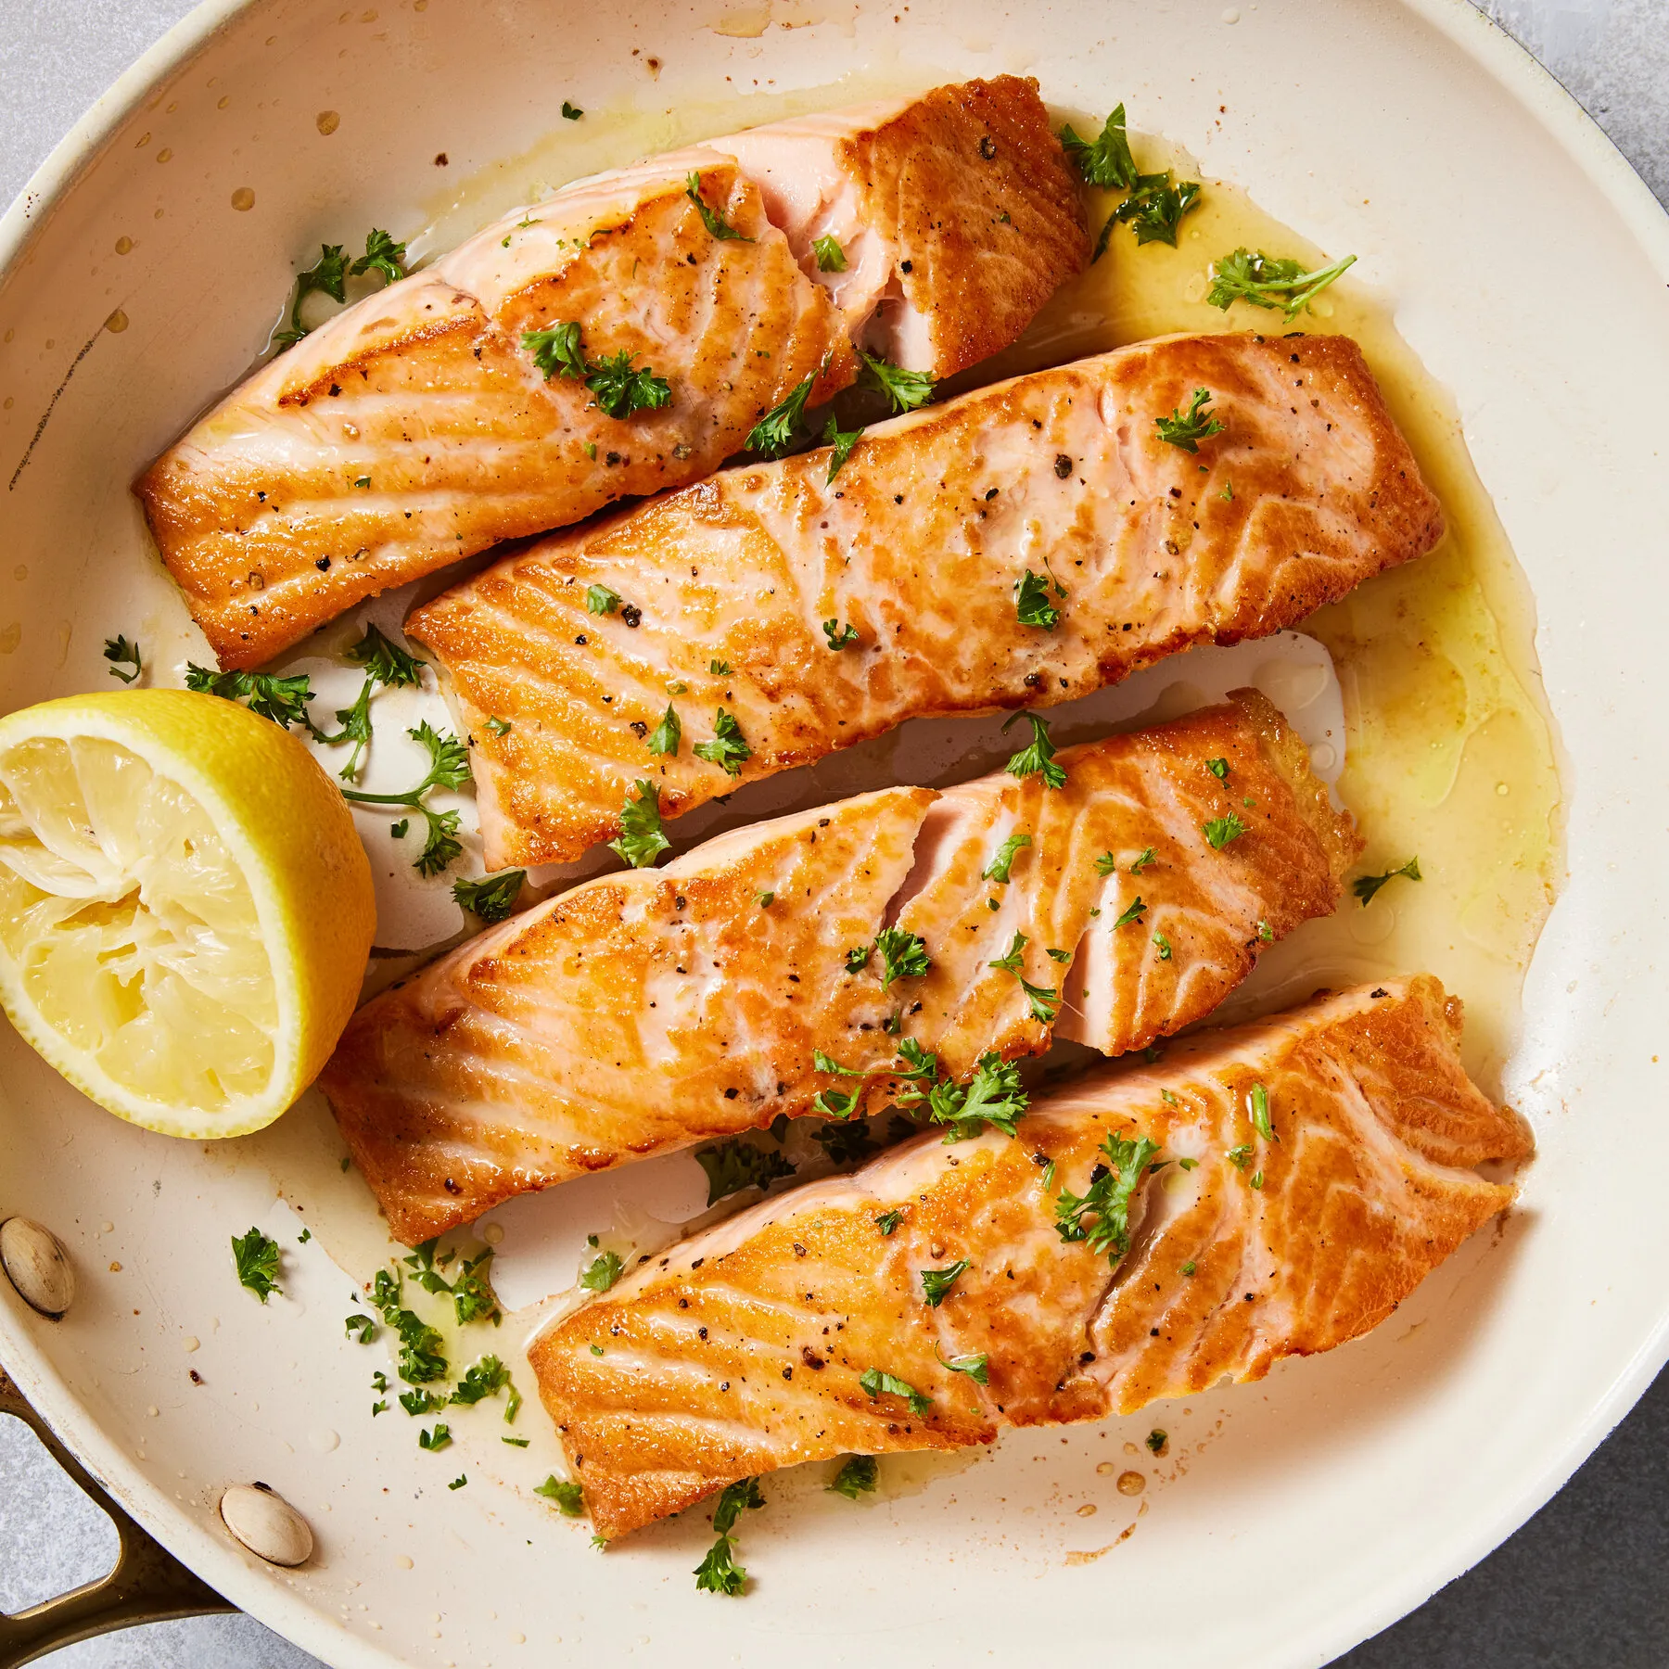
What do they eat?
- Lots and lots of seafood!
- Some Coast Salish communities have first foods ceremonies.
Yum!
(burke museum)
Notes:
Because they live by the ocean. They ate lots of seafood like salmon, crabs, seaweed, shellfish. But seafood was not their only source of sustenance. They also hunted deer, elk, ducks and gathered berries. Of course what they ate depended on the time of year it was. Also some coast salish communities host first food ceremonies which honour foods that have fed their communities for generations.

Slide 5
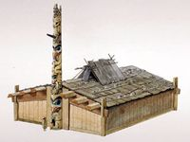
What did they use for shelter?
- Longhouses, or also known as plank houses
- Cedar was very regularly used
(Wikipedia)
Notes:
Longhouses are large wooden building that housed multiple families that were usually related or extended. Longhouses were made of mostly cedar and were a place to live and for community activities such as ceremonies and gatherings.
2) Cedar was one of the most used materials by the coast salish because it was very readily available. The coast salish used cedar to make houses, canoes, tools and even sometimes clothing.

Slide 6
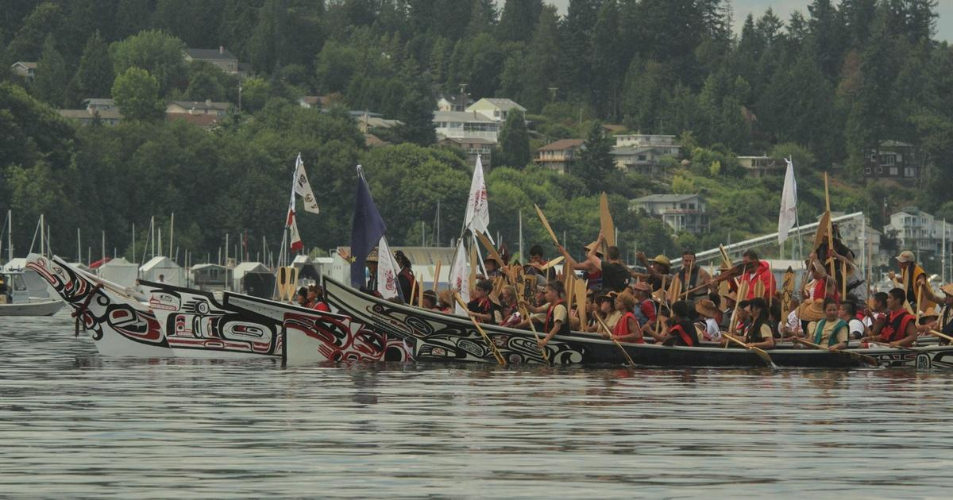
How did they get around?
- Canoes usually
- Cedar used to make them
Notes:
The coast salish people made canoes from whole big chunks of logs. They used cedar because it was readily available, and very strong/ sturdy. Canoes were a important part of the daily life for coast salish people as it was their main way of transportation. It was how they got food, traveled between villages to trade, and overall live their life. They would even hunt land animals on canoes, they would go on the river and move up or downstream following them.

Slide 7
Trade?
- Traded a lot of food and cedar products
- Cedar used to make them
(Canadian encyclopedia)
Notes:
The coast salish traded a lot of food such as fish and shellfish. They also traded many tools and clothing made from cedar. Trade to the coast salish was not just for their economy< it was to build relationships, alliances and to gain products that were not readily available to them

Slide 8
Spirituality?
-Coast salish beliefs were different than many other nations
- In summer they were like naked. They believed in being free
(Wikipedia)
- In winter they wore like super mysterious cloaks, and stuff out of like seal sking cuz its waterproof
Notes:
Salmon were seen as spiritual beings and not just food, they were important and very respected

Slide 9
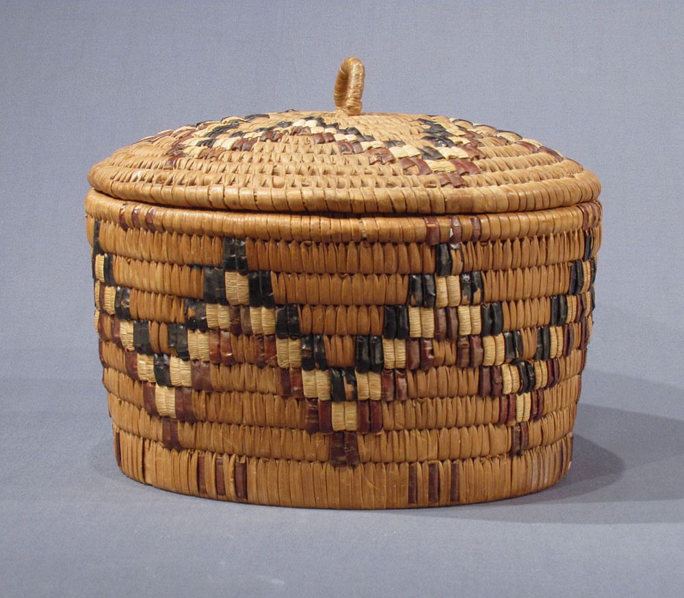
Art
-Many different examples of coast salish art
-Carving, weaving, painting, basketry, and cedar work
(Burke museum)
Notes:
Coast salish art is a super important part of their history, and more specifically basket weaving. They have been basket weaving for thousands of years. The baskets are made from cedar roots, cedar bark, and cattail leaves. Cattail leaves are long green flat leaves that frow in wetlands and are pretty strong. They used these baskets for storage, carrying stuff from place to place, and even cooking soups and stews. The basket weavers used 3 techniques, coiling, twining, and plaiting. Different materials and colors were used

Slide 10
Citations
Britannica Editors. "Coast Salish". Encyclopedia Britannica, 1 Aug. 2025, https://www.britannica.com/topic/Coast-Salish. Accessed 7 October 2026.
Kennedy, Dorothy, and Randy Bouchard. Coast Salish | the Canadian Encyclopedia, 7 Feb. 2006, www.thecanadianencyclopedia.ca/en/article/coastal-salish.
“Traditional Coast Salish Foods List.” | Burke Museum, 14 Sept. 2013, www.burkemuseum.org/search?results=coast%2Bsalish&sort_by=search_api_relevance&sort_order=DESC.
“Coast Salish Peoples.” Wikipedia, Wikimedia Foundation, 4 Oct. 2026, en.wikipedia.org/wiki/Coast_Salish_peoples.
Tom, Jeremy. “Government and Transportation.” The Coast Salish Peoples, coastsalishpeoples.weebly.com/government-and-transportation.html. Accessed 9 Oct. 2026.

Slide 11
Images
https://www.bing.com/images/search?view=detailV2&ccid=PNquAVqn&id=64F799B79E376DA358AD0BF34C25BC25BD4A44C5&thid=OIP.PNquAVqnICtN_bui1_nr0wHaD4&mediaurl=https%3A%2F%2Fimage.pbs.org%2Fvideo-assets%2FOWkkzrK-asset-mezzanine-16x9-1JCTdP3.jpg%3Ffocalcrop%3D1200x630x50x10%26format%3Dauto&cdnurl=https%3A%2F%2Fth.bing.com%2Fth%2Fid%2FR.3cdaae015aa7202b4dfdbba2d7f9ebd3%3Frik%3DxURKvSW8JUzzCw%26pid%3DImgRaw%26r%3D0&exph=630&expw=1200&q=coast+salish+peoples&FORM=IRPRST&ck=E66B63932B7E7E74CCCD49F7D454161B&selectedIndex=10&itb=0&cw=1375&ch=803&ajaxhist=0&ajaxserp=0
https://www.bing.com/images/search?view=detailV2&ccid=PGp0D4lT&id=412B13FB6FD7B1EE351C134BF31952260CA973F7&thid=OIP.PGp0D4lTGC-YZLu8Jxq5oAHaE8&mediaurl=https%3A%2F%2Fd3d0lqu00lnqvz.cloudfront.net%2Fmedia%2Fmedia%2F2538f1ce-3f3f-4a8d-be1d-43dbee07fb58.jpg&cdnurl=https%3A%2F%2Fth.bing.com%2Fth%2Fid%2FR.3c6a740f8953182f9864bbbc271ab9a0%3Frik%3D93OpDCZSGfNLEw%26pid%3DImgRaw%26r%3D0&exph=683&expw=1024&q=coast+salish+peoples&FORM=IRPRST&ck=AB35BC3F51792BA3D9CA708577120848&selectedIndex=1&itb=0&cw=1375&ch=803&ajaxhist=0&ajaxserp=0
https://www.bing.com/images/search?view=detailV2&ccid=sHlHgghR&id=0EE1E707391C85AC0EDFBAE1A68DF39CEE3AA0C5&thid=OIP.sHlHgghRxZ_ua8jSSBcw8AAAAA&mediaurl=https%3A%2F%2Fimages.squarespace-cdn.com%2Fcontent%2Fv1%2F64ec1a182c816524e40a9e40%2Fed3b848e-9e83-41c9-827e-1b2835c5064d%2Fmap%2Bof%2Bcoast%2B%2526%2Binterior%2Bsalish.jpg%3Fformat%3D1000w&cdnurl=https%3A%2F%2Fth.bing.com%2Fth%2Fid%2FR.b07947820851c59fee6bc8d2481730f0%3Frik%3DxaA67pzzjabhug%26pid%3DImgRaw%26r%3D0&exph=302&expw=373&q=coast+salish+territory+on+map&FORM=IRPRST&ck=E70BEE588D8F9AE5326A8E1987EEEC71&selectedIndex=17&itb=0&cw=1375&ch=803&ajaxhist=0&ajaxserp=0
https://www.bing.com/images/search?view=detailV2&ccid=ecrU30KX&id=EB5FA70B5B9B6CA13A0AB22C30B5906E8898D4C7&thid=OIP.ecrU30KXfDK8tyYzsBkQngHaHa&mediaurl=https%3A%2F%2Fstatic01.nyt.com%2Fimages%2F2024%2F02%2F13%2Fmultimedia%2FLH-pan-seared-salmon-lwzt%2FLH-pan-seared-salmon-lwzt-mediumSquareAt3X.jpg&cdnurl=https%3A%2F%2Fth.bing.com%2Fth%2Fid%2FR.79cad4df42977c32bcb72633b019109e%3Frik%3Dx9SYiG6QtTAssg%26pid%3DImgRaw%26r%3D0&exph=1800&expw=1800&q=salmon&FORM=IRPRST&ck=57F687F67C92179B1B14A695F98DE844&selectedIndex=2&itb=0&cw=1375&ch=803&ajaxhist=0&ajaxserp=0
https://www.bing.com/images/search?view=detailV2&ccid=hzJYc%2BZB&id=FDA293C1BE99CC28B860C6A5267E9470DE8EEF8C&thid=OIP.hzJYc-ZBHj4eihbPf0ZMAgHaGe&mediaurl=https%3A%2F%2Fth.bing.com%2Fth%2Fid%2FR.87325873e6411e3e1e8a16cf7f464c02%3Frik%3DjO%252bO3nCUfialxg%26riu%3Dhttp%253a%252f%252fwww.pegasusgallery.ca%252fimages%252flge%252f1322079431_Salish_Loop-top-lidded-Basket_x1000w.jpg%26ehk%3DjScnODPDnp%252bHik6BSkI2yiKWfV1GKkiT5znnWUxiAQ8%253d%26risl%3D%26pid%3DImgRaw%26r%3D0&exph=875&expw=1000&q=coast+salish+art+basketry&FORM=IRPRST&ck=9ECEAB79832CBE8BAE1F8308AA25568D&selectedIndex=0&itb=0&cw=1375&ch=803&ajaxhist=0&ajaxserp=0

