Slide 1
Presentation: Local Indigenous Groups
EFP 12

Slide 2
Prince George
Traditional territory of the Lheidli T’enneh (historically known as the Fort George Indian Band)
Lheidli T’enneh part of the larger Dakelh group
Because it’s a regional hub, there are many other groups present

Slide 3
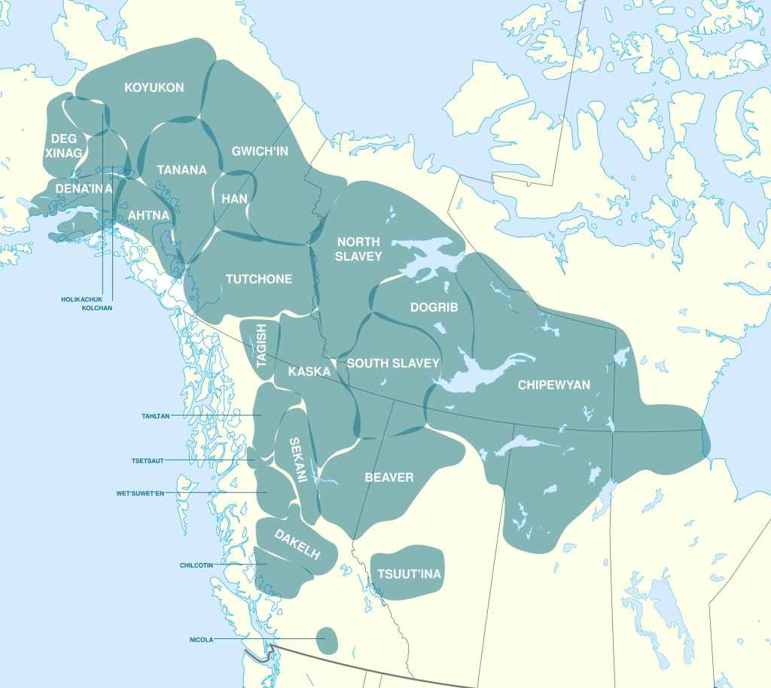
Dakelh
Dakelh (Carrier) people
  'Carrier' is a translation of the Sekani name 'aɣele' "people who carry things around on their backs",
Northern Athabaskan language group
winter villages were mainly located at the outlets of lakes or the confluences of rivers
(“Dakelh”)

Slide 4
Territory
sub-boreal forest, dotted with numerous lakes, and with numerous rivers
The climate is continental, with cold winters
The area is hilly, with mountains of modest size.
(“Dakelh”)

Slide 5
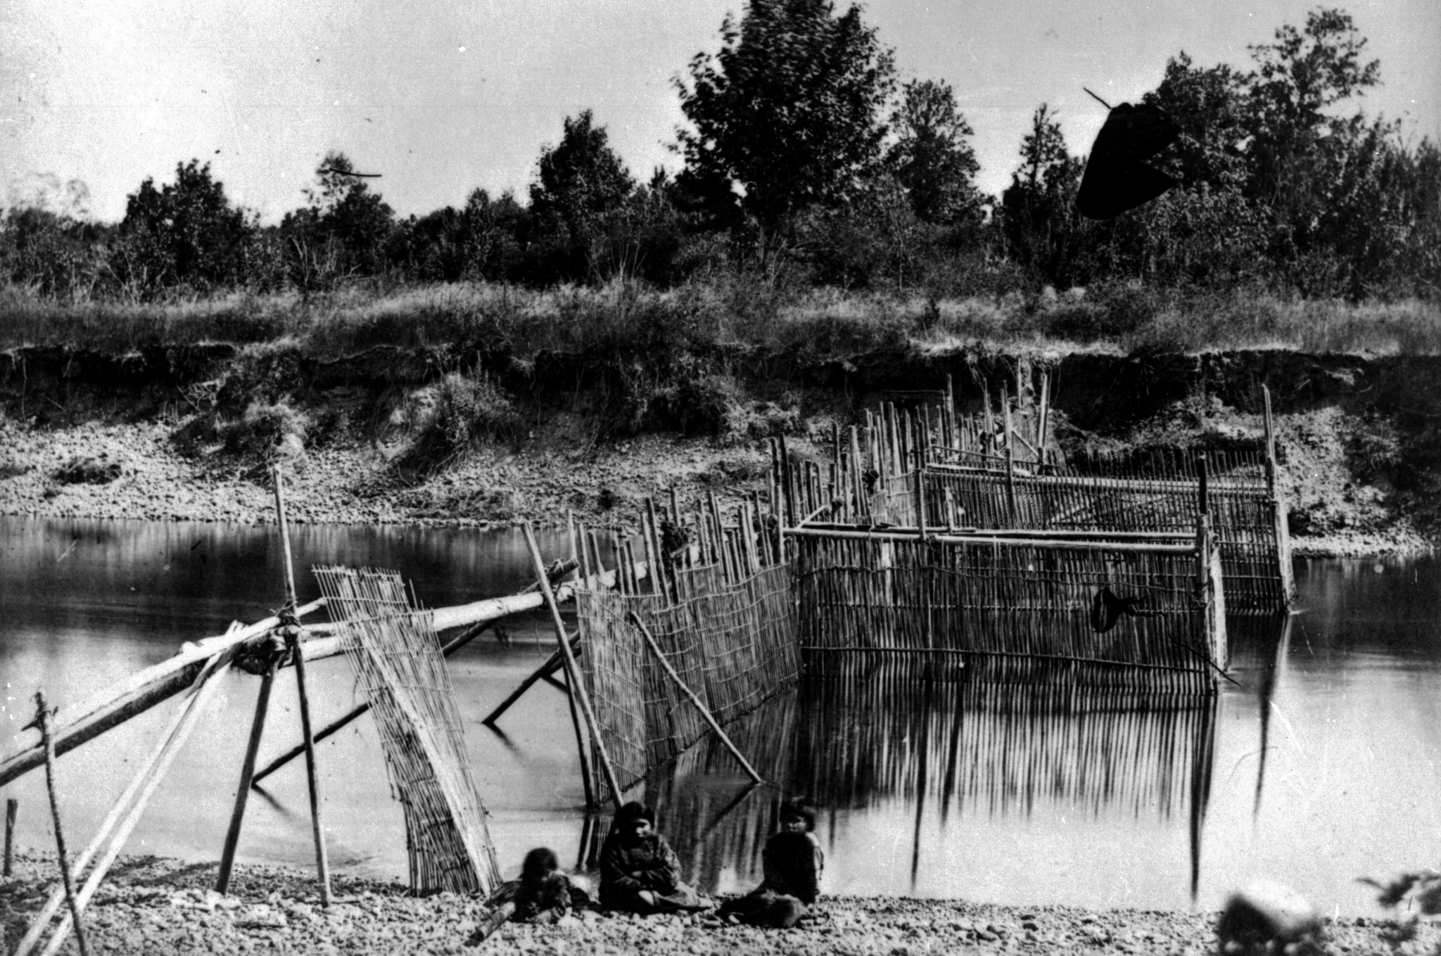
Lifestyle
based on fishing
  Salmon fishing was carried out by using weirs (enclosures) across river mouths or by spearing salmon along rivers
(Hudson)

Slide 6
Lifestyle
based on a seasonal round
  greatest activity in the summer when berries are gathered and fish caught and preserved
  Fish, especially the several varieties of salmon, are smoked and stored for the winter in large numbers
  Hunting and trapping of deer, caribou, moose, elk, black bear, beaver, and rabbit provided meat, fur for clothing, and bone for tools
  Plants are used extensively for medicine
Winter activity is more limited
  some hunting, trapping, and fishing under the ice
(“Dakelh”)

Slide 7
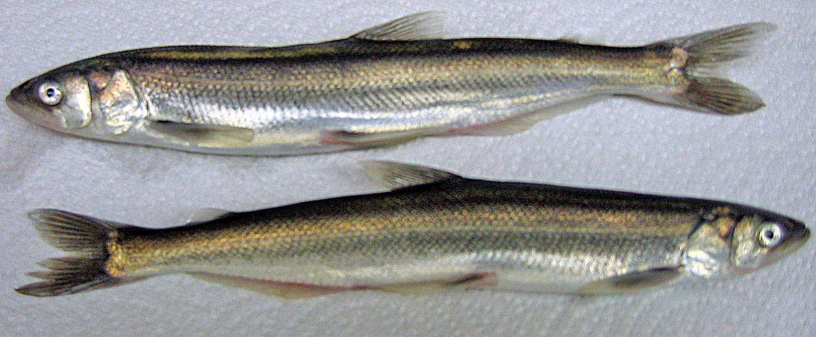
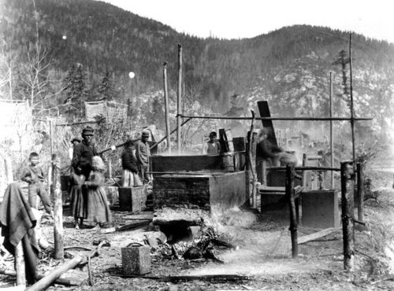
Lifestyle
(Hudson)
Trade
  "grease trails"
  extensive trade with the coast
  "grease", the oil extracted from eulachons

Slide 8
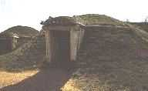
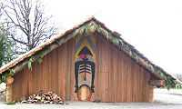
Housing
During the winter, the Dakelh often lived in pit houses
During the summer, the Dakelh lived in a variety of housing types, including plank houses

Slide 9
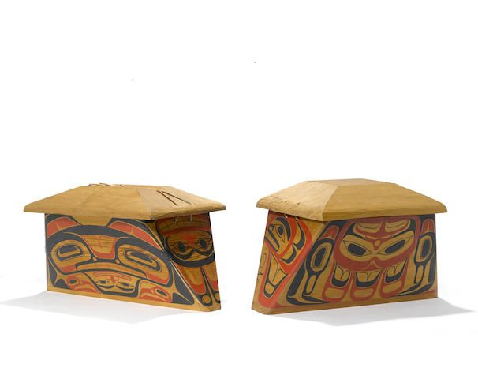
Culture
Dakelh bentwood containers
Art using ovid forms, similar to other Northwest groups

Slide 10
Culture
Lower Dakelh social organization was based on bilateral kinship groups centred on extended families consisting of brothers, their wives and children, and married sons’ families
Potlatches, were held by Clans to commemorate deaths, the inheritance of names and other special occasions.

Slide 11
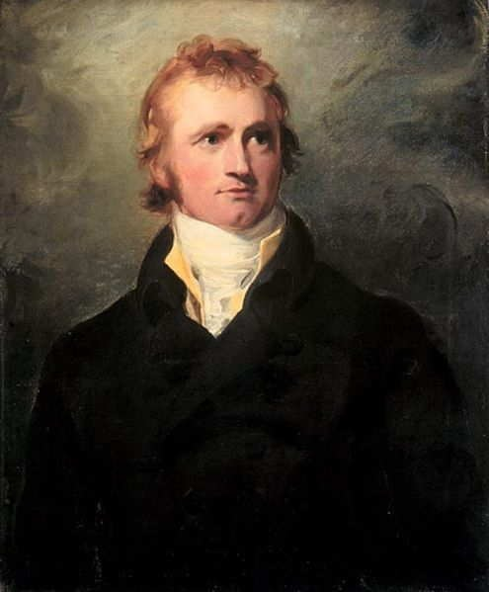
Colonial History
Alexander Mackenzie and other fur traders of the Northwest Company were the first Europeans to enter Dakelh territory in 1793.
Dakelh traded salmon and furs to fur-trading companies
By 1911, weirs (enclosures) had been banned from use on salmon streams in the Fraser River
Became involved in logging and seasonal wage labour
(Hudson)

Slide 12
Current
Consisting of over 700 members
Governed by a chief and council
The primary Lheidli T’enneh community is located at Shelley, about 16 km northeast of Prince George

Slide 13
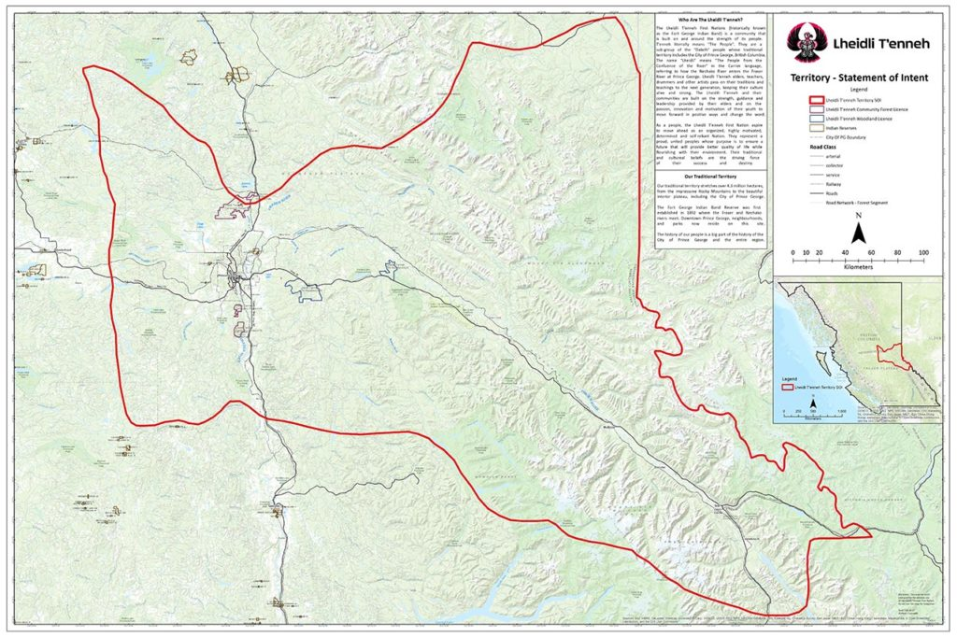
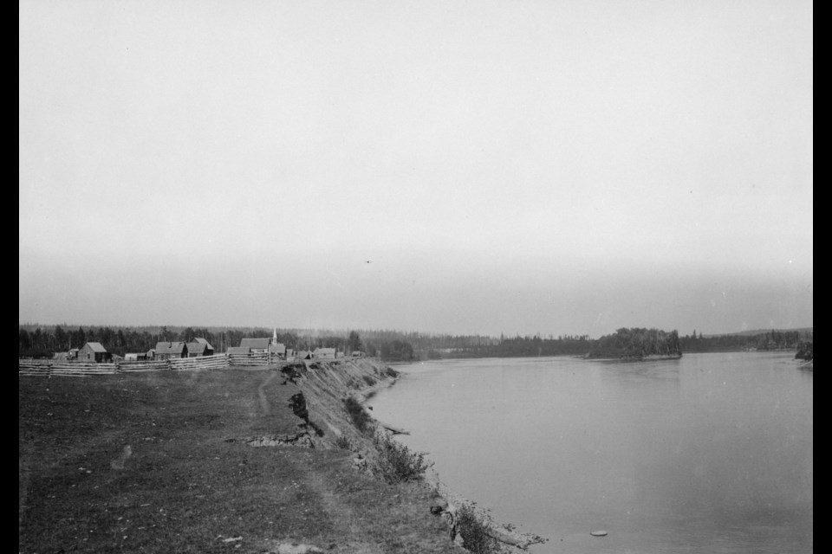
Lheidli T'enneh
(“Our Story”)
"The People from the confluence of the two rivers
Traditional village was at the current site of the Lheidle T’enneh Memorial Park

Slide 14
Works Cited
“Dakelh.” Wikipedia, en.wikipedia.org/wiki/Dakelh, Accessed 01 Sep 2025.
Hudson, D. “Dakelh (Carrier).” The Canadian Encyclopedia, https://www.thecanadianencyclopedia.ca/en/article/carrier, Accessed 01 Sep 2025.
“Our story.” Lheidli T'enneh, https://www.lheidli.ca/about/our-story/, Accessed 01 Sep 2025.

Slide 15
Quiz
Who are the Dakelh? An Indigenous group
Primarily from around the Great Lakes, noted for their use of agriculture, specifically corn and squash
Primarily from the boreal forest, lived in Wigwams, and hunted moose, deer, and beaver
Primarily from central BC, lived in winter pit houses and fished for salmon
Primarily on the plains, lived in tipis, and hunted bison

Slide 16
