Slide 1
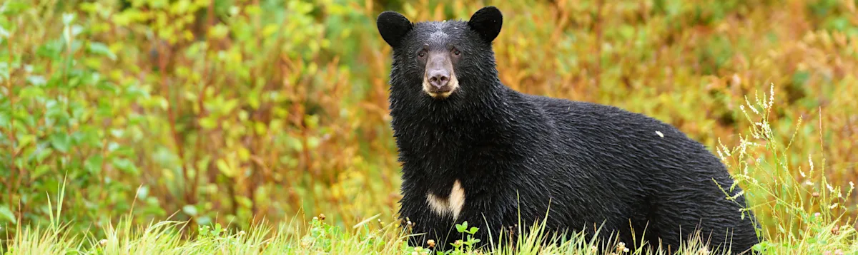
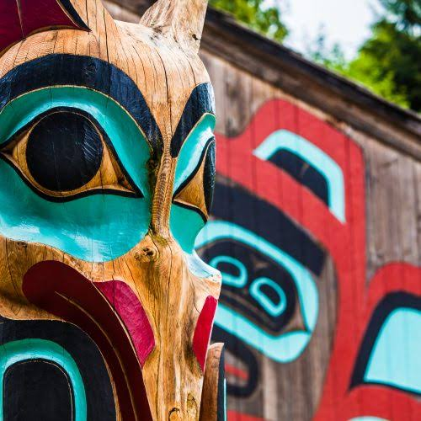
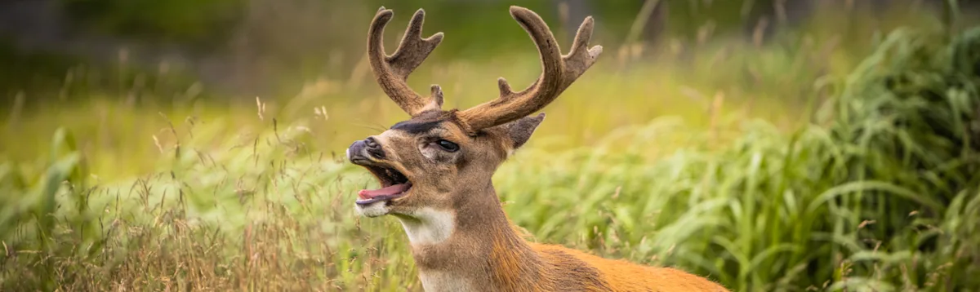
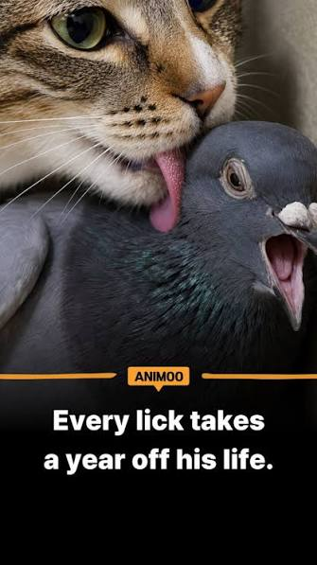
Haida Gwaii
Michael and Nice

Slide 2
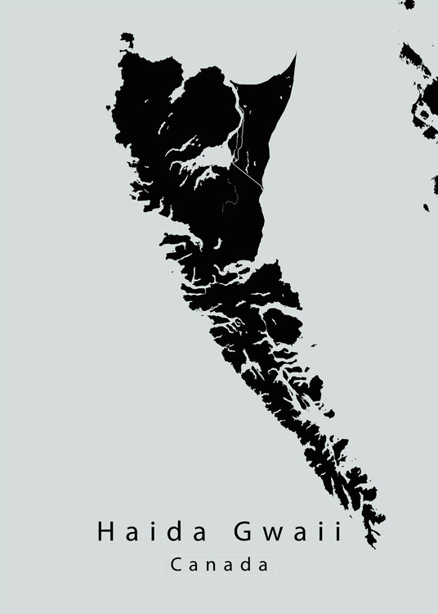
Haida Gwaii
Haida Gwaii means “ Islands of the people”
They have lived on these islands
The islands being separated from the mainland
The island is covered in lots of moss and big red cedar trees.
The weather is pretty rainy and windy because of the Pacific Ocean

Slide 3
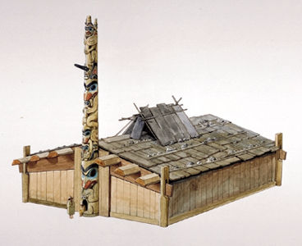
Lifestyle
The Haida people lived in long rectangular houses
Each long house could have around 30-40 people
Their way of getting food was the ocean
They are ocean people they made cedar canoes
Using the canoes they went to trade

Slide 4
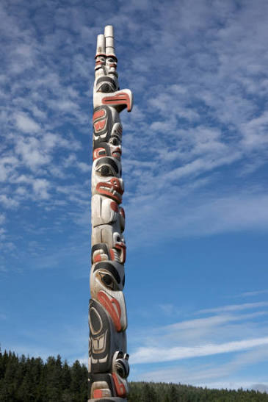
Culture
Every Haida person is from a family group
They use a matrilineal system
They had potlatch ceremonies and parties
The hosts gave away basically all their wealth to their guests
The Haida also had totem poles

Slide 5
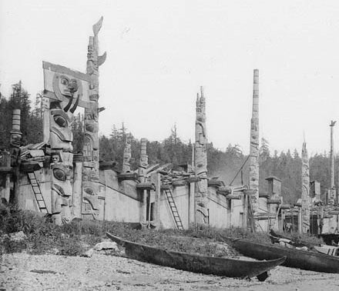
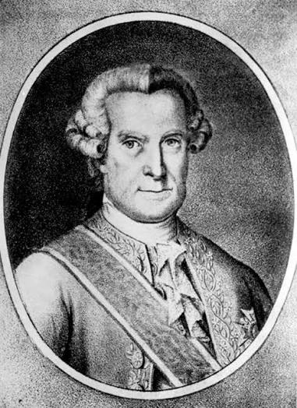
History
Juan Perez was the first european to meet haida
The europeans came with smallpox
The Haida were making decent wealth from trading
In 1884 the Canadian government made the potlatches illegal
Along with most other Indigenous people the haida children were taken away to residential schools

Slide 6
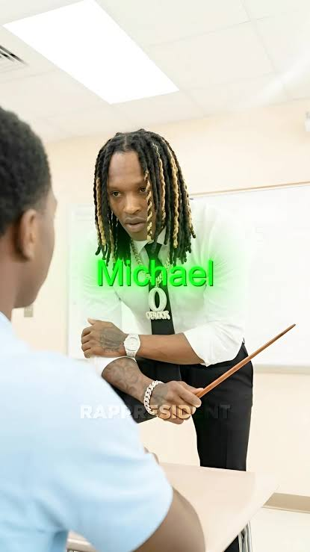
Kennedy, Dorothy, et al. "Haida." The Canadian Encyclopedia, 2025
https://thecanadianencyclopedia.ca/en/article/haida-native-group
Haida Heritage Centre. "Explore the Centre." Haida Heritage Centre, 2026
https://www.haidaheritagecentre.com/explore/
Ostroff, Joshua. "How a smallpox epidemic forged modern British Columbia." Maclean's, 2017
https://macleans.ca/news/canada/how-a-smallpox-epidemic-forged-modern-british-columbia/

