Slide 1
The Iglulingmuit Peoples
By Ryker and Kolby

Slide 2
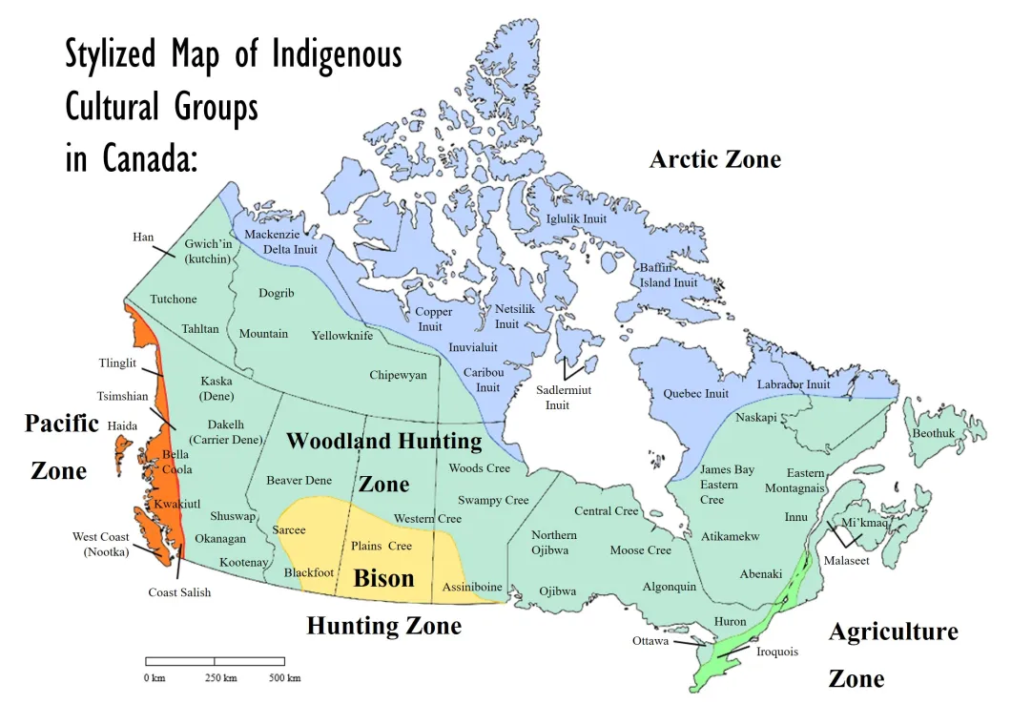

Traditional Territories
In the Arctic Zone
From Igluligaarjuk to northern third of Baffin Island
~500 people in 1822 2040 in 2021
Dates over 4000 years
Living in conditions as low as -66 (windchill)
142.2 cm snow 8.92cm rain
("Igloolik.“)

Slide 3
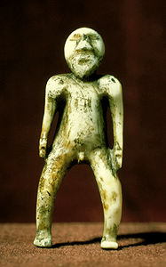
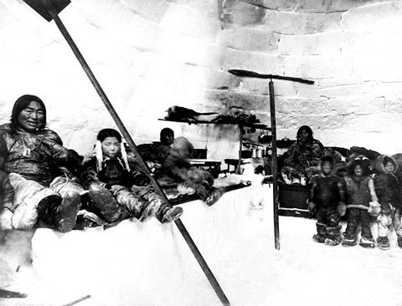
Lifestyle
Sculpture of a man
Seasonal hunting.
-Summer: whale, seal, walrus
-Autumn: caribou, salmon/trout
-Winter: seal
-Spring: seal, walrus
The traditional houses were igloos.
-igloos were vital for their survival in the arctic
Their community consist of elders, family, and shamans this was the basic unit of their society.
-Elders: provide wisdom
-Shamans: spiritual healer/leader
-Men: food providers, toolmakers
-Women: cooks, clothes-makers
("Home Page.“)
Iglulingmuit family inside an igloo

Slide 4
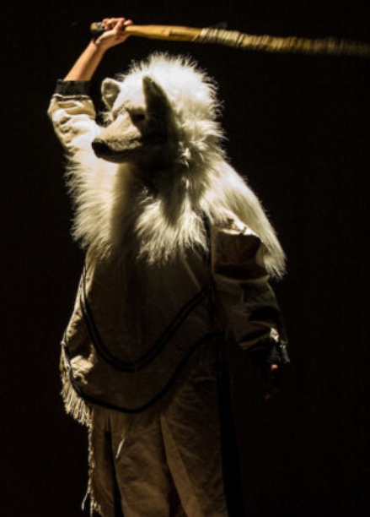
Culture
Traditional art ("Home Page.“)
-Their art is a naturalistic style used to depict their life
Sculptures: main art form they use
Artcirq (“Artcirq”)
- Founded 1998
- performed for 2010 Olympics
- Bridge of tradition and modern art
Spirituality And Belief ("Home Page.")
- Animistic
- Taboos and rituals
- Modern Christian belief

Slide 5
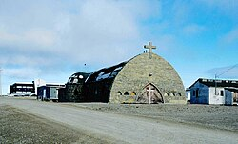
History of the Iglulingmuit
First contact for the Iglulingmuit
-1822: William Edward Parry first to make contact
-1860-1910: US/Scottish whalers
-After 1920: trade introduce/reports on their culture by the Danish
Post first contact
-1920-1940: The first northern residential schools open
-1960: modern residential schools were opened in the north
-1970: last residential school closes
Reconciliation in the north
-1971: 7 Inuit community leaders established the Inuit Tapirisat of Canada
("Igloolik.") ("Iglulingmiut“)

Slide 6
Work cited
"Artcirq." Artcirq, 25 June 2026, www.artcirq.org/. Accessed 7 Oct. 2026.
Craufurd-Lewis, Michael. "Iglulingmiut". The Canadian Encyclopedia, 11 December 2024, Historica Canada. thecanadianencyclopedia.ca/en/article/iglulik-inuit. Accessed 07 October 2026.
"Home Page." – Municipality of Igloolik, igloolik.ca/home-page/. Accessed 7 Oct. 2026.
"Igloolik." Wikipedia, the Free Encyclopedia, Wikimedia Foundation, Inc, 22 Sept. 2026, en.wikipedia.org/wiki/Igloolik. Accessed 7 Oct. 2026.

