Slide 1
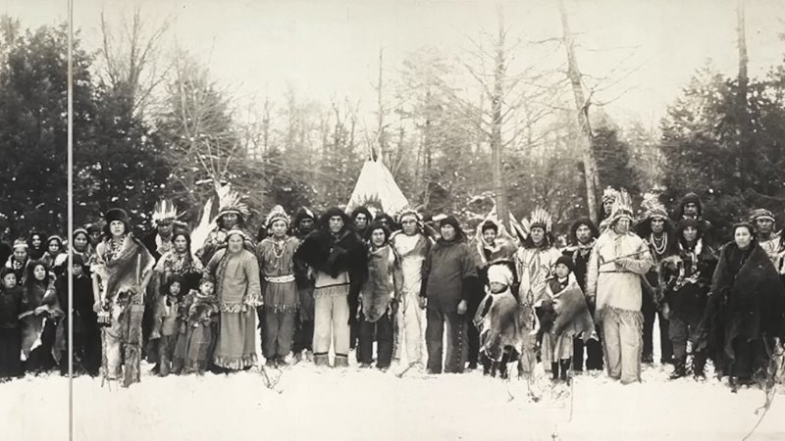
The Iroquois
Dylan and Abby

Slide 2
Also known as,
The Haudenosaunee "people of the longhouse"
Involves the Seneca, Cayuga,Onondoga,Onieda, and Mohawk (Kanyen'Kehaka) and the Tuscarora later joined on
Were referred as longhouse people as a metaphor of their alliance and this applies to their cultural life, mirroring the use of the Great law of peace as both political and cultural document.

Slide 3
The Handenosaunee Confederacy
Confederacy is united by great law of peace.
Cemented mainly by their desire to stand together against invasion, the tribes united in a common council composed of clan and village chiefs, each tribe had one vote, and unanimity was required for decisions.
Confederation of five (six) of indigenous groups known for their tragic role in the French-British rivalry in 17-18th century in upper new York.
Also referred to as the Six Nations
Britannica

Slide 4
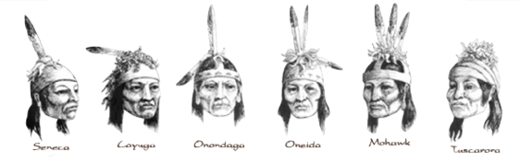
The six Nations Confederacy differed from other Native American confederacies primarily in being better organized, more consciously defined, and more effective. The Haudenosaunee used elaborately ritualized systems for choosing leaders and making important decisions.
and they fostered a tradition of political sagacity based on ceremonial sanction rather than on the occasional outstanding individual leader.

Slide 5
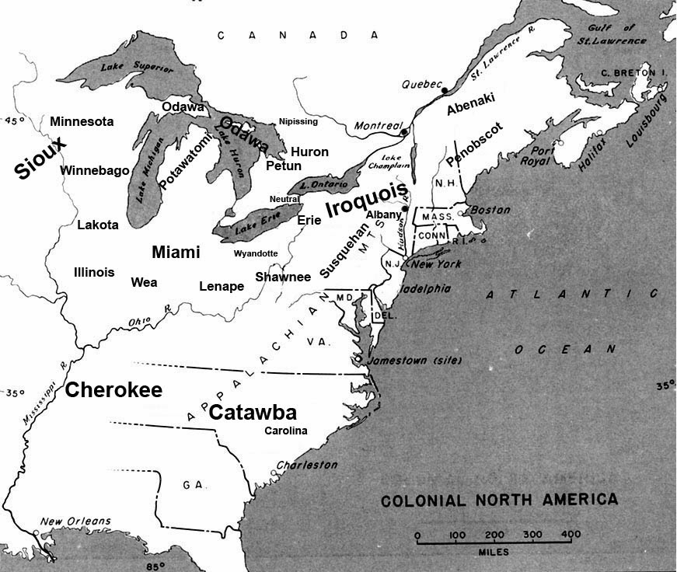
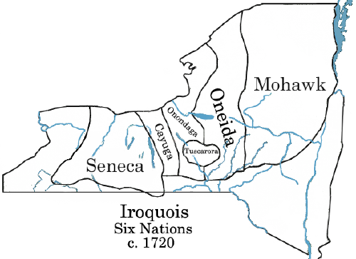
occupied a continuous territory around Lakes Ontario, Huron, and Erin in present-day New York and Pennsylvania (U.S.) and southern Ontario and Quebec (Canada).

Slide 6
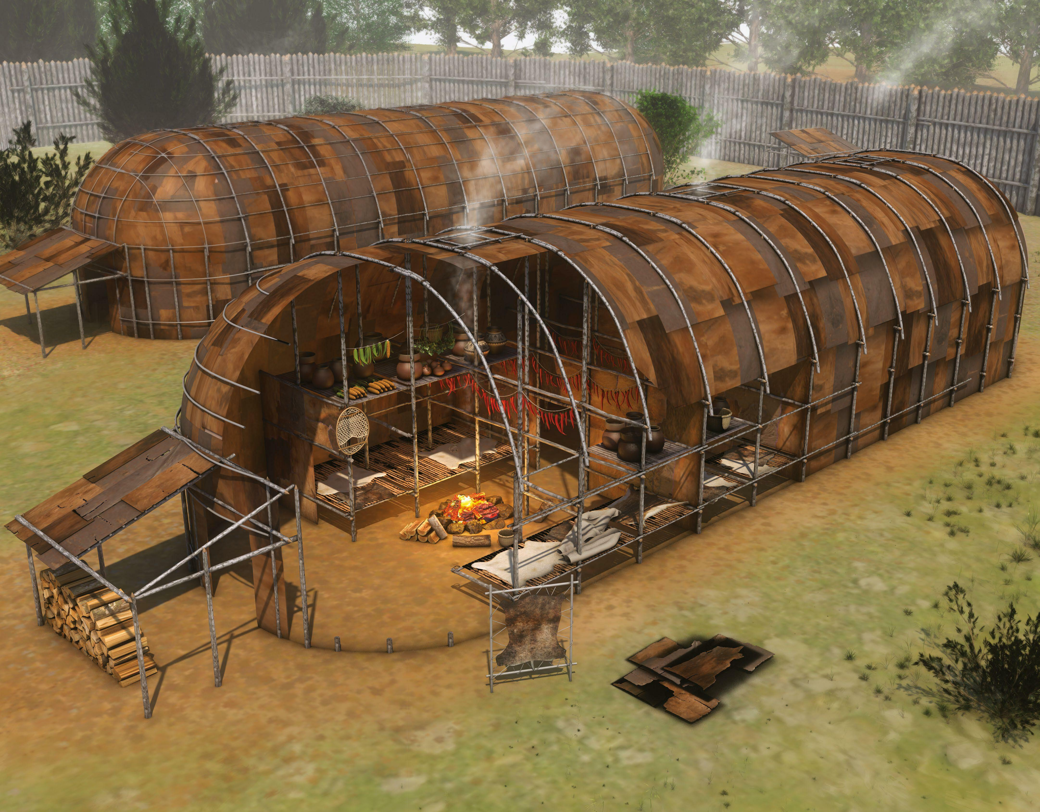
Iroquoian people lived in large longhouses made of saplings and sheathed with elm bark, each housing many families.
Groups of men built houses, fished, hunted, and engaged in military activities. Groups of women produced crops of corn, beans, and squash, gathered wild foods, and prepared all clothing and most other residential goods.
After Autumn, once all the crops were harvested, hunting parties started

Slide 7
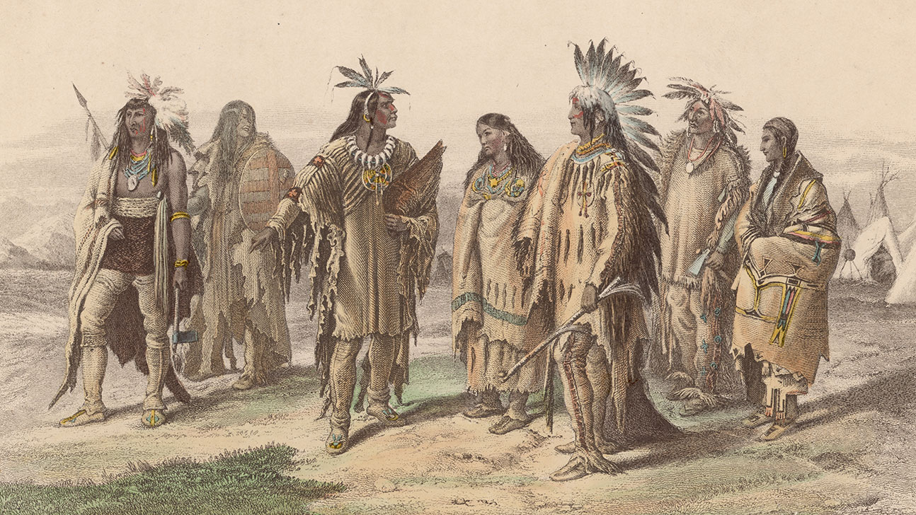
Iroquoian speakers were fond of meetings, spending considerable time in council. Council attendance was determined by locality, sex, age, and the specific question at hand, how well they could deescalate situations and their decision making.

Slide 8
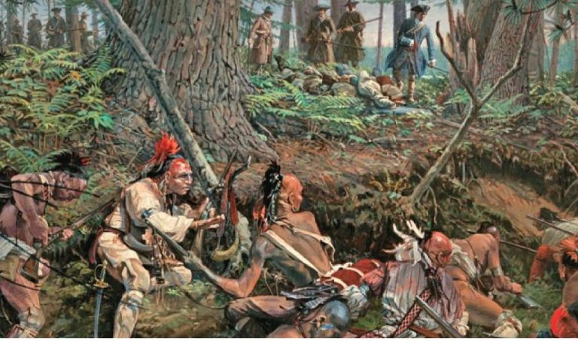
Warfare was important in the Six nations society, and, for men, self-respect depended upon achieving personal glory in war endeavors. War captives were often enslaved or adopted to replace dead family members.

Slide 9
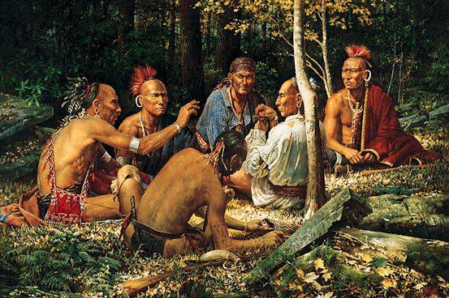
Their beliefs are very much surrounded by the exploration of the spirit world
Mythology holds a central place in their culture.
Which gives them an understanding of their moral values
Iroquois peoples was based on an origin tradition in which a woman fell from the sky. Other parts of the religious tradition featured supernatural aggression and cruelty, torture, cannibalism, star myths, and journeys to the spirit world.

Slide 10
The great spirit- often associated with the Sky woman, the great spirit represents the Sustaining force of life ​
Sky woman- she is the creator in stories. Representing fertility and nurturing acts of nature​
Nature Spirits- various spirits inhabit natural things like trees, rivers, and animals. Holding influence​

Slide 11
Baker, Jordan. "orgins of the Haudenosaunee (Iroquois) confederacy." World history. Jan 15 2021 www.worldhistory.org accessed oct 6th 2026
Bitannica, Editors. "Iroquoian peoples". Britannica. August 11, 2026. www.britannica.com accessed oct 7th 2026
Tayen, Whitecloud "The Iroquois" October 2, 2025 www.knahm.org accessed Oct 7th 2026

