Slide 1
The Metis People
Presentation by Sitara

Slide 2
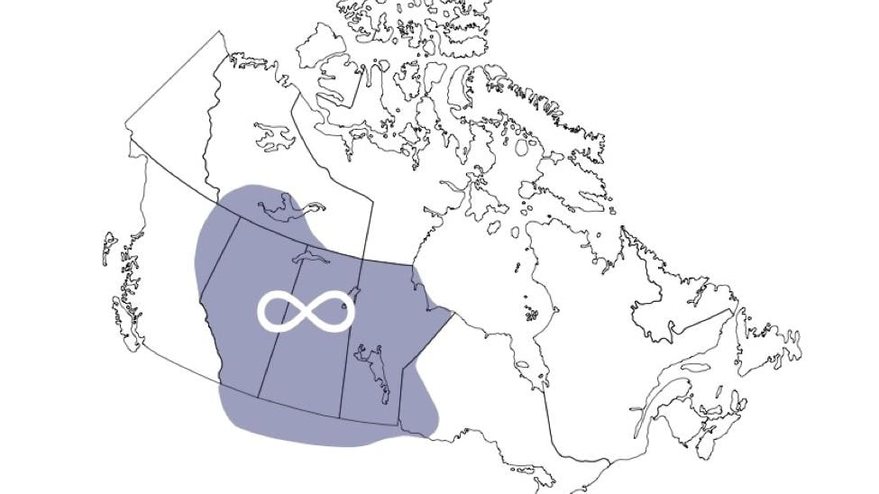
Metis Traditional Territory
The historic homeland of the Metis spans across Northwestern Canada and some parts of the Northern United States
    Manitoba
    Saskatchewan
    Alberta
    Parts of Ontario and British Columbia

Slide 3
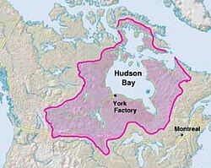
Metis Lifestyle
The most common type of shelter the Metis used were;
    Wigwams
    Log Houses
    Metis Tents
    Tepee
Metis food sources would mainly consist of;
    Bison hunting
    Fishing
    Berry and vegetable picking
    Bannock baking
The main trading system the Metis people used during the fur trade era was the Hudson’s Bay Company (HBC)
Metis involvement with HBC was a fundamental building block to the establishment of Metis as an ethnicity

Slide 4
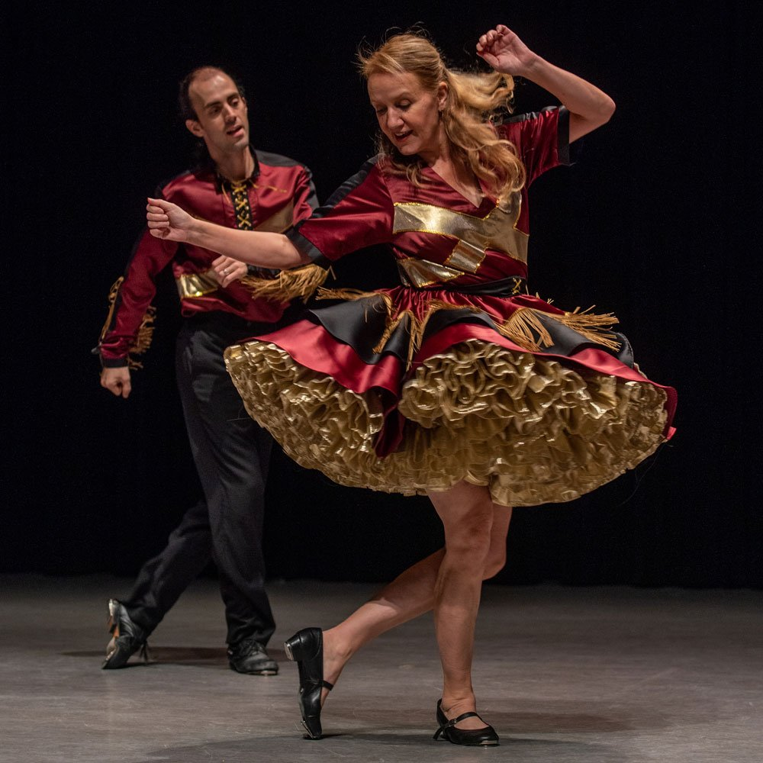
Metis Culture
Ethnogenesis occurred in the 18th and 19th centuries through fur trades with the Europeans (mostly French, Scottish, and Orcadian) and First Nation Women (mainly Cree and Ojibway)
    Ethnogenesis - the process where a new, distinct ethnic group comes into being
Descendants formed a separate consciousness from their maternal First Nations roots and parental European roots, forming the Metis
Metis spiritual beliefs consists of European-Christian traditions (typically Roman Catholic) and Indigenous cosmologies
    “One can honor the feather and the fiddle”
Metis music and dance is a combination of fiddle music and the Red River Jig

Slide 5

Metis History and Where They Are Now
Mixed-heritage children in the Great Lakes began identifying as Metis in the 1750’s
Metis people played an important role in fur trades as guides, interpreters, hunters, and traders
Despite promises from the Manitoba Act, Metis land rights were often ignored and overlooked
Scrip Certificates used to provide land were frequently exploited by speculators
Red River Resistance (1869-1870)
Red River Settlement (aka Winnipeg) became the central hub for Metis
    The Red River Settlement became politically organized in the 19th century
Metis people have very strong community networks
Contemporary Metis communities continue to maintain traditions and cultural identity
“A flag used by the Federation of Métis Settlements. National symbols in settlements are common, such as the motto "Our People, Our Land, Our Culture, Our Future“” -Wikipedia

Slide 6

Information and Fun Facts
The Metis are one of three constitutionally recognized Indigenous groups in Canada
    They are recognized under Section 35 of the 1982 Constitution Act
Being Metis requires self-identification, however:
    Being European and Indigenous alone does not qualify someone as Metis
    The Individuals lineage must connect to the cultural and geographical collective of Historic Metis Nation Homeland
I am Metis! (But I don’t have my status yet, unfortunately)

Slide 7
Credits
“Frequently Asked Questions.” Canadian Geographic, indigenouspeoplesatlasofcanada.ca/article/frequently-asked-questions-metis/. Accessed 5 Oct. 2026.
“Citizenship | Métis National Council.” Métis National Council, 20 May 2025, www.metisnation.ca/about/citizenship/. Accessed 5 Oct. 2026.
Métis Nation of Ontario. “Métis Nation of Ontario | Culture and Heritage | Métis of Ontario.” Métis Nation of Ontario, 16 Oct. 2024, www.metisnation.org/about-the-mno/culture-heritage/. Accessed 5 Oct. 2026.
Ontario Human Rights Commission. “11. Indigenous Spiritual Practices | Ontario Human Rights Commission.” Ohrc.On.Ca, 2015, www.ohrc.on.ca/en/policy-preventing-discrimination-based-creed/11-indigenous-spiritual-practices. Accessed 5 Oct. 2026.
“Shelter.” Métis, metisjelc.weebly.com/shelter.html. Accessed 5 Oct. 2026.
Wikipedia Contributors. “Métis.” Wikipedia, Wikimedia Foundation, 27 Jan. 2020, en.wikipedia.org/wiki/M%C3%A9tis. Accessed 5 Oct. 2026.

