Slide 1
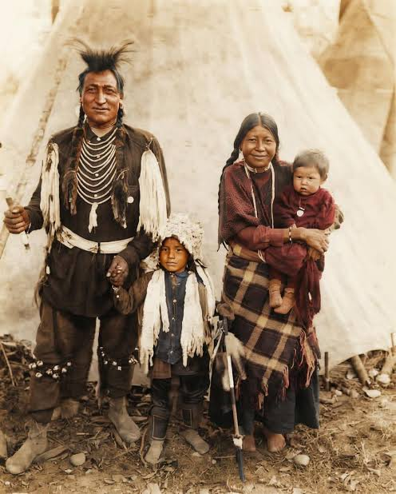
The Ojibwe People
The Anishinaabe or true people (Ojibwe)

Slide 2
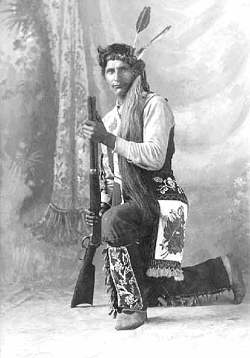
Who they are
The Ojibwe people are one of the largest groups of First Nations in North America.
Other names include the Anishinaabe and Chippewa.
They were also called Saulteurs by the French.

Slide 3
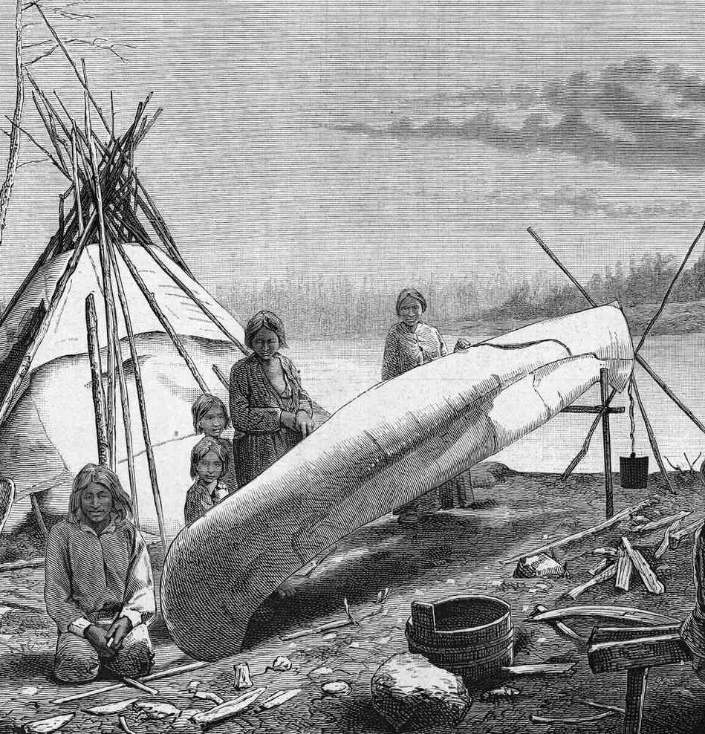
Spiritual Culture
Ojibwe people spoke and to this day speak Anishinaabemowin.
They believed in spirts that would act as guides in the waking world
Creators of the dreamcatcher that was believed to capture bad dreams before they manifest.
They also created the medicine wheel and 7 teachings.
(Red Rock Indian Band, Our Culture)

Slide 4
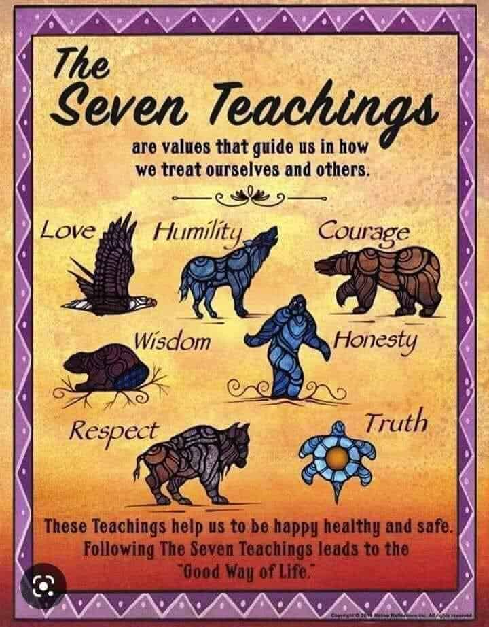
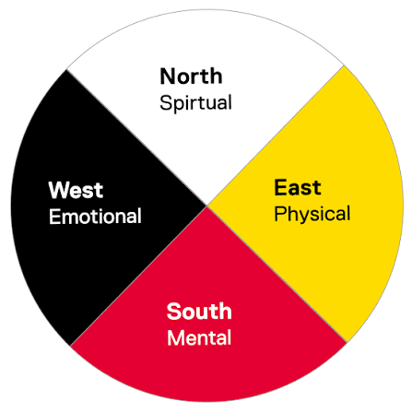
The 7 Teachings and Medicine Wheel

Slide 5
Post European Contact
With European contact brought the fur trade.
This caused the Ojibwe to disperse outwards from Lake Superior towards the west.
European contact resulted in some traditional items being replaced with European ones.
Due to a new focus on fur profits, self-sufficiency faltered, increasing Oijbwe reliance on European foodstuffs.
(The Canadian Encyclopedia Ojibwe)

Slide 6
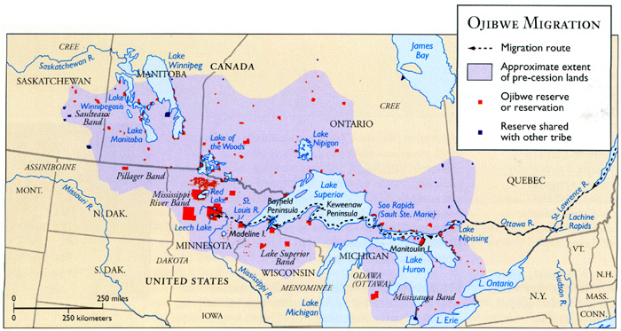
(OJIBWE)

Slide 7

Towards Modern Day
Like other Indigenous groups the Oijbwe were made to sign away their land.
Traditional subsistence way of life declined
Causing the Oijbwe people to become reliant on wage labour and government assistance.

Slide 8
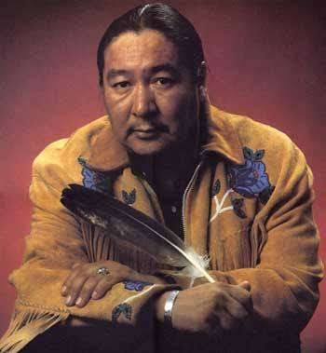
Activism
Nowadays the Ojibwe people are active in political and social activism.
They protest reserve conditions, unhonored treaty agreements, and indigenous rights.

Slide 9
Works Cited
"Oijbwe" Wikipedia, Wikimedia Foundation, last updated Oct 2, 2026, https://en.wikipedia.org/wiki/Ojibwe, Accessed Oct 8, 2026.
Bishop, Charles A.. "Ojibwe". The Canadian Encyclopedia, 26 September 2019, Historica Canada. thecanadianencyclopedia.ca/en/article/ojibwa. Accessed 08 October 2026.
"Our Culture" Red Rock Indian Band, Red Rock Indian Band, https://rrib.ca/our-culture/, Accessed Oct 8, 2026

Slide 10
Image Credit
https://www.facebook.com/IndigenousAmerica70/posts/me-she-ga-bo-ojibwa-circa-1910-ojibwa/122272018154259010/
https://grandmothersvoice.com/the-7-grandfather-teachings-a-path-to-balance-and-harmony/
https://www.mnhs.org/fortsnelling/learn/native-americans/ojibwe-people
https://www.facebook.com/CanadianHistoryEhx/posts/it-is-indigenoushistorymonth-and-this-is-the-story-of-elijah-harper-a-man-who-al/636581638511322/
https://project.geo.msu.edu/geogmich/ojibwe.html
https://www.google.com/imgres?q=medicine%20wheel%27&imgurl=https%3A%2F%2Fwww.torontomu.ca%2Fcontent%2Fdam%2Findigenous-student-services%2Fstudent-hand-guide%2Frass-medicine-wheel-framework-modified-v2.png&imgrefurl=https%3A%2F%2Fwww.torontomu.ca%2Findigenous-student-services%2Fstudent-digital-handbook%2Fmedicine-wheel-framework%2F&docid=1zVyp2c8y1MI_M&tbnid=RrYzDdZmXCT--M&vet=12ahUKEwjPvYW3_6mXAxV7IzQIHdGqF9cQnPAOegUIlQEQAA..i&w=1920&h=1920&hcb=2&ved=2ahUKEwjPvYW3_6mXAxV7IzQIHdGqF9cQnPAOegUIlQEQAA
https://www.thoughtco.com/ojibwe-people-4797430

